Slide 1





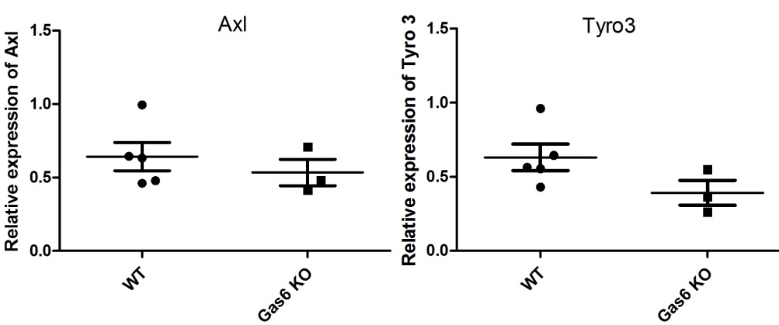

Supplementary Figure
S1.
WT
Gas6 KO
TYRO3
MER
GAS6
GAPDH
Vagina
S2.

Slide 2
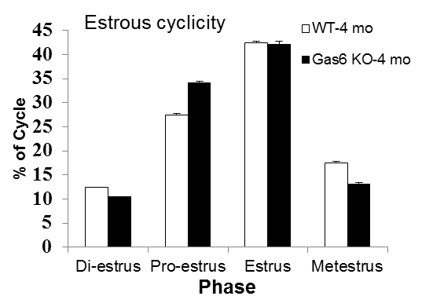
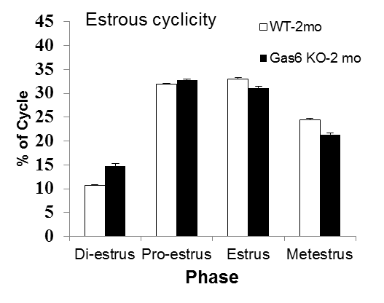
Supplementary Figure
S3.
S4.

