Slide 1
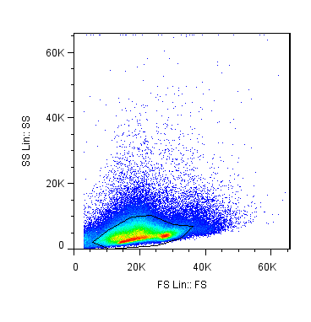
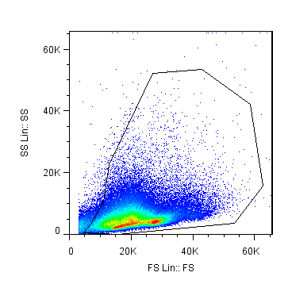
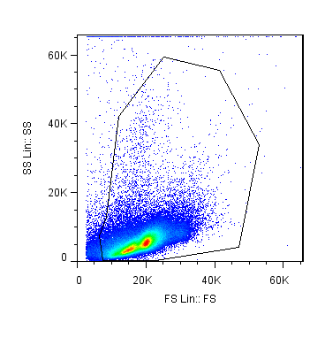
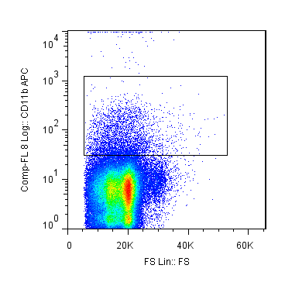
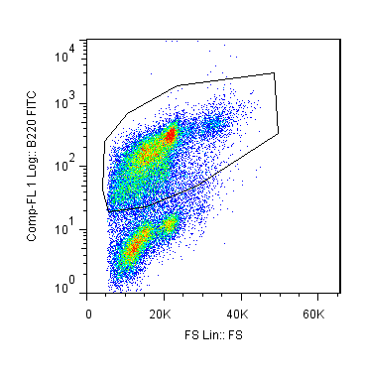
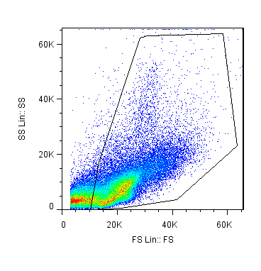
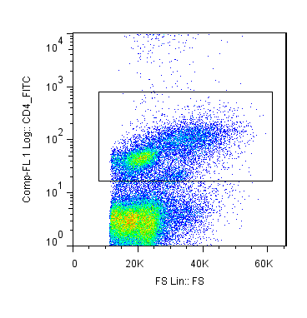
Supplementary figure 3
a) Gating strategy for Figure 2a, e
b) Gating strategy for Figure 2c, d
lymphocytes
leucocytes
c) CD11c+ DC
CD11c+CD11b+ mDC
CD3+ T cells
CD4/CD8+ T cells
a)
CD11c+PDCA+ Siglec-H+ pDC
B220+ Bcells
d) CD11b+ myeloid APC
e)
CD115+Gr-1+ monocytes/macrophages
c) Gating strategy for Figure 3a
d) Gating strategy for Figure 3b
viable leucocytes
CD11b+ myeloid APC
viable leucocytes
B220+ B cells
Expression of MHC II, CD40, CD80, CD86
Expression of MHC II, CD40, CD80, CD86
e) Gating strategy for Figure 5c
viable leucocytes
CD4+ T cells
CD4/FoxP3+ regulatory T cells

