Slide 1
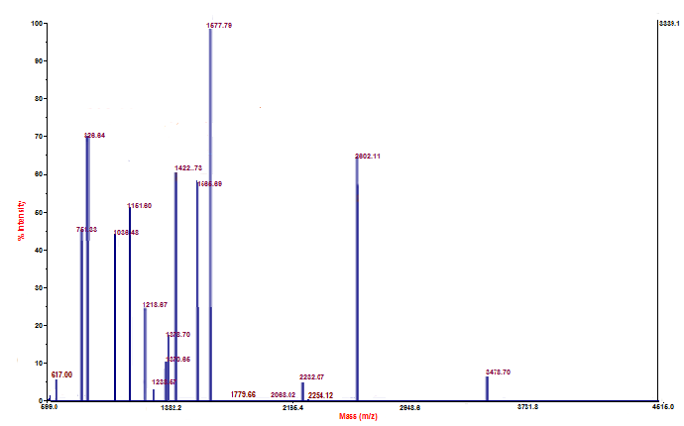

(A)
(B)
Additional File 1

