Slide 1
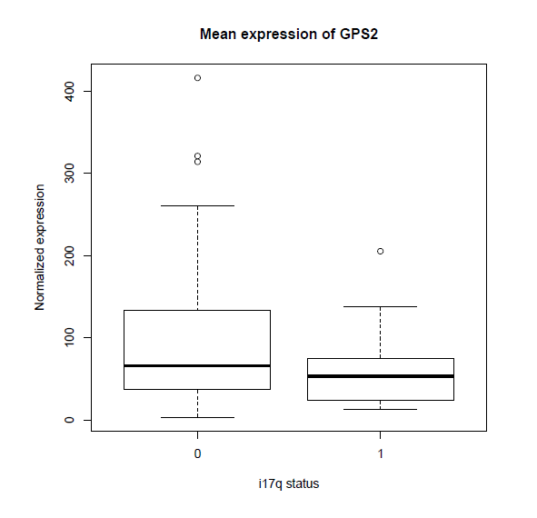
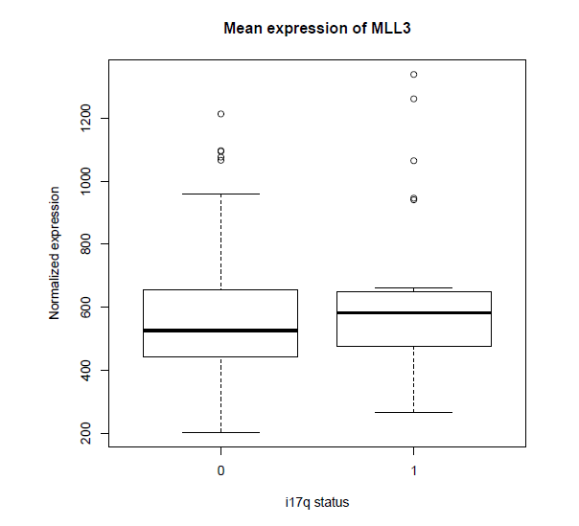
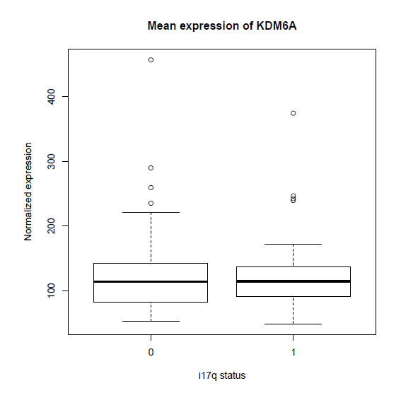
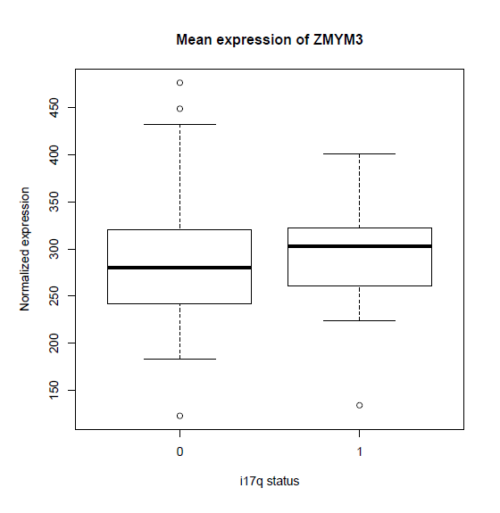
Supplemental Fig. 1
p= 0.036
p= 0.29
p= 0.30
p= 0.77

Slide 2
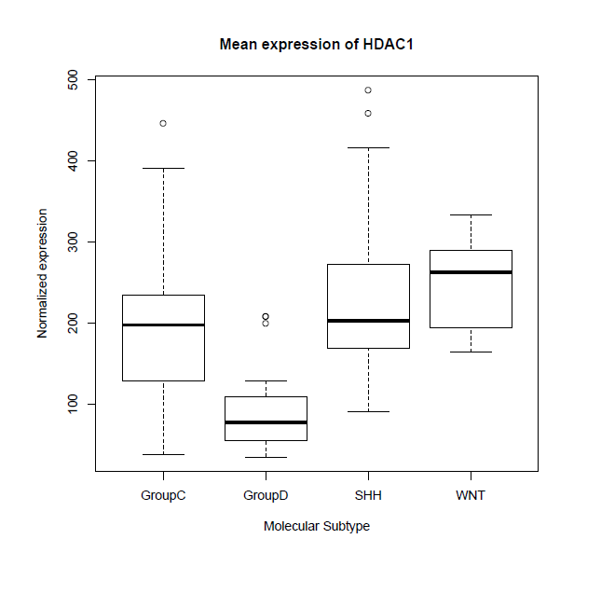
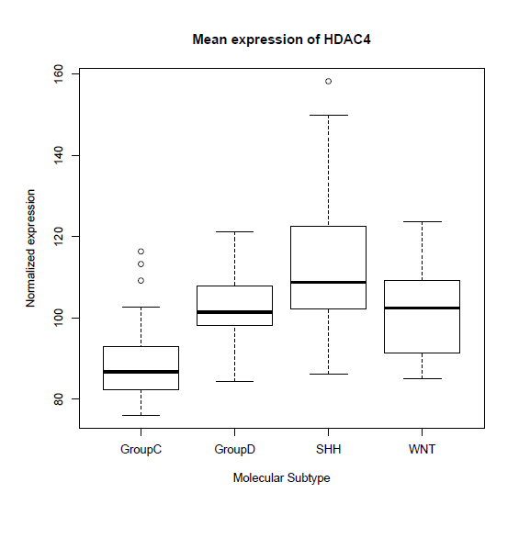
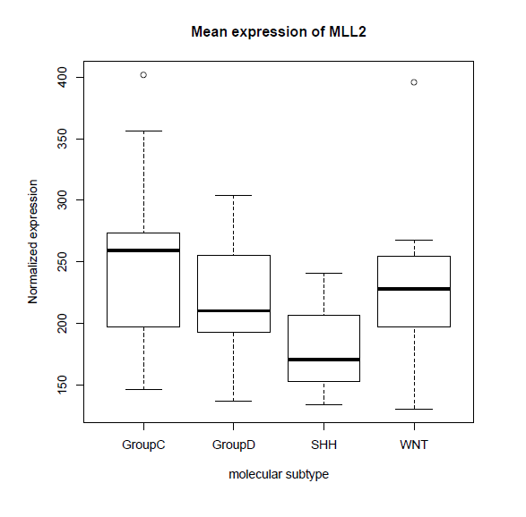
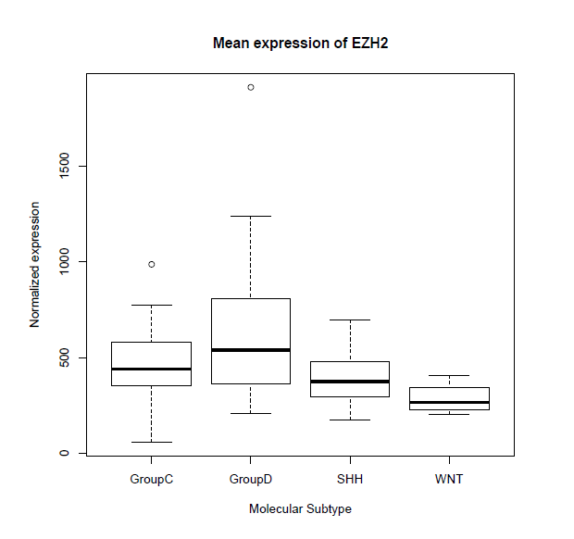
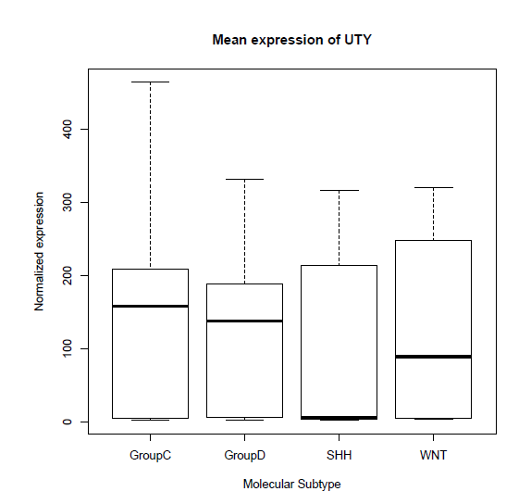
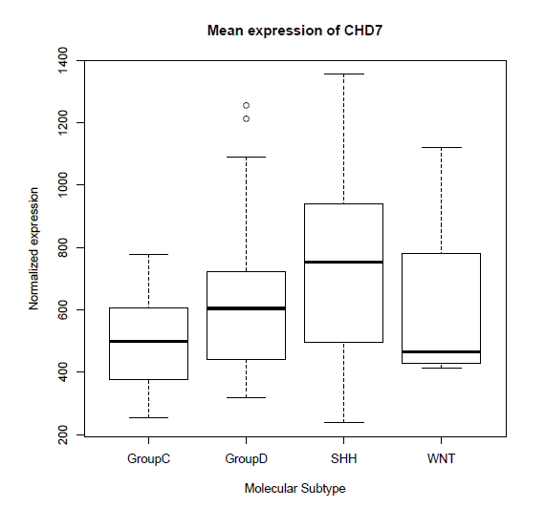
Supplemental Fig. 2
p= 1.8 x10⁻¹⁰
p= 6.9 x10⁻⁹
Group 3 Group 4 SHH WNT
Group 3 Group 4 SHH WNT
p= 6.58 x 10⁻⁶
p= 0.0002
Group 3 Group 4 SHH WNT
Group 3 Group 4 SHH WNT
p= 0.44
p= 0.001
Group 3 Group 4 SHH WNT
Group 3 Group 4 SHH WNT

Slide 3
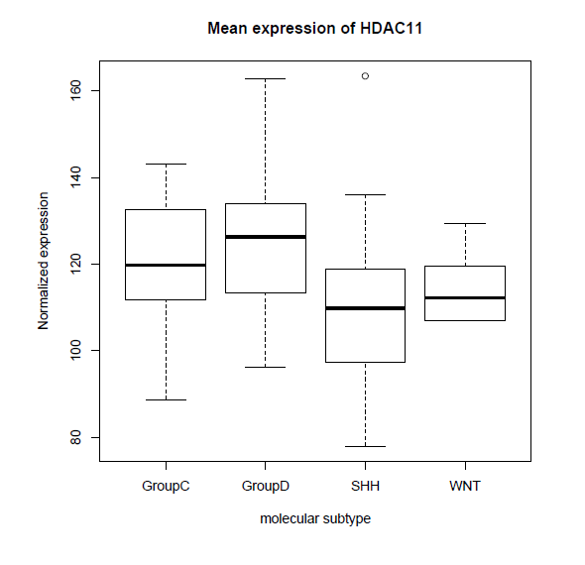
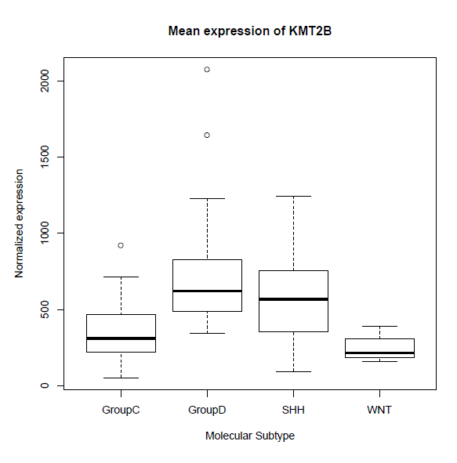
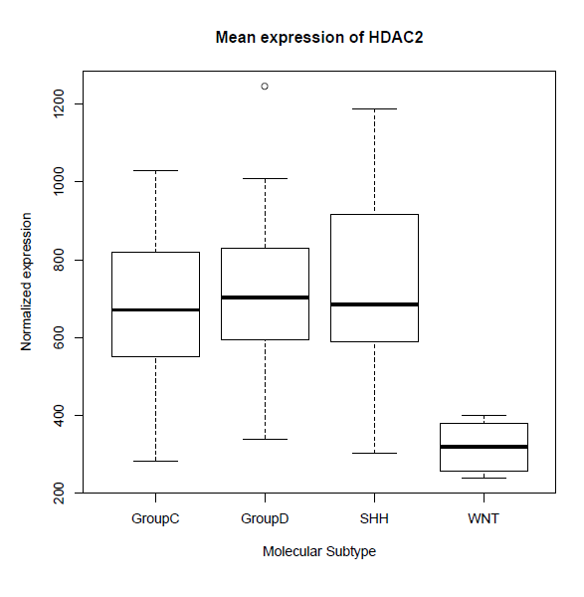
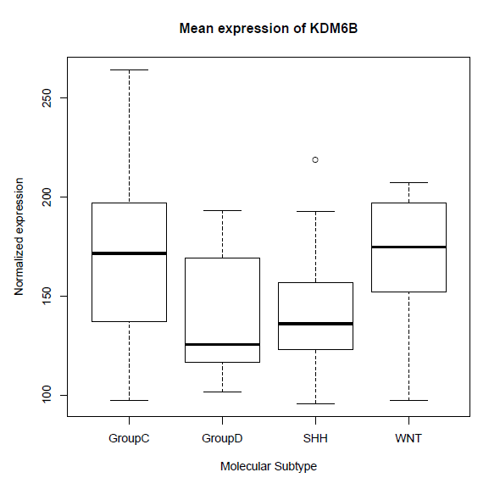
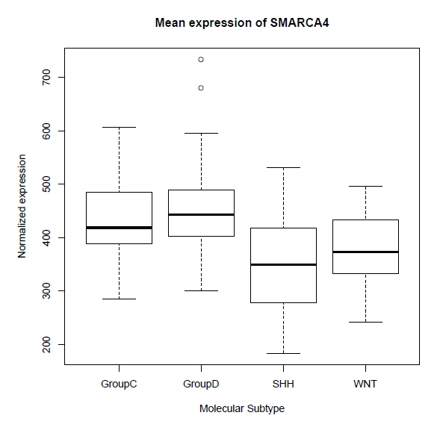
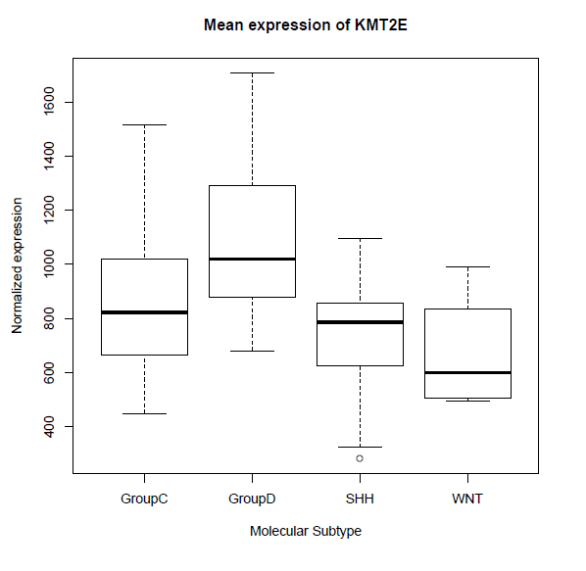
Supplemental Fig. 3
p= 0.001
p= 1.6 x10⁻⁶
Group 3 Group 4 SHH WNT
Group 3 Group 4 SHH WNT
p= 7.5 x10⁻⁶
p= 8.6 x10⁻⁴
Group 3 Group 4 SHH WNT
Group 3 Group 4 SHH WNT
p= 9.9 x10⁻⁶
p= 2.6 x10⁻⁷
Group 3 Group 4 SHH WNT
Group 3 Group 4 SHH WNT

