Slide 1
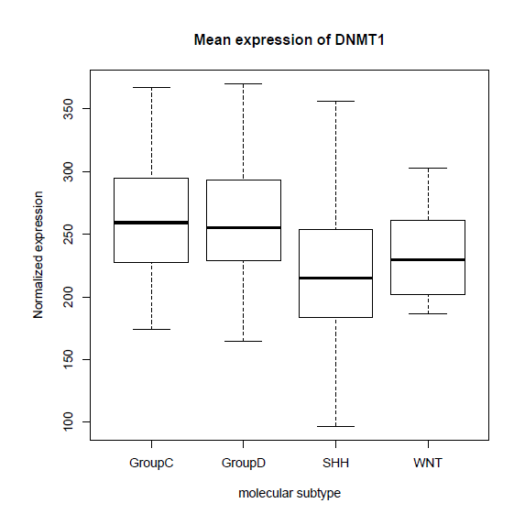
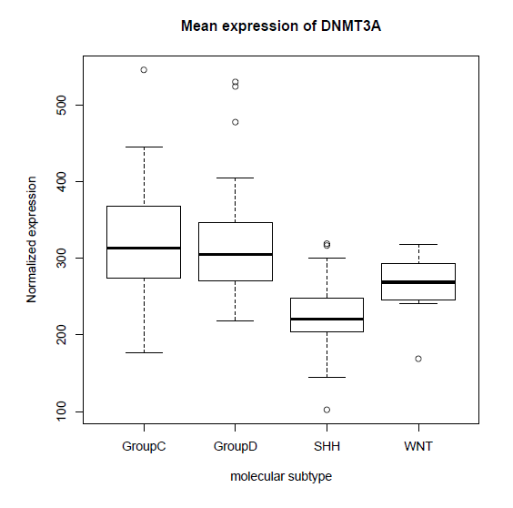
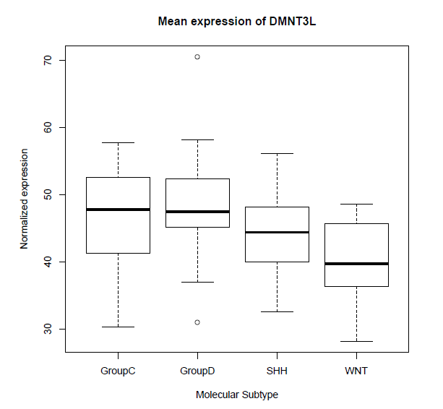
Supplemental Fig. 4
p= 9.5 x10⁻³
p= 2.0 x10⁻⁸
Group 3 Group 4 SHH WNT
Group 3 Group 4 SHH WNT
p= 0.0027
Group 3 Group 4 SHH WNT

Slide 2
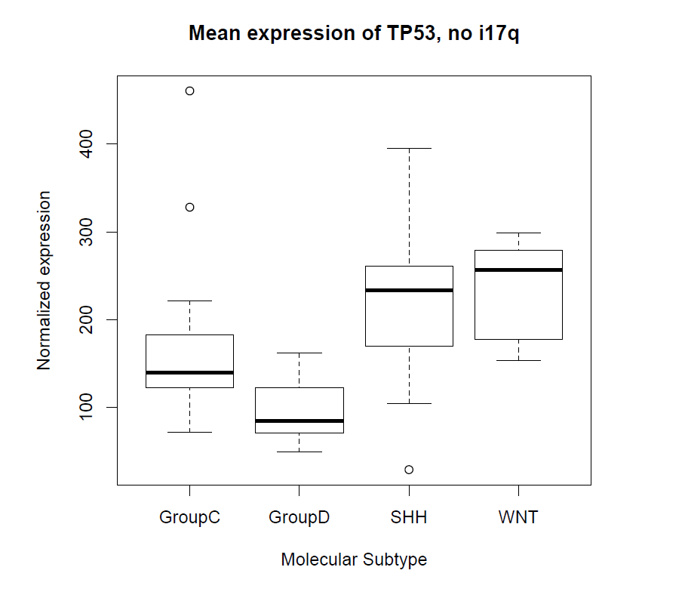
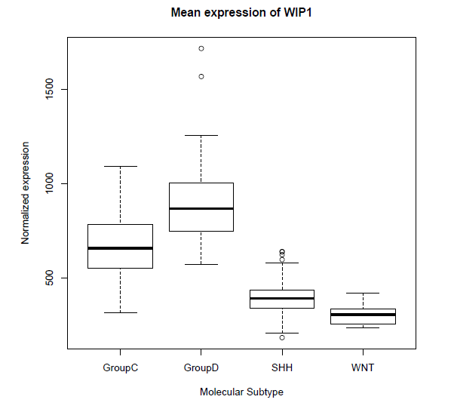
Supplemental Fig. 5

Slide 3
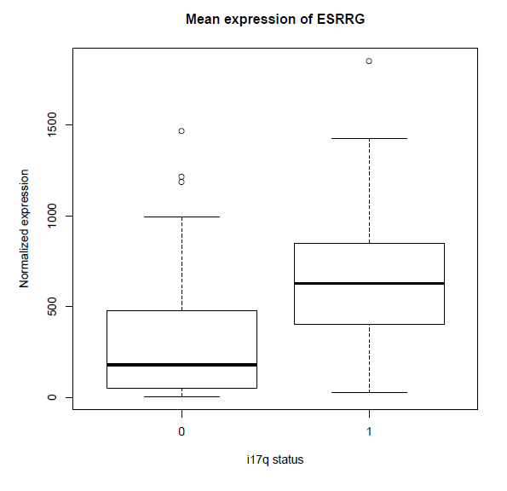
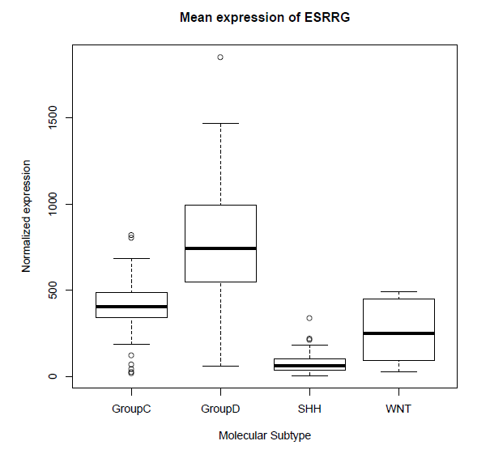
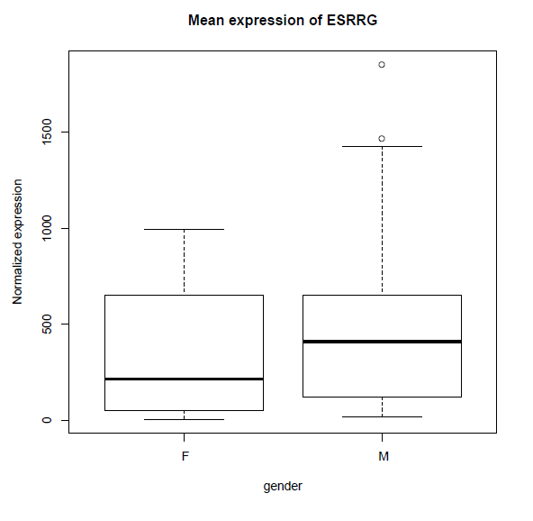
Supplemental Fig. 6
A
B
C
p=1.5x10⁻⁵
p=2.0x10⁻¹⁶
p=0.08

