Slide 1
Supplementary File 1, Figures S1 to S11
Figure legends
Figure S1. Validation of knockdowns of NOP58 (A) and RBFOX2 (B) by qPCR. The ovarian cancer cell line SKOV3ip1 was transfected with siRNAs against (A) NOP58 and (B) RBFOX2. As measured by qPCR, the two different siRNAs designed against each of these proteins resulted in a strong decrease of the respective transcripts of NOP58 (A) and RBFOX2 (B) (well below 0.5 as compared to the control samples treated with lipofectamine alone (LF)).
Figure S2. Bioanalysis and quality report for sequencing libraries generated. The cDNA libraries of small RNAs isolated from the SKOV3ip1, MCF-7, BJ-Tielf and INOF cell lines, as well as from SKOV3ip1 treated with lipofectamine alone (LF) or with specific siRNAs, were analysed by Bioanalyzer (Agilent) at the McGill University and Génome Québec Innovation Centre, to ensure high quality before the sequencing. The RIN value and 28S/18S ratio are given for each sample (A). The size distribution of the libraries are also given (B- O).
Figure S3. Processing and abundance patterns of orphan box C/D snoRNA in normal and cancer cells. Sequencing reads mapping to at least 77% of full-length orphan box C/D snoRNAs in normal (BJ-Tielf, INOF), breast cancer (MCF-7) and ovarian cancer (SKOV3ip) cell lines were counted and plotted with respect to their corresponding boxes C and D for every residue of all snoRNAs. CPM indicates count per million. All experiments were performed in duplicate.
Figure S4. Identification of discrete classes of box C/D snoRNAs varying in their ends with respect to boxes C and D. (A) Two general forms of box C/D snoRNAs were identified according to the distance between their ends and their characteristic boxes. The number of snoRNAs displaying only short forms, only long forms or a mix of forms was counted in the different cell lines. Only predominant forms displaying an abundance of at least 1 CPM were considered to determine the groups. (B) For most snoRNAs, the same forms are produced in all cell lines considered. The differences seen between the cell lines are mostly due to abundance differences (some snoRNAs are only expressed in a subset of cell lines) and only a very small subset of snoRNAs are actually processed differentially (ie change groups) in the different cell lines. The Venn diagrams were generated using http://bioinformatics.psb.ugent.be/webtools/Venn/.

Slide 2
Figure S5. Validation of snR39B forms and their response to RBFOX2 and NOP58 knockdown. (A) The distribution of the different forms of snR39B detected by sequencing. The abundance of the different forms generated from snR39B was determined before and after the knockdown of either NOP58 or RBFOX2 and plotted relative to the number of the nucleotides upstream of box C and downstream of box D. CPM, SI and LF respectively indicate counts per million reads mapped, siRNA knockdown and mock transfection (Lipofectamine). The data obtained after the transfection of two independent siRNA targeting either NOP58 (blue bars) or RBFOX2 (red bars) and three mock transfections (black bars) are shown. (B) Northern blot analysis of snoRNA snR39B. Total RNA was extracted from SKOV3ip1 after mock transfection using Lipofectamine (LF) or after transfection of two different siRNAs (KD_1 and KD_2) targeting RBFOX2 or NOP58 and separated using PAGE. The different species of snoRNA were identified using a probe complementary to the mature sequence of snR39B. The 5S and 5.8S rRNA are shown as loading control. The position of a DNA size marker (M) is indicated on the left, while the position of the long and short forms identified in A is indicated by arrows. The percent long (L) calculated as 100*L/(L+SH) is shown at bottom. The data are the average of two experiments and the standard deviation is shown below the percent long.
Figure S6. Validation of U31 expression and its response to RBFOX2 and NOP58 knockdown. (A) The distribution of the different forms of U31 detected by sequencing. The abundance of the different forms generated from U31 was determined before and after the knockdown of either NOP58 or RBFOX2 and plotted relative to the number of the nucleotides upstream of box C and downstream of box D. CPM, SI and LF respectively indicate counts per million reads mapped, siRNA knockdown and mock transfection (Lipofectamine). The data obtained after the transfection of two independent siRNA targeting either NOP58 (blue bars) or RBFOX2 (red bars) and three mock transfections (black bars) are shown. (B) Northern blot analysis of snoRNA U31. Total RNA was extracted from SKOV3ip1 after mock transfection using Lipofectamine (LF) or after transfection of two different siRNAs (KD_1 and KD_2) targeting RBFOX2 or NOP58 and separated using PAGE. The RNA was visualized using a probe complementary to the mature sequence of U31. The position of a DNA size marker (M) is indicated on the left, while the position of U31 is indicated by an arrow. The expression level of U31 before and after knockdown was determined using quantitative RT-PCR and the expression levels relative to that detected in mock transfected cells are indicated at bottom.
Figure S7. Predicted stability of different snoRNA forms of U15B (A-C), U26 (D-F) and SNORD126 (G-I) as analyzed using mfold. The three snoRNAs expressed as both long and short forms and showing the strongest effect in the NOP58 knockdown (long forms) and the RBFOX2 knockdown (short forms) were evaluated using mfold (http://mfold.rna.albany.edu/?q=mfold/RNA-Folding-Form). For each snoRNA, the predicted minimum free energy of the long form with secondary structure most likely to form a k-turn (as evaluated by visual inspection) was compared to the short form showing strongest canonical base pairing in the terminal region and the short form most likely to form a k-turn. Constraints (as described on the RNA folding form of the mfold web server and in the corresponding manuscript (Zuker (2003) NAR 31(13):3406-15)) were used to force base pairing of certain residues (in particular to force short forms to adopt a structure compatible with k-turn formation), in order to compare the minimum free energy of each form type. The boxes C and D are highlighted in orange and blue respectively for each structure. It should be noted that mfold does not predict non-canonical G-A and A-G base pairing found in k-turns and thus the actual minimum free energy of the k-turn forms is likely to be lower than the mfold predicted values.

Slide 3
Figure S8. Box C/D snoRNA forms most affected by NOP58 depletion. All snoRNA forms negatively affected by at least two-fold in the NOP58 depletions as compared to the lipofectamine (LF) control samples are listed.
Figure S9. Box C/D snoRNA forms most affected by RBFOX2 depletion. All snoRNA forms negatively affected by at least two-fold in the RBFOX2 depletions as compared to the lipofectamine (LF) control samples are listed.
Figure S10. Intronic position and stem length preference of snoRNAs affected by the NOP58 and RBFOX2 depletions. The snoRNA end and stem lengths as well as position of the snoRNA within its host intron (i.e. distance separating the snoRNA from the closest downstream exon) were determined for snoRNAs with at least one form affected by either NOP58 (left column) or RBFOX2 (right column) and presented in the form of pie charts. The snoRNAs considered for this analysis are those listed in Figures S8 and S9.
Figure S11. RBFOX2 directly binds to box C/D snoRNAs. RBFOX2 CLIP-seq reads mapping to all positions of the repeat-masked human genome were obtained from the UCSC Genome Browser, ‘FOX2 adaptor-trimmed CLIP-seq reads’ regulation track, and hg18 build. Reads mapping to coding genes, miRNAs and box C/D snoRNAs were intersected with the FOX2 CLIP-seq reads to determine the highest read count per position for each molecule. These maximum read counts were binned and their distribution is shown for each class of molecule. As seen in the graph, very low counts of miRNA reads were identified in the RBFOX2 CLIP-seq dataset. A larger proportion of UCSC genes were found bound by RBFOX2, with 7% of transcripts displaying more than 10 reads overlapping the same position. Finally, even though their length is much shorter than those of protein-coding transcripts, a strong proportion of box C/D snoRNAs were found bound by RBFOX2, with 40% of box C/D snoRNAs displaying more than 10 reads overlapping the same position.

Slide 4
A
LF
NOP58 SI1
NOP58 SI2
B
LF
RBFOX2 SI1
RBFOX2 SI2
Figure S1. Validation of knockdowns of NOP58 (A) and RBFOX2 (B) by qPCR.
Deschamps-Francoeur et al., 2014

Slide 5
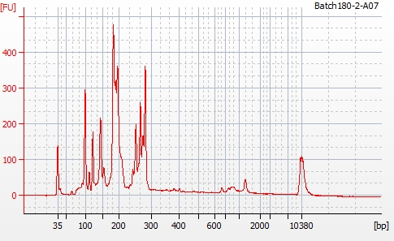
A
Sample | Replicate | 28S/18S | RIN
SKOV3ip1 | 1 | 1.74191 | 9.7
SKOV3ip1 | 2 | 1.7461 | 9.8
MCF-7 | 1 | 1.680451 | 9.4
MCF-7 | 2 | 1.636702 | 9.2
BJ-Tielf | 1 | 1.680261 | 9.4
BJ-Tielf | 2 | 1.731743 | 9.2
INOF | 1 | 1.559328 | 8.4
INOF | 2 | 2.021277 | 8.9
SKOV3ip1_LF | 1 | 1.770444 | 10
SKOV3ip1_LF | 2 | 1.900521 | 10
SKOV3ip1_LF | 3 | 1.787963 | 9.9
SKOV3ip1_NOP58_KD | 1 | 2.006542 | 10
SKOV3ip1_NOP58_KD | 2 | 1.786576 | 9.8
SKOV3ip1_RBFOX2_KD | 1 | 1.8329 | 9.8
SKOV3ip1_RBFOX2_KD | 2 | 1.757386 | 9.7
B
SKOV3ip1_1
Figure S2. Bioanalysis and quality report for RNAseq datasets generated.
Deschamps-Francoeur et al., 2014

Slide 6
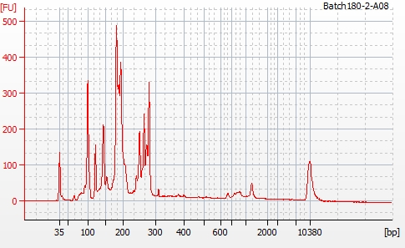
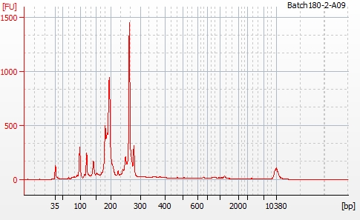
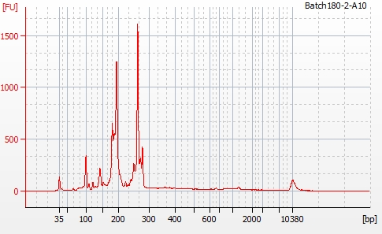
C
SKOV3ip1_2
D
MCF-7_2
E
MCF-7_2
Figure S2 (continued). Bioanalysis and quality report for RNAseq datasets generated
Deschamps-Francoeur et al., 2014

Slide 7
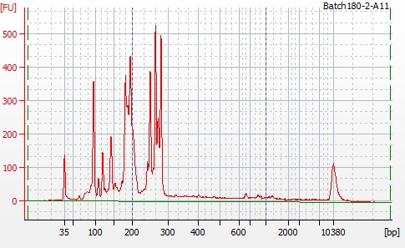
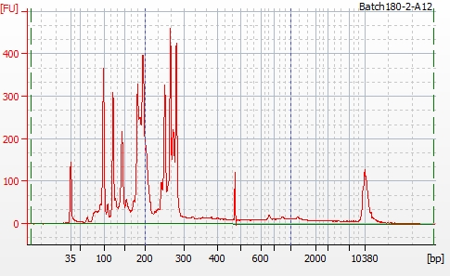
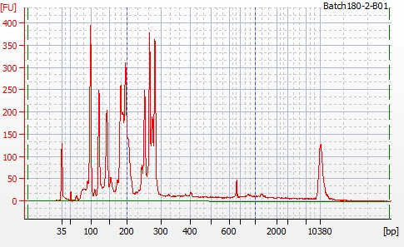
F
BJ-Tielf_1
G
BJ-Tielf_2
H
INOF_1
Figure S2 (continued). Bioanalysis and quality report for RNAseq datasets generated.
Deschamps-Francoeur et al., 2014

Slide 8
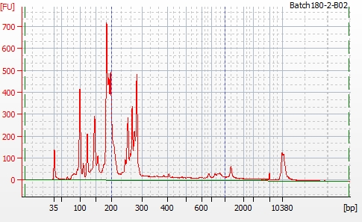
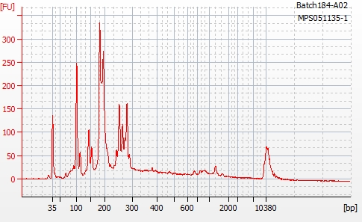
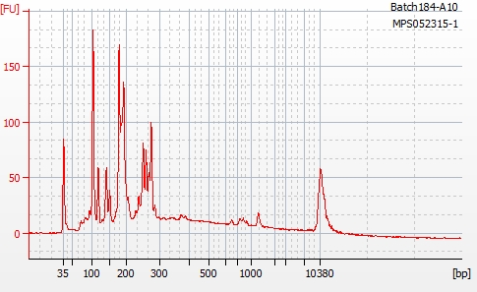
I
INOF_2
J
SKOV3ip1_LF_1
K
SKOV3ip1_LF_2
Figure S2 (continued). Bioanalysis and quality report for RNAseq datasets generated.
Deschamps-Francoeur et al., 2014

Slide 9
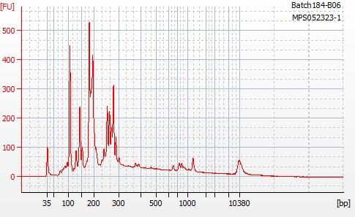
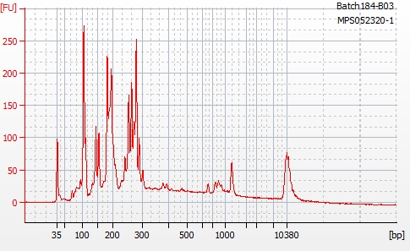
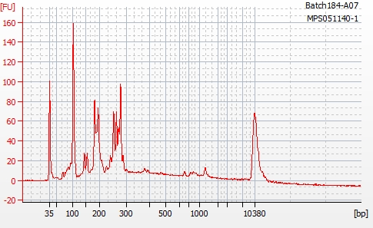
L
SKOV3ip1_LF_3
M
SKOV3ip1_NOP58_KD_1
N
SKOV3ip1_NOP58_KD_2
Figure S2 (continued). Bioanalysis and quality report for RNAseq datasets generated.
Deschamps-Francoeur et al., 2014

Slide 10
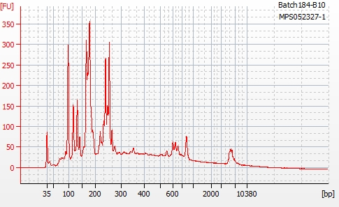
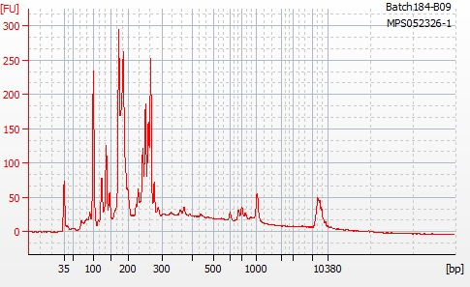
N
SKOV3ip1_RBFOX2_KD_1
O
SKOV3ip1_RBFOX2_KD_2
Figure S2 (continued). Bioanalysis and quality report for RNAseq datasets generated.
Deschamps-Francoeur et al., 2014

Slide 11
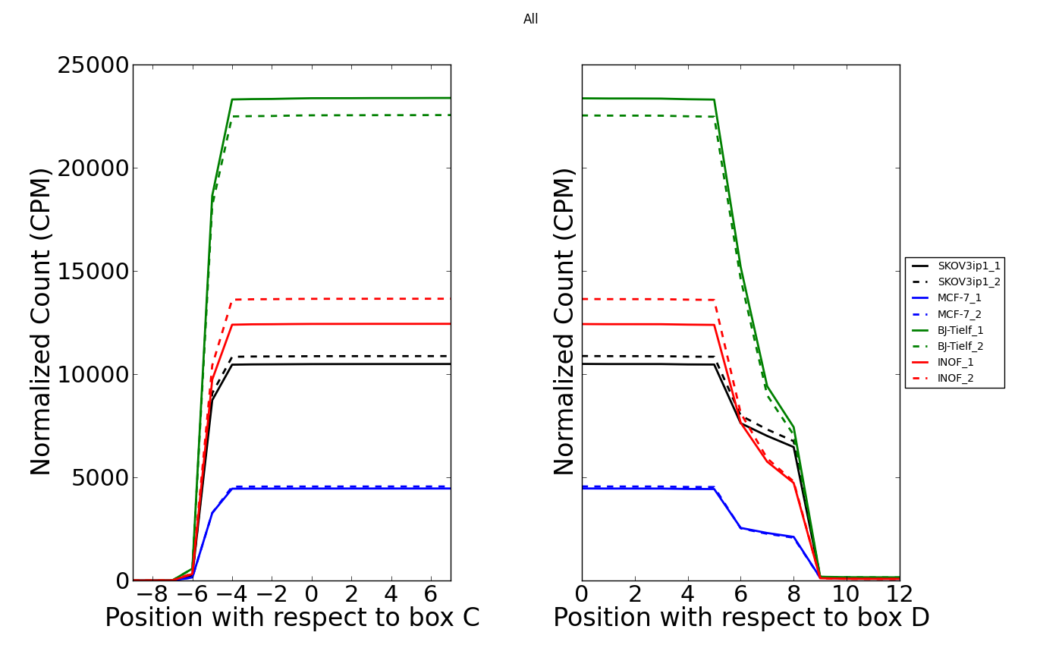
Abundance in CPM
Abundance in CPM
Figure S3. Processing and abundance patterns of orphan box C/D snoRNA in normal and cancer cells.
Deschamps-Francoeur et al., 2014

Slide 12
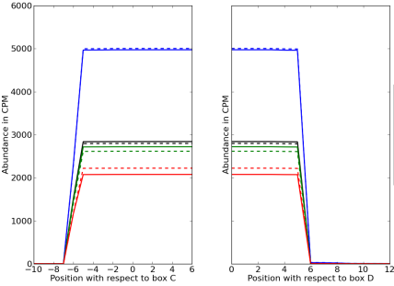
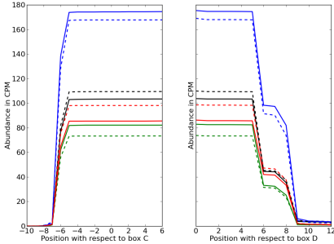
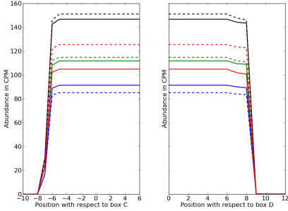
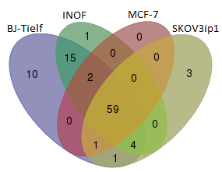
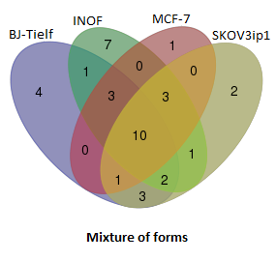
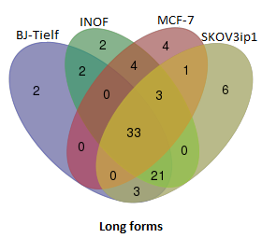
A
Cell line | snoRNA count
 | snoRNAs with only short ends Start: 4-5 nt before box C End: 2-3 nt after box D | Mixture of forms Start: 4-6 nt before box C End: 2-5 nt after box D | snoRNAs with only long ends Start: 5-6 nt before box C End: 4-5 nt after box D
Example
SKOV3ip1 | 68 | 22 | 67
MCF7 | 62 | 18 | 45
BJ-Tielf | 92 | 24 | 61
INOF | 81 | 27 | 65
U106
U15B
HBII-295
B
snoRNAs produced only with short ends
snoRNAs produced with both short and long ends
snoRNAs produced only with long ends
Figure S4. Identification of discrete classes of box C/D snoRNAs varying in their ends with respect to boxes C and D.
Deschamps-Francoeur et al., 2014

Slide 13
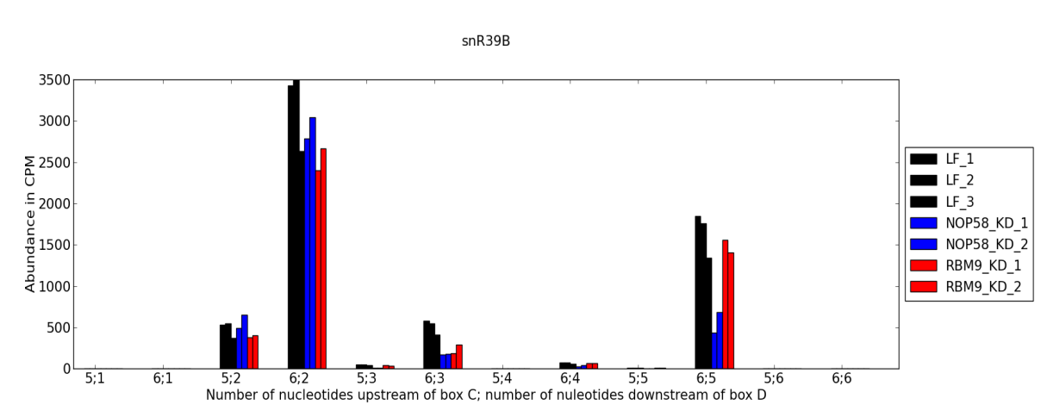


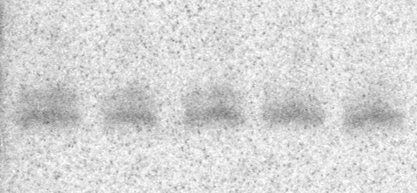
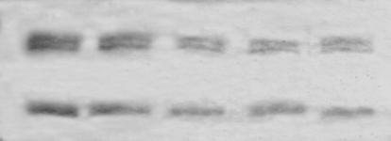
A
snR39B
snR39B_{SH}
snR39B_{L}
LF1
LF2
LF3
Abundance in CPM
NOP58 SI1
NOP58 SI2
RBFOX2 SI1
RBFOX2 SI2
Number of nucleotides upstream of box C : Number of nucleotides downstream of box D
B
RBFOX2 KD
NOP58 KD
M
LF
SI1
SI2
SI1
SI2
75
70
65
snR39B_{L}
snR39B_{SH}
5.8S rRNA
5S rRNA
37.7
35.2
34.4
19.9
17.9
% Long
± 0.7
± 0.8
± 5.6
± 2.9
± 0.4
Figure S5. Validation of snR39B forms and their response to RBFOX2 and NOP58 knockdown.
Deschamps-Francoeur et al., 2014

Slide 14
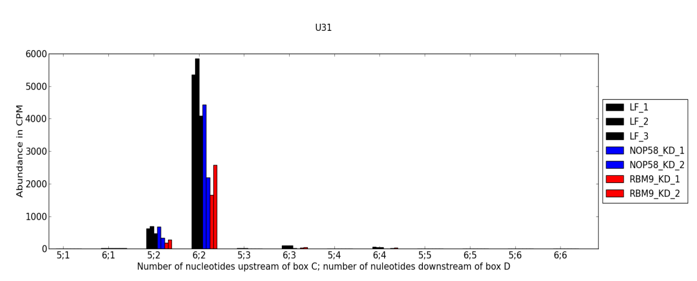


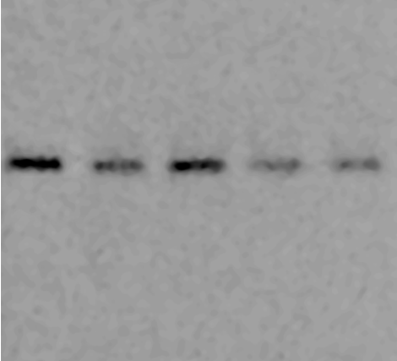
A
U31
LF1
LF2
Abundance in CPM
LF3
NOP58 SI1
NOP58 SI2
RBFOX2 SI1
RBFOX2 SI2
Number of nucleotides upstream of box C : Number of nucleotides downstream of box D
B
RBFOX2 KD
NOP58 KD
M
LF
SI1
SI2
SI1
SI2
75
70
65
U31
1.0
0.60
0.40
0.6
0.42
Relative Expression
Figure S6. Validation of U31 expression and its response to RBFOX2 and NOP58 knockdown.
Deschamps-Francoeur et al., 2014

Slide 15
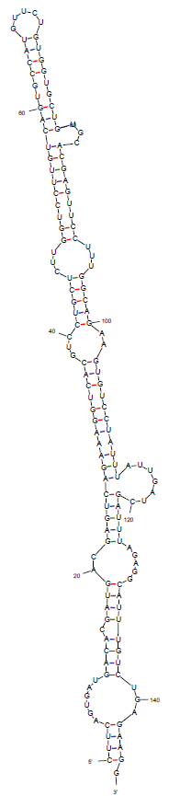
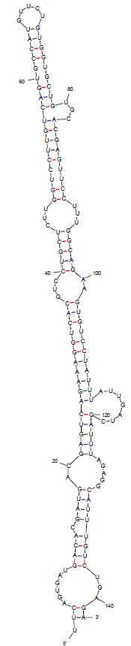
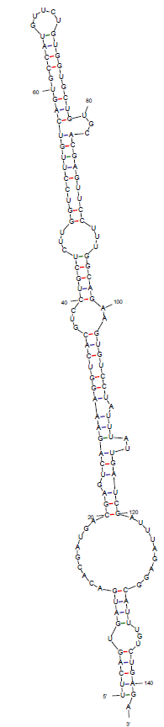
A
B
C
U15B long form (k-turn forming)
(ΔG = -44.20 kcal/mol)
U15B short k-turn form
(ΔG = -39.60 kcal/mol)
U15B short form, canonical pairing in terminal region
(ΔG = -43.90 kcal/mol)
Figure S7. Stability of different snoRNA forms of U15B (A-C), U26 (D-F) and SNORD126 (G-I) as analyzed using mfold.
Deschamps-Francoeur et al., 2014

Slide 16
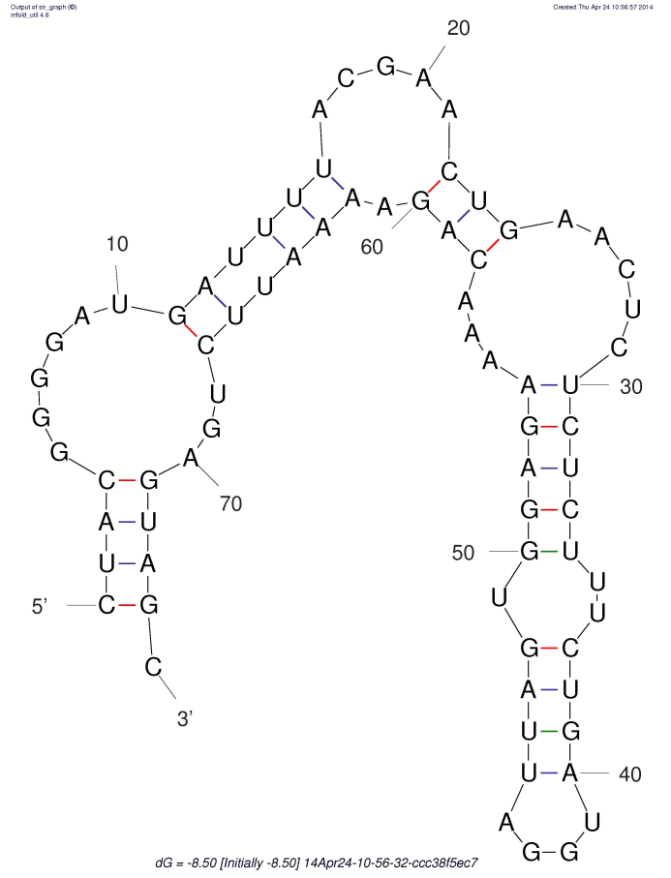
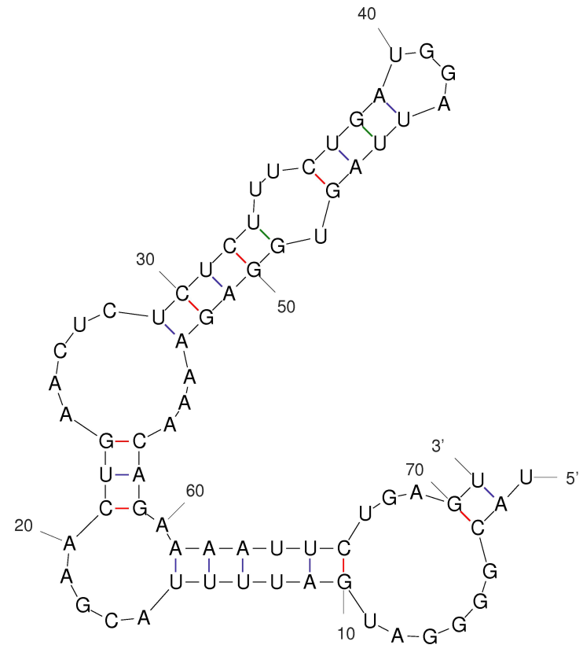
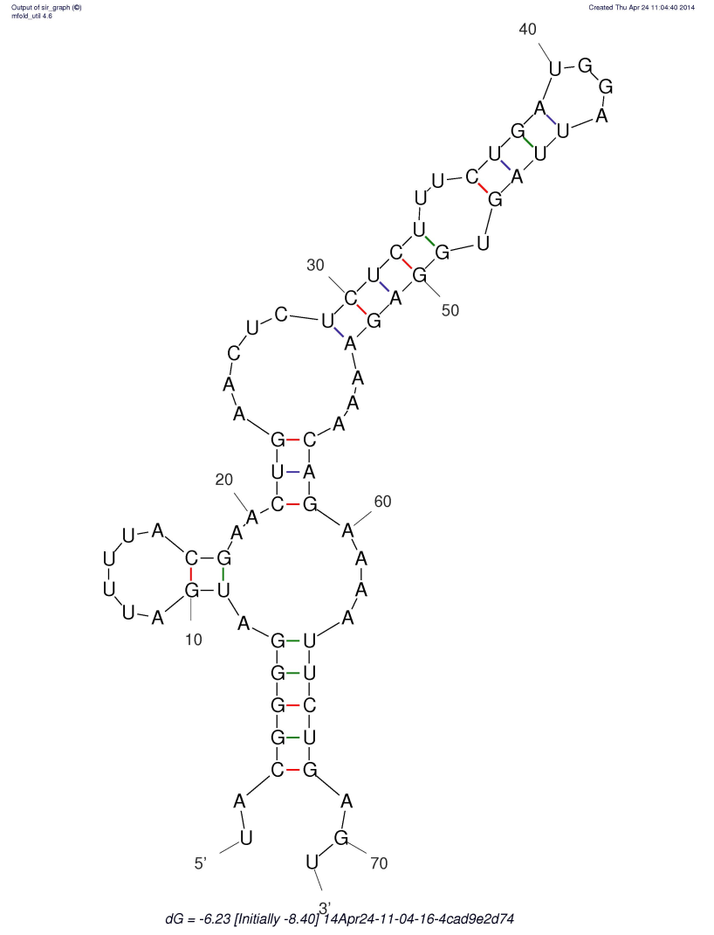
D
E
U26 long form (k-turn forming)
(ΔG = -8.50 kcal/mol)
U26 short k-turn form
(ΔG = -4.40 kcal/mol)
F
U26 short form, canonical pairing in terminal region
(ΔG = -6.23 kcal/mol)
Figure S7 (continued). Stability of different snoRNA forms of U15B (A-C), U26 (D-F) and SNORD126 (G-I) as analyzed using mfold.
Deschamps-Francoeur et al., 2014

Slide 17
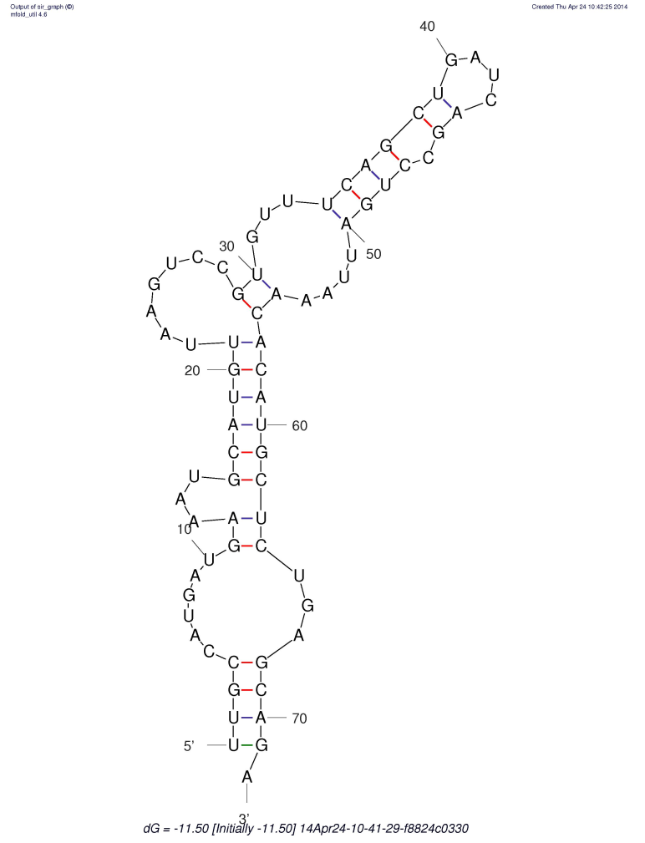
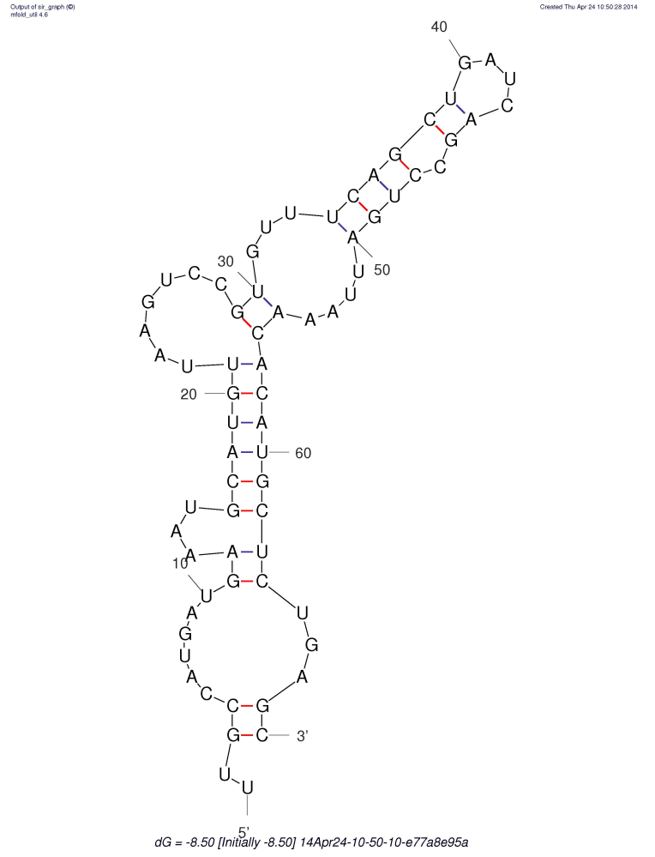
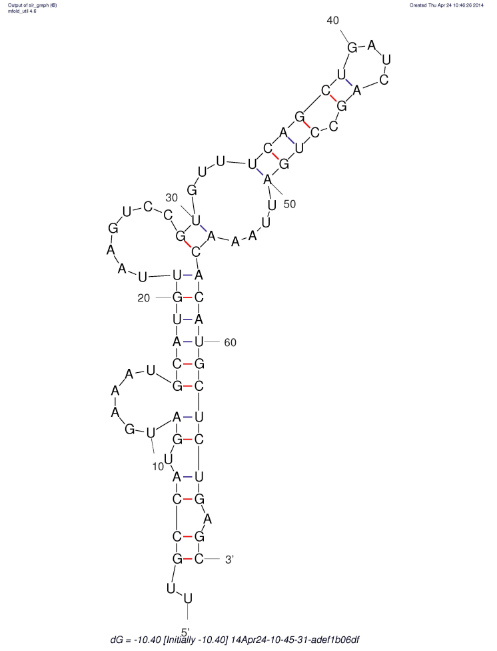
C
G
H
SNORD126 short k-turn form
(ΔG = -8.50 kcal/mol)
SNORD126 long form (k-turn forming)
(ΔG = -11.50 kcal/mol)
I
SNORD126 short form, canonical pairing in terminal region
(ΔG = -10.40 kcal/mol)
Figure S7 (continued). Stability of different snoRNA forms of U15B (A-C), U26 (D-F) and SNORD126 (G-I) as analyzed using mfold.
Deschamps-Francoeur et al., 2014

Slide 18
snoRNA | Fold change NOP58 KD/LF | Fold change RBFOX2 KD/LF | Number of nucleotides |  | Hostgene
 |  |  | before box C | after box D
HBII-82 | 0.077364 | 0.97859 | 5 | 5 | SF3B3
HBII-82 | 0.096885 | 1.194791 | 6 | 5 | SF3B3
U36C | 0.122488 | 1.252546 | 6 | 81 | RPL7A
U95 | 0.165759 | 2.565696 | 5 | 5 | GNB2L1
U35A | 0.168838 | 0.547203 | 4 | 4 | RPL13A
U18C | 0.184533 | 0.785771 | 5 | 2 | RPL4
HBII-85-13 | 0.209759 | 1.027023 | 5 | 5 | SNURF-SNRNP-UBE3A antisense
U38B | 0.214176 | 0.996793 | 5 | 3 | RPS8
U24 | 0.241806 | 0.756398 | 5 | 5 | RPL7A
HBII-85-11 | 0.249816 | 1.522075 | 5 | 5 | SNURF-SNRNP-UBE3A antisense
U51 | 0.259975 | 0.601412 | 5 | 2 | EEF1B2
U105 | 0.270892 | 0.575345 | 5 | 3 | PPAN
mgU6-53 | 0.276511 | 1.094886 | 6 | 5 | AB046784
Z17B | 0.277052 | 0.670555 | 5 | 2 | RPL23A
U58B | 0.277515 | 1.385619 | 5 | 5 | RPL17
U106 | 0.284604 | 0.841385 | 5 | 2 | C20orf199
HBII-210 | 0.299773 | 0.783148 | 5 | 2 | GNL3
U14A | 0.302189 | 0.656844 | 5 | 5 | RPS13
U36B | 0.313528 | 1.045191 | 5 | 2 | RPL7A
HBII-99 | 0.313684 | 0.744577 | 5 | 2 | C20orf199
U81 | 0.315153 | 1.226763 | 5 | 2 | GAS5
snR39B | 0.339362 | 0.898596 | 5 | 5 | EIF4A2
HBII-82B | 0.356613 | 1.125675 | 5 | 5 | SF3B3
U42A | 0.364032 | 1.099774 | 5 | 4 | RPL23A
HBII-135 | 0.372572 | 0.982964 | 5 | 2 | MGC40157
HBII-142 | 0.378646 | 0.98568 | 5 | 5 | EIF4G1
U38B | 0.379292 | 1.438134 | 4 | 3 | RPS8
U26 | 0.381466 | 1.10611 | 5 | 5 | UHG
U75 | 0.381634 | 0.587424 | 6 | 5 | GAS5
U61 | 0.382678 | 1.389008 | 5 | 5 | RBMX
Figure S8. Box C/D snoRNA forms most affected by NOP58 depletion (NOP58 KD/LF abundance fold change < 0.5)
Deschamps-Francoeur et al., 2014

Slide 19
snoRNA | Fold change NOP58 KD/LF | Fold change RBFOX2 KD/LF | Number of nucleotides |  | Hostgene
 |  |  | before box C | after box D
U58A | 0.390532 | 1.206919 | 5 | 5 | RPL17
SNORD126 | 0.39057 | 0.482052 | 5 | 3 | CCNB1IP1
U34 | 0.402386 | 1.039868 | 5 | 5 | null
HBII-99B | 0.404214 | 1.079766 | 5 | 2 | C20orf199
HBII-429 | 0.412968 | 1.177562 | 5 | 0 | RPS12
U59B | 0.430695 | 0.858964 | 5 | 2 | ATP5B
U74 | 0.43361 | 0.548633 | 5 | 2 | GAS5
U18B | 0.434727 | 0.743819 | 5 | 2 | RPL4
U105B | 0.441883 | 1.135713 | 5 | 5 | PPAN
HBII-85-25 | 0.457069 | 0.680997 | 5 | 5 | SNURF-SNRNP-UBE3A antisense
U97 | 0.457696 | 0.56613 | 6 | 5 | EIF4G2
U38A | 0.470434 | 0.667526 | 5 | 2 | RPS8
HBII-52-41 | 0.472166 | 1.445768 | 5 | 5 | SNURF-SNRNP-UBE3A antisense
U105B | 0.473735 | 0.970201 | 4 | 5 | PPAN
U60 | 0.474843 | 1.101538 | 5 | 5 | Cluster of ESTs
HBII-85-29 | 0.489022 | 1.382926 | 5 | 5 | SNURF-SNRNP-UBE3A antisense
SNORD127 | 0.49217 | 0.766752 | 5 | 2 | PRPF39
HBII-438A | 0.494372 | 1.791306 | 5 | 5 | SNURF-SNRNP-UBE3A antisense
Figure S8 (continued). Box C/D snoRNA forms most affected by NOP58 depletion (NOP58 KD/LF abundance fold change < 0.5)
Deschamps-Francoeur et al., 2014

Slide 20
snoRNA | Fold change NOP58 KD/LF | Fold change RBFOX2 KD/LF | Number of nucleotides |  | Hostgene
 |  |  | before box C | after box D
U101 | 0.516114 | 0.27488 | 5 | 2 | RPS12
U15A | 1.24994 | 0.275712 | 5 | -1 | RPS3
U101 | 0.800563 | 0.315795 | 4 | 2 | RPS12
U84 | 0.962314 | 0.318905 | 4 | 2 | BAT1
U84 | 1.089246 | 0.320577 | 5 | 2 | BAT1
HBII-95 | 0.945459 | 0.328438 | 5 | 2 | NOP5/NOP58
HBI-43 | 1.088261 | 0.335696 | 4 | 2 | SNX5
HBI-43 | 0.616657 | 0.354653 | 5 | 2 | SNX5
U15A | 1.358398 | 0.356948 | 5 | 2 | RPS3
HBII-99 | 0.738031 | 0.380006 | 4 | 2 | C20orf199
U43 | 0.61581 | 0.412376 | 5 | 2 | RPL3
U31 | 0.650126 | 0.416538 | 5 | 2 | UHG
U18A | 0.654657 | 0.420201 | 4 | 2 | RPL4
U105 | 0.660804 | 0.422807 | 5 | 2 | PPAN
SNORD124 | 0.938954 | 0.433917 | 5 | 3 | THRAP4/MED24
U83B | 0.884643 | 0.434072 | 5 | 3 | RPL3
U16 | 1.092941 | 0.449932 | 5 | 3 | RPL4
SNORD126 | 0.39057 | 0.482052 | 5 | 3 | CCNB1IP1
SNORD126 | 0.919925 | 0.49532 | 5 | 2 | CCNB1IP1
Figure S9 (continued). Box C/D snoRNA forms most affected by RBFOX2 depletion (RBFOX2 KD/LF abundance fold change < 0.5)
Deschamps-Francoeur et al., 2014

Slide 21
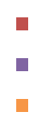
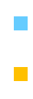
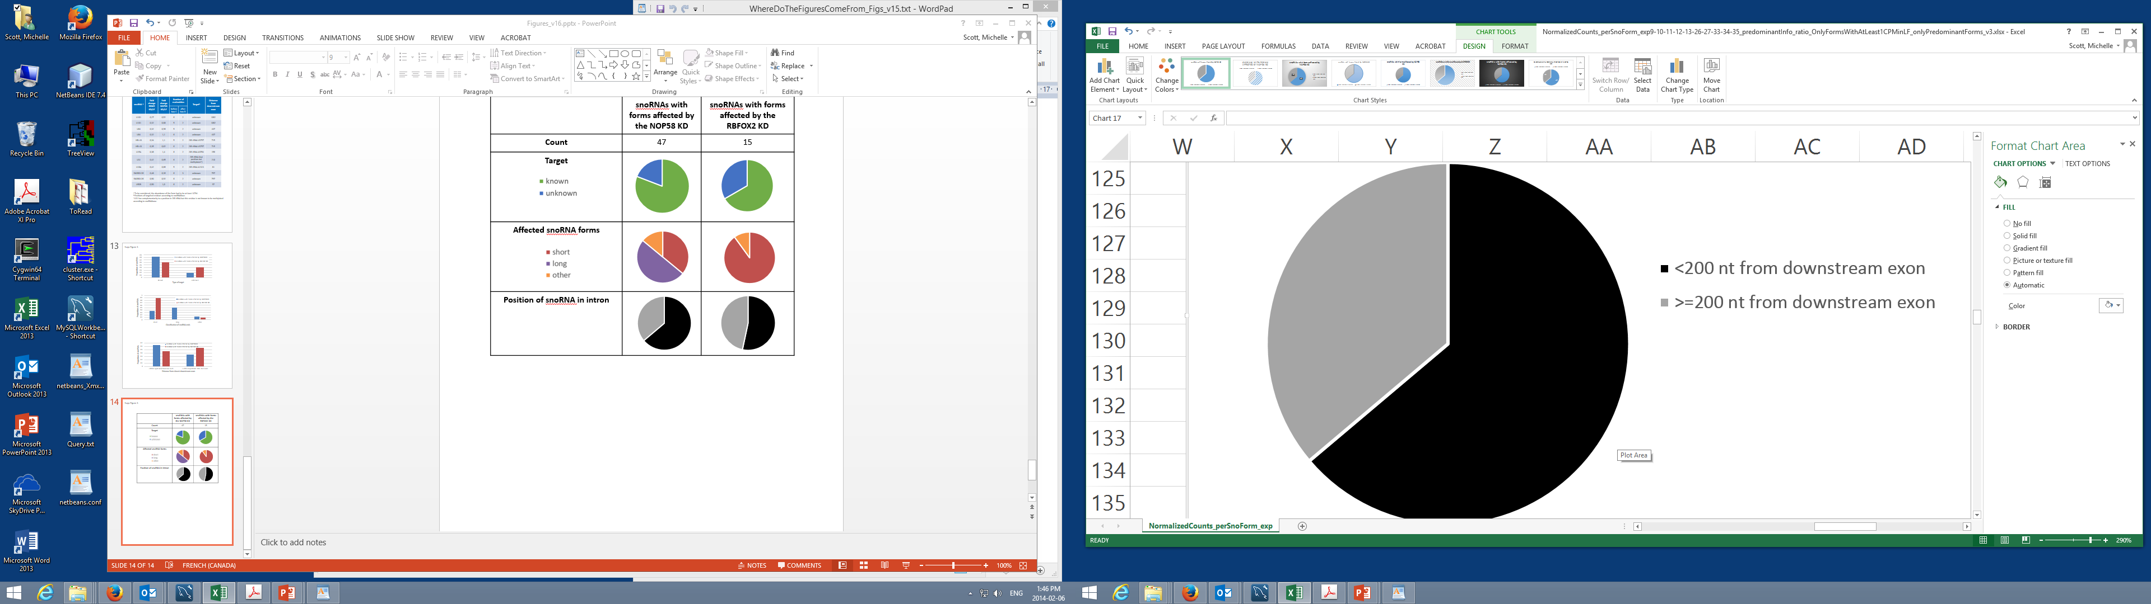
 | NOP58 Dependent snoRNA | RBFOX2 Dependent snoRNA
Form
Terminal stem length
Position of snoRNA in intron
short form
long form
other
> 4 base pairs
<= 4 base pairs
<150 nt from downstream exon
>=150 nt from downstream exon
Figure S10. Intronic position and stem length preference of snoRNAs most affected by the NOP58 and RBFOX2 depletions.
Deschamps-Francoeur et al., 2014

Slide 22
Figure S11. RBFOX2 directly binds to box C/D snoRNAs
Deschamps-Francoeur et al., 2014

