Slide 1
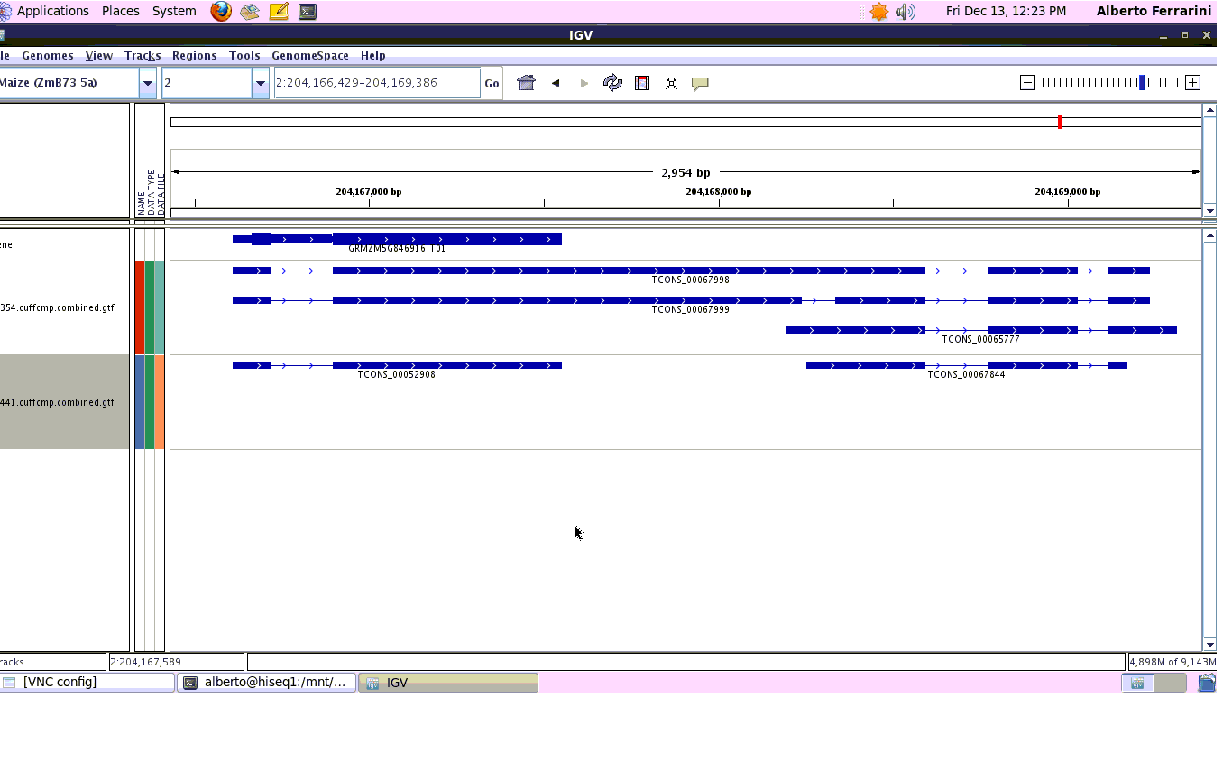
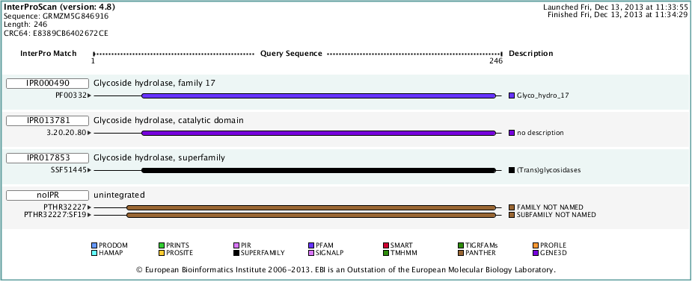
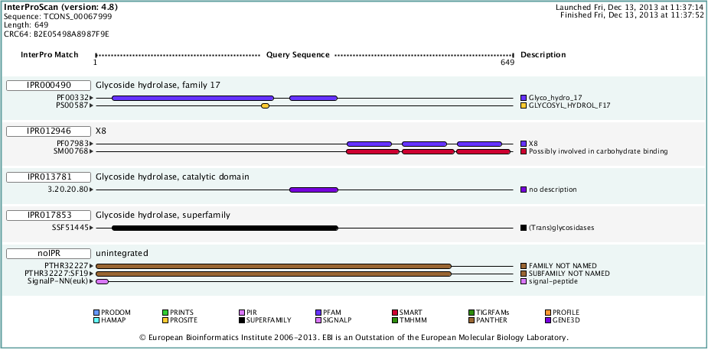
XLOC_029870: o-glycosyl hydrolase Position: Chr. 2:204,166,429-204,169,386
A
I
GRMZM5G846916_T01
II
TCONS_00067999
B
I
Inter Pro Match
Query Sequence
Description
1
246
IPR000490
Glycoside hydrolase, family 17
PF00332
Glyco_hydro_17
II
Inter Pro Match
Query Sequence
Description
1
649
IPR000490
Glycoside hydrolase, family 17
PF00332
Glyco_hydro_17
PS00587
GLYCOSYL_HYDROL_F17
IPR012946
X8
PF07983
X8
SM00768
Possibly involved in carbohydrate binding

Slide 2
