Slide 1

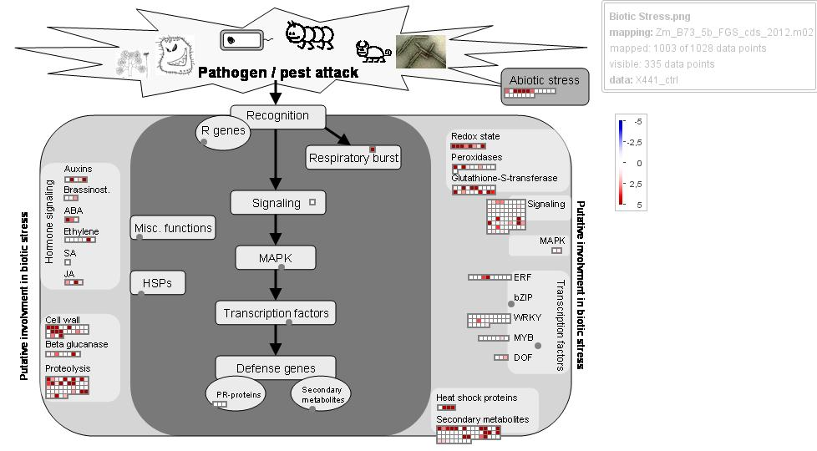
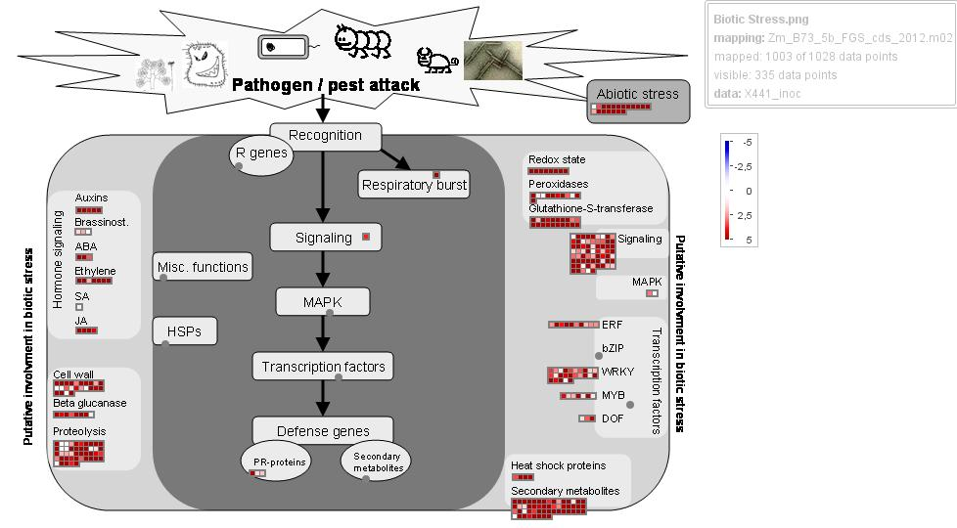
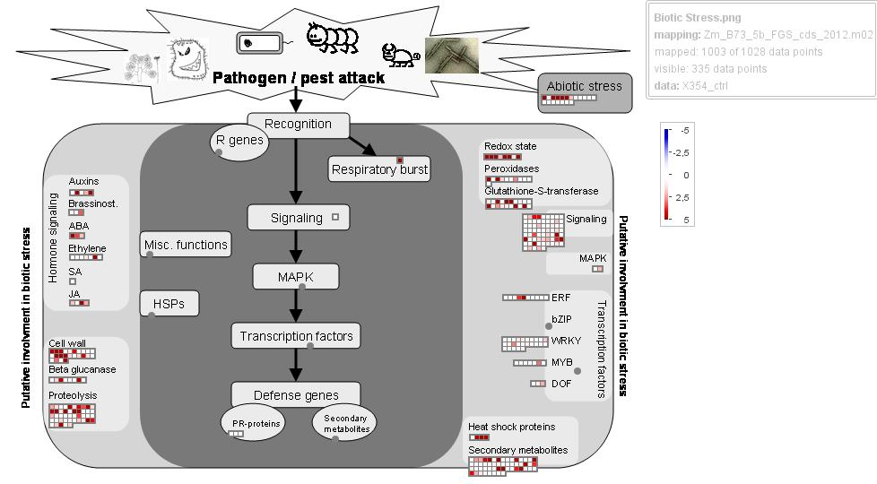
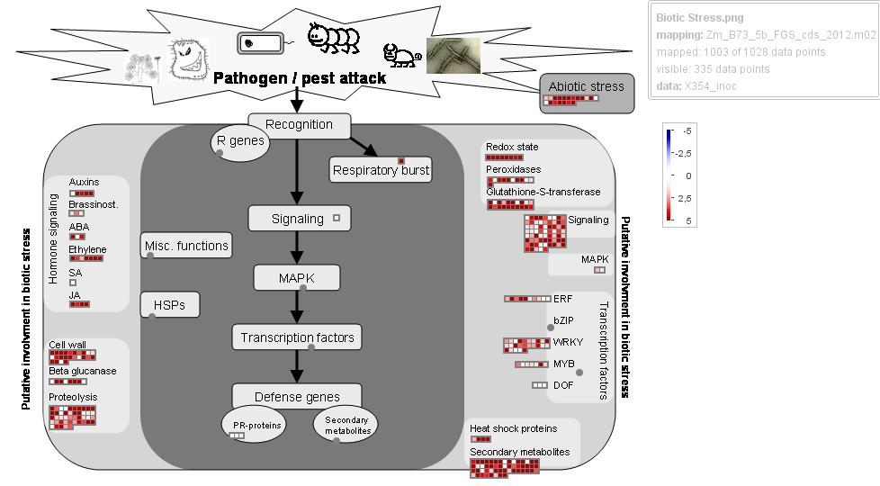
Common
0
A CO441
2.5
Pathogen attack
5
Auxin
Recognition
C
Redox state
I
C
I
Peroxidases
C
Brassinosteroid
R genes
C
I
C
I
ABA
I
Respiratory burst
Gluthiatone-S-transferase
Hormone signaling
C
I
C
I
Ethylene
Signaling
C
SA
I
C
I
Signaling
C
I
C
I
MAPK
C
JA
I
HSPs
MAPK
C
I
C
ERF
Cell wall
TF
I
C
I
C
WRKY
Transcription factors
I
Beta glucanase
Defense genes
C
MYB
C
I
PR
Secondary
I
C
I
C
DOF
Proteolysis
I
C
I
C
Heat shock proteins
I
C
Secondary metabolism
I
Common
0
B CO354
2.5
Pathogen attack
5
Auxin
Recognition
C
Redox state
I
C
I
Peroxidases
C
Brassinosteroid
R genes
C
I
C
I
ABA
I
Respiratory burst
Gluthiatone-S-transferase
Hormone signaling
I
C
Ethylene
C
I
C
I
C
Signaling
SA
I
Signaling
C
I
C
I
MAPK
C
JA
I
HSPs
MAPK
C
I
C
ERF
Cell wall
TF
I
C
I
C
WRKY
Transcription factors
I
Beta glucanase
Defense genes
C
MYB
C
I
PR
Secondary
I
C
I
C
DOF
Proteolysis
I
C
I
C
Heat shock proteins
I
C
Secondary metabolism
I

