Slide 1
Leadership and Strategy for Improvement
Anuwat Supachutikul, M.D.
CEO, The Healthcare Accreditation Institute, Thailand
Presented at the JLN Quality Tract Workshop
“Accreditation as an Engine for Improvement”
10 April 2013

Slide 2
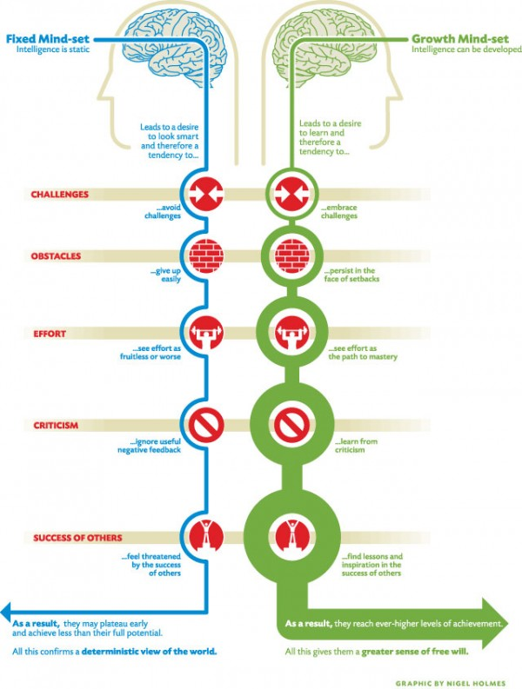
Leadership
Growth mindset
  Embrace challenges
  Persist in the face of setbacks
  See effort as the path to mastery
  Learn from criticism
  Find lessons and inspiration in the success of others
  -> reach ever-higher levels of achievement, a greater sense of free will
Visionary Leadership
  Clear, inspirational vision
  Respectful, empowering relationship
  Innovative, courageous action

Slide 3
Example of Conceptual Planning for Accreditation Program
Purpose
  Quality culture and learning community in the healthcare system
Principle
  Accreditation as an educational process, not an inspection
  Real value of accreditation is the external peer evaluation
Participation
  Professional organization, healthcare provider, purchaser, other certification/accreditation program, educational institute, MOPH, quality champions
Process
  Communication, capacity building, networking, quality improvement support, survey & decision, maintenance of accreditation

Slide 4
Strategic Moves
Start on what the country has, make most hospital feel success early
Trial on different type, size, & location of hospitals to learn from success & failure
Balance of quick win and last-long achievement
Use threat to improve our program
  ISO9000 -> consultation model
  Universal coverage program -> use stepwise approach to expand coverage of the program
  Stress from multiple visit -> provincial KM activities
Work with partner
  Professional organizations, teaching hospitals, provincial networks, hospital champions
Annual meeting
  Initiatives & new concepts, experience sharing, reward & pride

Slide 5
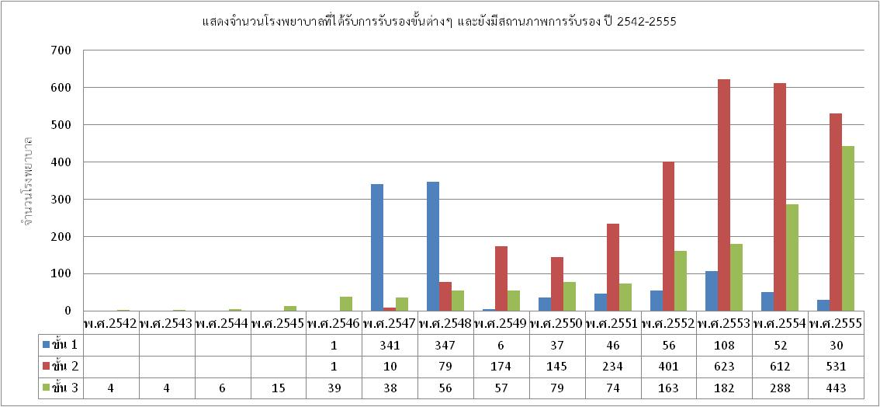
Stepwise Recognition
A strategy to gain acceptance and expand coverage
Step 3: Quality Culture
Identify OFI from standards
Focus on integration, learning, result
Step 2: Quality Assurance & Improvement
Identity OFI from goals & objectives of units
Focus on key process improvement
Step 1: Risk prevention
Identify OFI from 12 reviews
Focus on high risk problems
93 95 97 99 01 03 05 07 09 11 13

Slide 6
Information & Knowledge Management
Number is easy to monitor, but cannot tell the whole picture
Keep update & simplify knowledge

Slide 7
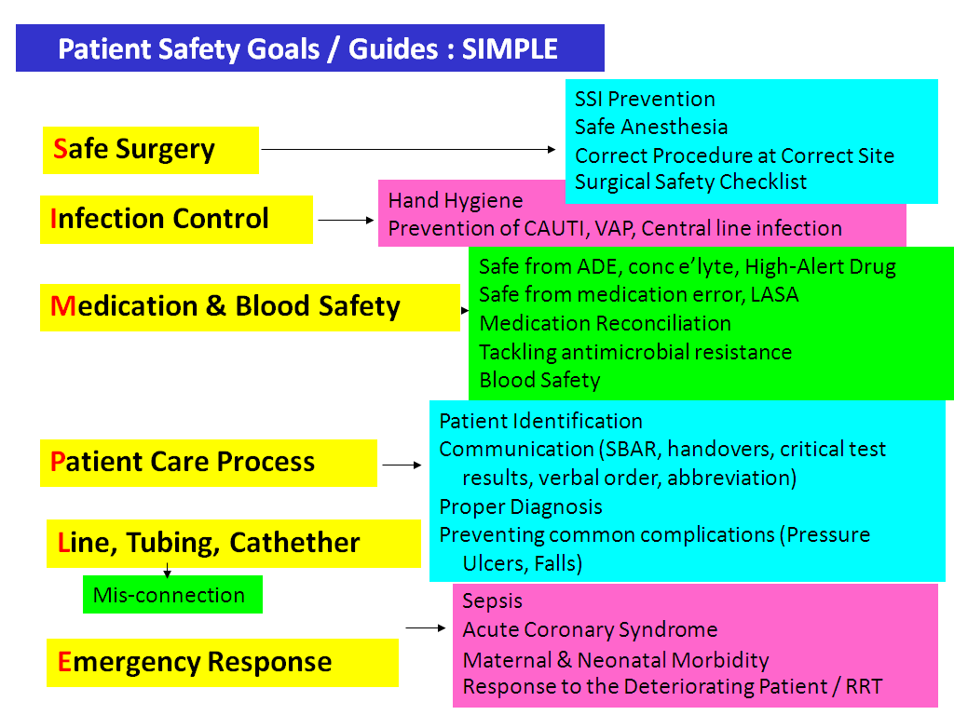
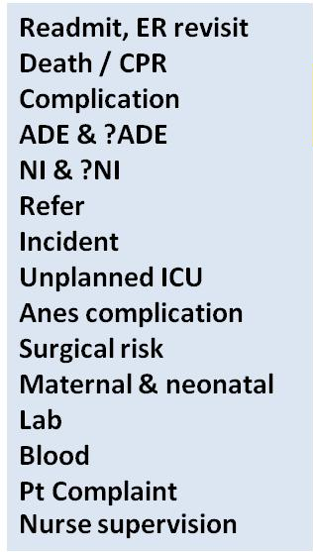
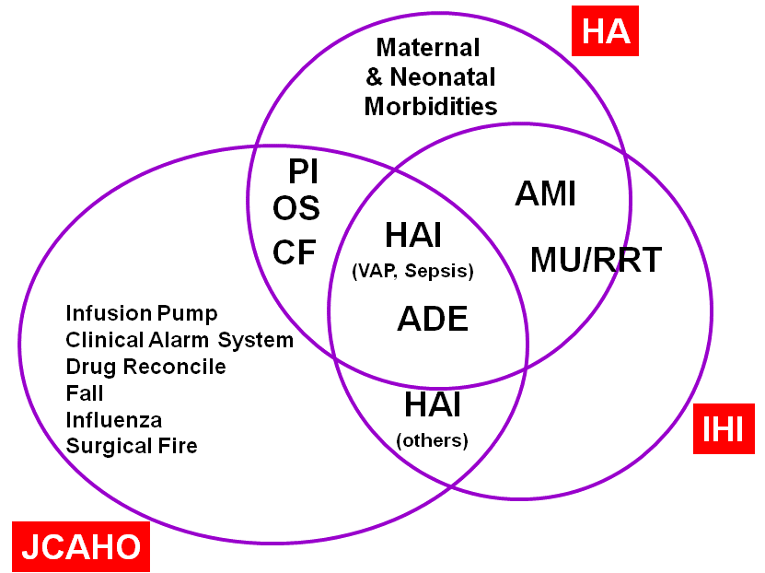
Keep Update & Simplify
Example of Patient Safety
Review &
Redesign
2nd Patient Safety Goals
Trigger Tools
1st Patient Safety Goals
Quality Review
1996 1998 2000 2002 2004 2006 2008 2009
Notes:
Thai patient safety goals has been set up since 2006 to guide hospitals on key areas to pay attention. Various guidelines, including WHO Patient Safety Solutions, JC Patient Safety Goals, and IHI Campaigns are studied and we select 9 issues as the first set of patient safety goals.
In 2008, they were grouped together under the heading of SIMPLE (safe surgery, infection control, medication & blood safety, patient care process, line/tube/catheter, emergency response) for ease of campaign. SIMPLE is now being promoted as a guide for tracing strengths and opportunities for improvement.
Furthermore, a methodology of trigger tool has been modified to enable hospital to identify serious adverse events that often are under-reported. Our approach is different from the IHI’s that we use triggers as criteria to screen medical records for reviewing and we emphasis on learning from the events rather that the trying to make an accurate calculation of adverse event rate. FOCUS ON HIGH RISK CHARTS & LEARN MORE.
We simplify the method for root cause analysis using the advantage of hindsight bias to identify the steps or process for potential improvement or change of decision, balanced by information from those practicing in the real situation , and then use the concept of human factor engineering to create the best solution.

Slide 8
People Focus
Engage with professional organizations
Engage healthcare staff, demonstrate benefits for them, use attractive tools for specific professions, e.g. clinical tracer for physician
Working with physicians: don’t tell, just ask
Create inspiration from within, story telling or narrative medicine makes people realize their value
Work with 3rd party payer to create optimal financial incentive, but be aware of its side effect
Promote a concept of living organization

Slide 9
Living Organization
Living system : open, self-organizing system, flexible/adaptive, creative, learning capability, spirituality
Leadership is the person who put a right influence at a right time
Efficient communication is through informal network, allow free interpretation of information
The staff should have opportunities to work on what value and have meaning to them
Turning & listening to one another, deep listening, dialogue, U theory
HRD need to consider spiritual development

Slide 10

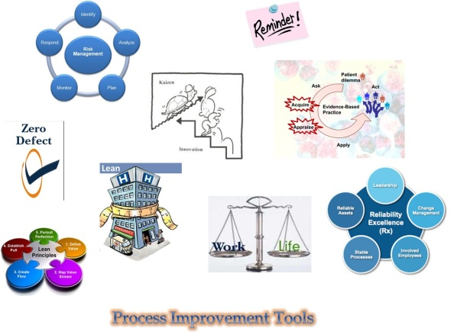
Process Focus
QI support is important at the beginning, will gain acceptance easier than standards & evaluation
Integrate all QI concepts and tools into practice
Develop tools for self assessment, for the hospitals to identify their own problems
Use coaching skill & learning mode rather than inspection & audit mode
Develop & calibrate surveyor

Slide 11
Integration
HA Standards
Quality Improvement Movement

Slide 12
Challenges & Strategies
Staff
  Attitude and education ->
    Role model of educational institutes
    Re-train after graduate
  Turnover of staff -> area-based collective effort
Management
  Leadership -> peer motivation
  Incentive -> keep balance
  Workload -> empower the communities
Patient-centered care
  Referral system -> Provincial Network Accreditation
  Quality of primary care -> local mechanism

Slide 13
Lesson Learned from Thailand
Quality tools is essential as a basic for improvement
Core values is difficult to understand, but make effective & sustainable improvement
Balance of everything, e.g. system & culture, process & outcome
Stepwise recognition works
Keep on moving to sustain momentum
Documentation may draw staff from patients

Slide 14
How to Move the Elephant
Start with R & D
Power of Recognition
Stepwise Approach
Integrate with the others & existing initiatives
Move the whole organization
Multiple tools
Forum for campaign & sharing
Humanized Healthcare
Living Organization
Collaboration with the educational swctor
From “Training” to “Doing & Learning”

Slide 15
Recommendation
Make it easy and fun for everyone
Go together, don’t left someone behind
Don’t hurry to use pass/fail decision, use appreciation at the beginning
Use peer assist (e.g. local hospitals visit each other) and sharing

