Slide 1
Supplemental figure S5. Comparison of expression profile of propionylated proteins between exponential and stationary phase on 2-DE gels.
The 2-DE gels were prepared in pI 4 to 7 and 12.5 % SDS-polyacrylamide gel. The images were analyzed with two biological replicates for each growth phase by ImageMaster Platinum 5.0 (GE Healthcare, USA). The reference gel image of mid-exponential phase of T. thermophilus had been reported in our previous study (1), and used for comparative analysis as one of exponential phase image in this study. The spot number of each protein is corresponded to the number on reference map (1). Left side showed 3D spot image of each protein and right side showed magnified each spot image on 2-DE gel. Red arrows indicate the spot corresponding to target protein. The number of identified propionylation sites in each propionylprotein was presented in parentheses. The black colored number indicates total number of identified propionylation sites (n≥1) in both growth phases. The blue and red colored number indicates identified propionylation site in mid-exponential and late stationary phase of T. thermophilus, respectively.
Reference
1. Kim, K., Okanishi, H., Masui, R., Harada, A., Ueyama, N., and Kuramitsu, S. (2012) Whole-cell proteome reference maps of an extreme thermophile, Thermus thermophilus HB8. Proteomics 12, 3063-3068

Slide 2
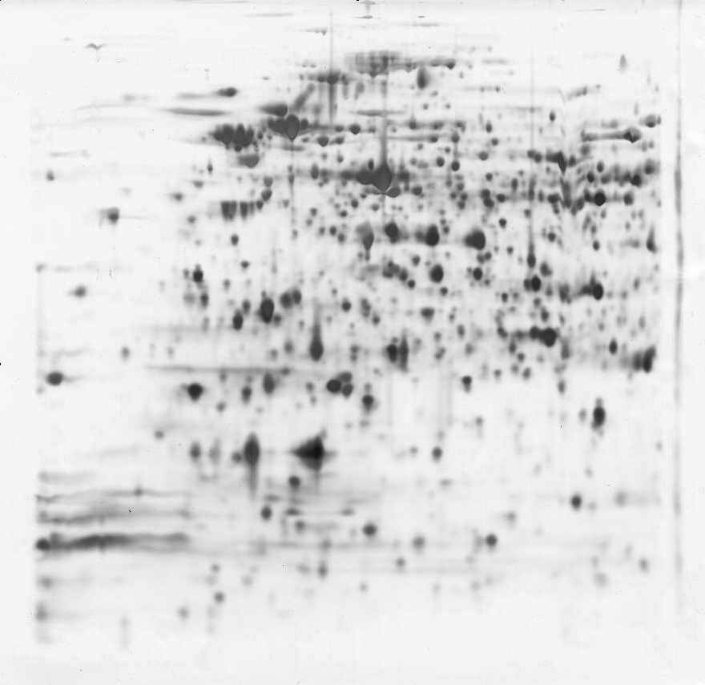
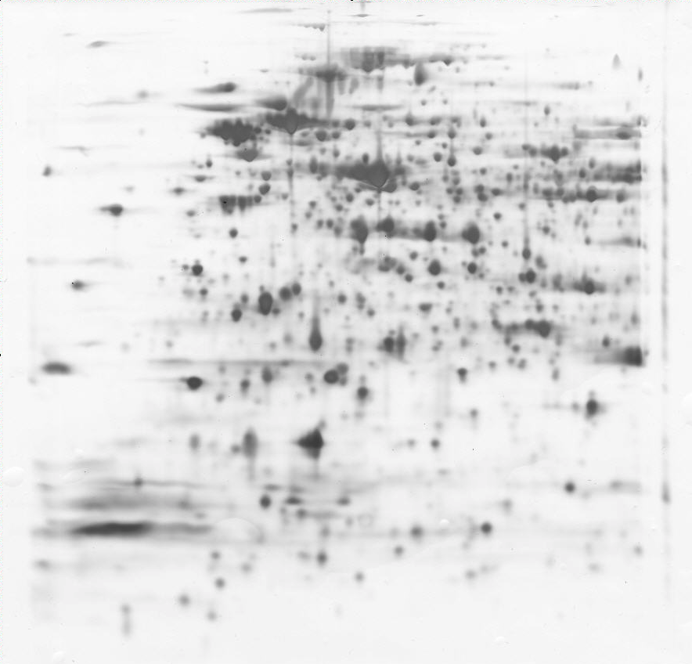
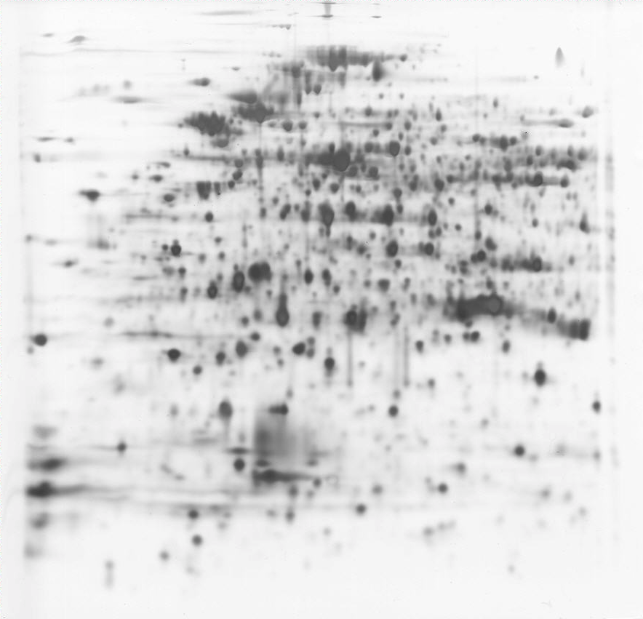
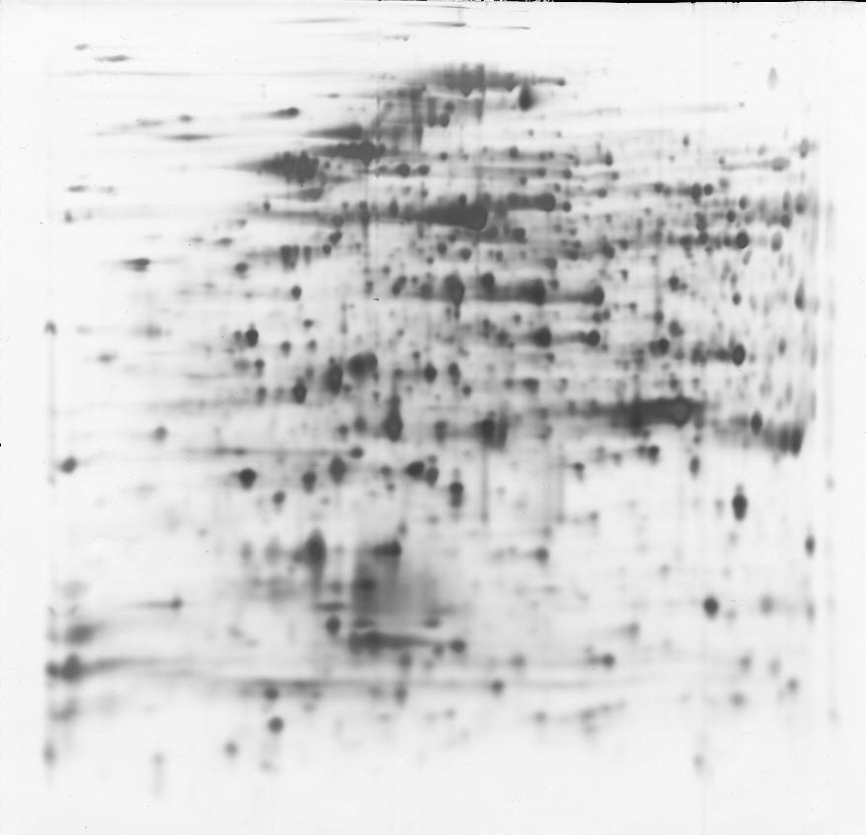
Exponential Phase, I
Exponential Phase, II
(kDa)
200
pI4
pI4
pI7
pI7
(kDa)
200
Reference
3
13
36
23
35
37
18
19
60
47
34
46
61
33
50
44
56
62
40
66
57
49
55
101
88
105
103
104
150
163
180
181
199
192
218
191
225
10
223
10
(kDa)
200
Stationary Phase, I
Stationary Phase, II
pI4
pI4
(kDa)
200
pI7
pI7
10
10

Slide 3
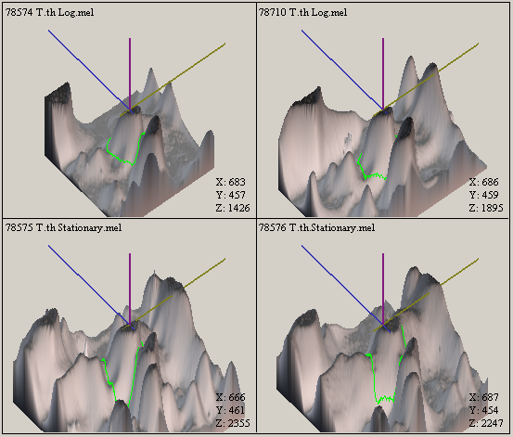
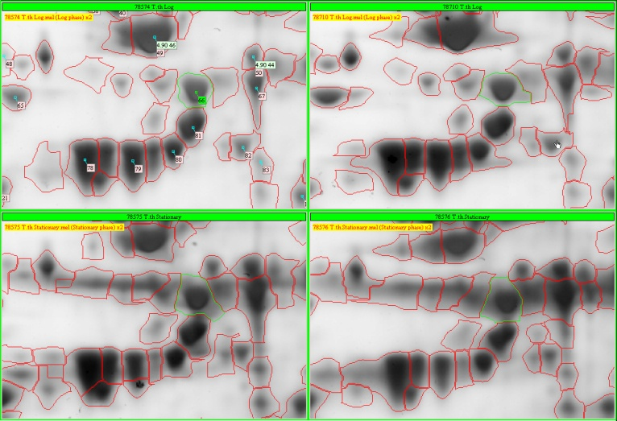
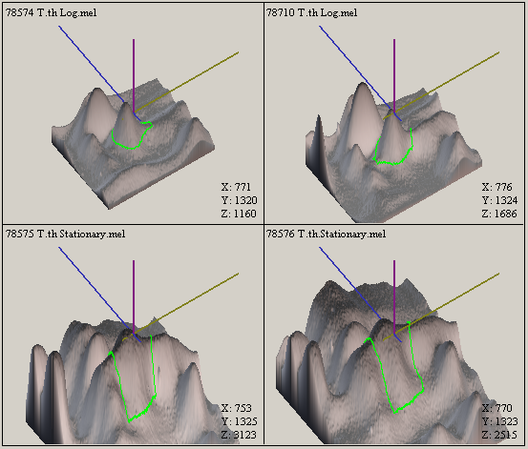
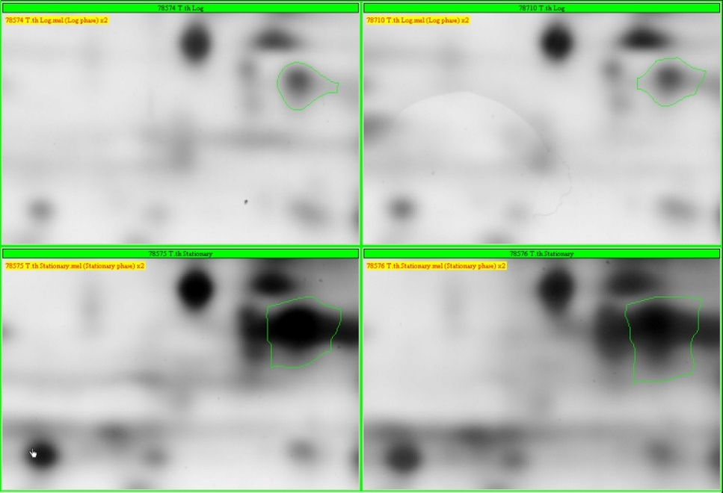
TTHA0002, Spot No. 66, Enolase (1)
pI 4.93 (0) → 4.88 (1)
0.1
Log phase
(0)
Stationary phase
(1)
TTHA0210, Spot No. 223, 50S ribosomal protein L12 (6)
pI 5.01 (0) → 4.89 (1) → 4.43 (6)
0.1
Log phase
(1)
Stationary phase
(6)

Slide 4
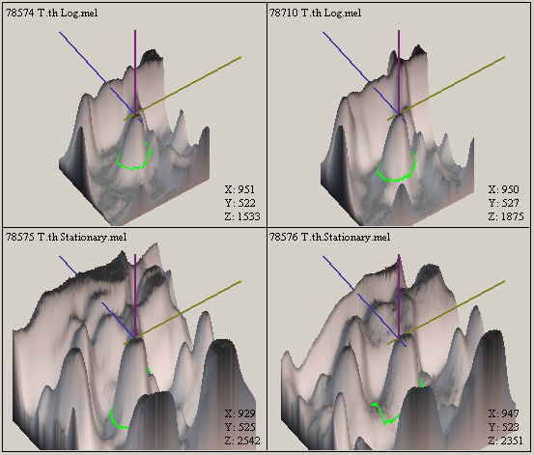
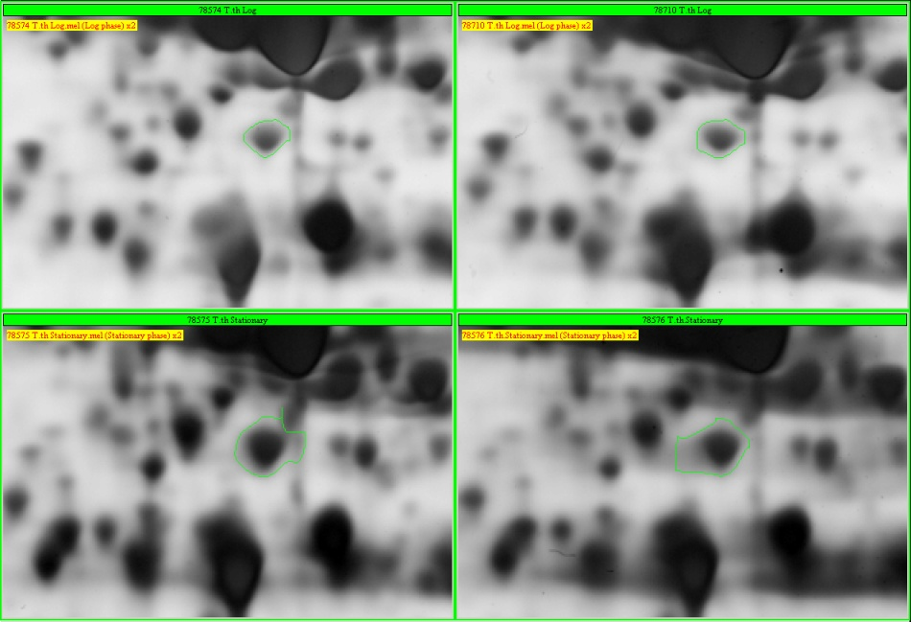
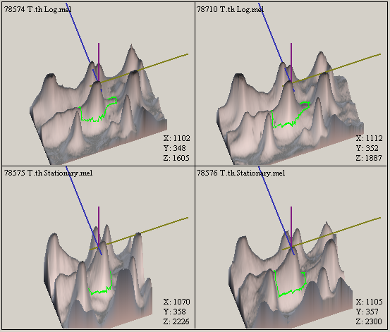
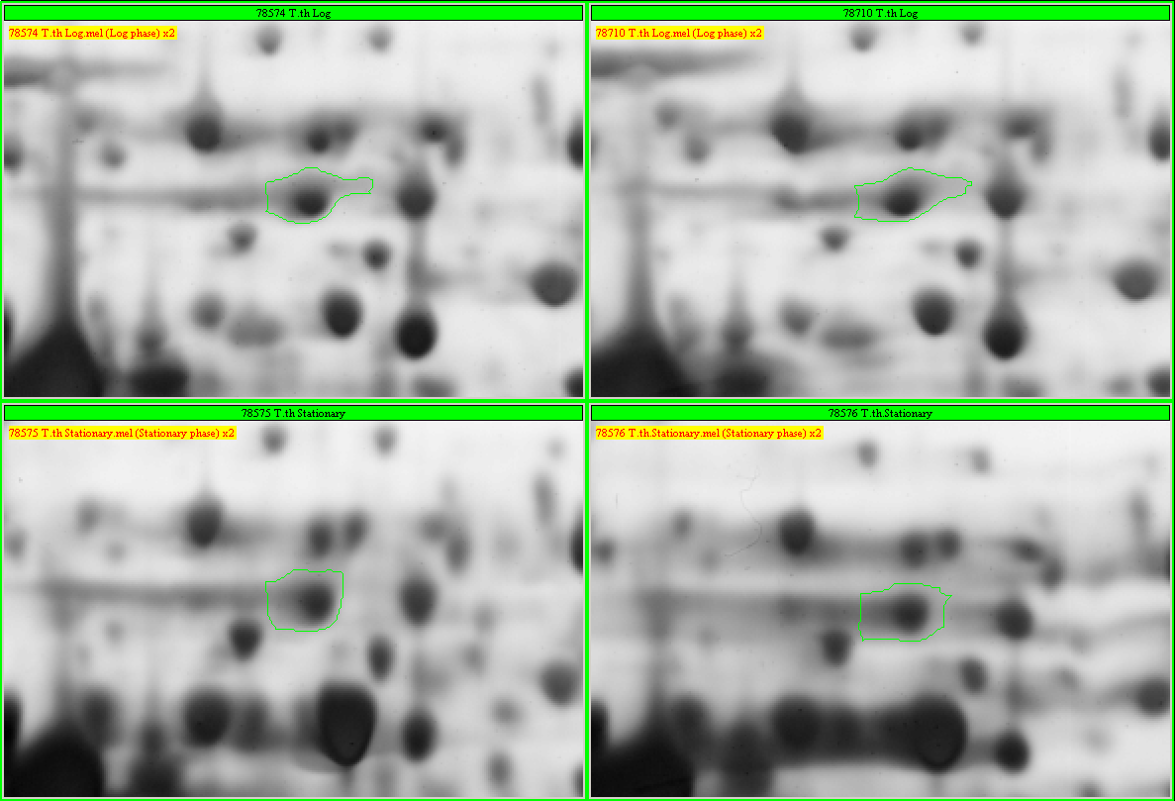
TTHA0229, Spot No. 88, 50S ribosomal protein L12 (1)
pI 5.38 (1) → 5.47 (0)
0.1
Log phase
(0)
Stationary phase
(1)
TTHA0232, Spot No. 44, Pyruvate DH E2 component (2)
pI 5.74 (0) → 5.63 (1) → 5.53 (2)
0.1
Log phase
(1)
Stationary phase
(2)

Slide 5
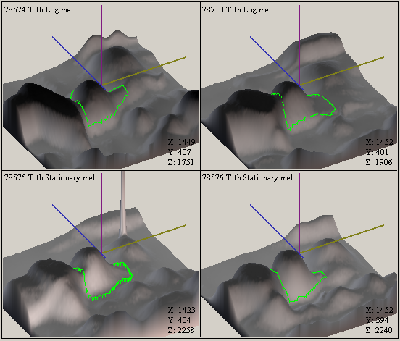
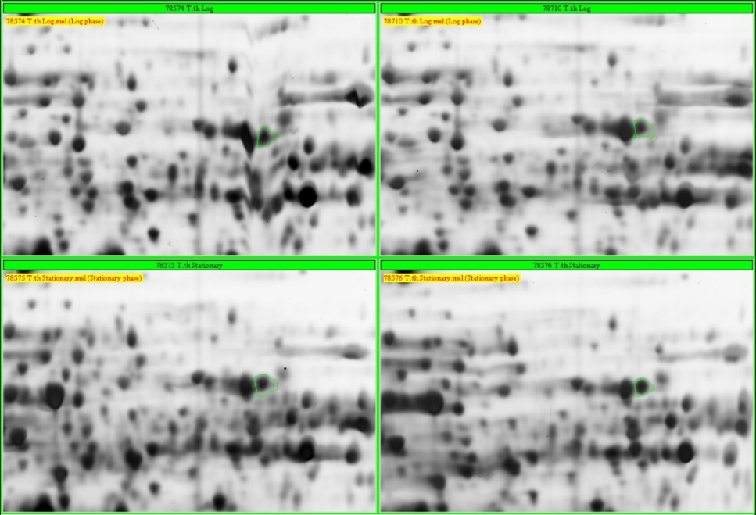
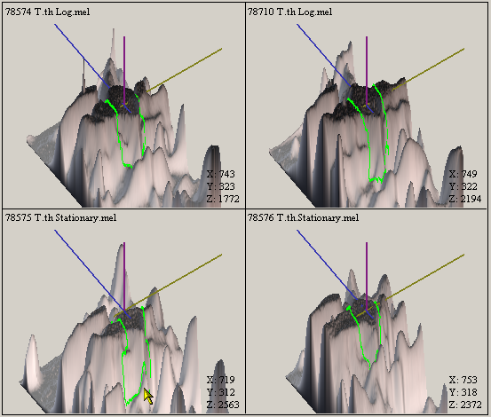
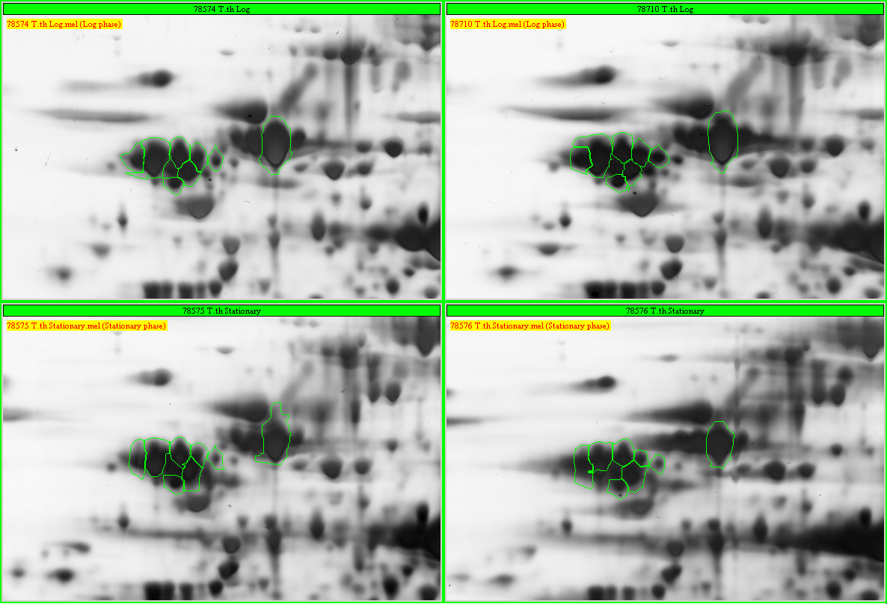
TTHA0233, Spot No. 62, Pyruvate DH E3 component (8)
pI 6.70 (0) → 6.53 (1) → 5.63 (8)
0.2
Log phase
(1)
Stationary phase
(8)
TTHA0271, Spot No. 23, GroEL (19)
pI 5.10 (0) → 4.71 (12) → 4.54 (19)
0.2
Log phase
(12)
Stationary phase
(19)

Slide 6
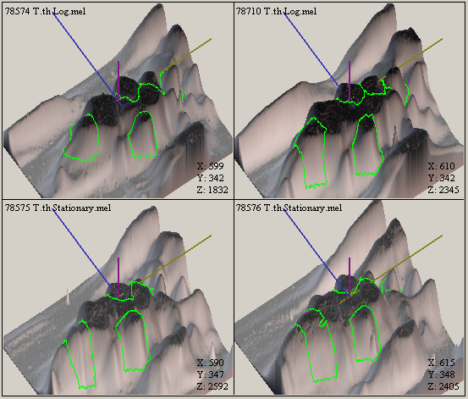
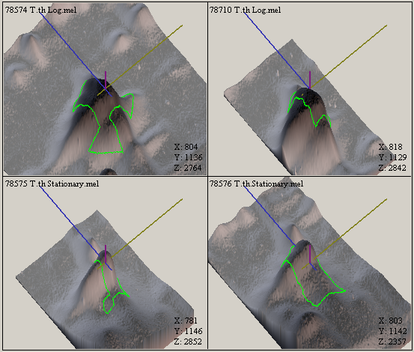
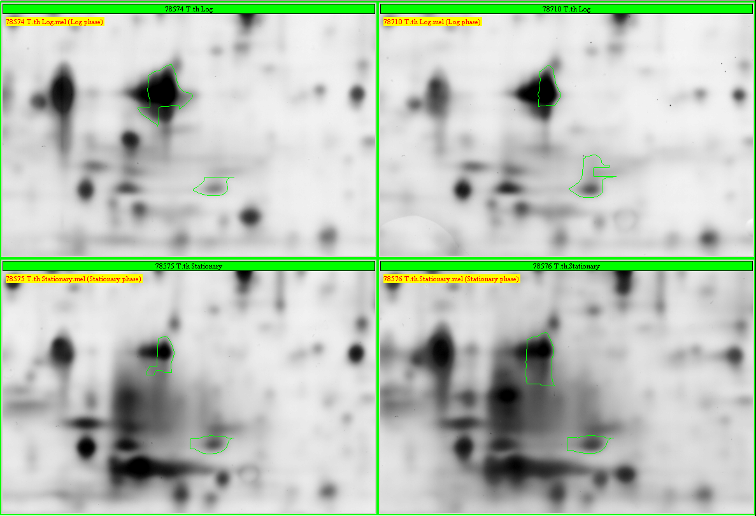
TTHA0271, Spot No. 33, 34, 35, 36, 37, and 40., GroEL (19)
pI 5.10 (0) → 4.71 (12) → 4.54 (19)
0.2
Log phase
(12)
Stationary phase
(19)
TTHA0272, Spot No. 218, GroES (4)
pI 5.19 (0) → 4.69 (3) → 4.83 (2)
0.2
Log phase
(3)
Stationary phase
(2)

Slide 7
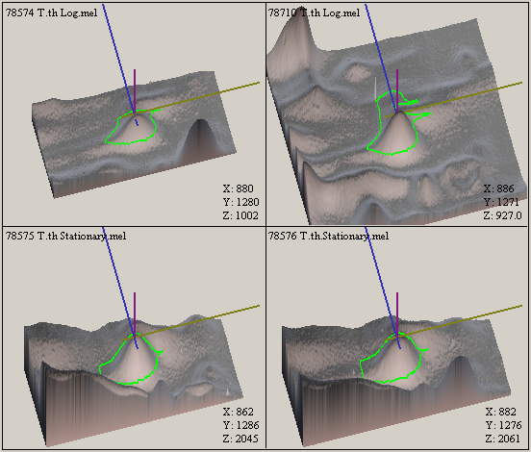
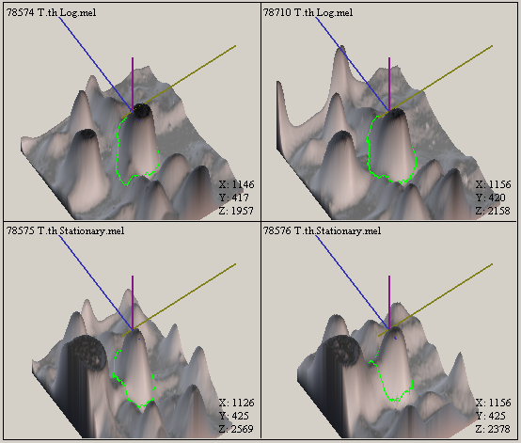
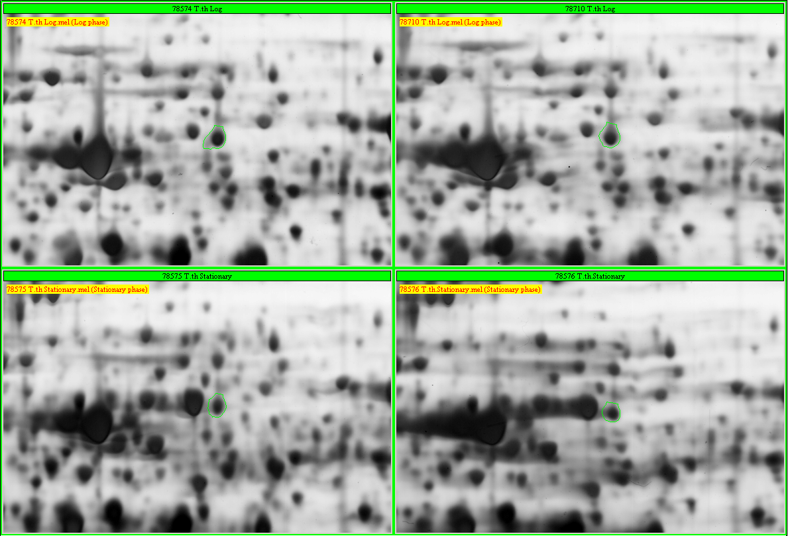
TTHA0272, Spot No. 225, GroES (4)
pI 5.19 (0) → 4.69 (3) → 4.83 (2)
0.2
Log phase
(3)
Stationary phase
(2)
TTHA0288, Spot No. 55, 2-oxoglutarate DH E2 component (4)
pI 5.90 (0) → 5.47 (3)
0.2
Log phase
(3)
Stationary phase
(3)

Slide 8
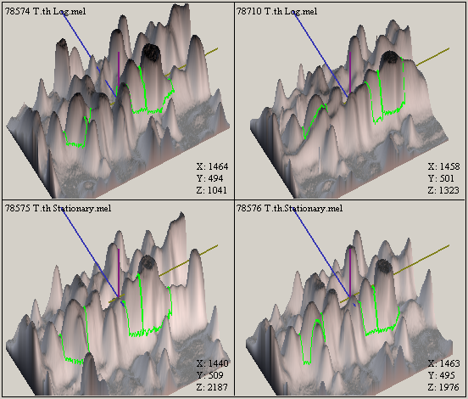
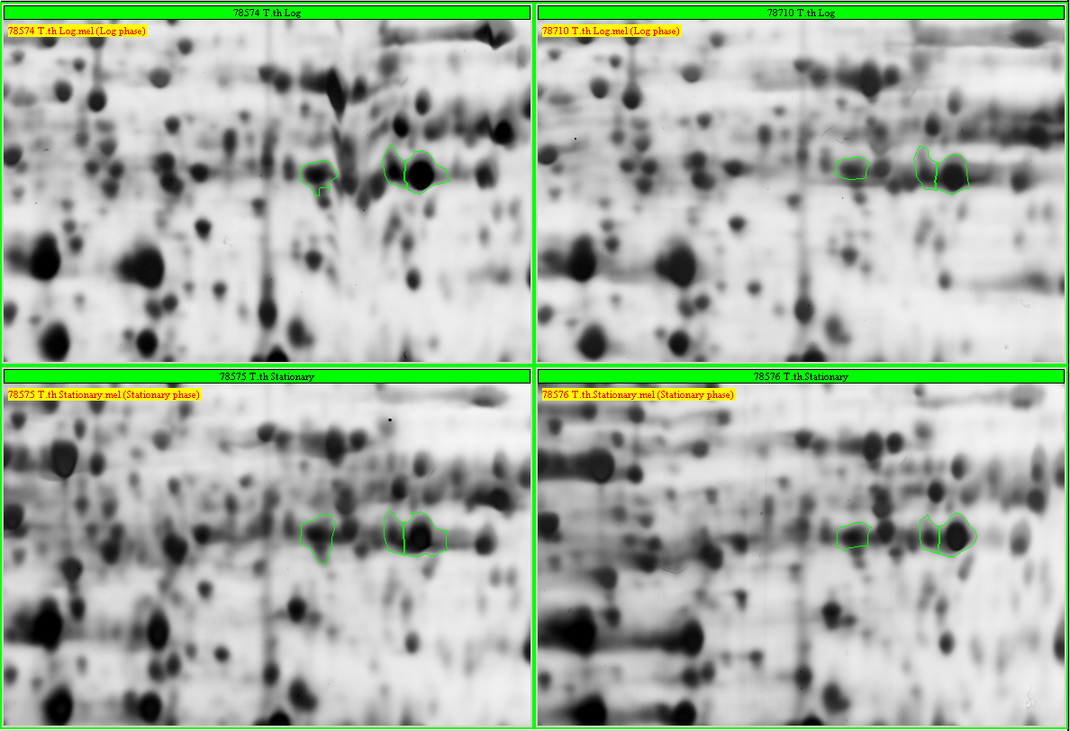
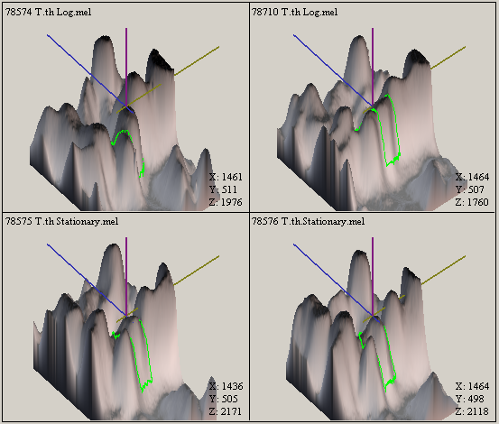
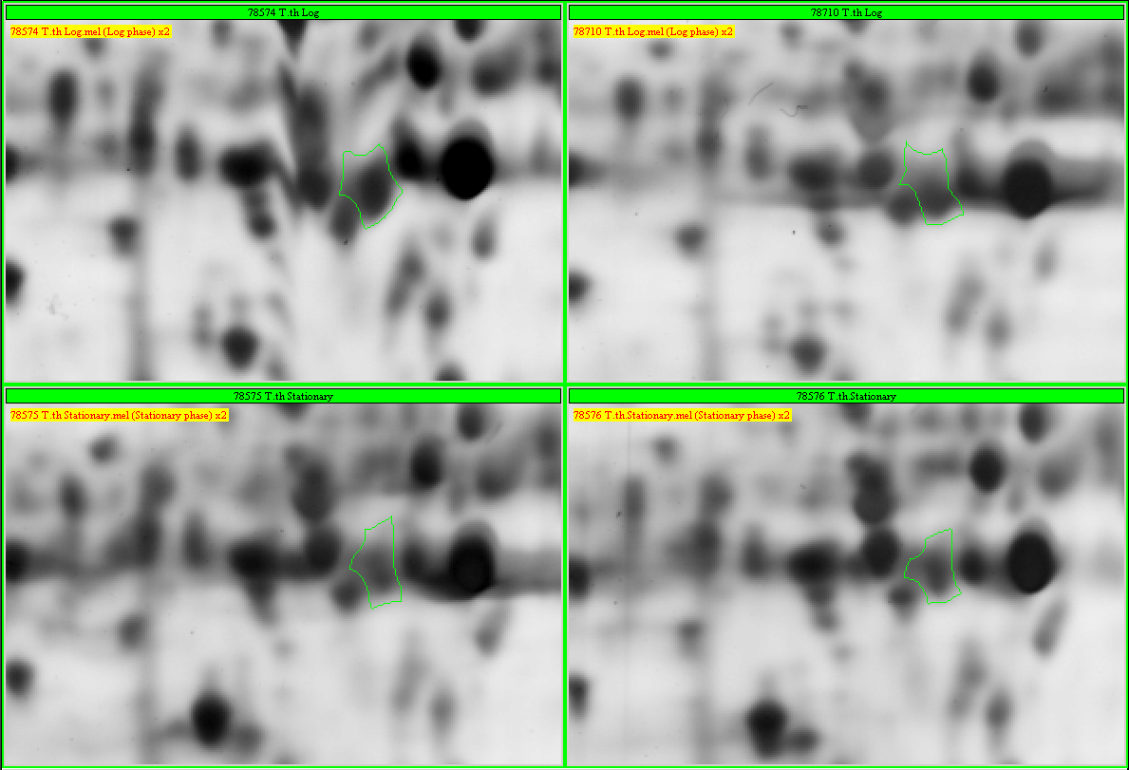
TTHA0538, Spot No. 101,104, and 105, Succinyl-CoA synthetase beta (7)
pI 6.98 (0) → 6.18 (3) → 5.50 (7)
0.2
Log phase
(3)
Stationary phase
(7)
TTHA0545, Spot No. 103, Aspartate-semialdehyde dehydrogenase (1)
pI 6.37 (0) → 6.19 (1)
0.1
Log phase
(0)
Stationary phase
(1)

Slide 9
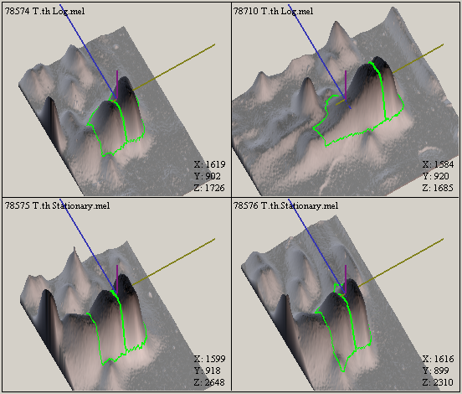
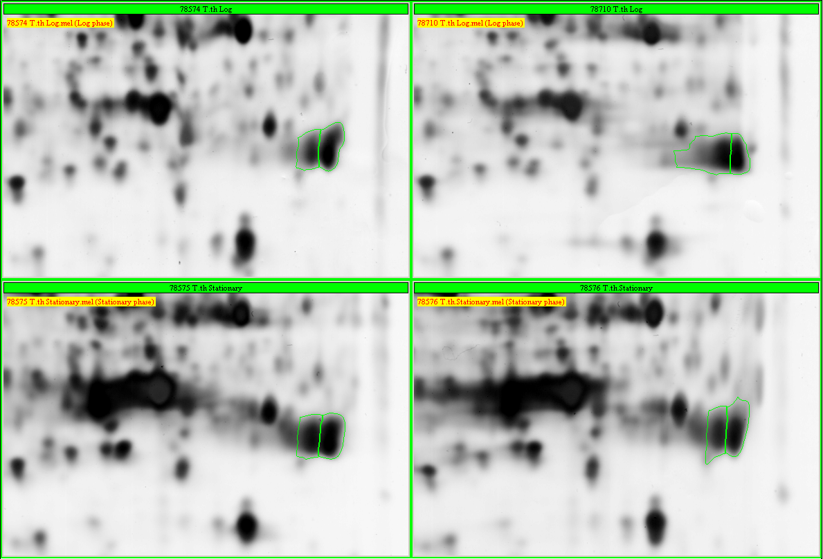
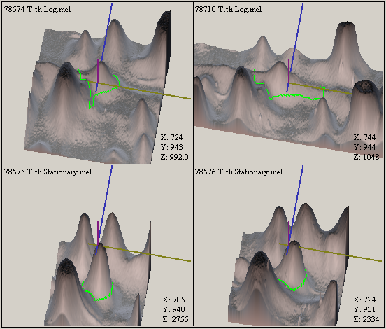
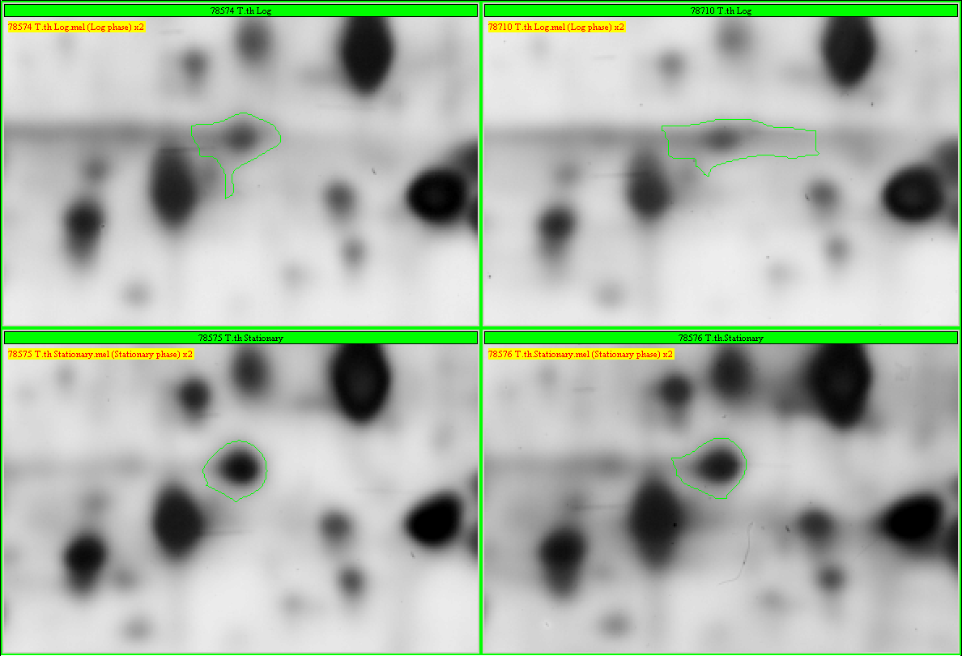
TTHA0557, Spot No. 191,192, Superoxide dismutase [Mn] (5)
pI 6.73 (0) → 5.96 (5)
0.2
Log phase
(0)
Stationary phase
(5)
TTHA0593, Spot No. 199, Probable thiol-disulfide isomerase/thioredoxin (1)
pI 5.20 (0) → 5.08 (1)
0.1
Log phase
(1)
Stationary phase
(1)

Slide 10
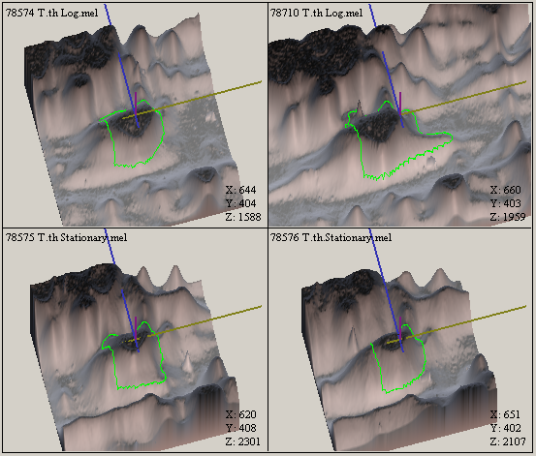
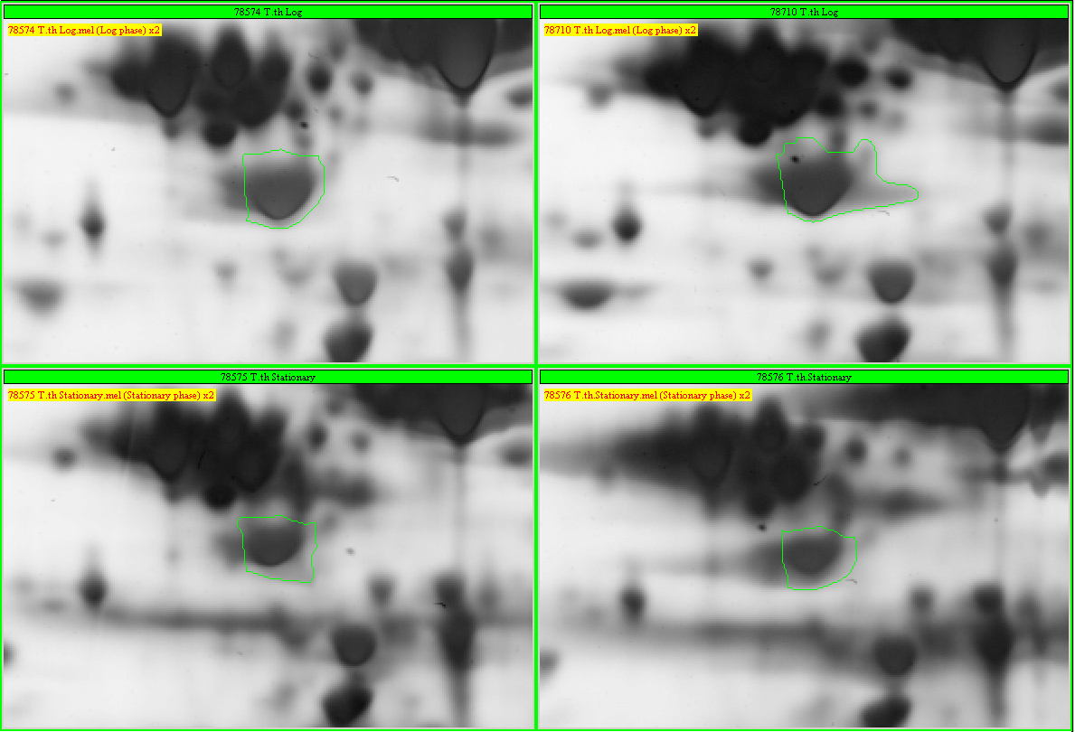
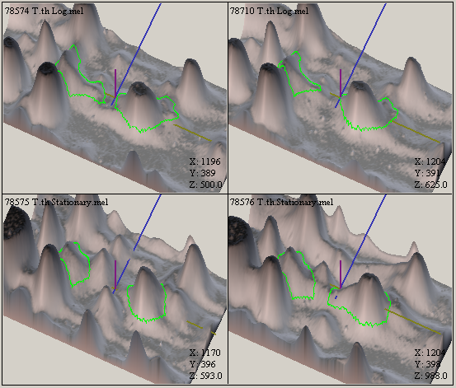
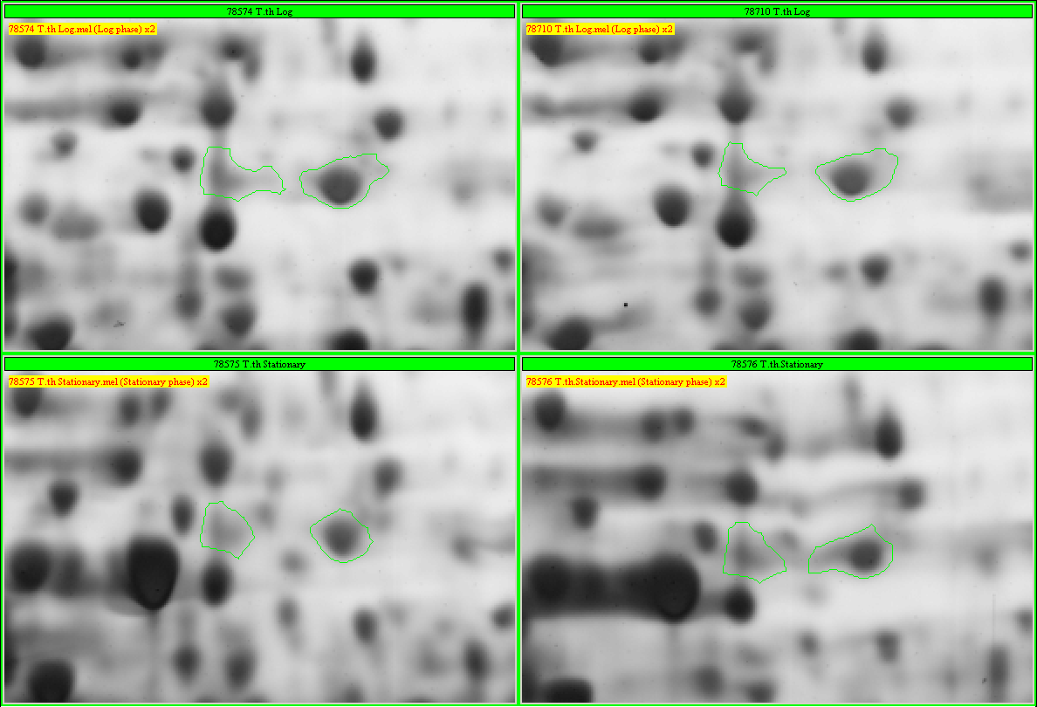
TTHA0614, Spot No. 49, Trigger factor (1)
pI 4.95 (0) → 4.92 (1)
0.1
Log phase
(1)
Stationary phase
(1)
TTHA0701, Spot No. 56, 57, N utilization substrance protein A, NusA (2)
pI 5.84 (0) → 5.61 (2)
0.1
Log phase
(0)
Stationary phase
(2)

Slide 11
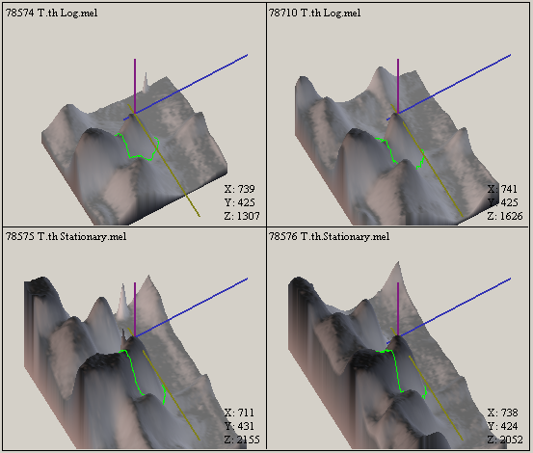
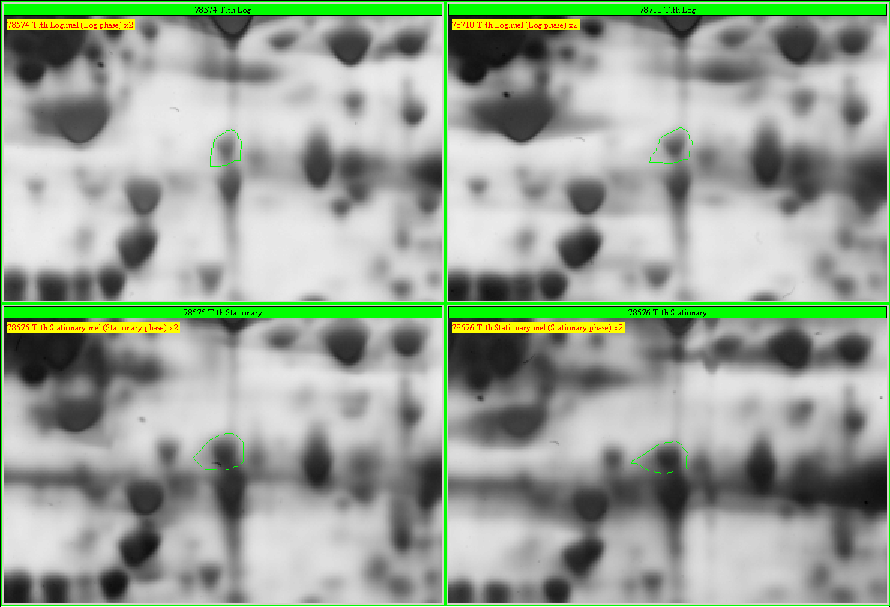
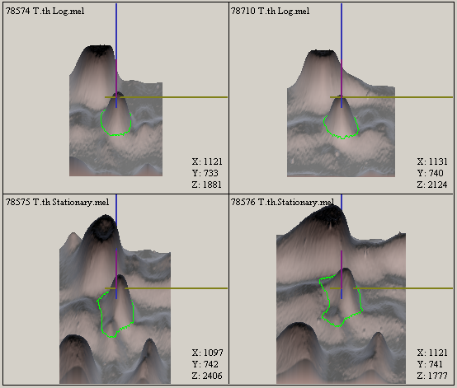
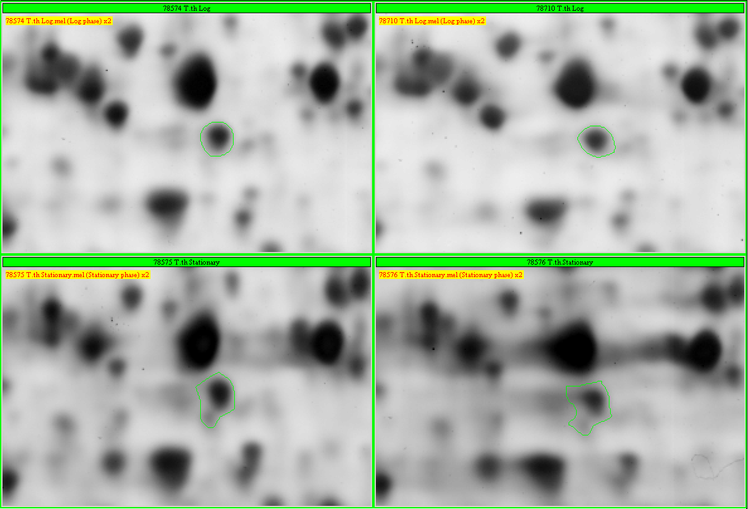
TTHA0722, Spot No. 50, Histidinol dehydrogenase (1)
pI 4.99 (0) → 4.94 (1)
0.1
Log phase
(0)
Stationary phase
(1)
TTHA0810, Spot No. 163, Metallo-beta-lactamase related protein (2)
pI 5.91 (0) → 5.71 (2)
0.1
Log phase
(0)
Stationary phase
(2)

Slide 12
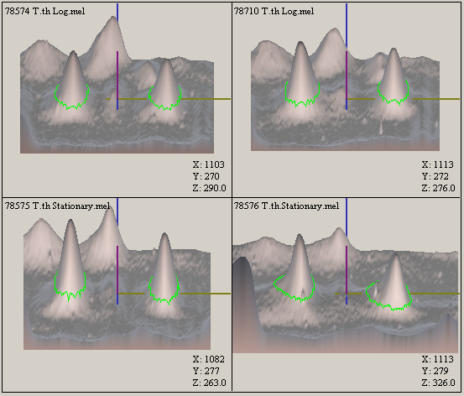
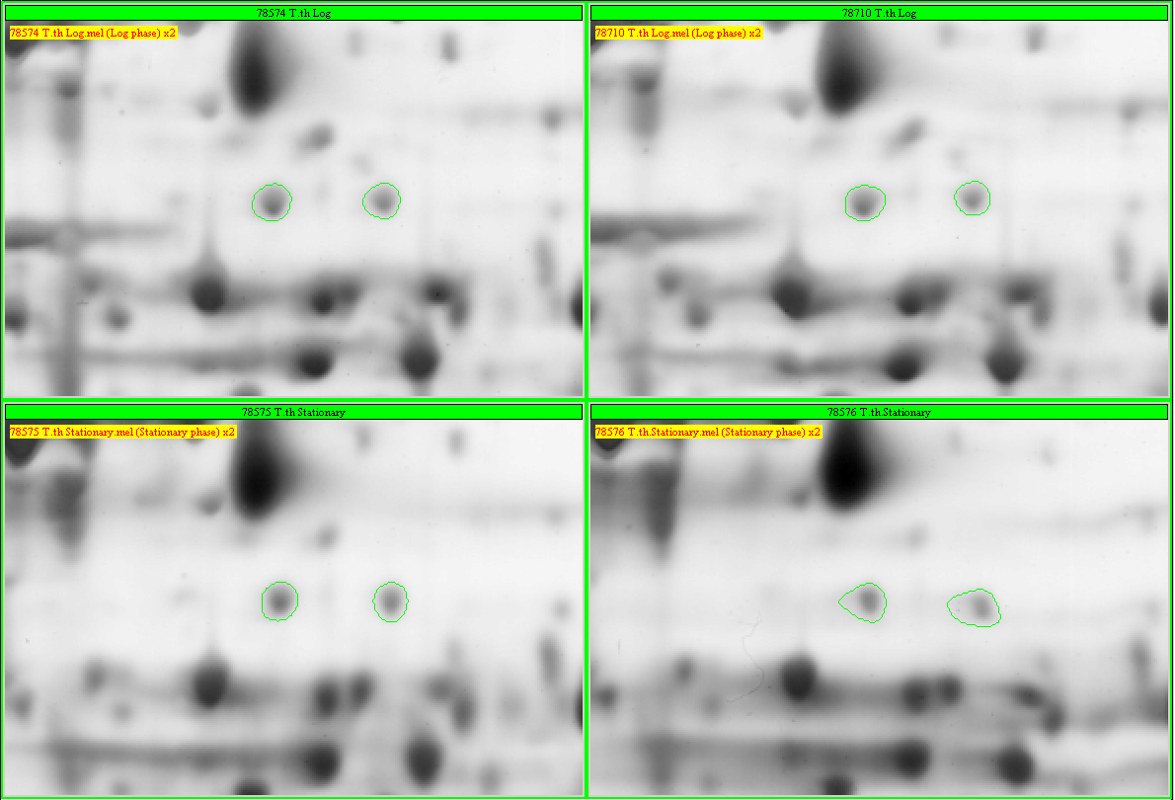
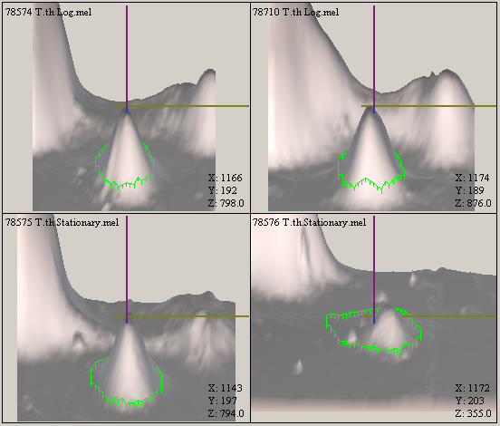
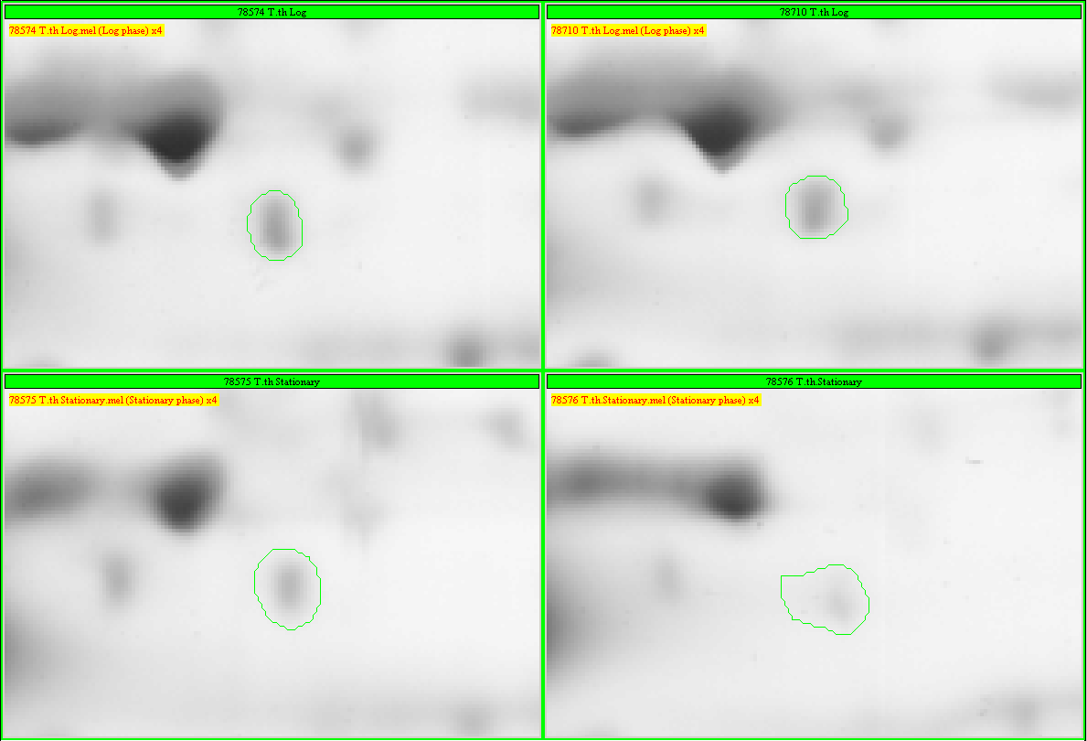
TTHA0892, Spot No. 18, 19, Acyl-CoA dehydrogenase (2)
pI 5.65 (0) → 5.56 (1) → 5.48 (2)
0.1
Log phase
(1)
Stationary phase
(2)
TTHA1248, Spot No. 13, Acetyl-coenzyme A synthetase (3)
pI 6.42 (0) → 6.28 (2) → 6.35 (1)
0.1
Log phase
(2)
Stationary phase
(1)

