Slide 1
Supplementary Figure 1

Slide 2
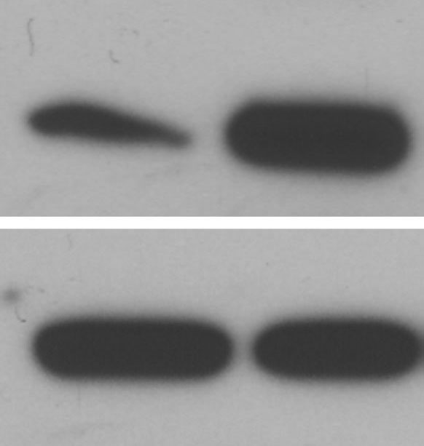
Supplementary Figure 2
A
B
MCF7-control
MCF7-Id1
Id1 expression
Id1
β-actin
Metastasis
MCF7-Id1
Primary tumor
MCF7-control

Slide 3
Supplementary Figure 3

Slide 4
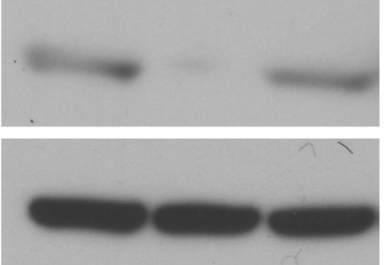
Supplementary Figure 4
A
B
Control
Id1
Id2
S100A9
β-actin

Slide 5
Supplementary Figure 5
A
B
C
Vector
Vector
Id1
Id1
Id1+S100A9
Id1+S100A9
Number of cells migrated
Number of cells invaded
*
*p=0.0001
*p=0.0001
**p=0.003
*p=0.0009
**p=0.002
**
**
*
*

Slide 6
Supplementary Figure 6
MCF7

