Slide 1
Supplementary Figure S1
ATGCi
>= 10 species ?
Yes
Species Tree
Matrix COGS/Species
dN,dS
 | Sp1 | … | SpN
COG1
…
COGM
ATGCs
Concatenated alignment
FastTree
(GTR)
Root Tree
(Least-squared)
Gain/Duplication/Loss
COUNT

Slide 2
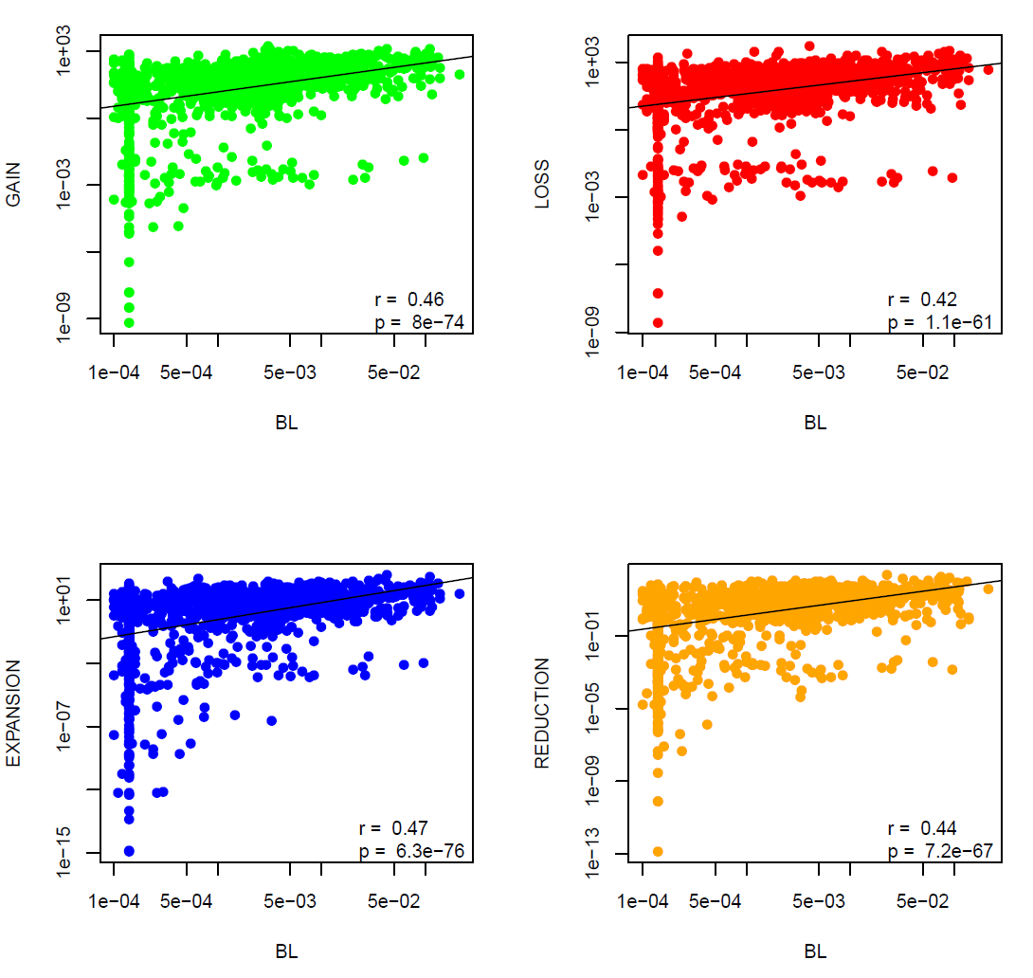
Supplementary Figure S2
a)
b)
c)
d)

Slide 3
Supplementary Figure S3
a)
b)
c)
d)

Slide 4
Supplementary Figure S4

Slide 5
Supplementary Figure S5

Slide 6
Supplementary Figure S6
c)
Median gain rates:
All branches: 10,280
Depth < 0.05: 20,559
a)
d)
Median loss rates:
All branches: 29,309
Depth < 0.05: 51,168
e)
b)
Median reduction rates:
All branches: 1,213
Depth < 0.05: 2,009
f)
Median expansion rates:
All branches: 1,538
Depth < 0.05: 1,538

Slide 7
Supplementary Figure S7
R = -0.53
p = 0.0009

Slide 8
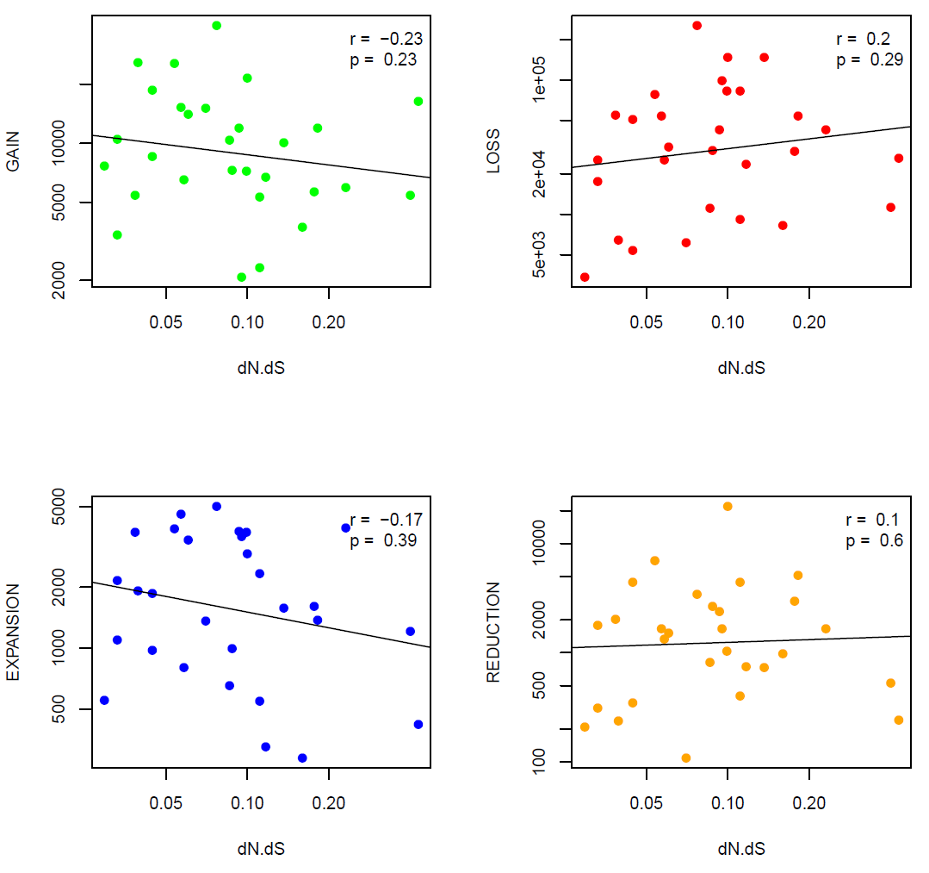
Supplementary Figure S8
a)
b)
c)
d)

Slide 9
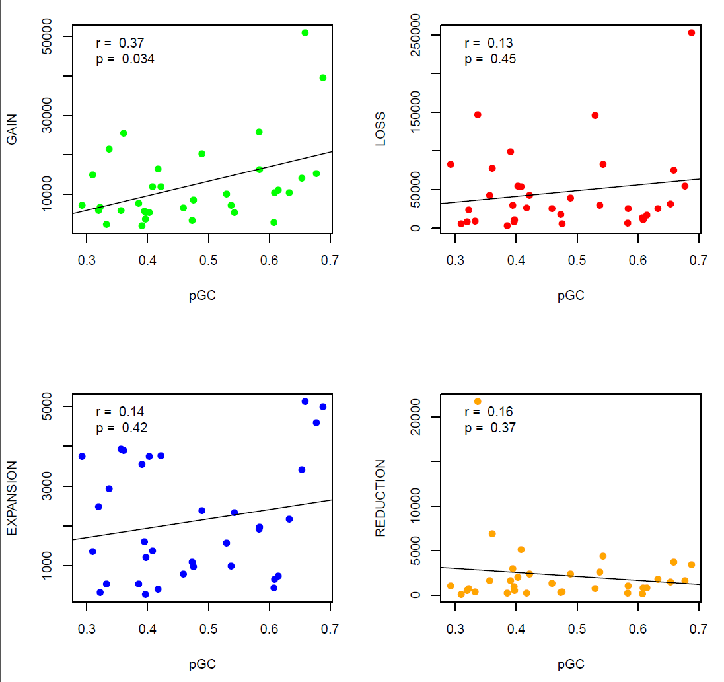
Supplementary Figure S9
a)
b)
c)
d)

Slide 10
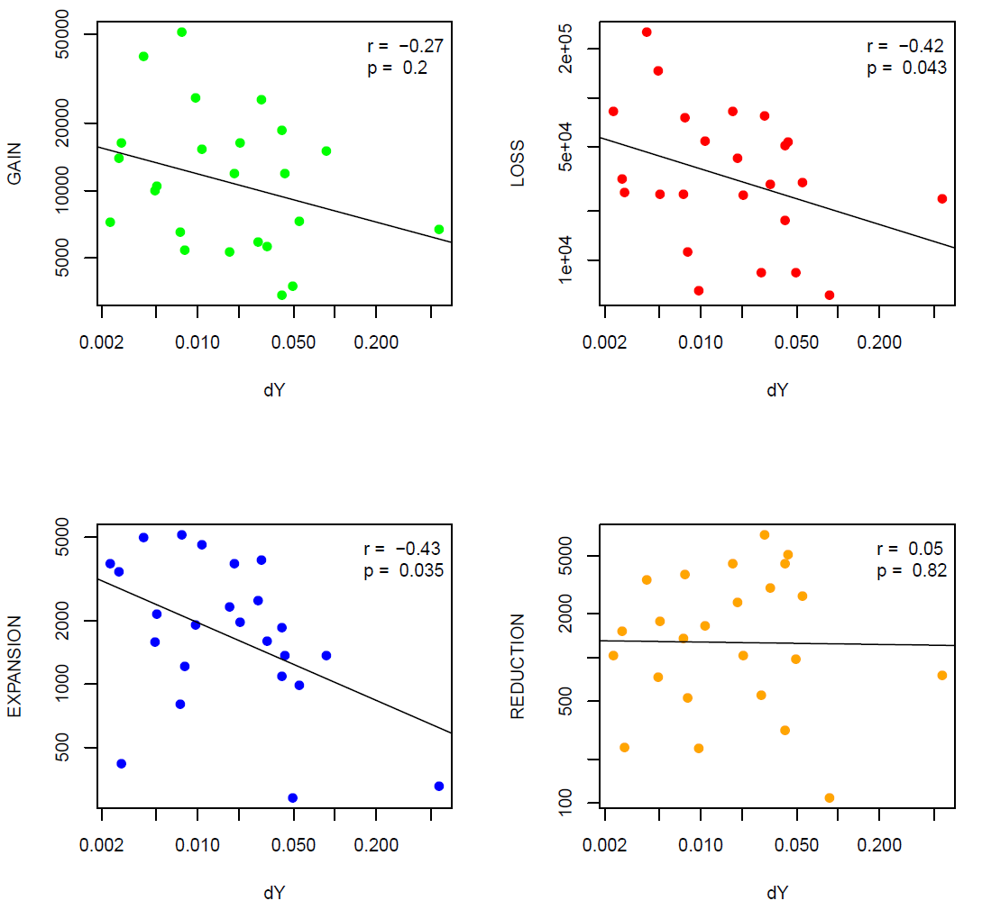
Supplementary Figure S10
a)
b)
c)
d)

Slide 11
Supplementary Figure S11
a)
b)
c)

Slide 12
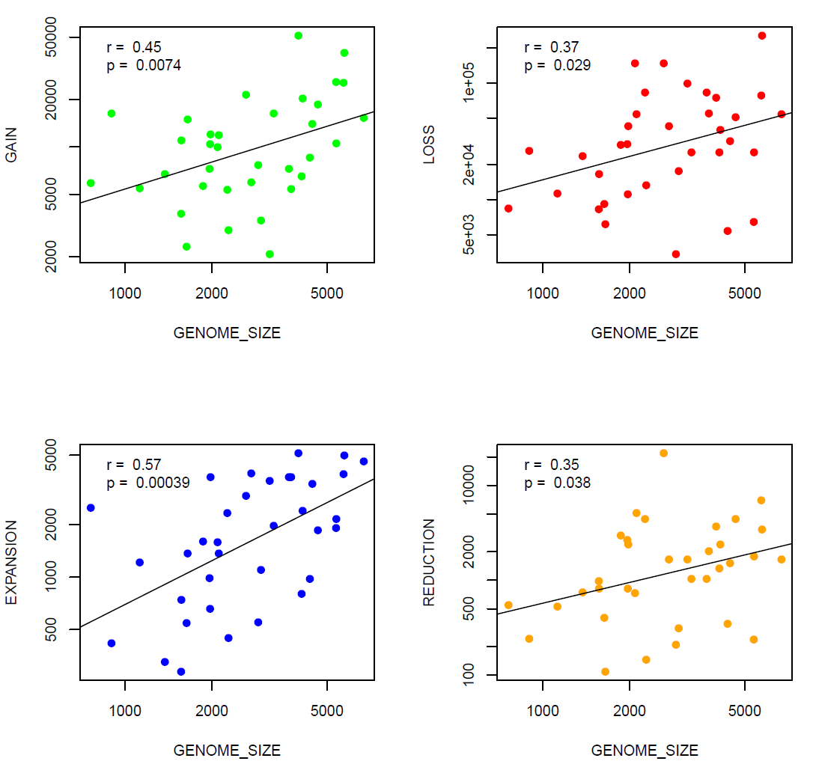
Supplementary Figure S12
a)
b)
c)
d)

Slide 13
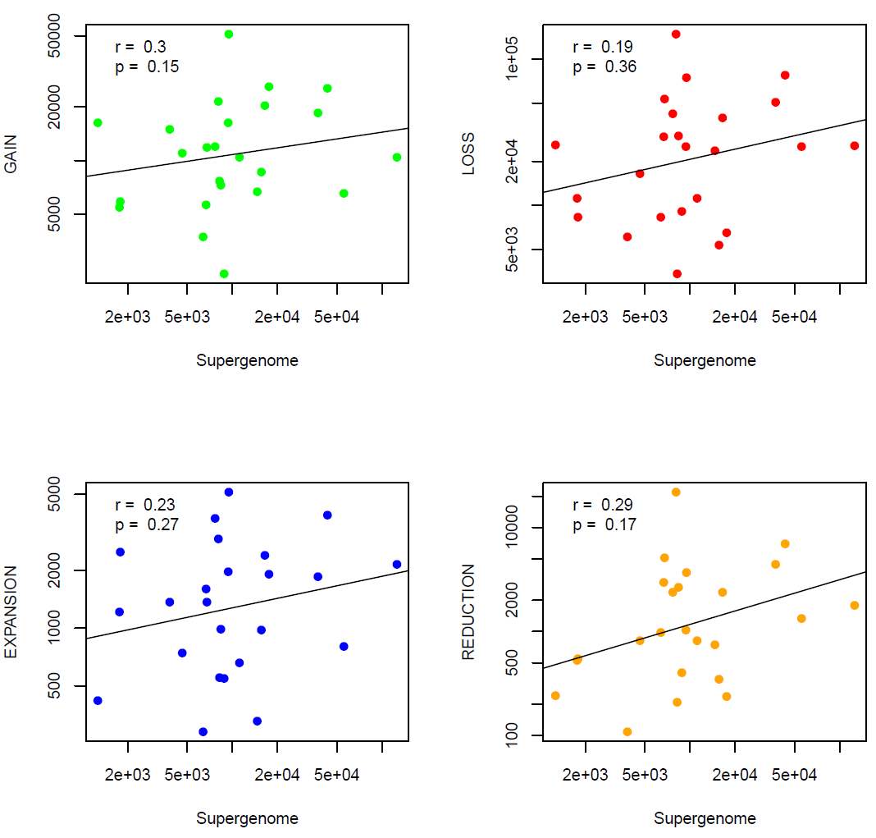
Supplementary Figure S13
a)
b)
c)
d)
e)
OPEN

Slide 14
Supplementary Figure S14
a)
b)
R = 0.61
p = 0.0185
R = -0.73
p = 0.0481
c)
R = -0.71
p = 0.0006
d)
R = -0.45
p = 0.0225

Slide 15
Supplementary Figure S15

Slide 16
Supplementary Figure S16
a)
Expansion
gain
κ
κ + (n/λ)
κ + (n/λ)
0
1
2
3
…
μ
nμ
nμ
loss
Reduction
Expansion
Reduction
Gain
Loss
b)
Possible
HGT

