Slide 1
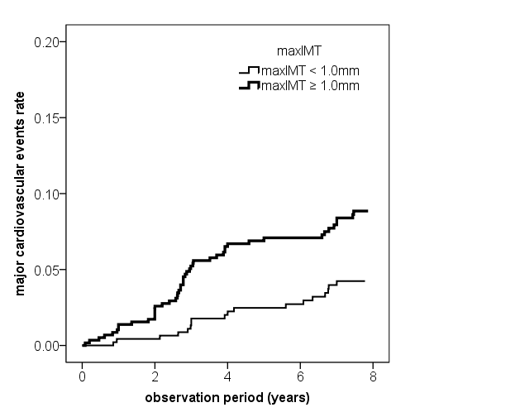
Supplementary Figure 1B
p=0.003, log-rank test

