Slide 1
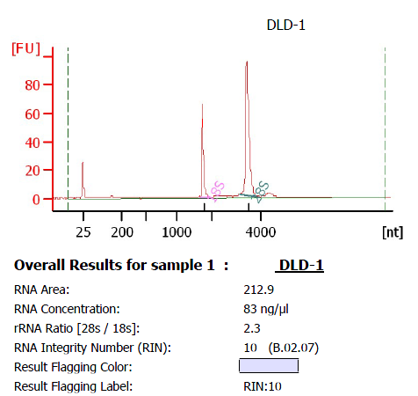
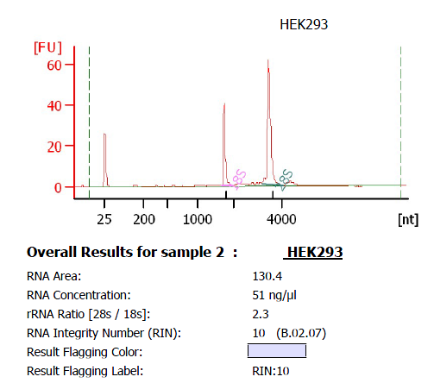
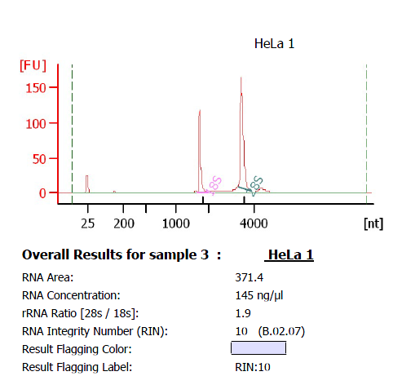
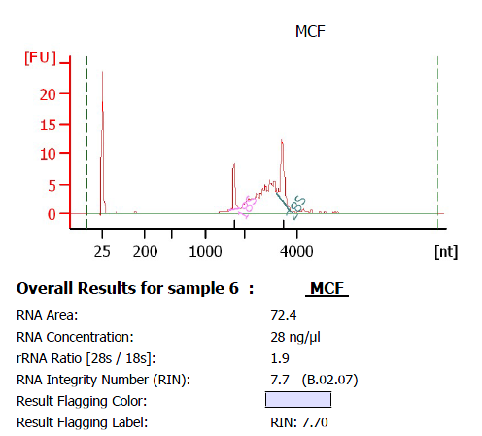
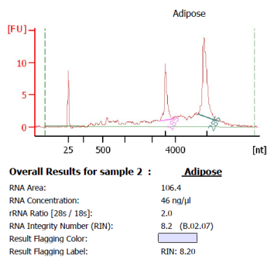
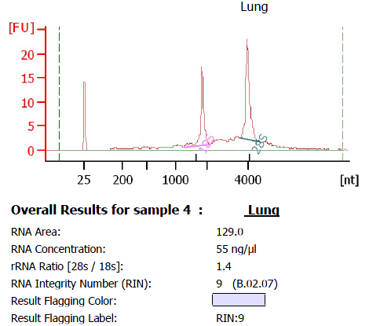
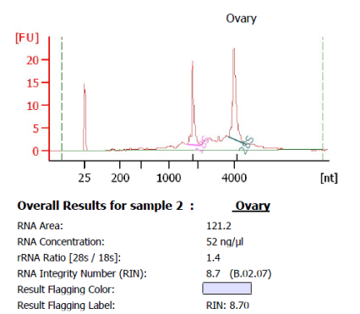
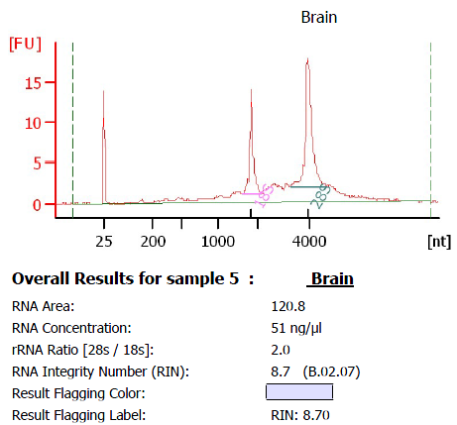
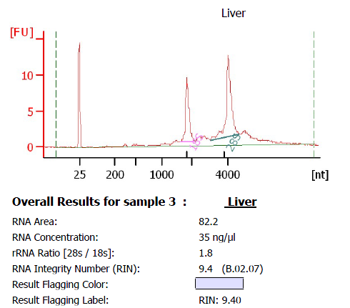
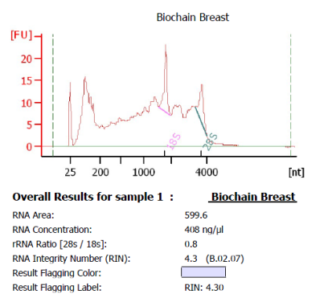
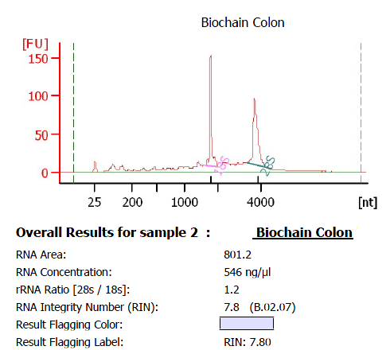
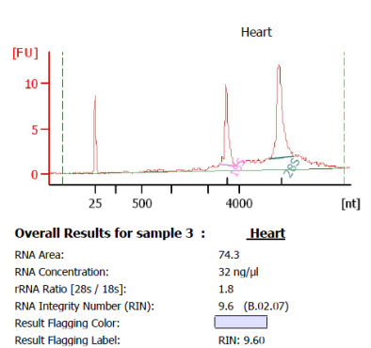
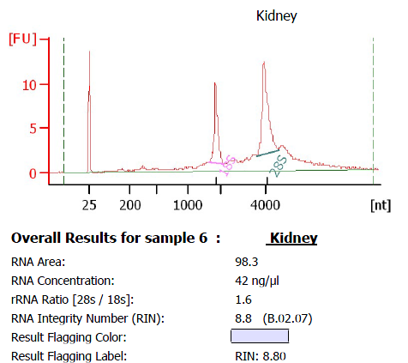
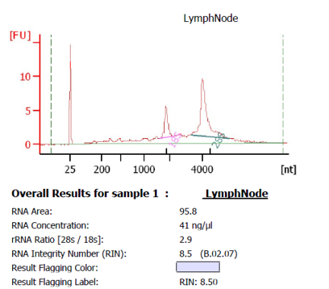
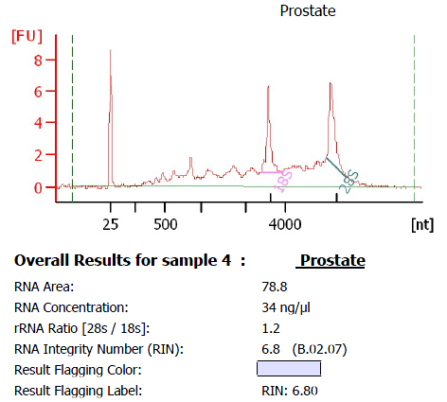
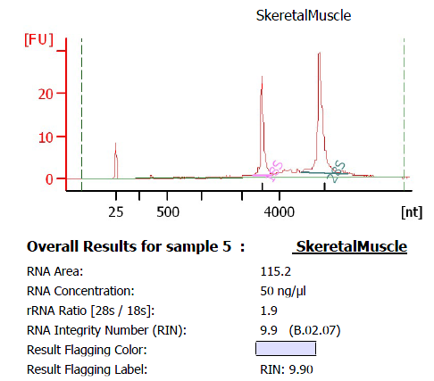
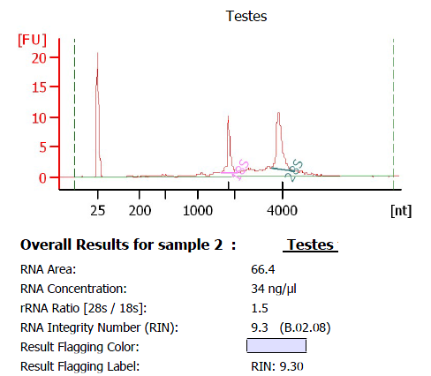
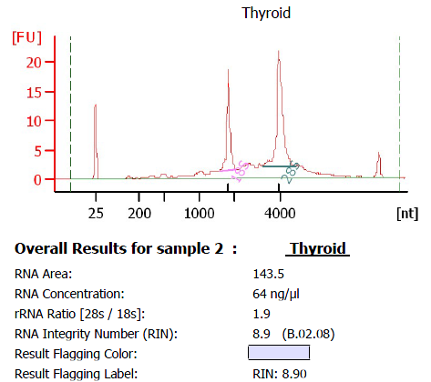
A
 | RIN
DLD1 | 10.0
HEK293 | 10.0
HeLa | 10.0
MCF7 | 7.7
Adipose | 8.2
Lung | 9.0
Ovary | 8.7
Brain | 8.7
Breast | 4.3
Colon | 7.8
Heart | 9.6
Kidney | 8.8
Liver | 9.4
Lymph Node | 8.5
Prostate | 6.0
Skeletal Muscle | 9.9
Testis | 9.3
Thyroid | 8.9
Supplementary Figure S1

Slide 2
B
 | Number of library | Number of tags generated | Number of tags mapped to upstream or first exon (%) | Number of tags mapped to downstream or last exon (%) | Number of represented NM genes by > 5ppm tags | Number of represented NR genes by > 5ppm tags | Number of genes containing multiple TSCs | Number of genes containing multiple PACs
DLD1 | - | 8,097,384 | 95% | 74% | 7,540 | 80 | 243 | 1,440
HEK293 | - | 3,367,796 | 95% | 67% | 7,768 | 113 | 227 | 1,622
HeLa | - | 5,635,548 | 95% | 67% | 7,488 | 91 | 323 | 1,550
MCF7 | - | 5,617,408 | 94% | 64% | 7,472 | 128 | 396 | 1,522
Adipose | - | 2,414,959 | 90% | 77% | 6,076 | 88 | 212 | 1,071
Lung | - | 2,533,045 | 84% | 69% | 4,545 | 52 | 201 | 759
Ovary | - | 3,921,177 | 93% | 81% | 5,138 | 90 | 247 | 790
Brain | - | 4,068,184 | 92% | 85% | 6,440 | 132 | 286 | 948
Breast | - | 3,154,960 | 94% | 82% | 6,620 | 101 | 312 | 1,145
Colon | - | 4,473,789 | 93% | 85% | 6,956 | 88 | 344 | 1,029
Heart | - | 4,513,913 | 94% | 87% | 4,026 | 56 | 205 | 614
Kidney | - | 3,378,219 | 94% | 87% | 6,074 | 115 | 272 | 948
Liver | - | 2,552,292 | 94% | 89% | 3,379 | 36 | 166 | 442
Lymph Node | - | 3,074,947 | 94% | 88% | 4,778 | 85 | 247 | 707
Prostate | - | 387,113 | 92% | 72% | 2,541 | 43 | 83 | 425
Skeletal Muscle | - | 2,430,014 | 93% | 88% | 4,647 | 74 | 268 | 690
Testis | - | 6,292,637 | 84% | 85% | 7,045 | 384 | 532 | 989
Thyroid | - | 6,382,769 | 94% | 82% | 6,626 | 106 | 312 | 1,155
Average | - | 4,016,453 | 92% | 79% | 5,983 | 107 | 281 | 1,033
Total | 18 | 72,296,154 | 91% | 76% | 10,038 | 574 | 2,488 | 5,096
Supplementary Figure S1

Slide 3
C
 | Number of library | Number of tags generated | Number of tags mapped to upstream or first exon (%) | Number of represented NM covered by >90% | Number of represented NM with all of the exons covered by the tag | Number of represented NR covered by > 90% | Number of represented NR with all of the exons covered by the tag
DLD1 | 0.5 1 2 | 7,374,699 5,731,468 6,948,401 | 92% | 425 | 1,053 | 87 | 313
HEK293 | 0.5 1 2 | 3,976,025 4,094,137 8,511,193 | 94% | 335 | 1,430 | 72 | 353
HeLa | 0.5 1 2 | 14,180,262 5,284,007 8,639,636 | 93% | 442 | 2,040 | 67 | 345
MCF7 | 0.5 1 2 | 7,275,826 12,813,315 5,259,460 | 93% | 338 | 1,728 | 73 | 357
Adipose | 0.5 1 2 | 4,460,047 3,723,208 5,081,920 | 87% | 593 | 1,768 | 48 | 277
Lung | 0.5 1 2 | 4,116,414 6,741,772 15,416,440 | 85% | 734 | 1,490 | 58 | 225
Ovary | 0.5 1 2 | 3,522,169 5,027,249 6,962,983 | 92% | 879 | 1,781 | 76 | 361
Brain | 0.5 1 2 | 5,333,608 6,988,354 12,433,092 | 86% | 1732 | 2,704 | 93 | 473
Breast | 0.5 1 2 | 3,561,190 6,728,231 15,849,297 | 86% | 756 | 2,033 | 113 | 447
Colon | 0.5 1 2 | 2,739,680 5,931,351 10,413,570 | 92% | 657 | 1,826 | 78 | 367
Heart | 0.5 1 2 | 5,149,486 5,929,058 8,087,642 | 90% | 983 | 2,496 | 50 | 335
Kidney | 0.5 1 2 | 5,600,064 8,488,442 12,285,999 | 91% | 1193 | 2,550 | 66 | 377
Liver | 0.5 1 2 | 2,035,847 7,048,782 10,611,824 | 93% | 387 | 1,304 | 37 | 183
Lymph Node | 0.5 1 2 | 2,770,236 4,822,871 7,336,121 | 82% | 399 | 1,511 | 52 | 303
Prostate | 0.5 1 2 | 3,386,518 3,498,422 7,484,706 | 88% | 113 | 786 | 21 | 123
Skeletal Muscle | 0.5 1 2 | 3,838,335 4,127,464 6,645.,758 | 87% | 727 | 1,528 | 40 | 237
Testis | 0.5 1 2 | 4,580,445 4,018,607 3,858,634 | 77% | 1086 | 3,308 | 123 | 660
Thyroid | 0.5 1 2 | 2,905,811 4,775,469 4,326,014 | 92% | 282 | 1,275 | 27 | 211
Average | - | 6,458,097 | 89% | 647 | 1,807 | 66 | 332
Total | 54 | 348,737,226 | 93% | 9,254 | 1,2168 | 497 | 1,596
Supplementary Figure S1

Slide 4
D
 |  | DLD1 | HEK293 | HeLa | MCF7
H3K4me1 | Number of used reads | 29,677,167 | 39,535,295 | 23,434,100 | 33,209,524
 | Number of MACS peaks | 91,412 | 106,309 | 100,902 | 78,056
H3K4me3 | Number of used reads | 15,279,900 | 9,926,213 | 22,520,220 | 20,653,434
 | Number of MACS peaks | 16,917 | 14,172 | 13,829 | 15,698
H3K27Ac | Number of used reads | 9,904,703 | 32,718,928 | 62,651,043 | 31,876,276
 | Number of MACS peaks | 24,332 | 35,877 | 56,492 | 39,646
Pol II | Number of used reads | 14,471,858 | 9,926,213 | 139,395,594 | 35,905,171
 | Number of MACS peaks | 32,865 | 25,175 | 11,395 | 23,836
H3K36me3 | Number of used reads | 42,143,304 | 45,931,584 | 34,927,046 | 13,828,184
 | Number of MACS peaks | 101,691 | 58,624 | 76,265 | 47,560
CTD-PS2 | Number of used reads | 40,176,827 | 46,185,168 | 38,011,086 | 20,263,552
 | Number of MACS peaks | 24,686 | 14,379 | 7,288 | 9,965
Rad21 | Number of used reads | 49,777,780 | 55,483,641 | 39,470,089 | 7,724,200
 | Number of MACS peaks | 43,108 | 37,792 | 77,372 | 5,634
CTCF | Number of used reads | 40,743,100 | 29,032,630 | 24,818,196 | 46,715,322
 | Number of MACS peaks | 52,241 | 50,027 | 51,401 | 30,208
H3K27me3 | Number of used reads | 15,754,505 | 47,865,947 | 42,484,670 | 20,988,401
 | Number of MACS peaks | 6,326 | 97,553 | 70,776 | 51,686
Supplementary Figure S1

Slide 5
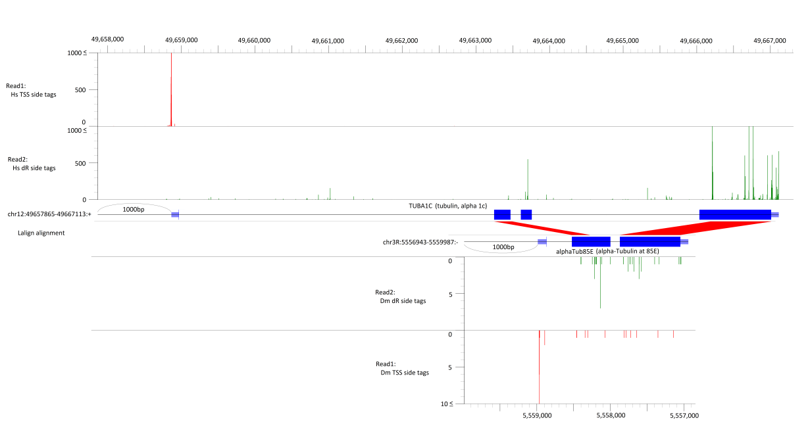
A
D
our 5' cluster
> 5ppm
32,808
GIS-RNA-PET 5' cluster
> 5ppm
7,564
6,503
B
C
our 3' cluster
> 5ppm
42,945
GIS-RNA-PET 3' cluster
> 5ppm
7,624
6,274
E (top)
F
TSS tags in Hs
our 3' cluster
> 5ppm
42,945
PA-seq 3' cluster
> 5ppm
59,692
Random tags in Hs
12,250
Gene model in Hs
Gene model in Dm
Sequence
alignment
Random tags in Dm
TSS tags in Dm
Supplementary Figure S2

Slide 6
E (bottom)
Species | Total number of valid tag pairs (TSS-Random)
Hs | 348,708,022 pairs
Dm | 3,465,945 pairs
Gene pairs in Homologene (between Hs and Dm) | Aligned gene pairs (with E(1) < 1e-15) | Total aligned base positions (including gap) | Total identified base positions | Total mismatch base positions (including gap) | %identified
4,508 | 1,541 | 594,867 | 399,380 | 195,487 | 67.1%
Hs tag (1:exist) | Dm tag (1:exist) | Base aligned (1:yes) | Tags | Number of genomic positions in Hs | Number of genomic position in Dm | Number of Hs tags | Number of Dm tags
1 | 1 | 1 | TSS | 532 | 513 | 6,616 | 887
 |  |  | PAS | 25,548 | 8,523 | 5,553,380 | 135,869
1 | 1 | 0 | TSS | 218 | 199 | 4,516 | 350
 |  |  | PAS | 11,156 | 3,887 | 2,250,707 | 74,894
1 | 0 | 1 | TSS | 394 | 23,235 | 5,574 | 0
 |  |  | PAS | 14,990 | 258,723 | 1,112,303 | 0
1 | 0 | 0 | TSS | 233 | 11,103 | 2,611 | 0
 |  |  | PAS | 7,553 | 124,026 | 610,342 | 0
0 | 1 | 1 | TSS | 198,911 | 10,288 | 0 | 25,724
 |  |  | PAS | 181,694 | 2,597 | 0 | 49,156
0 | 1 | 0 | TSS | 92,437 | 3,889 | 0 | 9,574
 |  |  | PAS | 84,939 | 1,201 | 0 | 9,474
0 | 0 | 1 | TSS | 199,543 | 365,344 | 0 | 0
 |  |  | PAS | 177,148 | 129,537 | 0 | 0
0 | 0 | 0 | TSS | 102,599 | 180,296 | 0 | 0
 |  |  | PAS | 91,839 | 66,373 | 0 | 0
 |  | total |  | 1,189,734 | 1,189,734 | 9,546,049 | 305,928
Supplementary Figure S2

Slide 7
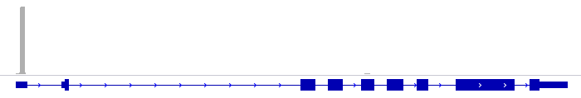
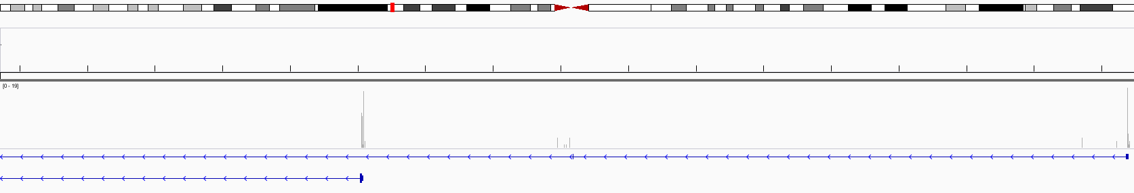
G
H
%
First base of the TSS
GA
GT
GG
GC
The last bases of the cap-oligo
I
tags
The last bases of the cap-oligo
8%
GAPDH
chr12: 6643680-6643697
Genome sequence
5’-> 3’
chr1:85,877,055-86,045,353
86,040 kb
85,960 kb
85,880 kb
TSS tags in DLD1
RefSeq gene model
Supplementary Figure S2
DDAH1 (dimethylarginine dimethylaminohydrolase 1)

Slide 8
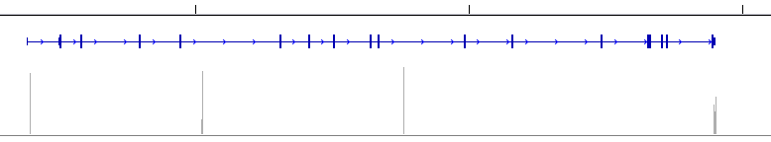
J
ARMC2
(NM_032131; chr6:109,169,619-109,295,675 , strand : plus)
Number of RefSeq NM genes
109,200 kb
109,250 kb
109,300 kb
(tag count)
100
Distance from RefSeq NM_TSS (kbp)
12,819
0
Number of RefSeq NM genes
Distance from Refseq start
TSS1 : +7 bp
Distance from Refseq start
TSS2 : +68,519 bp
Distance from RefSeq NM_TSS (kbp)
8,112
ARMC2
(NM_032131; chr6:109,169,619-109,295,675 , strand : plus)
1,287
Number of RefSeq NM genes
(tag count)
109,200 kb
109,250 kb
109,300 kb
100
Distance from RefSeq NM_PAS (kbp)
0
19,091
Distance from Refseq end
PAS1 : -94,217 bp
Distance from Refseq end
PAS2 : -939 bp
Number of RefSeq NM genes
Supplementary Figure S2

Slide 9



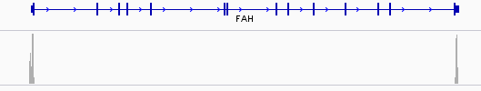

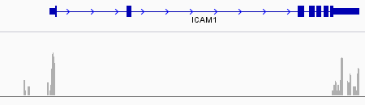


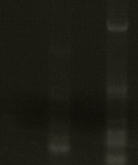
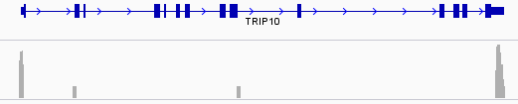
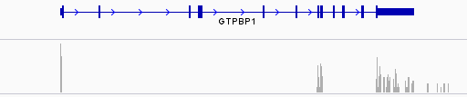

RT
- +
TSS
PAS
2kb
(tag count)
ACTB
(NM_001101)
50000
full
0
RT
- +
TSS
PAS
FAH
(NM_000137)
(tag count)
1.5kb
400
full
RT
- + - +
0
3kb
TSS
PAS
ICAM1
(NM_000201)
(tag count)
Alternative
TSC
200
full
RT
- + - +
0
2kb
ACAD8
(NM_014384)
TSS
PAS
(tag count)
200
Alternative
PAC
full
RT
- + - +
0
2kb
TSS
PAS
TRIP10
(NM_004240)
(tag count)
30
Alternative
TSC - PAC
full
0
RT
- + - +
TSS
PAS
2kb
GTPBP1
(NM_004286)
(tag count)
500
Alternative
TSC
Alternative
PAC
0
Supplementary Figure S3

Slide 10
A
B
C
TATA motif
Number of TSC pairs
CpG island overlapped
Number of TSC pairs
Poly(A)- addition signal motif
Number of PAC pairs
Supplementary Figure S4

Slide 11
A
 |  | DLD1 | HEK293 | Hela | MCF7
Pol II | GAPDH 30 | (previous paper) | 373.53 | 59.86 | 29.00
 | GAPDH-359 |  | 56.93 | 7.45 | 773.00
H3K4me3 | GAPDH 30 | (previous paper) | 7292.09 | 1222.78 | 272.58
 | GAPDH-359 |  | 510.74 | 199.68 | 46.86
H3K27Ac | ACTB 356 | (previous paper) | 2.87 | 192.73 | 113.99
 | CDKN1A 3959 |  | 3.66 | 22.39 | 7.03
H3K27me3 | HOXD13 -538 | (previous paper) | 7.24 | 37.44 | 5.21
 | HOXD13 -925 |  | 6.55 | 43.31 | 7.35
H3K36me3 | GAPDH | 30.30 | 8.19 | 0.12 | 8.08
 | ACTB | 137.81 | 46.89 | 26.95 | 19.11
H3K4me1 | GAPDH 2165 | 29.14 | 8.93 | 19.56 | 31.25
 | CDKN1A | 39.34 | 8.47 | 25.46 | 32.82
CTCF | CTCF-1 | N.S. | 2.97 | 1.25 | 3.07
 | CTCF-2 | 7.07 | 3.83 | 1.49 | 3.62
 | CTCF-3 | 1.06 | 0.12 | 1.63 | 4.23
CTD-PS2 | GAPDH_3end | 0.38 | 0.59 | 0.46 | 1.41
 | NM153339_3end | 5.02 | 6.33 | 3.67 | 6.40
 | NM004781_3end | 1.20 | 2.15 | 0.41 | 3.08
Rad21 | CSNP | 8.18 | 31.62 | 1.85 | 8.61
 | ERE2 | 18.23 | 7.24 | 4.46 | 16.19
Supplementary Figure S5

Slide 12
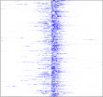
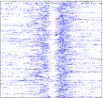
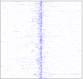
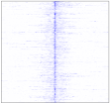
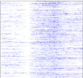
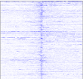
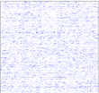
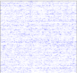
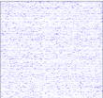
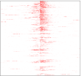
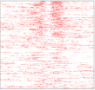
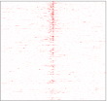
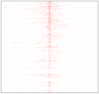
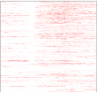
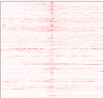
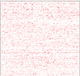
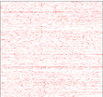
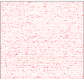
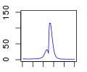
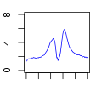
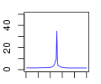
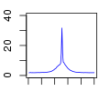
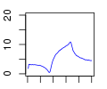





















































































B
H3K4me3
H3K4me1
Pol II
H3K27Ac
H3K36me3
CTD-PS2
CTCF
Rad21
H3K27me3
DLD1
>5ppm
<5ppm
100
0
%
IP/WCE
fold average
%
0
100
Signal intensity
(Relative fold enrichment)
IP / WCE
fold average
HEK293
>5ppm
<5ppm
IP/WCE
fold average
IP / WCE
fold average
MCF7
>5ppm
<5ppm
IP/WCE
fold average
IP / WCE
fold average
-5
TSS
5
-5
TSS
5
-5
TSS
5
-5
TSS
5
TSS
PAS
-5
PAS
5
TSS
PAS
TSS
PAS
TSS
PAS
Supplementary Figure S5

Slide 13












































































































C
H3K4me3
H3K4me1
Pol II
H3K27Ac
H3K36me3
CTD-PS2
CTCF
Rad21
H3K27me3
DLD1
“Preferred” TSC-PACs
in DLD1
“Preferred” TSC-PACs
in other cell types
100
0
%
%
0
100
IP/WCE
fold average
Signal intensity
(Relative fold enrichment)
IP / WCE
fold average
HEK293
“Preferred” TSC-PACs
in HEK293
“Preferred” TSC-PACs
in other cell types
IP/WCE
fold average
IP / WCE
fold average
MCF7
“Preferred” TSC-PACs
in MCF7
“Preferred” TSC-PACs
in other cell types
IP/WCE
fold average
IP / WCE
fold average
-5
TSS
5
-5
TSS
5
-5
TSS
5
-5
TSS
5
TSS
PAS
-5
PAS
5
TSS
PAS
TSS
PAS
TSS
PAS
Supplementary Figure S5

Slide 14
A
B
dT Library | Authentic model | Inter-chromosomal | Intra-chromosomal
 | TSC-PAC (>5ppm) | TSC-PAC (>5ppm) | TSC-PAC (>5ppm)
# Total Pair-Cluster | 44,902 | 4 | 1
C
5’ Gene | 5’ location (chromosome, strand , TSS position) |  |  | 3’ Gene | 3’ location (chromosome, strand, PAS position) |  |  | DLD1 | HEK293 |  | HeLa | MCF7 | LC2AD
 |  |  |  |  |  |  |  | tag counts(ppm)
BCAS4 | chr20 | + | 49,411,598 | BCAS3 | chr17 | + | 59,469,767 | 0 |  | 0 | 0 | 3213 | 0
MCTS1 | chrX | + | 119,737,982 | PSIMCT-1 | chr20 | + | 30,135,753 | 190 |  | 213 | 282 | 157 | 168
PIGY | chr4 | - | 89,444,906 | ICA1L | chr2 | - | 203,637,882 | 5 |  | 7 | 0 | 0 | 9
BCAS4 | chr20 | + | 49,411,598 | REG4 | chr1 | - | 120,336,729 | 0 |  | 0 | 0 | 23 | 0
CCDC6 | chr10 | - | 61,666,314 | RET | chr10 | + | 43,622,123 | 0 |  | 0 | 0 | 0 | 19
Supplementary Figure S6

Slide 15





TSS
PAS
(tag count)
TSS
PAS
RT
-
+
600
1.5kb
NDUFA13 / YJEFN3
0
TSS
PAS
TSS
PAS
(tag count)
RT
-
+
4000
2kb
VAMP8 / VAMP5
0
TSS
PAS
(tag count)
TSS
PAS
1.5kb
RT
-
+
10000
HLA-A / HLA-J
0
TSS
PAS
TSS
PAS
RT
-
+
(tag count)
1.2kb
30000
RPLP2 / CD151
0
TSS
TSS
PAS
PAS
RT
(tag count)
1.5kb
-
+
HOXA4 / HOXA3
50
0
Supplementary Figure S7

Slide 16
A
Supplementary Figure S8

Slide 17


B
Supporting split tags (number <) | Known junction | Tophat unique | Total
1 | 30,730 | 25,503 | 56,233
10 | 21,717 | 11,456 | 33,173
50 | 12,945 | 5,223 | 18,168
100 | 9,436 | 3,459 | 12,895
Supporting split tags (number <) | Constitutive donor | Alternative donor (number of total combinations) | Constitutive acceptor | Alternative acceptor (number of total combinations)
1 | 39,145 | 6,127 (17,088) | 43,143 | 5,357 (13,090)
10 | 25,121 | 3,077 (8,052) | 27,449 | 2,474 (5,724)
50 | 14,833 | 1,332 (3,335) | 15,829 | 1,063 (2,339)
100 | 10,792 | 862 (2,103) | 11,407 | 670 (1,488)
RefSeq junction
Assembled model
Tophat junction
(from split tag)
Supplementary Figure S8

Slide 18
Supplementary Figure S9

Slide 19
Primers for validation analysis of the fusion gene (Fig. 5)
Cell | Gene | Forward Primer | Reverse Primer
LC2AD | CCDC6 / RET | GCAGCAAGAGAACAAGGTGC | ACCATCCTAAGTTGCTGGGC
MCF7 | BCAS4 / BCAS3 | CCTCCTGATGCTGCTCGT | AACCACGGTTTCCTTCACTG
Supplementary Table1

Slide 20
Primers for validation analysis of the TSCs and PACs (Fig. S3)
 | Forward Primer | Reverse Primer
ACTB (NM_001101), full | TTTTTAAGGTGTGCACTTTTATTCA | AGCACAGAGCCTCGCCTTT
FAH (NM_000137), full | GGCGAGACTGTGGAGGAC | CCTCAGAGCACAATGGCTTTA
ICAM1 (NM_000201), Alternative TSC – PAC | ATTTTCCCAGGCCTTCTGAG | CAGGTTGGCCAATGAGAAGT
ICAM1 (NM_000201), full | CGCTGAGCTCCTCTGCTACT | CAGGTTGGCCAATGAGAAGT
ACAD8 (NM_014384), TSC – Alternative PAC | AGGCGTTCAGACTCTTAGCTG | GGATCCCTGAGAACCACGTA
ACAD8 (NM_014384), full | AGGCGTTCAGACTCTTAGCTG | AAAGCCAAATTGGACGAGAG
TRIP10 (NM_004240), Alternative TSC – Alternative PAC | CTCCTTCTAGGAGCGCAGAG | GAGTTCAGGCCGTCCATC
TRIP10 (NM_004240), full | CTCCTTCTAGGAGCGCAGAG | CCGGTGTGACAGGTAGGACT
GTPBP1 (NM_004286), Alternative TSC – PAC | GTGGGCACTTCCTACAGTGG | AAGAAGGTGGGGAGGACAGT
GTPBP1 (NM_004286), TSC – Alternative PAC | AAGTTATTAAAGATGGCGAC | CTCAGTGTTGTCCCCGAAAC
Supplementary Table2

Slide 21
Primers for validation analysis of the ChIP Seq of histone modifications (Fig. S5)
antibody | Region | Forward Primer | Reverse Primer
Pol II / H3K4me3 | GAPDH 30 | CTCTGCTCCTCCTGTTCGAC | CTAGCCTCCCGGGTTTCTCT
 | GAPDH-359 | CAATTCCCCATCTCAGTCGT | GCAGCAGGACACTAGGGAGT
H3K27Ac | ACTB 356 | TCTTGCCAATGGGGATCG | CAGTTAGCGCCCAAAGGAC
 | CDKN1A 3959 | AAAATCCAGTTGCTGCCAAG | AGGAGAGGGAAAACGGAGAG
H3K27me3 | HOXD13 -538 | GGGCCTGTTTTCACATCATT | TGTTTTTGCCACCTCTCCTC
 | HOXD13 -925 | CGTTCTCAGGGTCTTTCTGC | CAACGCTCTTCGCCTCTACT
H3K36me3 | GAPDH | CTTCGTATGACTGGGGGTGT | GGCCCAAGAGGTTGAATTTT
 | ACTB | TTTGCACTTTCTGCATGTCC | GGGGTGTTGAAGGTCTCAAA
H3K4me1 | GAPDH 2165 | CCCCTTCATACCCTCACGTA | GACAAGCTTCCCGTTCTCAG
 | CDKN1A | AAAATCCAGTTGCTGCCAAG | AGGAGAGGGAAAACGGAGAG
CTCF | CTCF-1 | TGGGAAAATTCCTCAAACCA | CGCCTATAGACAACAAGTGCAA
 | CTCF-2 | GGTCAGACACTCTGGCCTGT | TTCAGCCATAGAGCTCCACA
 | CTCF-3 | TTGCAGAGGTACAGGGCTTT | TGAGACTGAGCAGAGCTCCA
CTD-PS2 | GAPDH_3end | CGGCCTCTTTTGCTTTCTTA | GGAGGACGTGGGAATCAGTA
 | NM153339_3end | TGCCTGGTCTCCACAGTAGC | TTAGGGCAGGTGGTCCTAGA
 | NM004781_3end | TGTTCCCTTAACATCGCTGA | CAGGAGCCAGTGGGTTACAT
Rad21 | CSNP | AACTTTCCCAGCCTCGTTCT | GTCAGAGGTGGAGCTGGAAG
 | ERE2 | GAGCTTCTCCCTAGCCCAGT | CCAGATGAATTGCCCTCATT
Supplementary Table3

Slide 22
Primers for validation analysis of the adjoining RefSeq transcripts (Fig. S7)
 | Forward Primer | Reverse Primer
NDUFA13 / YJEFN3 | CGTCAAAGGTGAAGCAGGA | GGTGGGAGGGCTGTTTATTG
VAMP8 / VAMP5 | GGGCAAAGGTACCCCTTAGT | AGCATGGCCAGTACAGCAG
HLA-A / HLA-J | CGGTCCCGGTTCTAAAGTC | TGTCTTCCATTTATTTTGTCTCTCA
RPLP2 / CD151 | CCGCGTGAGTGTGGTGAC | TTTATTGAGCACCTGTATGTGG
HOXA4 / HOXA3 | TGTGGTTTGGACACTTCTGG | AGATGGCCAATCTGCTGAAC
Supplementary Table4

Slide 23
Primers for Validation analysis of the putative intergenic lncRNAs (Fig. S9)
 | Forward Primer | Reverse Primer
chr19:24,216,222-24,241,128 | TGAAGAGGAGTGCATGGTTTC | GAGGCAAGGAAATGGAGTCA
chr5:179,894,258-179,910,338 | GGGTTGTCCAAGAGCTTGTC | TGTTGGCTCAGGGTAATGCT
chr11:2,454,029-2,465,780 | CACACAGTCTAGCCCCAGGT | GTCTGCATCTCCCCTGCTT
chr12:104,357,876-104,359,488 | TTCAGTGTCCTCACCGACAA | ACCAGAAGACGGGGACTAGG
chr14:54,173,737-54,317,608 | ATGCGCCTTGCCTACAAATA | TGCATGGCATTTTCTCTGAA
chr18:33,760,073-33,767,365 | ATTTCGCTGTCTGACGTCCT | GACCGGACTTTCACTTCTGG
chr21:40,389,228-40,394,316 | TGCCCCCATCACTTCTTAAA | GACTGACATCGTGCCCTAGC
Supplementary Table5

