Slide 1
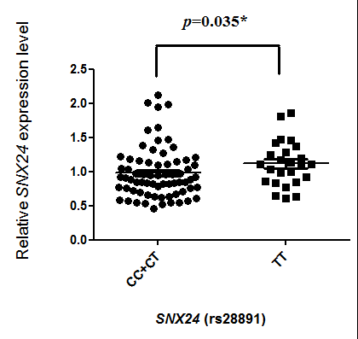
Figure S1
Figure S1. SNX24 mRNA expression levels in peripheral blood mononuclear cells between the SNX24 SNP (rs28891) genotypes. The relative SNX24 expression was detected by real-time RT-PCR, and expression from individuals with CC+CT genotypes was compared to that from individuals with TT genotypes. The relative expression levels were expressed as SNX24 mRNA/ HPRT mRNA ratio.

Slide 2
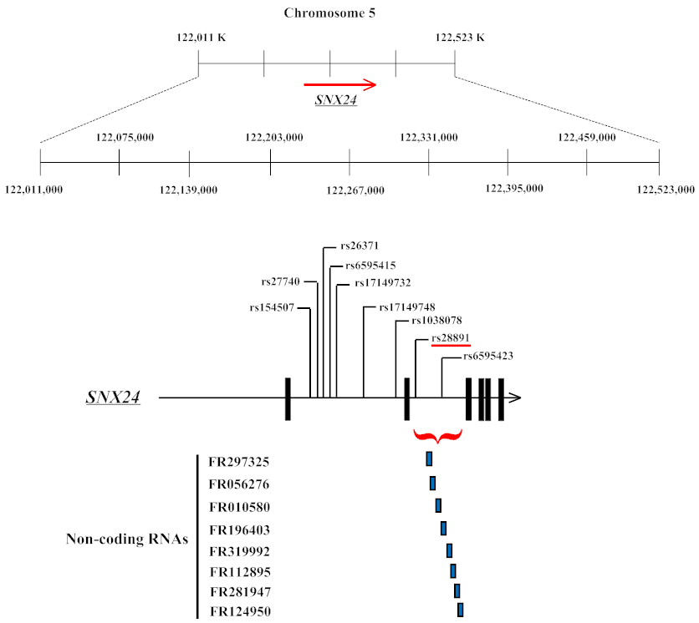
Figure S2
Figure S2. Single nucleotide polymorphisms (SNPs) of the SNX24 gene used in this study. Above and middle: Genomic location of SNPs present on chromosome 5. Down: Non-coding RNAs mapped to the intron 3 of SNX24 gene.

