Slide 1
Compound | 5
Structure
hLDHA IC₅₀ | 0.032 ± 0.016 µM
hLDHB IC₅₀ | 2.512 ± 0.07 µM
Supplementary Figure S1

Slide 2
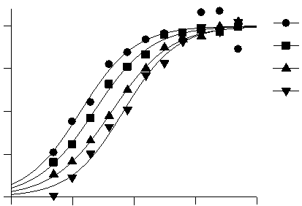
A
concentration in cell, μM
Cmpd 1
Cmpd 2
Cmpd 3
B
NADH
Cmpd IC50
100
120 μM
67 nM
60 μM
43 nM
75
30 μM
22 nM
% inhibition
5 μM
12 nM
50
25
-9
-8
-7
-6
-5
Compound 2
Supplementary Figure S2

Slide 3
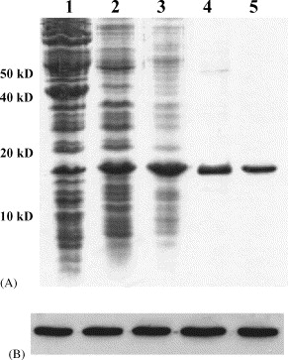
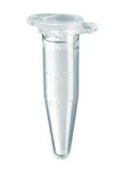
A
SILAC
LLIVSNPVDILTYVAWK
¹³C
¹⁵N-
Arg/Lys
100
HEK293
Trypsin digest
%
Spike
Relative Intensity
LC-MS/MS
recomb LDHA
Protein Concentration
0
973
975
977
B
SILAC
rLDHA
HEK293
¹³C
¹⁵N-
Arg/Lys
HEK293
100
Prepare lysates
Protein Concentration
Mix 1:1 Ratio
Trypsin digest
%
triplicate
Relative Intensity
LC-MS/MS
¹²C
¹⁴N-
Arg/Lys
SNU398
0
973
975
977
Snu398
HEK293
C
LDHA
copies/cell
LDHA
cell concentration
μM
Hek293
3.8 x 10⁶
5.4
Snu398
2.9 x 10⁶
1.5
HepG2
4.7 x 10⁶
2.6
Supplementary Figure S3

Slide 4
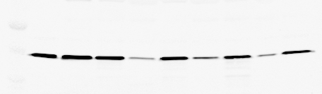

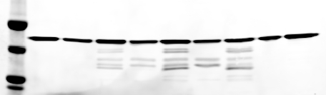
A
B
A2780
MDA-MB-453
Snu423
NCI-H1395
Cal-27
MiaPaCa-2
HepG2
786-O
Snu398
U251
HepG2
Kidney
Melanoma
Liver
Colon
Pancreas
Breast
LDHA
LDHA
LDHB
LDHB
β-actin
β-actin
C
D
LDHA, μM
LDHA, μM
E
trxn 1, days
trxn 2, days
2
3
4
7=0
2
4
7
WB
LDHA
+ + + + + + +
LDHAsi
Supplementary Figure S4

Slide 5
Supplementary Figure S5

Slide 6
A
FBP, nmol/mln cells
DMSO
Cmpd 1
Cmpd 2
B
FBP, nmol/mln cells
< 0.3
DMSO
Cmpd 1
Cmpd 2
Supplementary Figure S6

Slide 7
Supplementary Figure S7

Slide 8
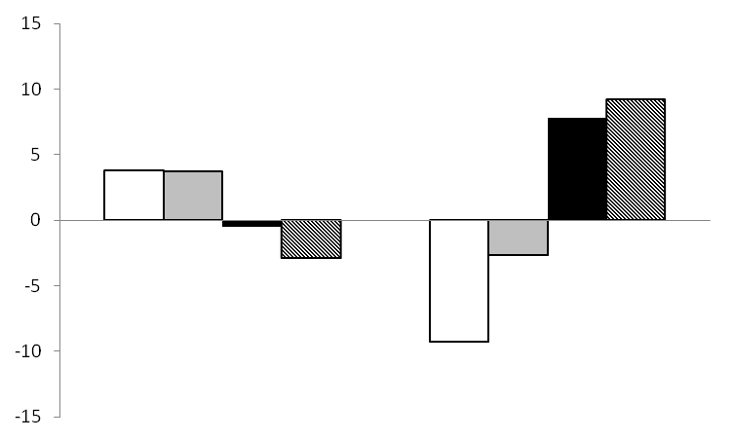
A
Snu398
HepG2
relative pathway activity
pentose phosphate
glycolysis
fatty acid synthesis
glutaminolysis
B
Supplementary Figure S8

