Slide 1
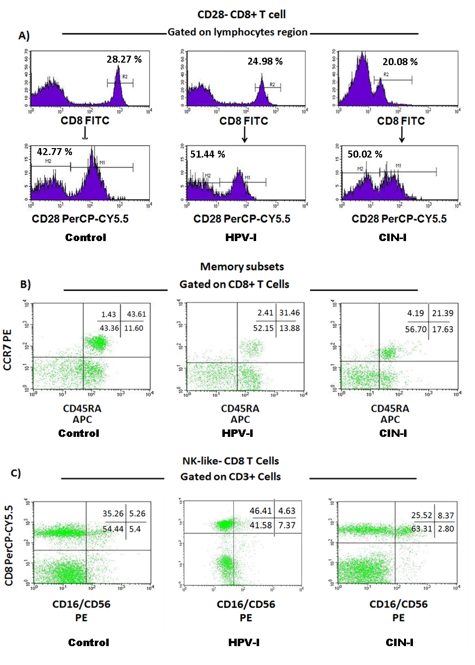
Additional file. Dot plots and histograms representating control, HPV-I and CIN-I groups. Analysis of CD28‒CD8+ T cells (A). Analysis of memory subsets according to differential expression of CCR7 and CD45RA (B). NK-like CD8+ T cells (CD16+/CD56+bright/dim CD3+) (C).

