Slide 1
















Figure R1A. 1µM DJ4 inhibits activity of ROCK1 at 1mM concentration of ATP
nM µM
DMSO 5 10 50 100 1 2 5
Recombinant pMYPT1
60kD
Recombinant MYPT1
60kD
ROCK1 Kinase activity (1mM ATP)
Figure R1B. Endogenous expression of ROCK1/2 and pMYPT1 in NSCLC cells
H2126
H23
H460
ROCK1
Actin
The individual bands are rearranged from a blot for presentation. They are proportionately resized without affecting intensity of the bands.
ROCK2
Actin
pMYPT1
Actin
Figure R1C. Morphology of A549 and H2126
DMSO
DJ4
A549
H2126

Slide 2
Figure R1D

Slide 3
Figure R1E.

Slide 4
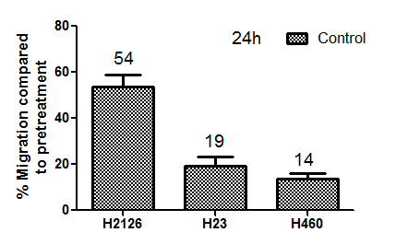
Figure R1F. H23 and H460 cells are less migratory than H2126 (migration over 24h)

