Slide 1
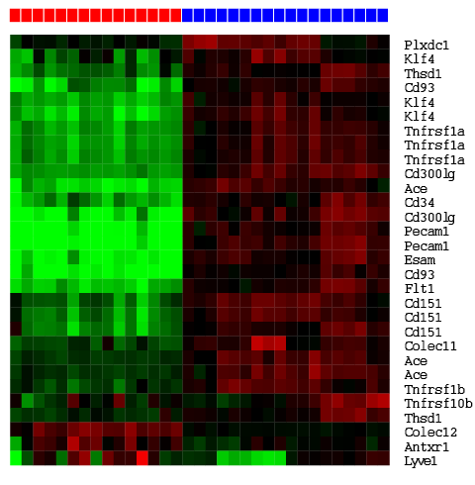
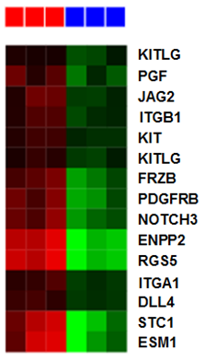
Su et al. Supplemental Figure 1.
A
Renal epithelium Renal endothelium
B
Endothelial
markers
- - - + + +
Treatment

Slide 2
Su et al. Supplemental Figure 2.
UMRC3
Cell Proliferation
HUVEC
Cell Proliferation

Slide 3
Relative Expression
Relative Expression
Su et al. Supplemental Figure 3.
UMRC3
Caki-1
Relative Expression
Relative Expression
786-O
HRC-223

Slide 4
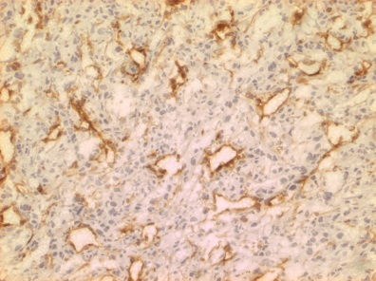
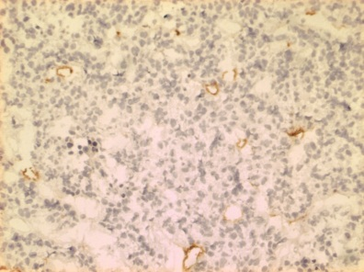
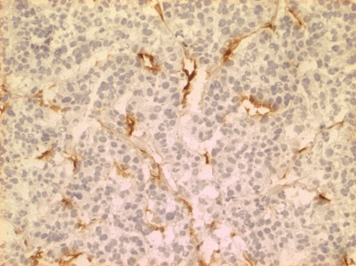
A
Sunitinib control
(mm³)
(mm³)
(weeks)
(weeks)
(mm³)
(mm³)
(weeks)
(weeks)
(mm³)
(mm³)
Su et al. Supplemental Figure 4.
(weeks)
(weeks)
(mm³)
(mm³)
(weeks)
(weeks)
(mm³)
(mm³)
(weeks)
(weeks)
(mm³)
(mm³)
(weeks)
(weeks)
B
C
Microvascular Density
*
Control Sensitive Resistant
Day 11 post-treatment Day 48 post-treatment

Slide 5
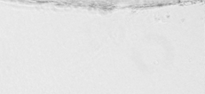
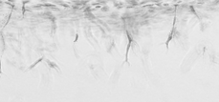
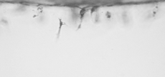
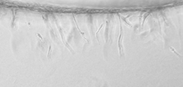
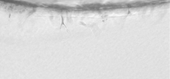
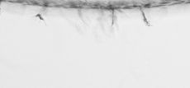
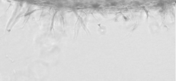

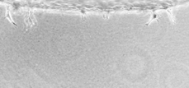
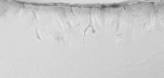
Su et al. Supplemental Figure 5.
A
CTL VEGF IL-8 bFGF
Sunitinib (0.1uM)
Sunitinib (1uM)
B
C
Invading cells
Invasion distance (um)
**
**
**
**
nd

