Slide 1

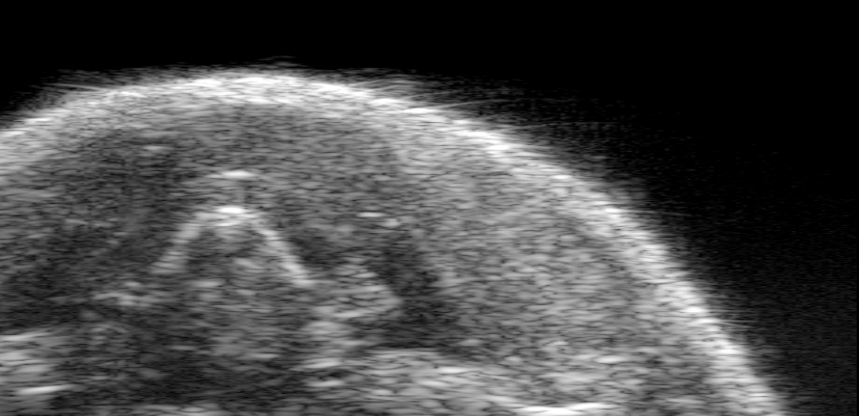
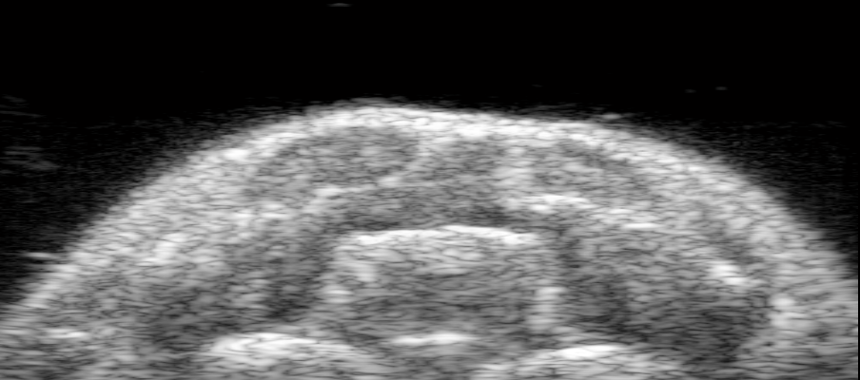

Silica-coated gold nanoplates
MAPS
a
Normal LN
b
Metastatic LN
Normal LN

