Slide 1
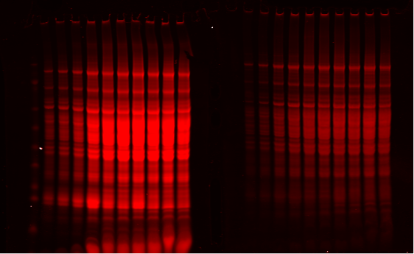
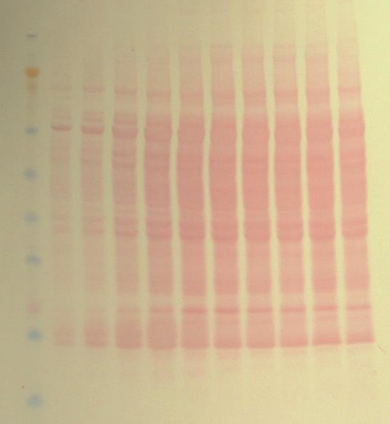
A)
Ladder
10ug
20ug
40ug
65ug
S380.03
S380.16
S380.11
S380.13
S380.14
S380.15
B)
S380.01
Ladder
10ug
20ug
40ug
65ug
S380.03
S380.16
S380.11
S380.13
S380.14
S380.15
S380.01
C)
D)
Ladder
10ug
20ug
40ug
65ug
S380.03
S380.16
S380.11
S380.13
S380.14
S380.15
S380.01

