Slide 1
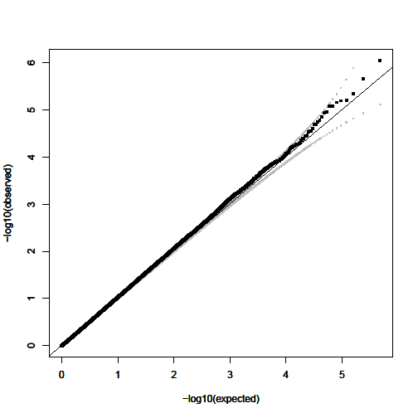
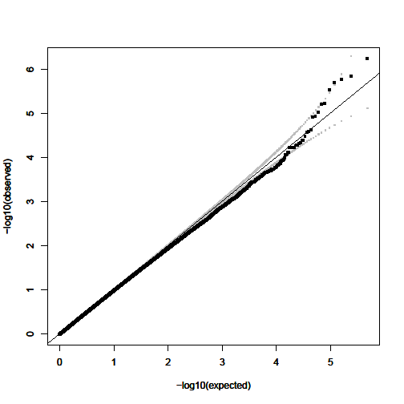
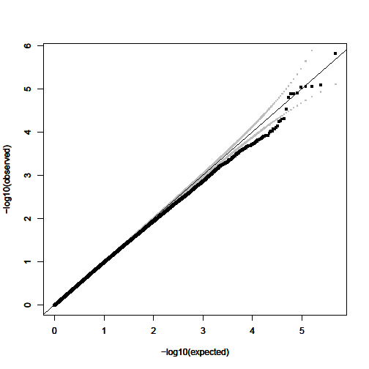
a. EU λ=1.009
b. AJ λ=0.982
c. SA λ=0.969
Notes:
Figure S7: Quantile-quantile plots of observed vs. expected –log(p) for: (a) EU, (b) AJ, and (c) SA Samples. The 95% confidence interval of expected values is indicated in grey. Corresponding genomic control lambda values are indicated within each plot (lambda=1.009 for EU, 0.982 for AJ, and 0.969 for SA).

