Slide 1
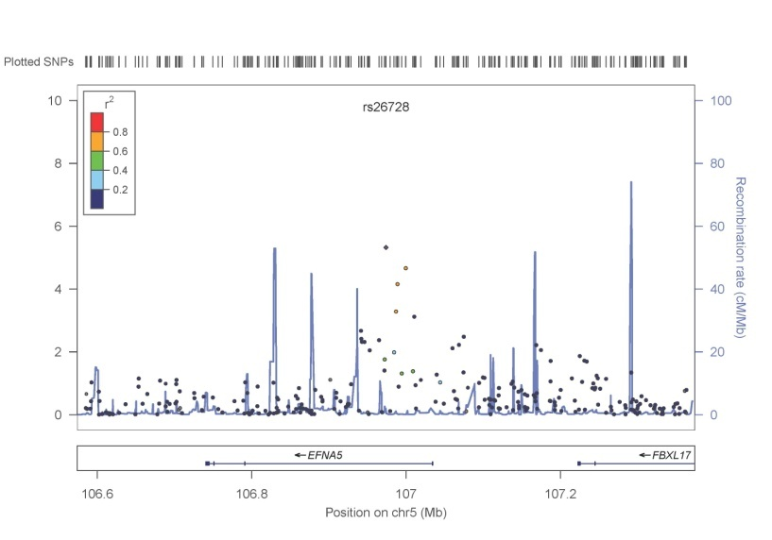
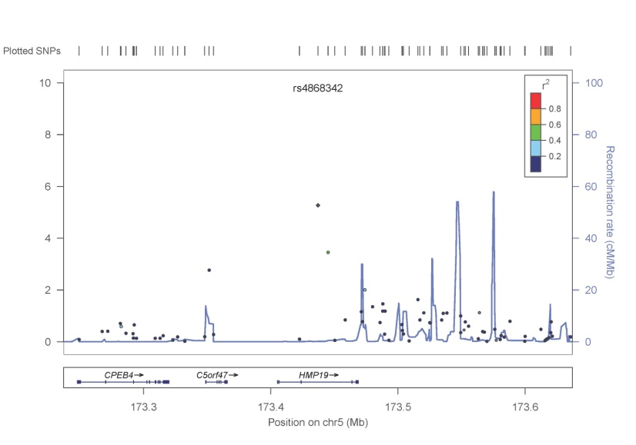
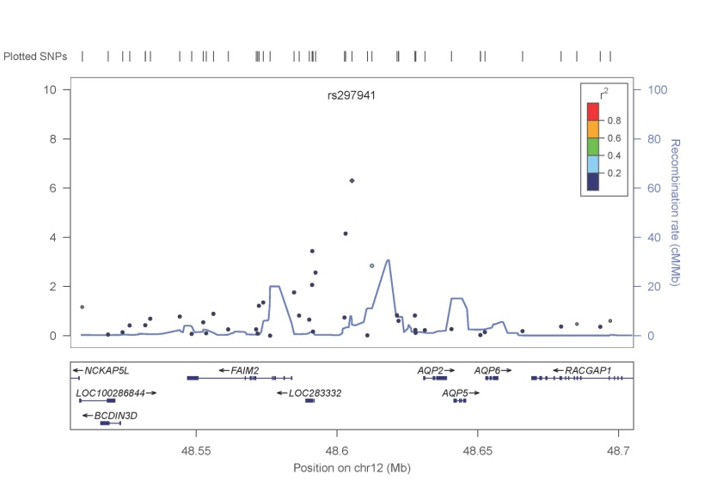
a
b
c
Notes:
Figure S9: Regional results of top hits in meta-analyses. a) LocusZoom plot of rs26728 from the case-control meta-analysis; b) LocusZoom plot of rs4868342 from the case-control meta-analysis; c) LocusZoom plot of rs297941 from the trio-case-control meta-analysis

