Slide 1
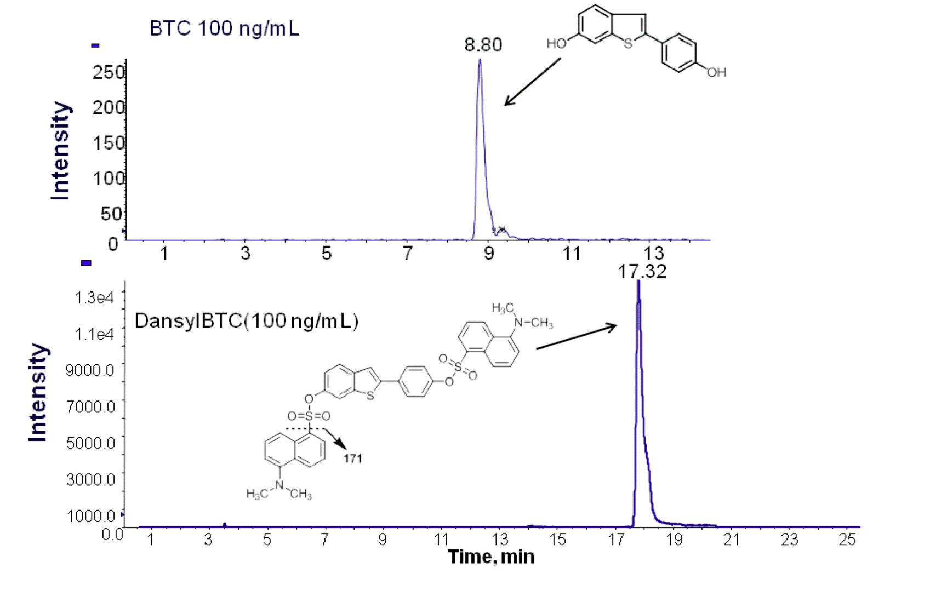
(A)
(B)
Supplementary Figure 2: LC–MS/MS MRM chromatograms of BTC and DansylBTC. (A) Reconstructed ion chromatogram for the MRM transition m/z 241 → 208 of standard BTC (100 ng/mL); (B) Reconstructed ion chromatogram for the MRM transition m/z 709 → 171 of standard DansylBTC (100 ng/mL).

