Slide 1
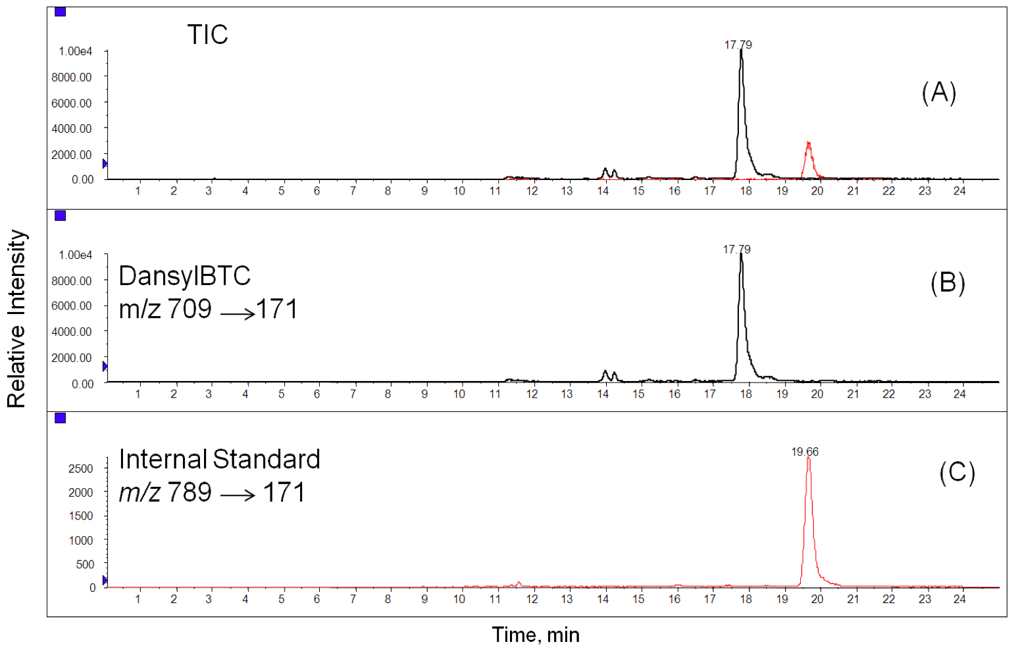
Supplementary Figure 5: LC–MS/MS MRM chromatograms of DansylBTC and internal standard (DansylBr-BTC).
(A) Total ion chromatogram; (B) BTC (25ng/mL) in mouse plasma; and (C) IS Br-BTC (20 ng/mL)

