Slide 1






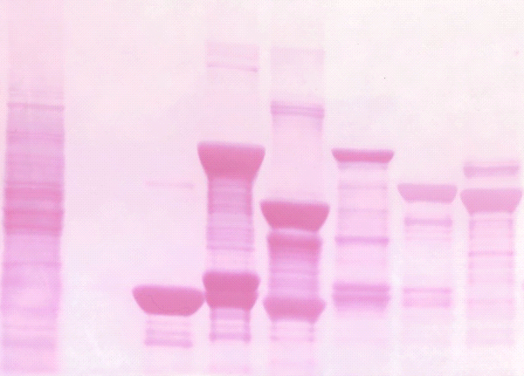
A
B
-
-
+
+
-
-
+
+
Serum
+
-
+
-
Serum
+
-
+
-
Con shRNA
-
+
-
+
Con Vec
-
+
-
+
PELP1 shRNA
PELP1 Vec
PELP1
PELP1
P-p70S6K
P-S6
p70S6K
S6
Actin
Actin
C
GST-PELP1 fragments
960-1130
400-600
800-960
Input
GST
1-400
600-866
mTOR
GST-PELP1 Fragments
(Ponceau stain)
*
*
*
*
*
*
Figure 1S. PELP1 down regulation or upregulation alters mTOR signaling and PELP1 interacts with mTOR. (A) MCF7 cells stably expressing control shRNA or PELP1 shRNA were serum starved for 24h and stimulated with serum for 10 min. Status of PELP1 knockdown and p70S6K phosphorylation was analyzed by Western analysis. Quantitation of S6K phosphorylation after normalizing to its respective total protein is shown. (B) MCF7 cells stably expressing control vector or PELP1 vector were serum starved for 24h and stimulated with serum for 10 min. Status of PELP1 expression and S6 phosphorylation was analyzed by Western analysis. Quantitation of S6 phosphorylation after normalizing to its respective total protein is shown. (C) MCF7 cell lysates were incubated with various deletions of PELP1 as GST-fusion proteins and their interaction with mTOR was determined by using GST pull-down assays.

