Slide 1
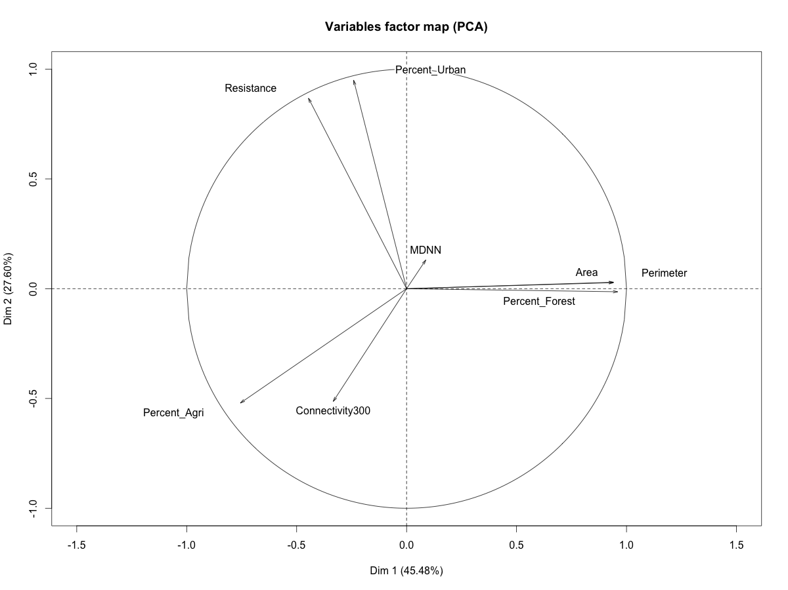
Figure S3
PC2 (27.60%)
PC1 (45.48%)

