Slide 1
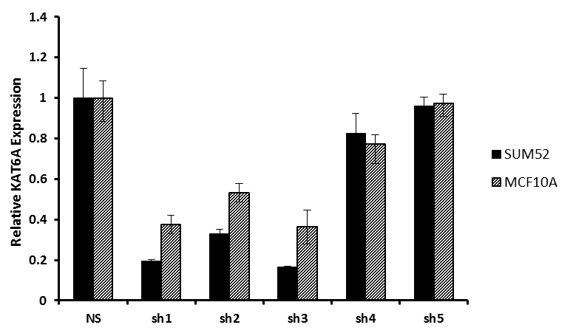
Supplementary Figure 1
Supplementary Figure S1. RT-PCR data showing relative KAT6A expression in SUM-52 and MCF10A cells. Lentivirus was generated through transfection of 293FT cells using five lentiviral shRNA vectors, each targeting different KAT6A sequences. Cells were lentivirally transduced and selected in puromycin for 3 days before RNA was harvested to confirm knockdown of KAT6A. The shRNA vectors sh1 and sh3 yielded the best knockdown of KAT6A in both cell lines.

Slide 2
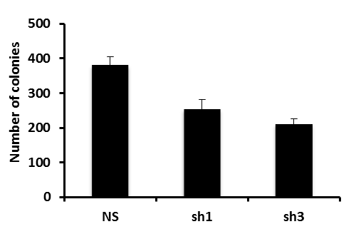
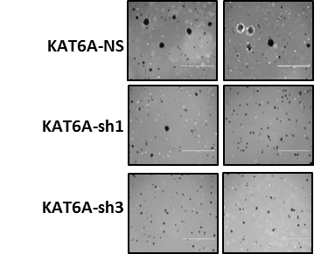
Supplementary Figure 2
A
B
Supplementary Figure S2. (A) A soft agar assay with SUM52 non-silencing control and KAT6A knockdown cells was performed to assay for anchorage-independent growth. Results show the number of colonies is reduced upon knockdown of KAT6A. (B) Images of p-Iodonitrotetrazolium violet stained colonies were taken using an EVOS Imaging System. Colonies that formed under KAT6A knockdown are smaller compared to the non-silencing control.

Slide 3
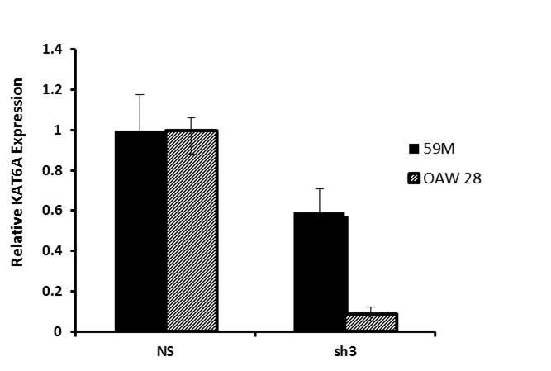
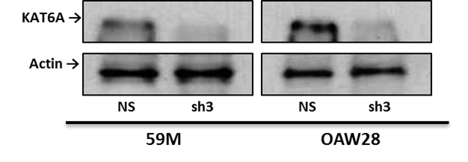
Supplementary Figure 3
A
B
Supplementary Figure S3. (A) RT-PCR data showing relative KAT6A expression in OAW28 and 59M cells. Cells were infected with only sh3, as this shRNA consistently yielded the best KAT6A knockdown. Following lentiviral transduction, cells were selected in puromycin for 3 days before RNA was harvested to confirm knockdown . (B) Western blot showing knockdown of KAT6A at the protein level.

Slide 4
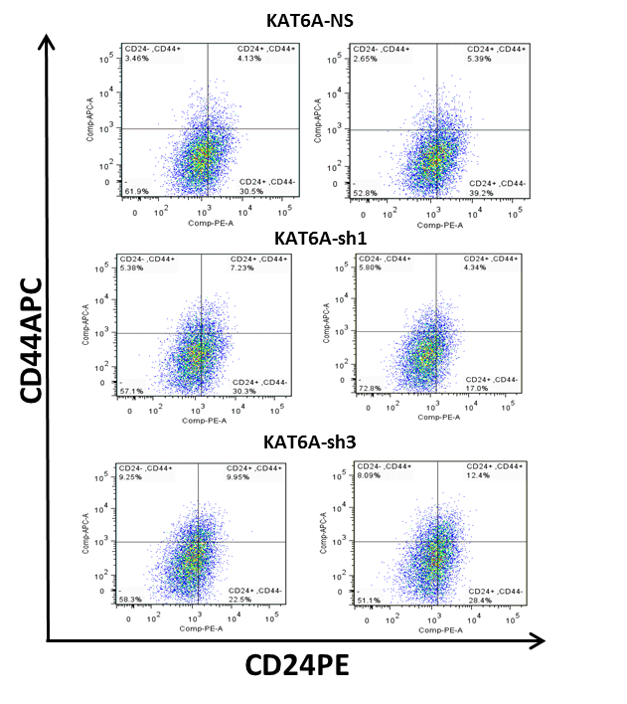
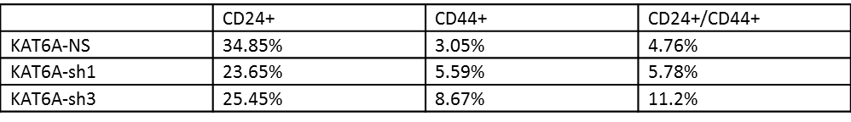
Supplementary Figure 4
A
B
Supplementary Figure S4. (A) CD24/CD44 flow cytometry analysis of SUM-52 non-silencing control and KAT6A knockdown down cells. (B) Table showing the percentage of SUM-52 cells (control and KAT6A knockdown) positive for CD24, CD44, and CD24/CD44 staining.

