Slide 1
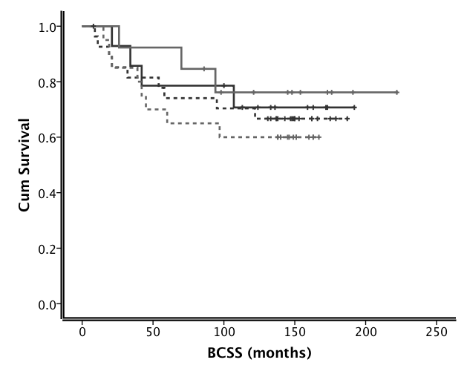
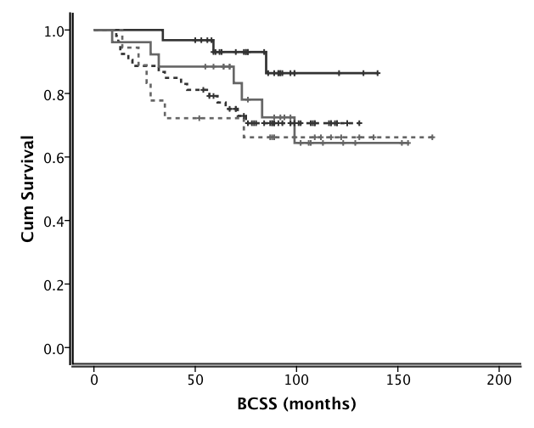
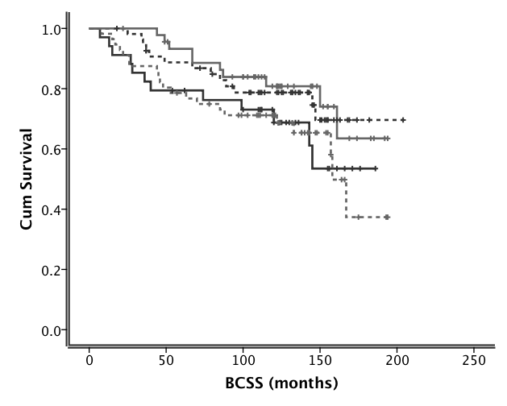
NPI>3.4;ER-ve;CMF chemotherapy
NPI>3.4; ER- ; Anthracyclin chemotherapy
CHK2+/ATM+ (n=13)
CHK2-/ATM+ (n=31)
CHK2-/ATM+ (n=14)
CHK2-/ATM- (n=53)
CHK2+/ATM- (n=18)
CHK2-/ATM- (n=28)
CHK2+/ATM+ (n=26)
CHK2+/ATM- (n=20)
Log Rank = 1.175; p = 0.759
Log Rank =4.106 ; p = 0.250
NPI>3.4; ER+ ; endocrine therapy
CHK2-/ATM- (n=55)
CHK2+/ATM+ (n=46)
CHK2-/ATM+ (n=130)
Supplementary Figure S3
CHK2+/ATM- (n=34)
Log Rank = 4.922; p = 0.178

