Slide 1
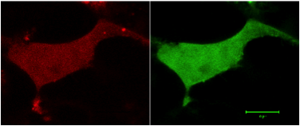
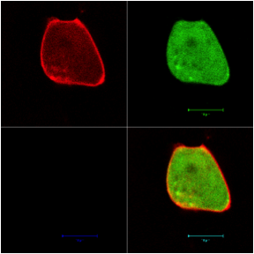
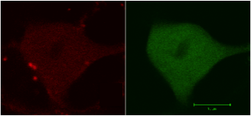
A.
B.
C.
Figure S1.
Visualization of co-expression of D₁ and D₂ short dopamine receptors.
A. D₂ short receptor (GFP) (green) and D₁-NLS (RFP) (red) co-translocated to the cytoplasm and nucleus. B. L14 (D₂-NLS (GFP) (green) and D₁ RFP (red) co-translocated to the cytoplasm and nucleus. C. L15 (D₂-NLS) (GFP) (green) and D₁-RFP (red) co-translocated to the cytoplasm and nucleus.

