Slide 1
Atlas of Dbx1 mouse (P0) medulla oblongata
Ruangkittisakul A¹, Kottick A², Picardo MCD², Ballanyi K¹*, Del Negro CA²*
¹ Department of Physiology, University of Alberta,
Edmonton, AB, Canada
² Department of Applied Science, The College of William & Mary, Williamsburg, VA, USA

Slide 2
Abbreviations
AP area postrema
IO inferior olive
IOD dorsal inferior olive
IOM medial inferior olive
IOP principal inferior olive
LRN lateral reticular nucleus
NA nucleus ambiguus, compact formation
NTB nucleus of the trapezoid body
PD pyramidal decussation
OBEX Obex, the point where the central canal opens to the 4th ventricle
V4 4th ventricle
VII facial nucleus
VIIdor dorsal nucleus of the facial nucleus
VIImed medial nucleus of the facial nucleus
VIIlat lateral nucleus of the facial nucleus
XII hypoglossal nucleus

Slide 3
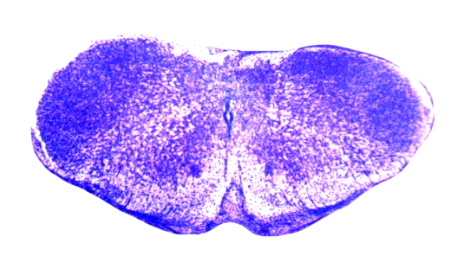
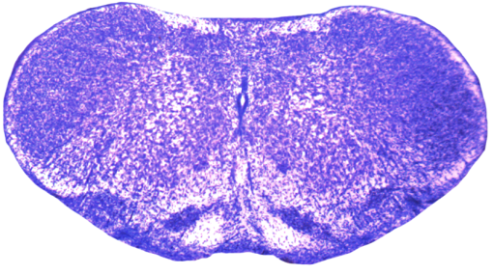
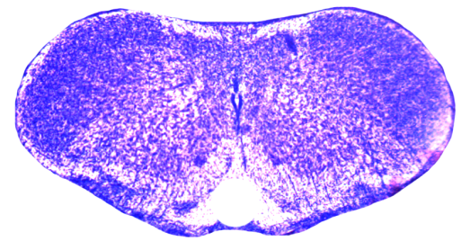
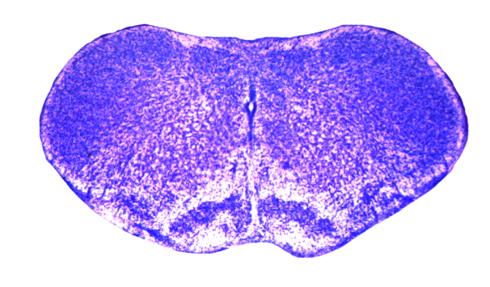
-0.95 mm
-0.85 mm
Spinal-medullary transition zone
-0.90 mm
-0.80 mm
IOM: caudal end
LRN: caudal end
PD: rostral end
XII: caudal end
PD
LRN
IOM
XII

Slide 4
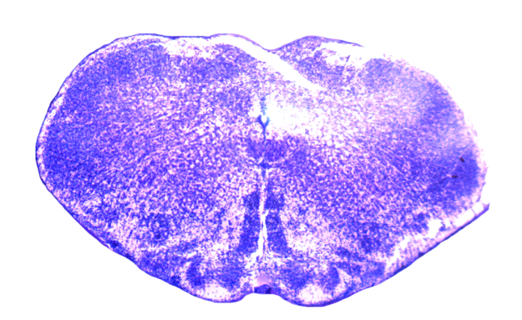
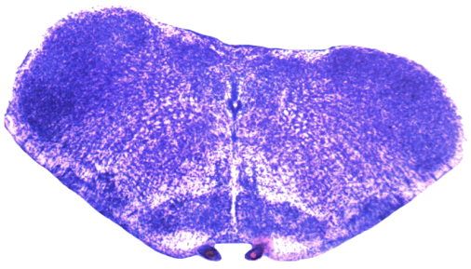
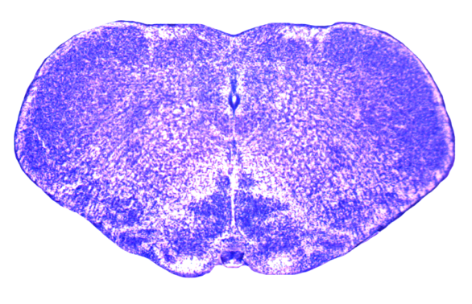
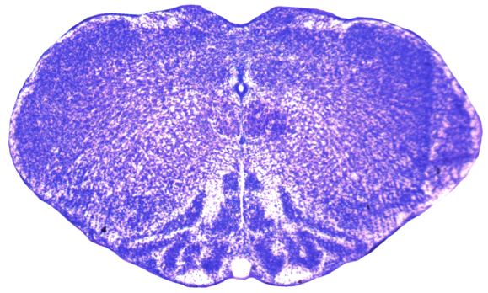
-0.75 mm
-0.65 mm
IOP: caudal end of 1st loop
IOD: broken band toward ventral surface
LRN: small
-0.70 mm
-0.60 mm
IOD: caudal end
IOP: caudal end
IOP: small 1st loop
IOD: big dorsal band, forms 2nd loop
IOD
IOM
IOP
LRN
XII

Slide 5
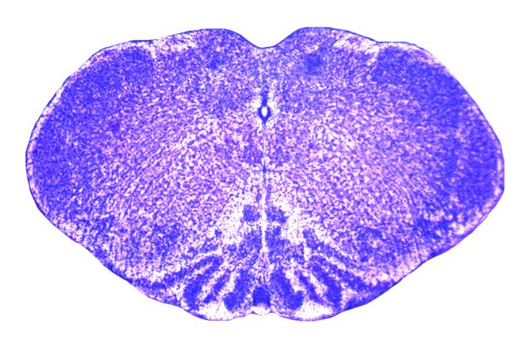
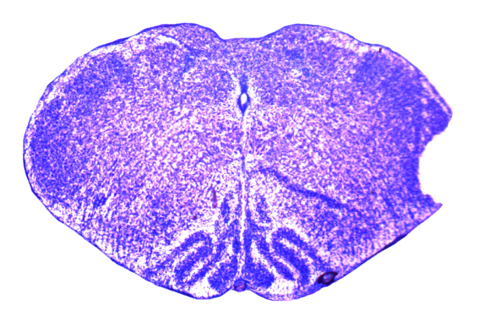
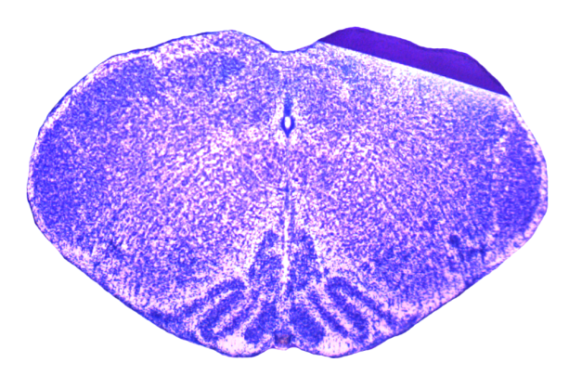
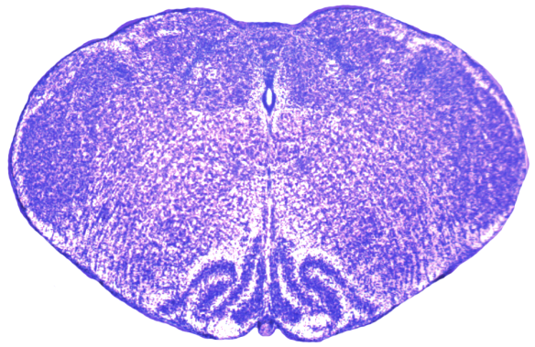
-0.55 mm
-0.45 mm
IOD: small dorsal band, rostral end of 2nd loop
IOM: rostral end of dorsal part, dorsal tip elongated
-0.50 mm
-0.40 mm
IOM: sharp dorsal cap
IOP: prominent 1st loop
IOD: lateral part flat
LRN: rostral end
IOM: dorsal tip narrowed
IOP: dorsal part straight edge
AP: caudal end. Obex.
AP
IOD
IOM
IOP
LRN
NA
XII

Slide 6
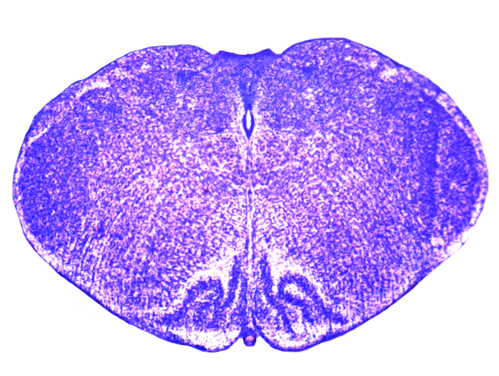
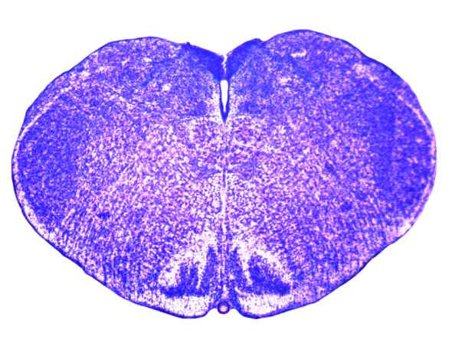
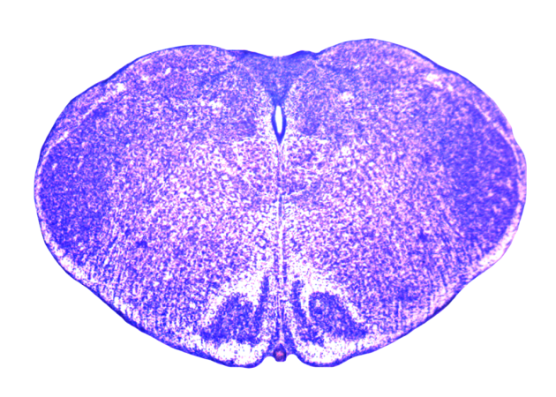
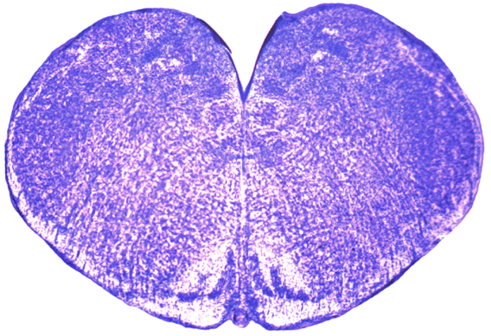
-0.35 mm
-0.25 mm
IOM: small, rostral end
IOP: dorsal part reaches midline
IOP, IOD: small
-0.30 mm
-0.20 mm
IOP: rostral end of 1st loop
IOD: thick, unites with IOP
IOP, IOD: small
XII: small
AP
IOD
IOM
IOP
NA
V4
XII

Slide 7
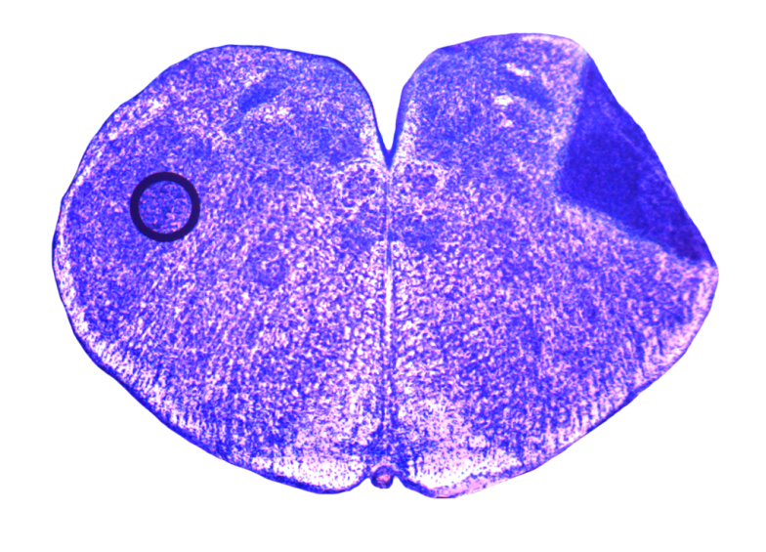
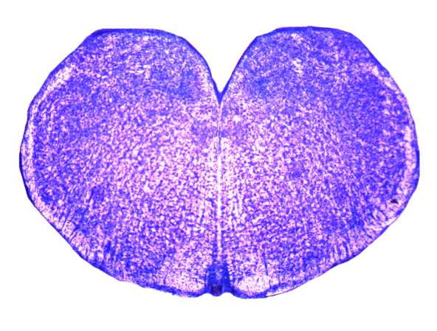
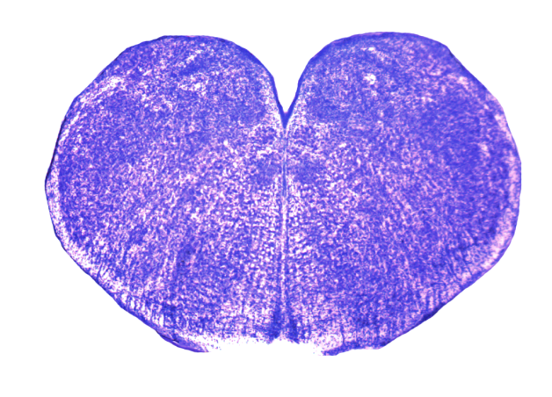
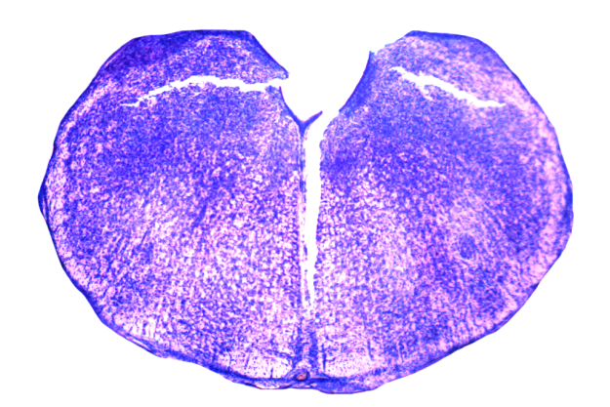
-0.15 mm
-0.05 mm
IOD and IOP united, rostral end
No IOP/IOD, no VII
-0.10 mm
0.00 mm
XII: rostral end
No IOP/IOD, no VII
VII_{lat}: caudal end
IOD
IOP
NA
VII_{lat}
V4
XII

Slide 8
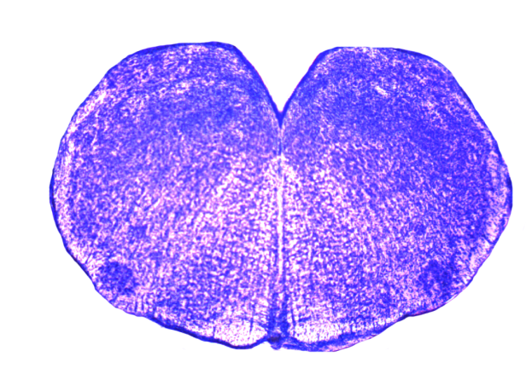
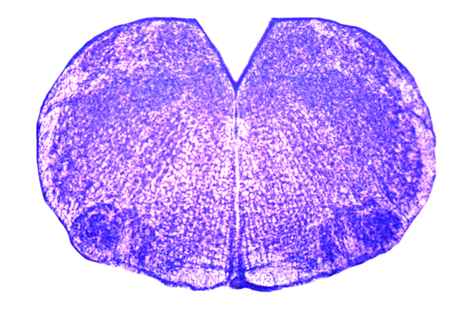
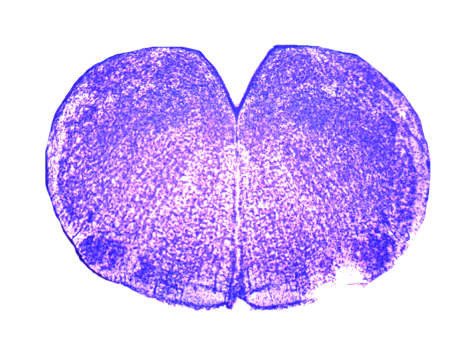
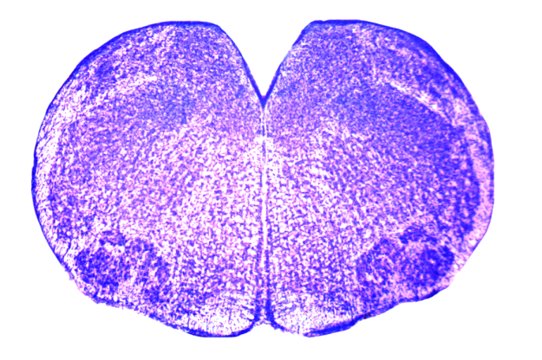
0.05 mm
0.15 mm
VII_{med} : caudal end
0.10 mm
0.20 mm
VII_{dor} : caudal end
NA
VII_{lat}
VII_{dor}
VII_{med}
V4

Slide 9
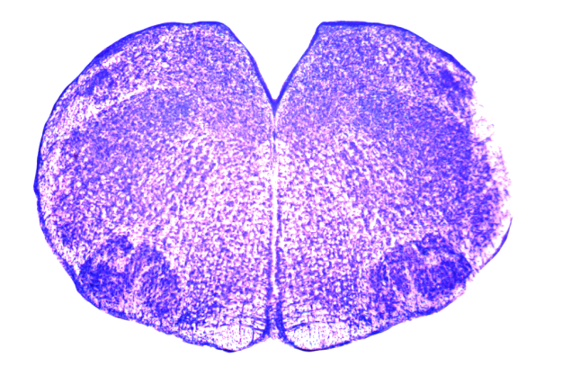
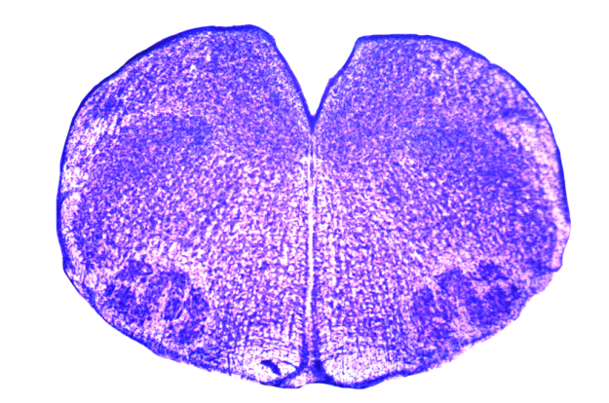
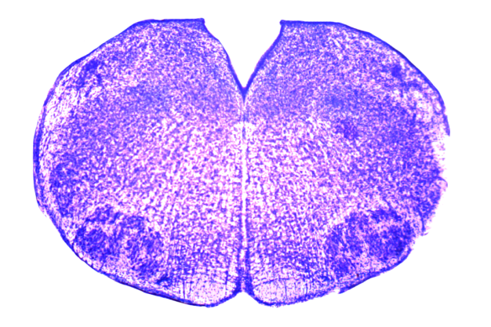
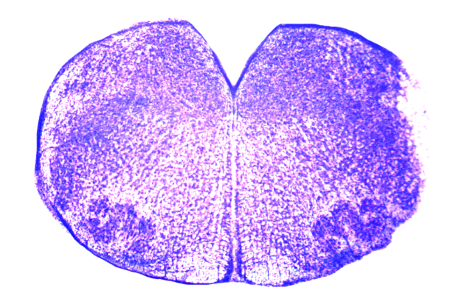
0.25 mm
0.35 mm
0.30 mm
0.40 mm
NTB: caudal end
NTB
VII_{lat}
VII_{dor}
VII_{med}
V4

Slide 10
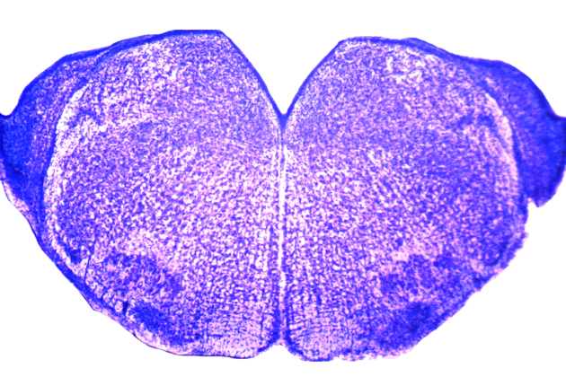
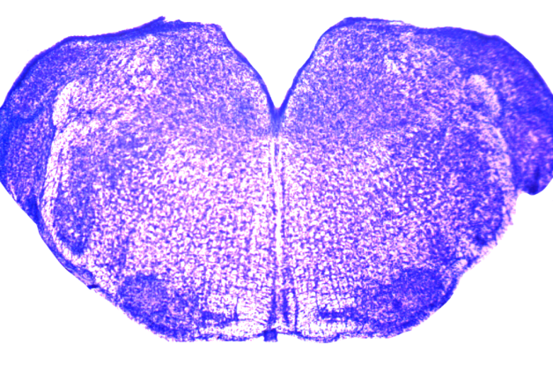
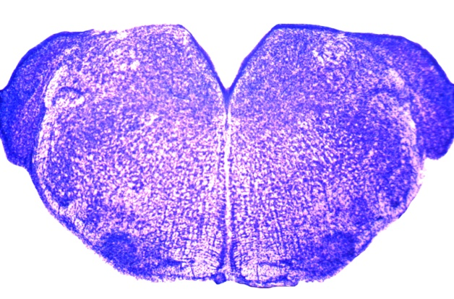
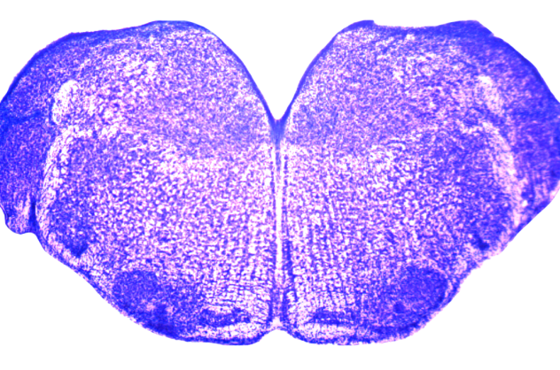
0.45 mm
0.55 mm
VII: rostral end
0.50 mm
0.60 mm
NTB
VII_{lat}
VII_{dor}
VII_{med}
V4

