Slide 1
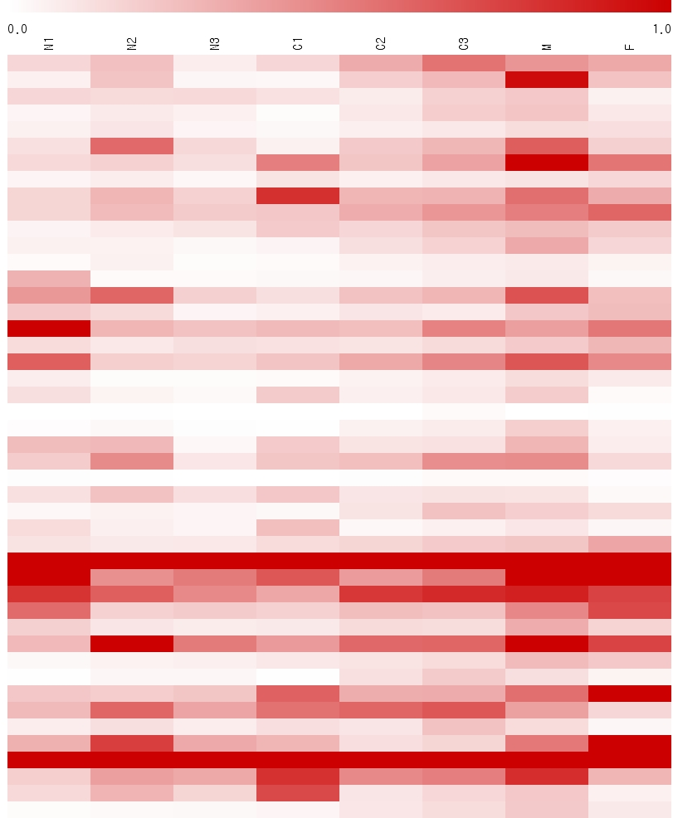
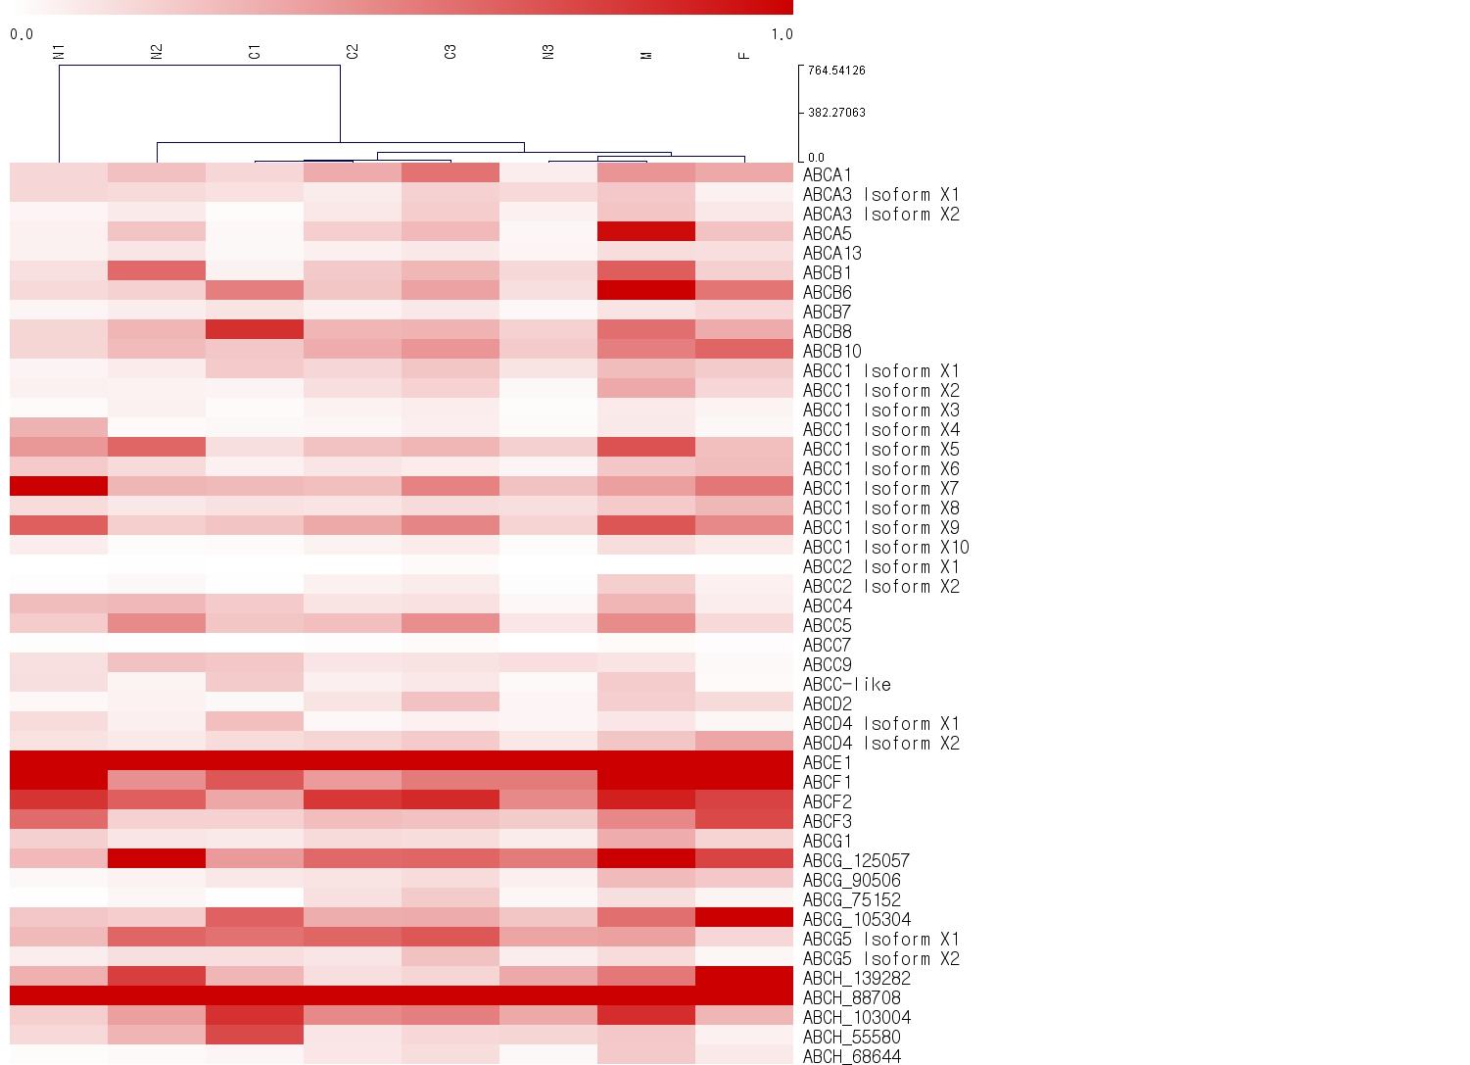
0.0
1.0
Additional file 11
NI
NII
CI
CII
CIII
NIII
M
F
ABCA1
ABCA2
ABCA3 Isoform X1
ABCA3 Isoform X2
ABCA13
ABCB1
ABCB6
ABCB7
ABCB8
ABCB10
ABCC1 Isoform X1
ABCC1 Isoform X2
ABCC1 Isoform X3
ABCC1 Isoform X4
ABCC1 Isoform X5
ABCC1 Isoform X6
ABCC1 Isoform X7
ABCC1 Isoform X8
ABCC1 Isoform X9
ABCC1 Isoform X10
ABCC2 Isoform X1
ABCC2 Isoform X2
ABCC4
ABCC5
ABCC7
ABCC9
ABCC-like
ABCD2
ABCD4 Isoform X1
ABCD4 Isoform X2
ABCE1
ABCF1
ABCF2
ABCF3
ABCG1
ABCG_125057
ABCG_90506
ABCG_75152
ABCG_105304
ABCG5 Isoform X1
ABCG5 Isoform X2
ABCH_139282
ABCH_88708
ABCH_103004
ABCH_55580
ABCH_68644
ABCA1
ABCA3 isoform X1
ABCA3 isoform X2
ABCA5
ABCA13
ABCB1
ABCB6
ABCB7
ABCB8
ABCB10
ABCC1 isoform X1
ABCC1 isoform X2
ABCC1 isoform X3
ABCC1 isoform X4
ABCC1 isoform X5
ABCC1 isoform X6
ABCC1 isoform X7
ABCC1 isoform X8
ABCC1 isoform X9
ABCC1 isoform X10
ABCC2 isoform X1
ABCC2 isoform X2
ABCC4
ABCC5
ABCC7
ABCC9
ABCC-like
ABCD2
ABCD4 isoform X1
ABCD4 isoform X2
ABCE1
ABCF1
ABCF2
ABCF3
ABCG1
ABCG_125057
ABCG_90506
ABCG_75152
ABCG_105304
ABCG5 isoform X1
ABCG5 isoform X2
ABCH_139282
ABCH_88708
ABCH_103004
ABCH_55580
ABCH_68644

