Slide 1
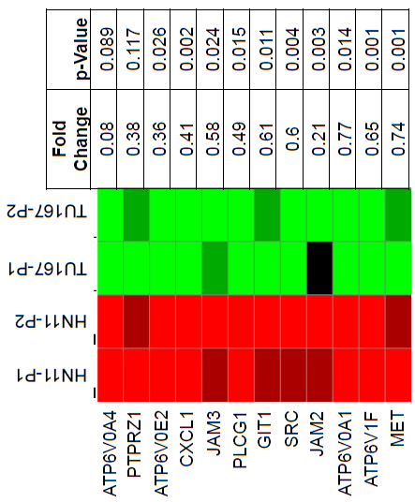
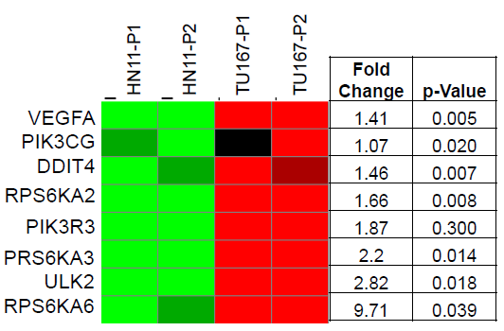
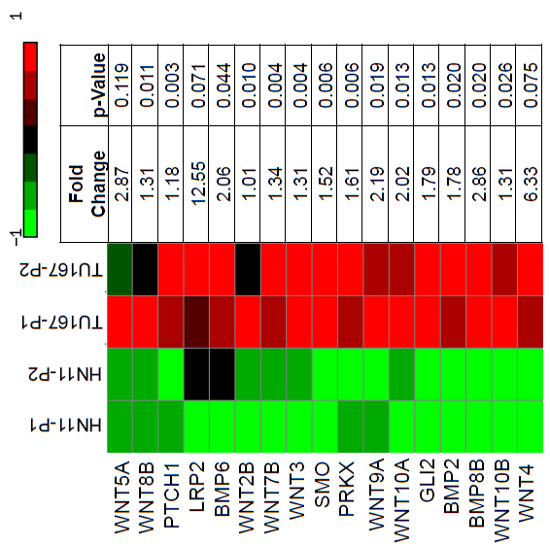
Supplemental Figure 1
Epithelial Cell Signaling Pathway
mTOR Signaling Pathway
Hedgehog Signaling Pathway

Slide 2
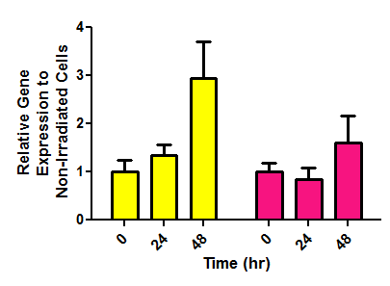
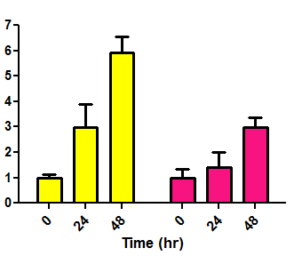
Supplemental Figure 2.
HN11
Scramble
shGLI1
**
***
n.s.
n.s.
TU167
Scramble
shGLI1
***
***
**
***
n.s.
*P<0.05; **P<0.01; ***P<0.001

Slide 3
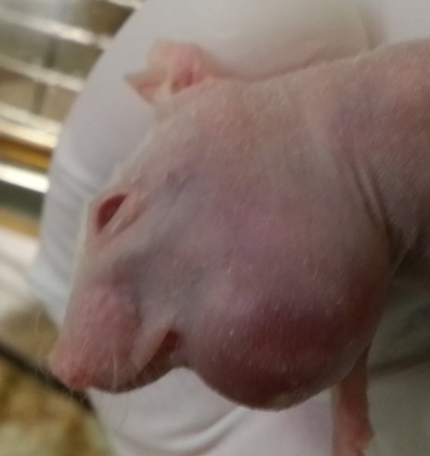
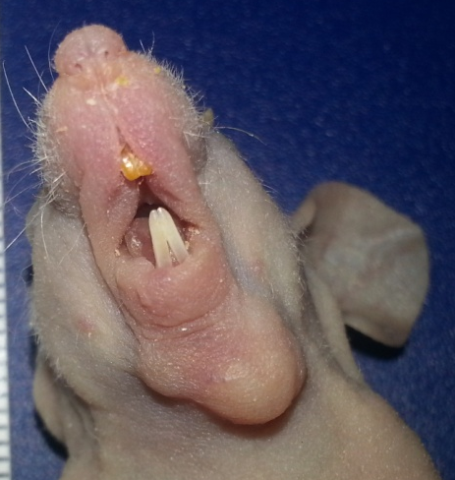
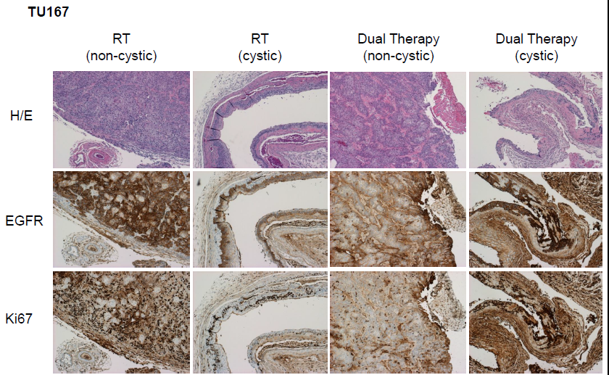
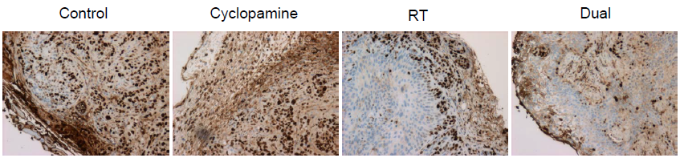
Supplemental Figure 3.
A.
Cystic Tumor
Non-Cystic Tumor
B.
C.

Slide 4
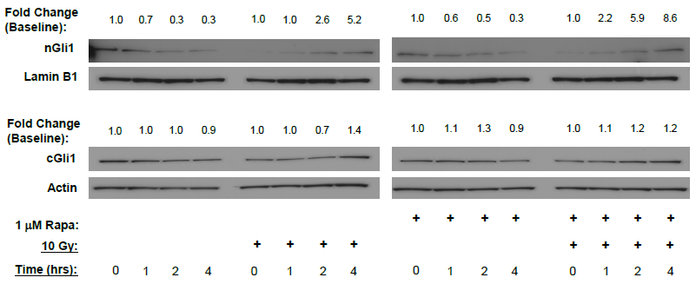
Supplemental Figure 4

Slide 5
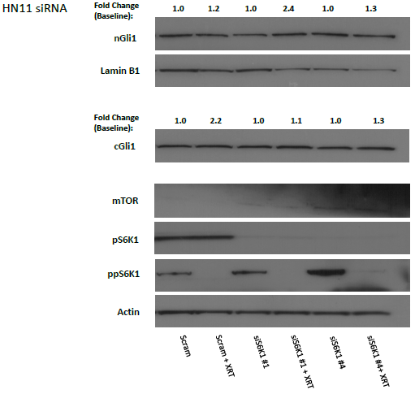
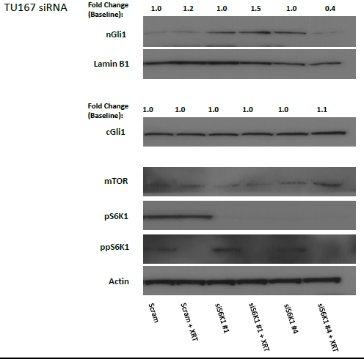
Supplemental Figure 5

Slide 6
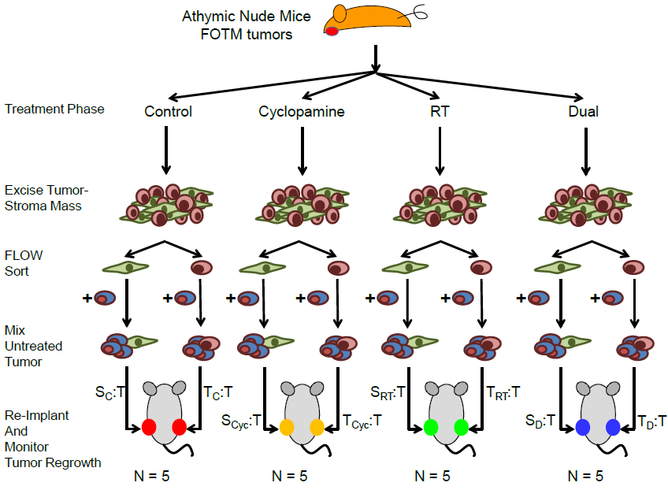
Supplemental Figure 6
A.

Slide 7
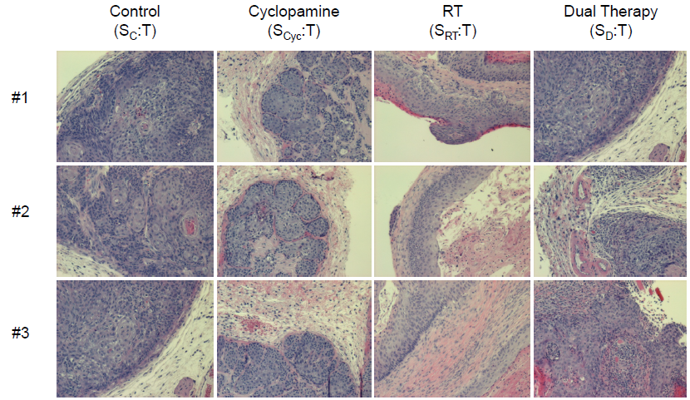
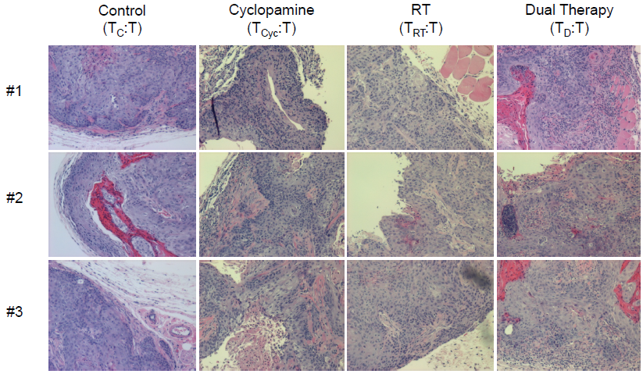
Supplemental Figure 6
B.
C.

