Slide 1
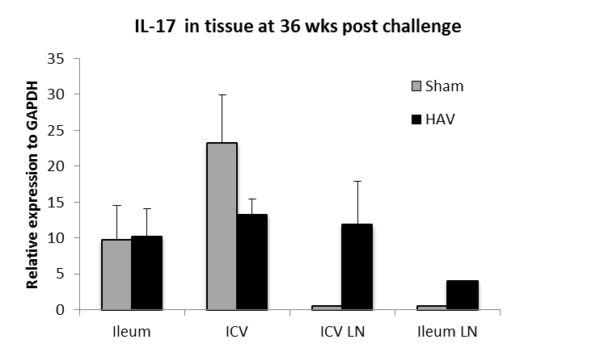
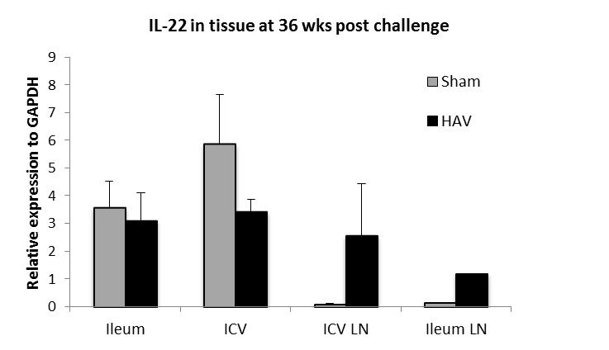
A
B
Fold increases relative to GAPDH in expression of cytokines A. IL-17, B. IL-22 in mucosal and lymph node tissue from ileal, ileocaecal valve sites obtained from HAV vaccinated (black) or Sham vaccinated (grey) calves obtained 38 weeks post challenge. No significance between groups was seen (P > 0.05).

