Slide 1
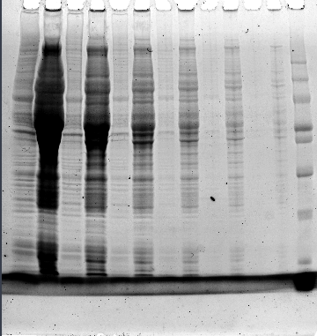
Fig. S1 Ezure et al.
Lysate
Sf21mm
mass
/kDa
140
100
70
50
40
30
20

