Slide 1
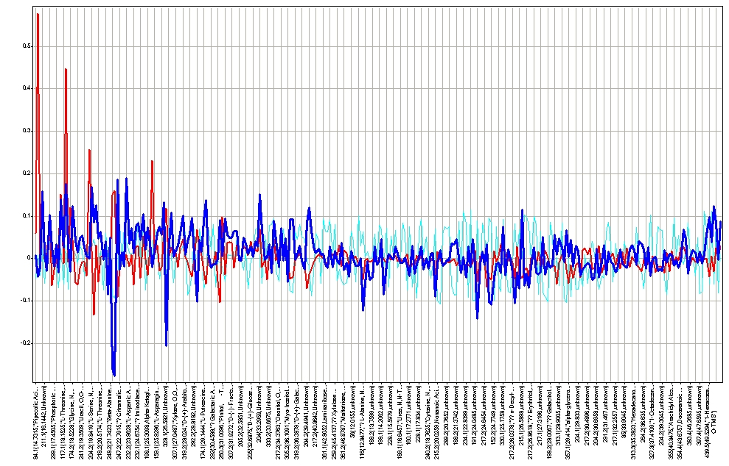

Supporting Figure S5. Eigenvectors of all polar and non-polar GC/MS derivatives
Polar extractions
Non-polar extractions

