Slide 1
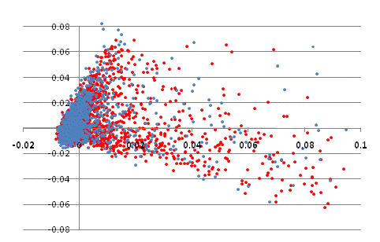
Ansung
Ansan
Principal Component 2
Principal Component 1
Figure S1. Population stratification of Ansung and Ansan. The PCA analysis by using the Affymetrix 5.0 SNP array were conducted by EIGENSTAT

