Slide 1
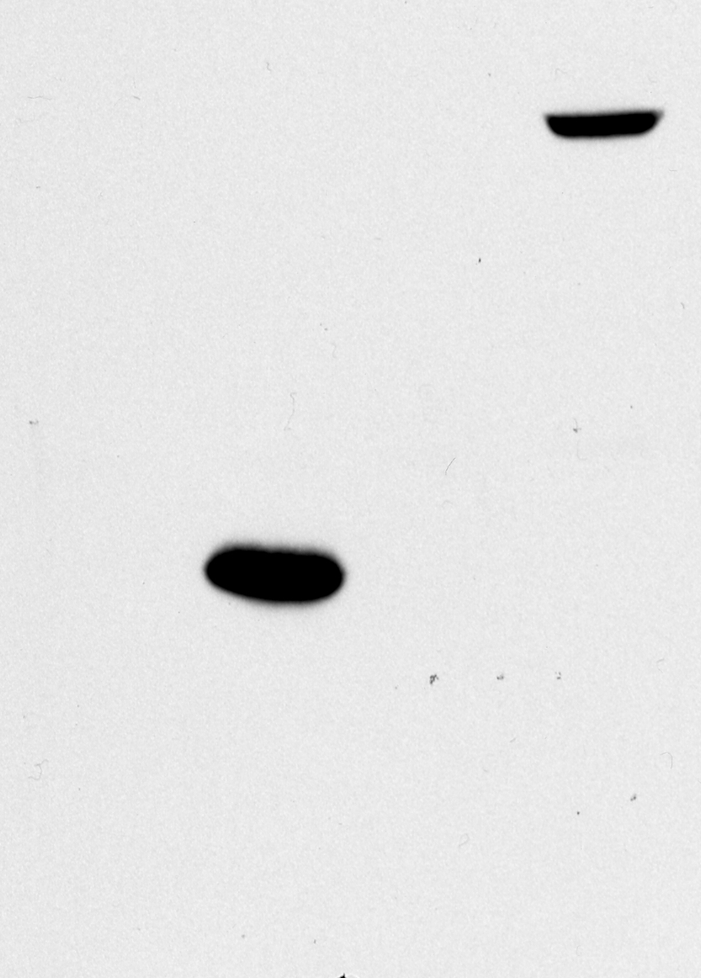
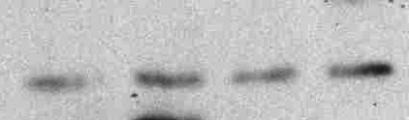
Flag-TDP-43WT
Flag-TDP-12xQ/N
TET
-
+
-
+
80
58
46
30
α-Flag
α-Tub
Suppl. Fig.1

Slide 2
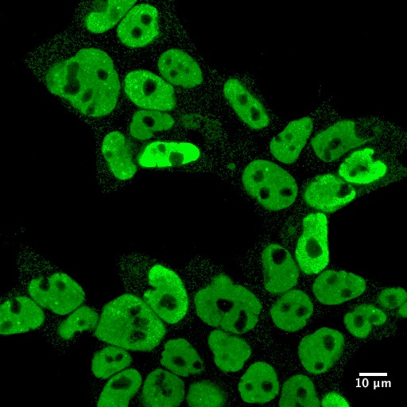
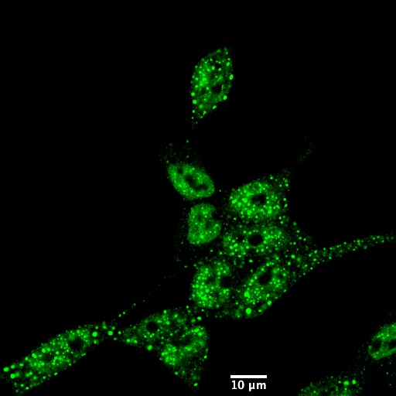
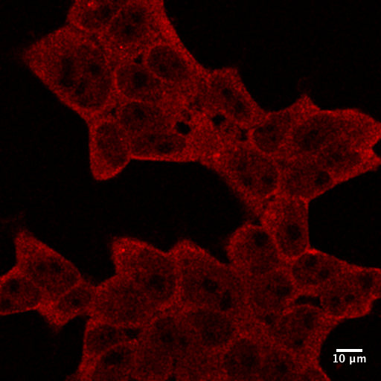
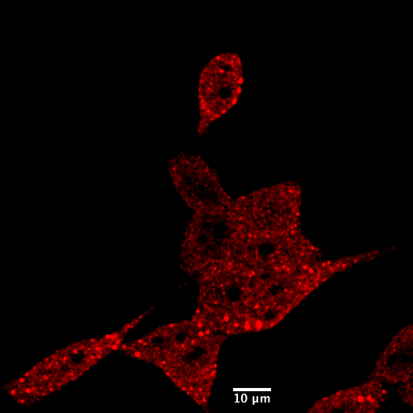
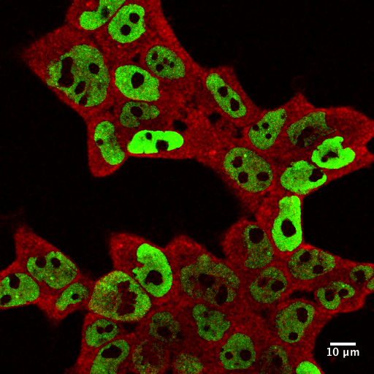
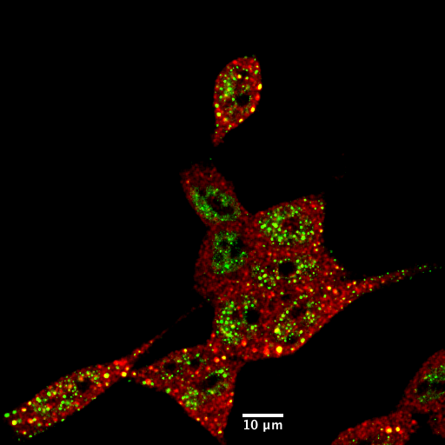
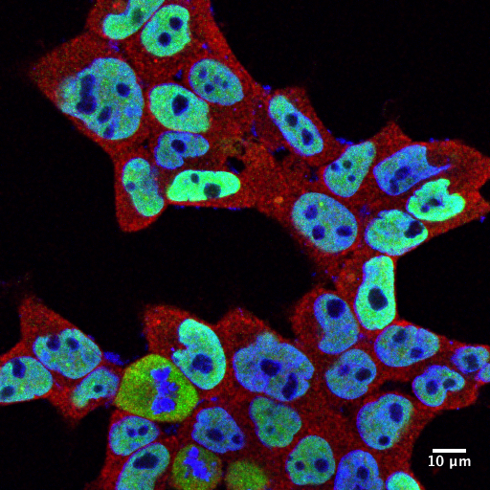
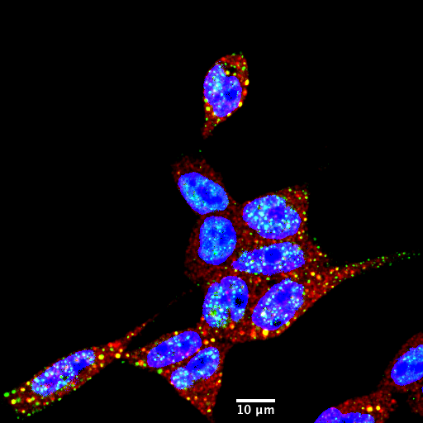
Flag-TDP-43WT (+ TET)
Flag-TDP-12xQ/N (+ TET)
α-TDP-43
α-HSP70
MERGE
(α-TDP-43/α-HSP70
MERGE
(α-TDP-43/α-Flag/TOPRO-3
Suppl.Fig. 2

Slide 3
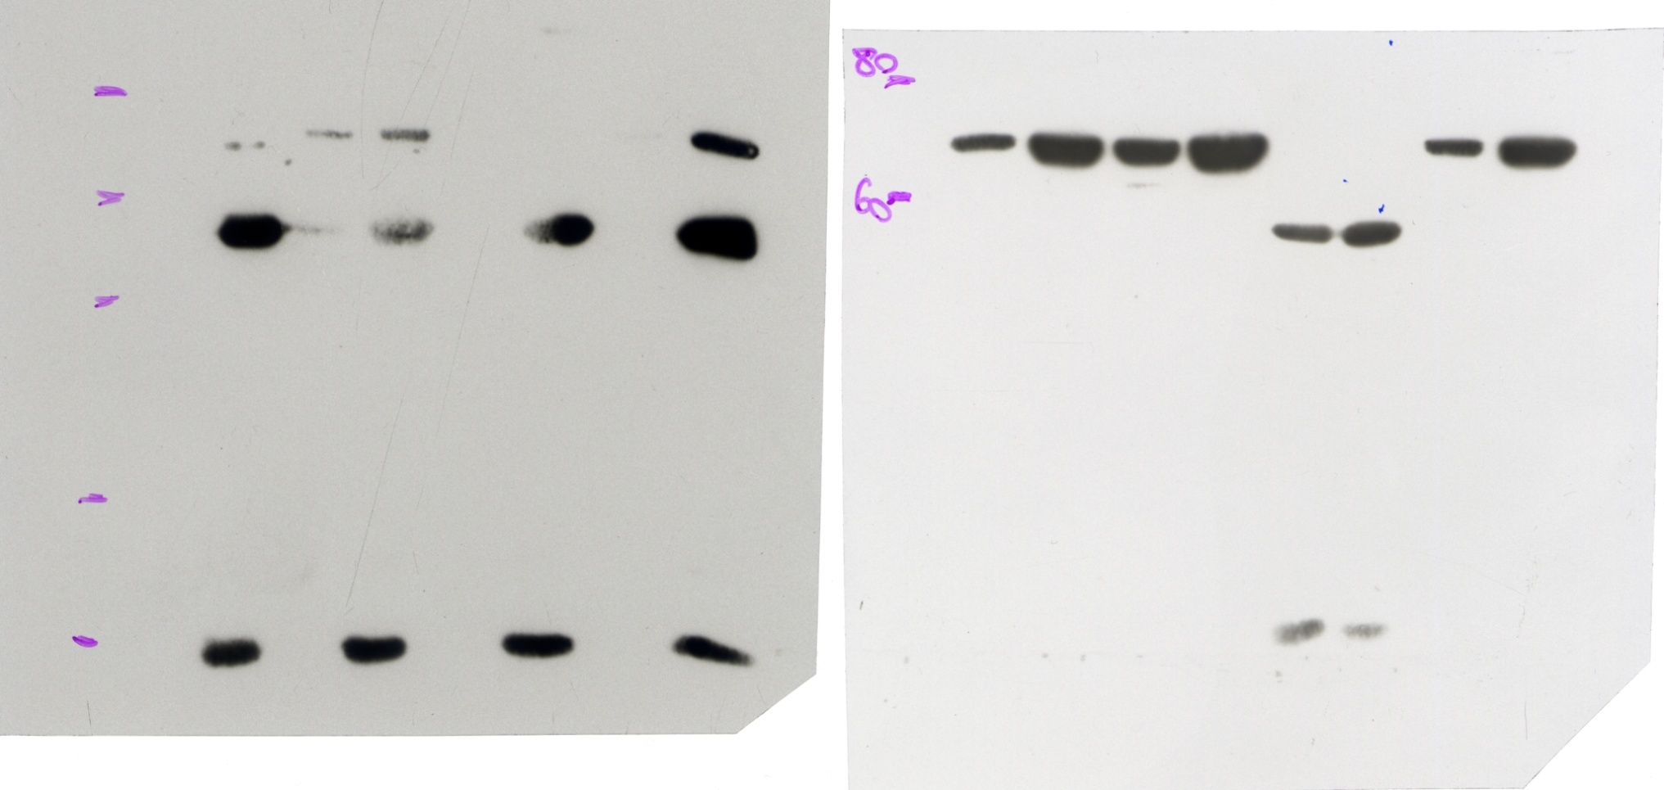
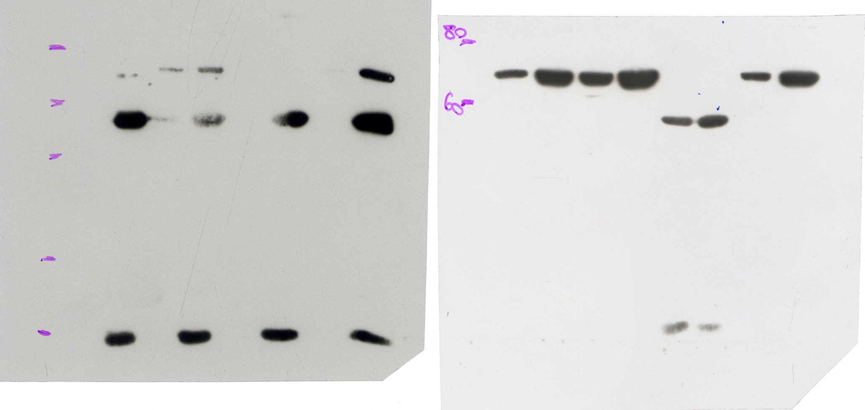
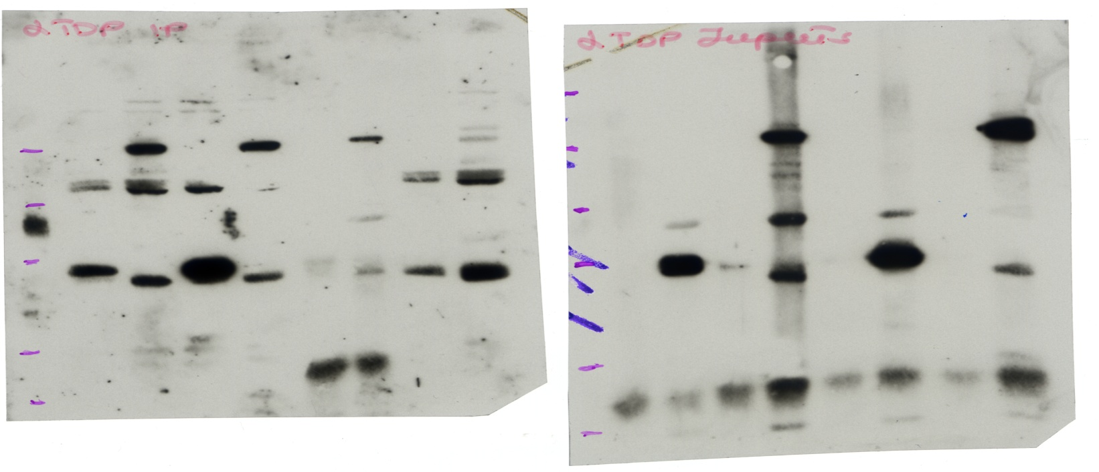



Flag- TDP-43WT
Flag- TDP-12xQ/N
Flag- TDP-12xQ/N
Flag- TDP-43WT
Flag-beads
Flag-beads
IP
beads
beads
Inputs
83
HSP70
α-HSP70
83
α-TDP-43
Flag-TDP-12xQ/N
47.5
Flag-TDP-43
endo-TDP-43
α-TDP-43
Suppl.Fig.3

Slide 4
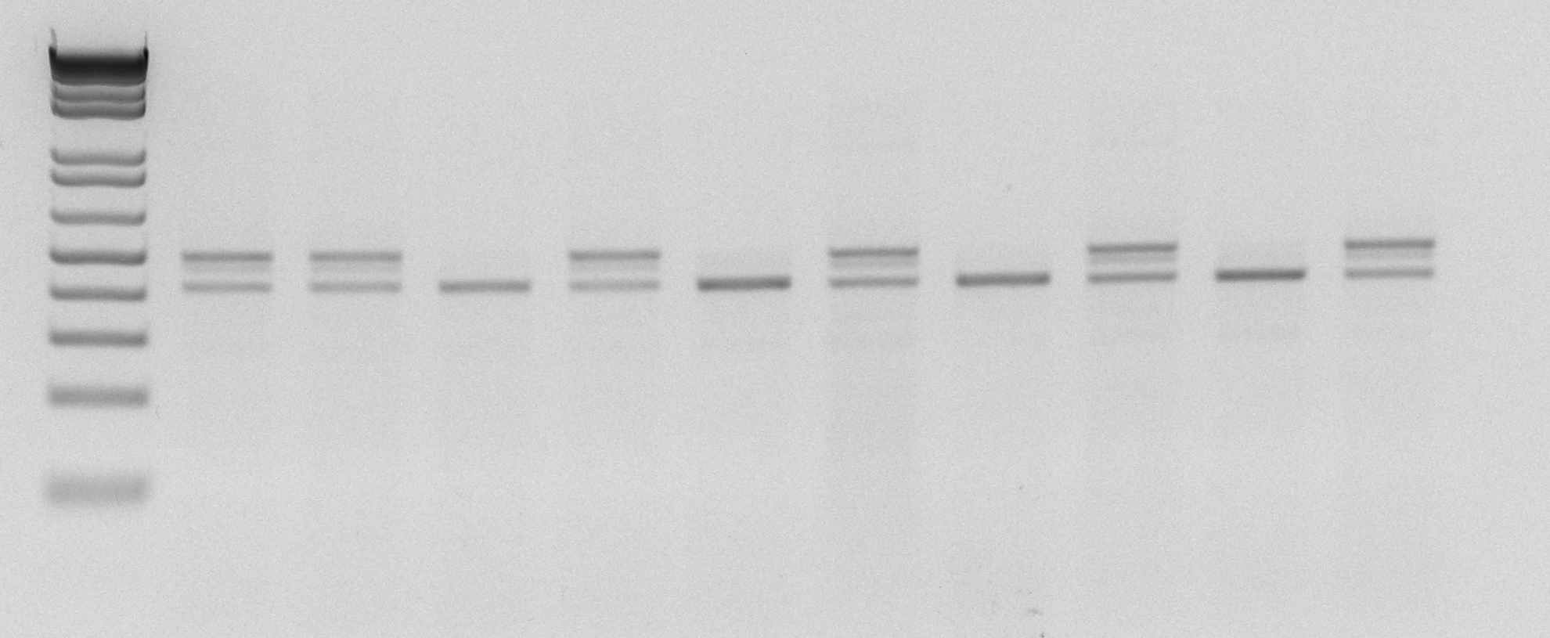
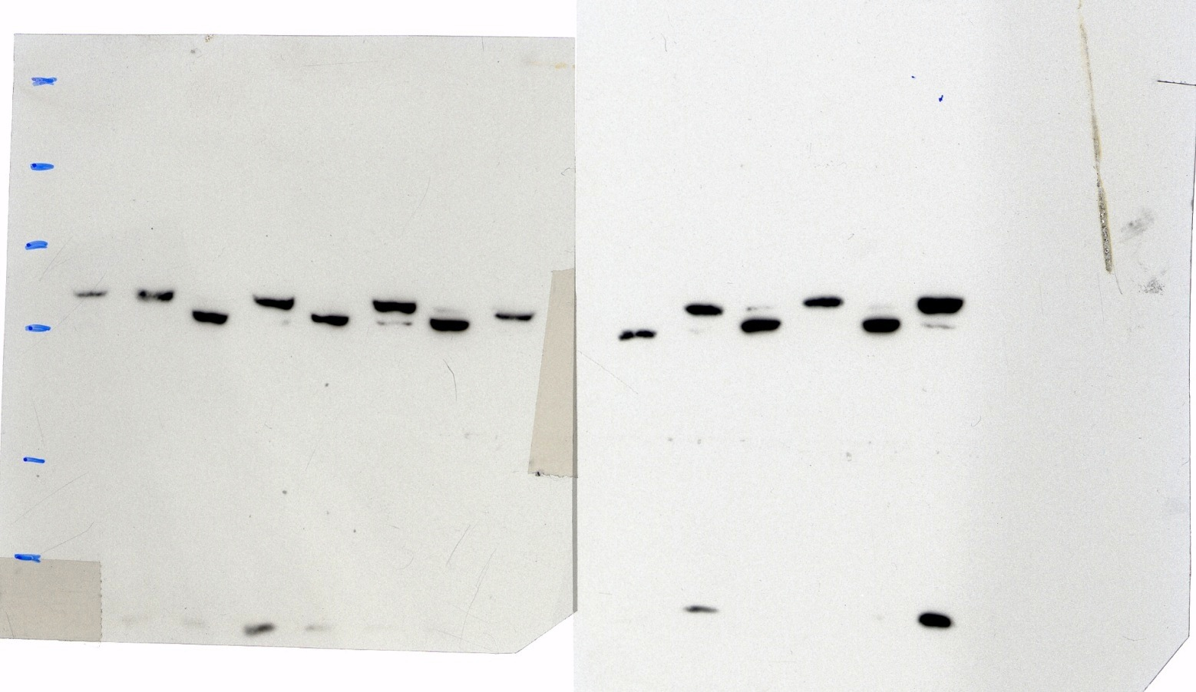
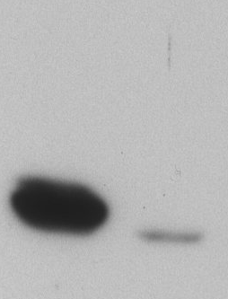
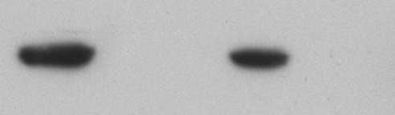
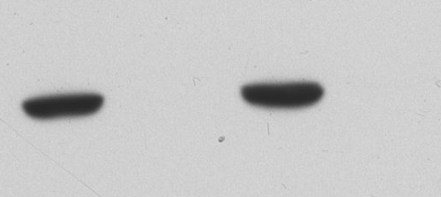
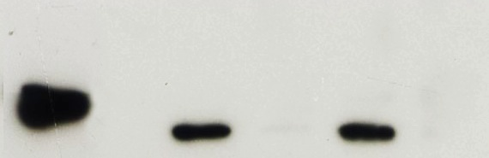
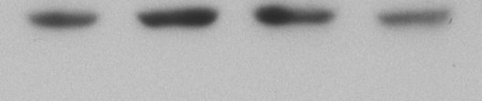
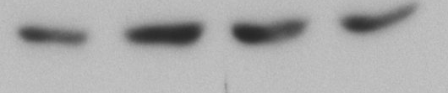

A
TDP-12xQ/N ΔRRM1
TDP-12xQ/N ΔRRM2
+
-
+
-
TET
E2
E3
E4
(variant 1)
E2
E4
(variant 2)
TDP-12xQ/N ΔRRM1
TDP-12xQ/N ΔRRM2
(variant 1)
(variant 2)
α-POLDIP3
B
TDP-12xQ/N ΔRRM1
TDP-12xQ/N ΔRRM2
TDP-12xQ/N ΔRRM1/2
TDP-12xQ/N ΔRRM1/2, ΔN
TDP-12xQ/N ΔRRM1/2, ΔC
TDP-43WT
TDP-12xQ/N
TDP-12xQ/N F4L
TET
+
-
+
-
+
-
+
-
+
-
+
-
+
-
+
-
83
α-Flag
47.5
1 2 3 4 5 6 7 8 9 10 11 12 13 14 15 16
α-Actin
Suppl. Fig.4

Slide 5
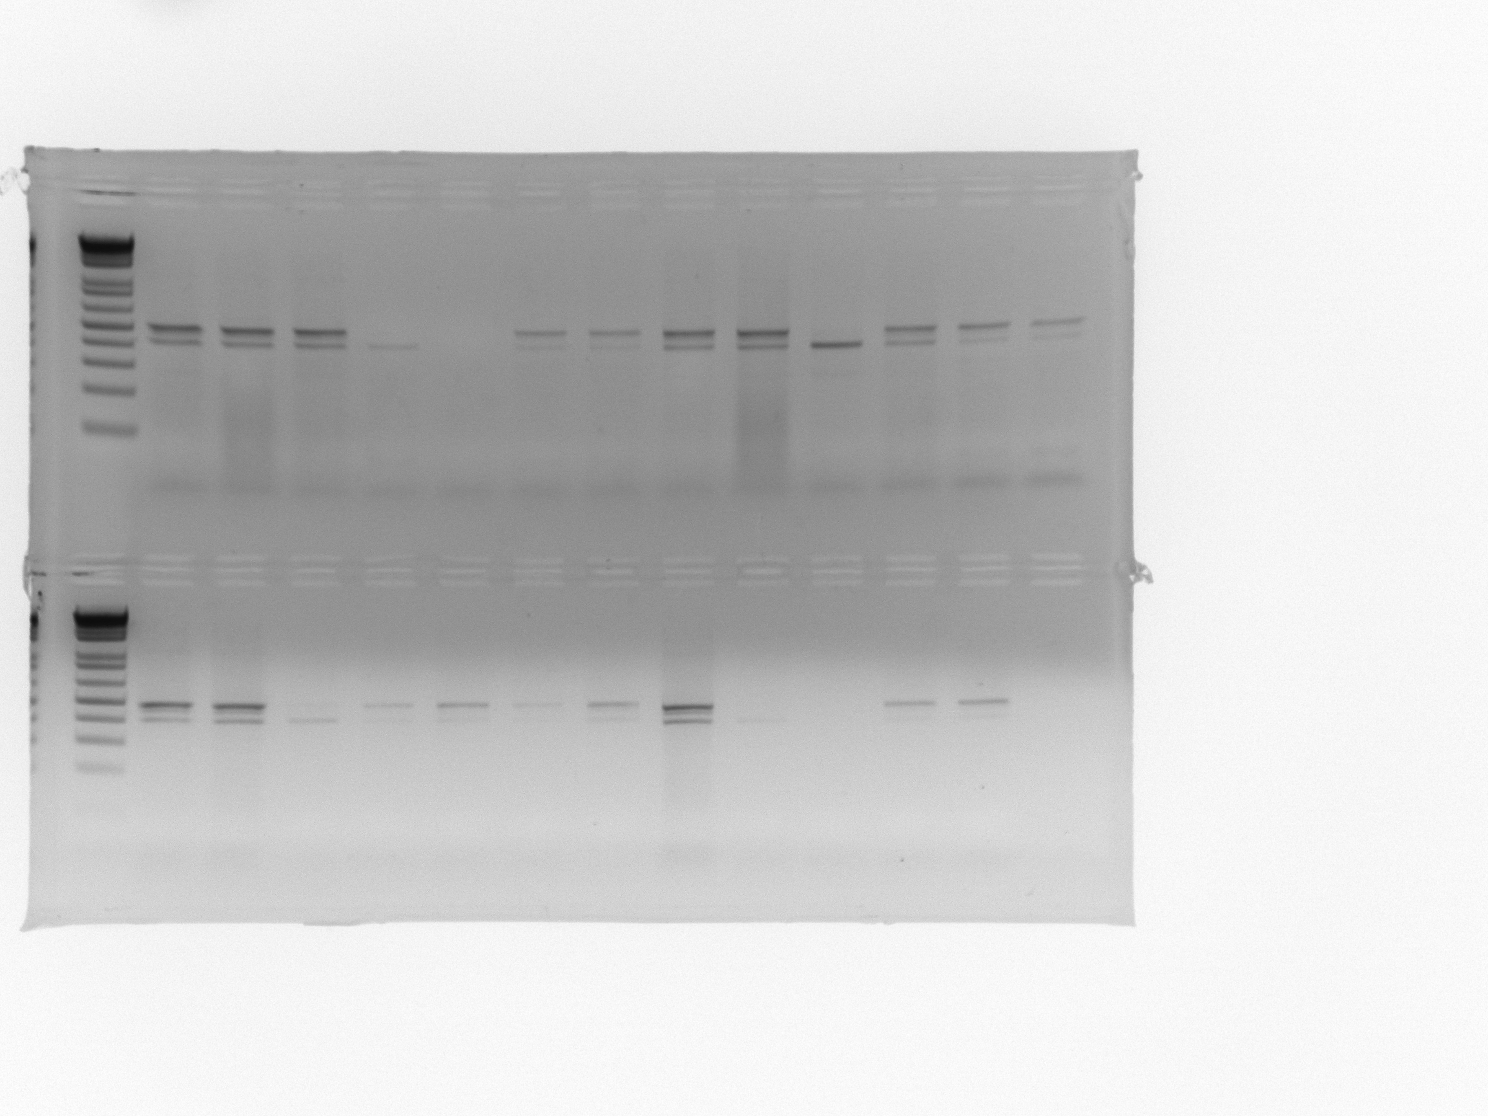
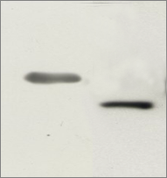
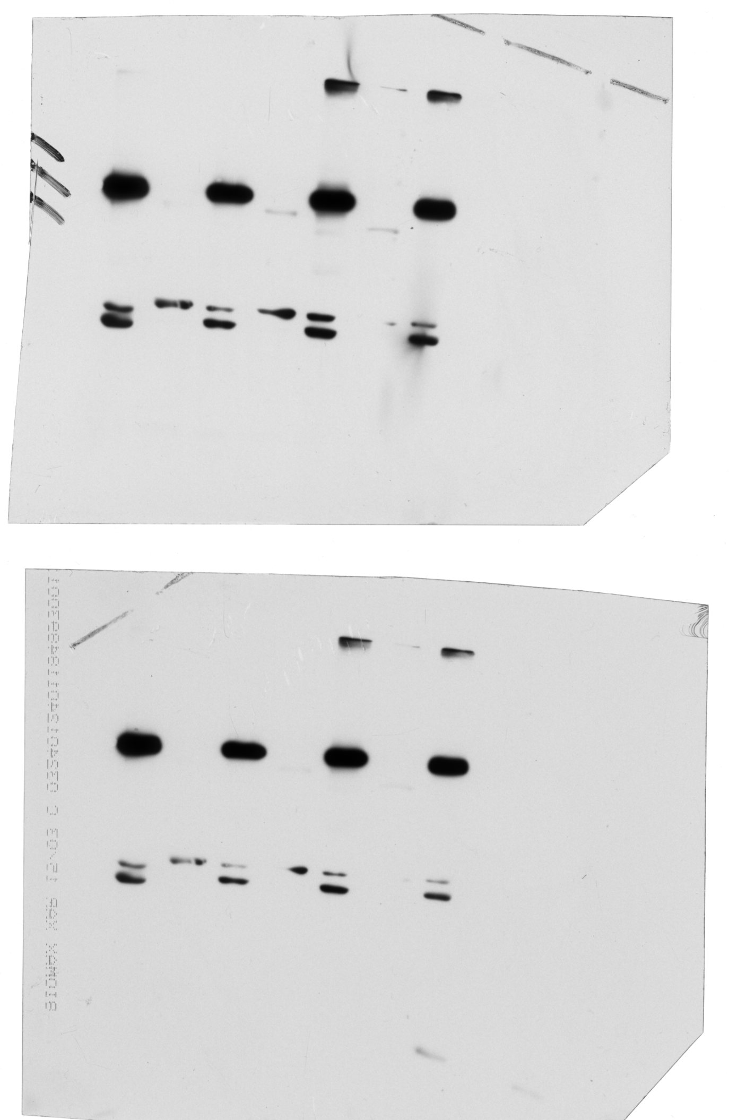
A
NLS
NES
Q/N
RRM1
RRM2
TDP-12xQ/N
NES
RRM1
RRM2
TDP-12xQ/N ΔN
B
TDP-43WT
TDP-12xQ/N
TDP-12xQ/N ΔN
TET
+
-
+
-
+
-
E2
E3
E4
(variant 1)
E2
E4
(variant 2)
C
RT-PCR
TDP-12xQ/N
TDP-12xQ/N ΔN
TDP-12xQ/N ΔN
TDP-12xQ/N
TET
+
+
+
TET
+
80
variant 1
47.5
variant 2
α-FLAG
α-POLDIP3
Suppl. Fig.5

Slide 6
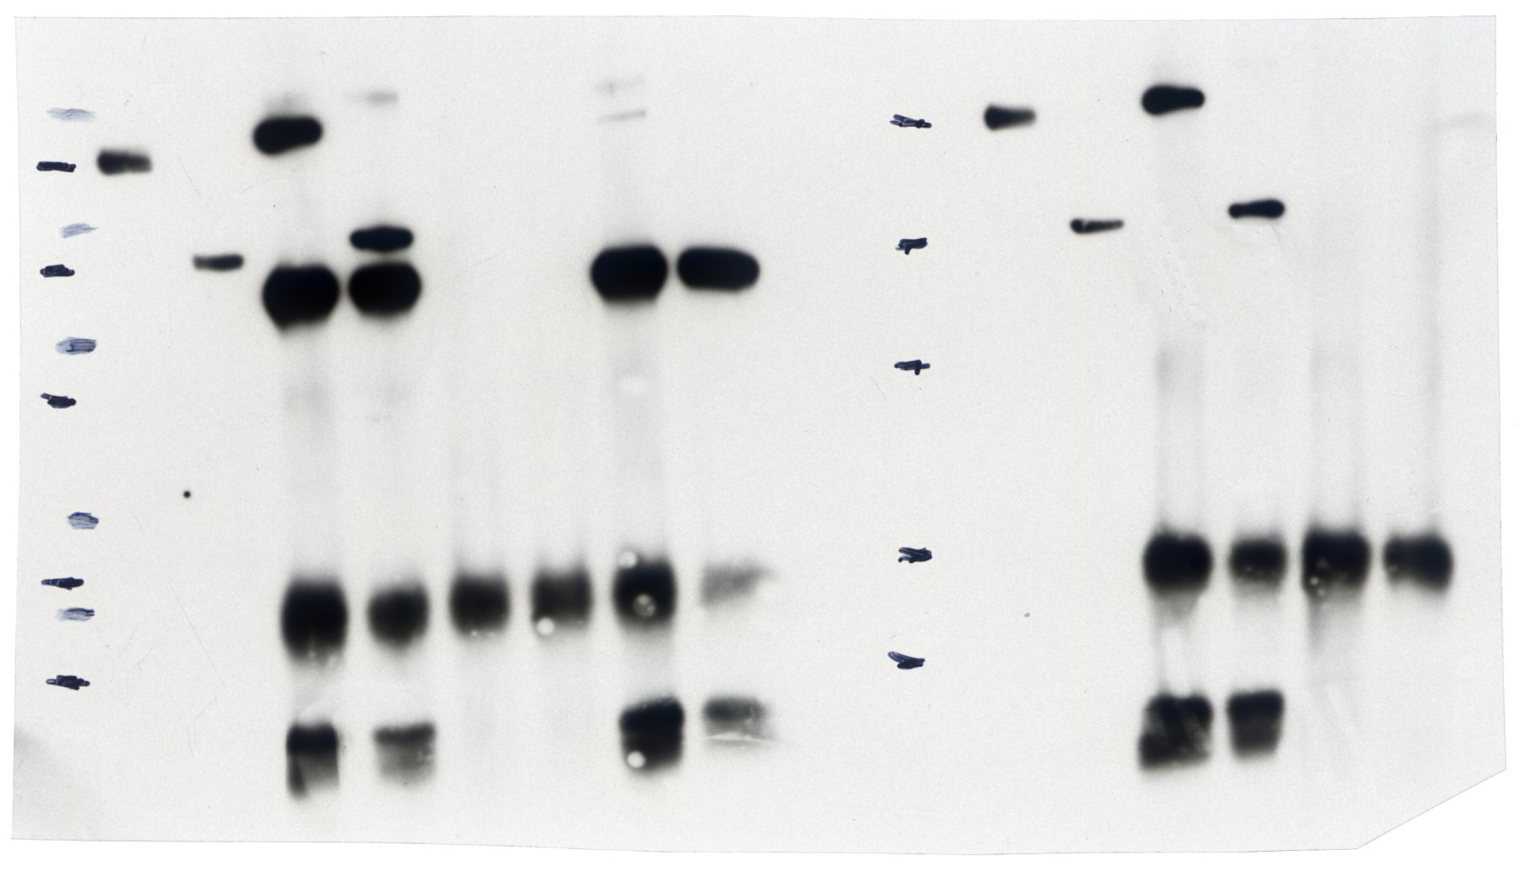
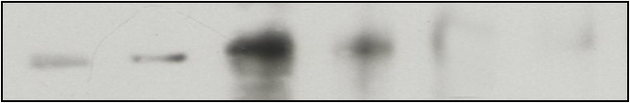
Flag-TDP-12xQ/N Δ1/2 ΔC
Flag-TDP-12xQ/N Δ1/2 ΔC
Flag-TDP-12xQ/N Δ1/2 ΔC
Flag- TDP-12xQ/N
Flag- TDP-12xQ/N
Flag- TDP-12xQ/N
Flag- TDP-12xQ/N
WB: α-Flag
Flag-TDP-12xQ/N Δ1/2 ΔC
Inputs
IP: α-Flag
Beads
WB: α-TDP-43
endo-TDP-43
1 2 3 4 5 6
Suppl. Fig.6

