Slide 1


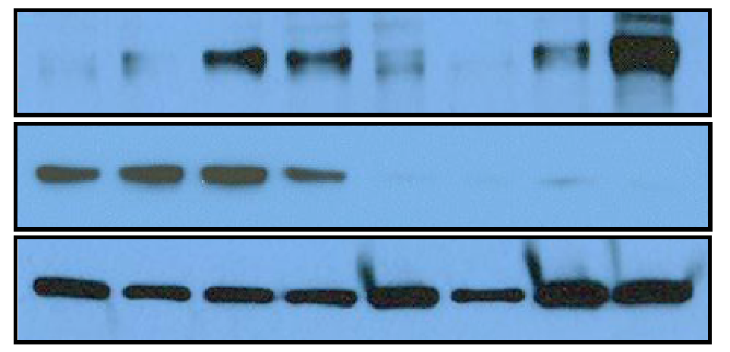
A
B
**
Control
Mig-6^{over}
Relative Expression
MIG-6
Actin
WT
PR^{cre/+}
Mig-6^{LSL}
Mig-6^{over}
C
D
**
**
Control
Mig-6^{over}
Pten^{d/d}
Mig-6^{over}
Pten^{d/d}
Relative Expression
MIG-6
PTEN
Actin
Control
Mig-6^{over}
Pten^{d/d}
Mig-6^{over}
Pten^{d/d}
Supplemental Figure 2. Generation of overexpression Mig-6 and Pten Ablation Mice using PR-cre mice model in the Murine Uterus. (A) Real-time RT-PCR analysis of Mig-6 in whole uteri from 6 week-ovariectomized wild-type, PR^{cre/+}, Mig-6^{LSL}, and Mig-6^{over}mice at 8 weeks of age. The results represent the mean ± SEM of three independent mice. ** p<0.01. (B) Western blot analysis of MIG-6 and ACTIN in control and Mig-6^{over}mice. Equal amounts of protein were subjected to SDS-PAGE and Western blot analysis. (C) Real-time RT-PCR analysis of Mig-6 in whole uteri from control (Mig-6^{LSL}, Pten^{f/f} and Mig-6^{over}Pten^{f/f}), Mig-6^{over}, Pten^{d/d} and Mig-6^{over}Pten^{d/d} mice. The results represent the mean ± SEM of three independent mice. ** p<0.01. (D) Western blot analysis of MIG-6, PTEN and ACTIN expression in control, Mig-6^{over}, Pten^{d/d} and Mig-6^{over}Pten^{d/d} mice. Equal amounts of protein were subjected to SDS-PAGE and Western blot analysis.

