Slide 1
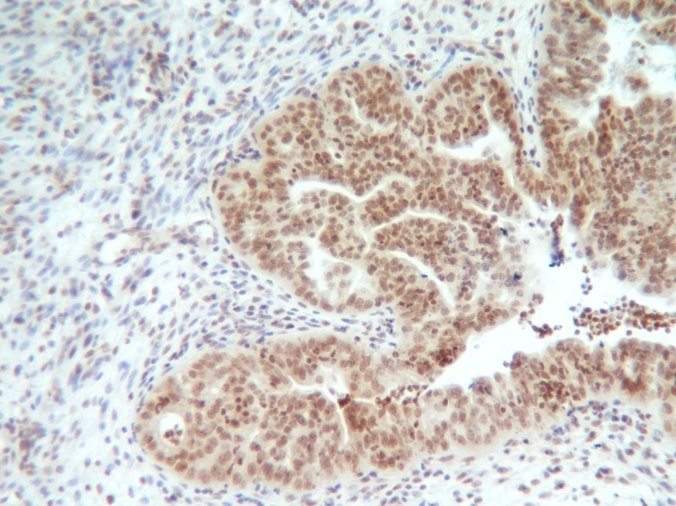
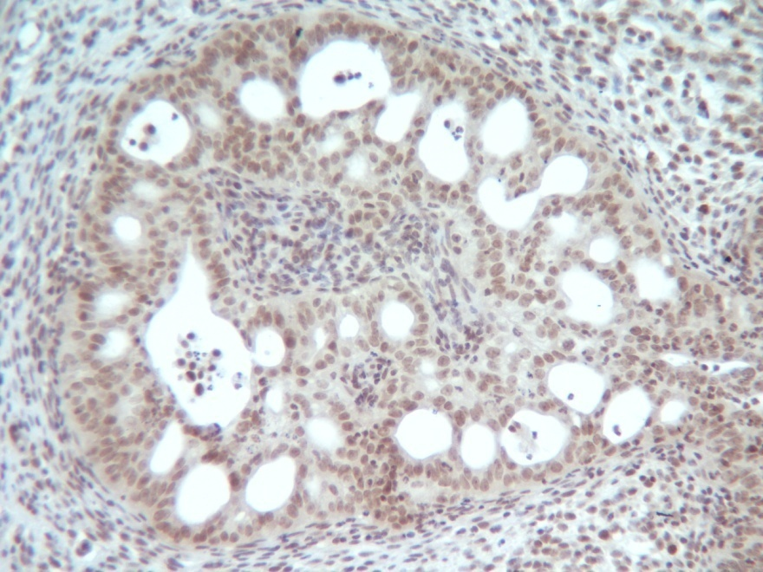
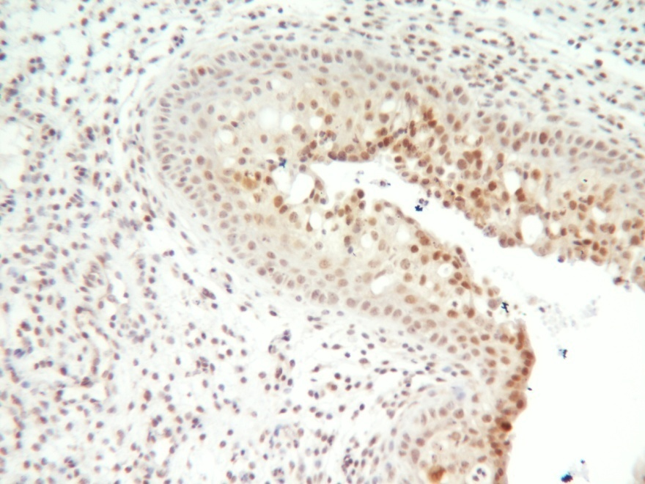
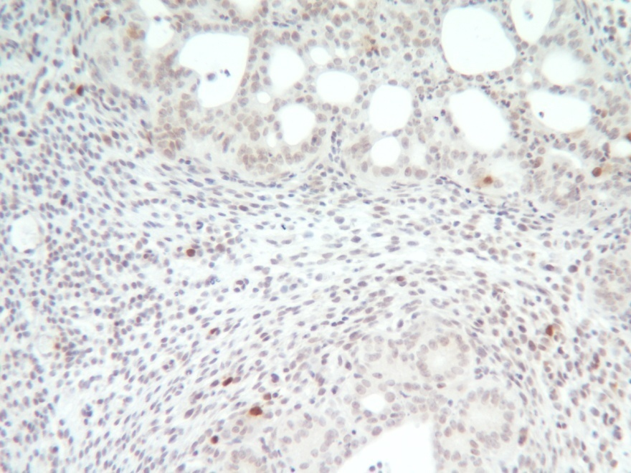
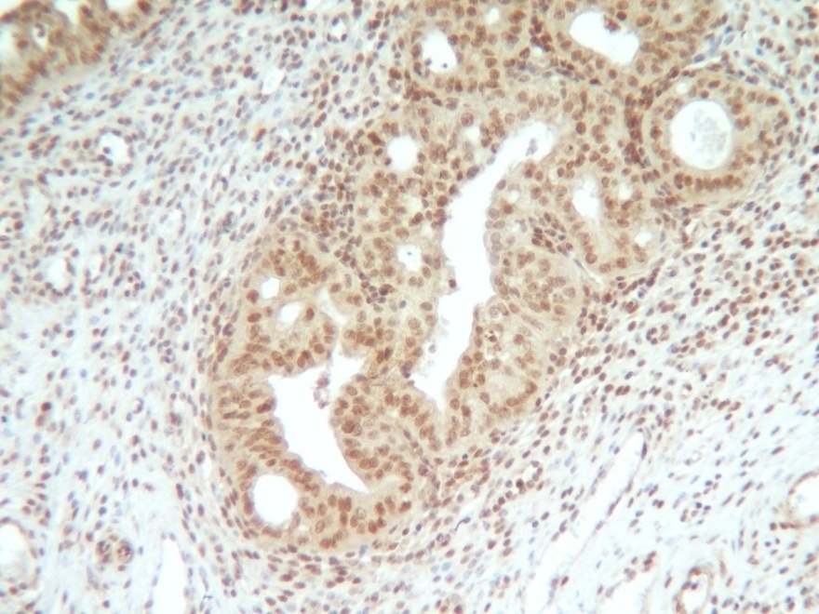
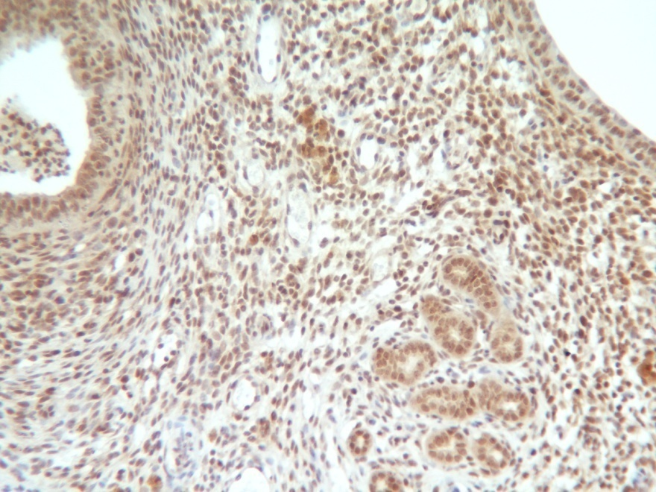
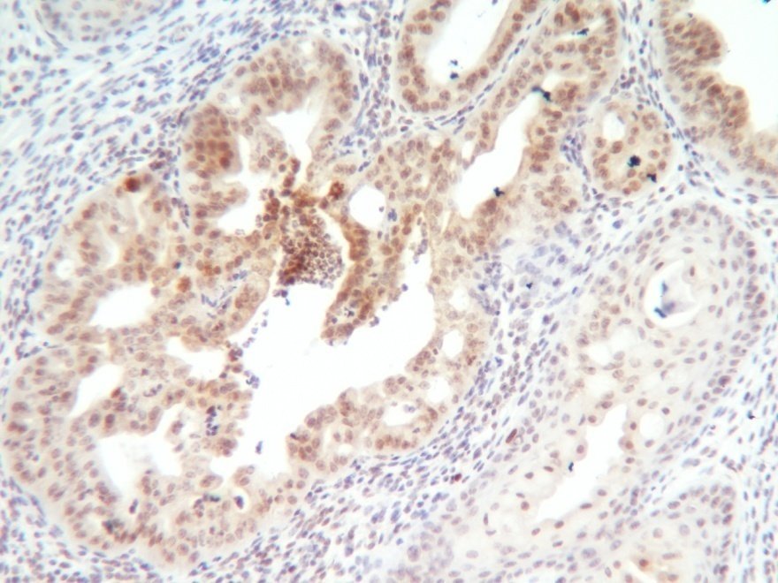
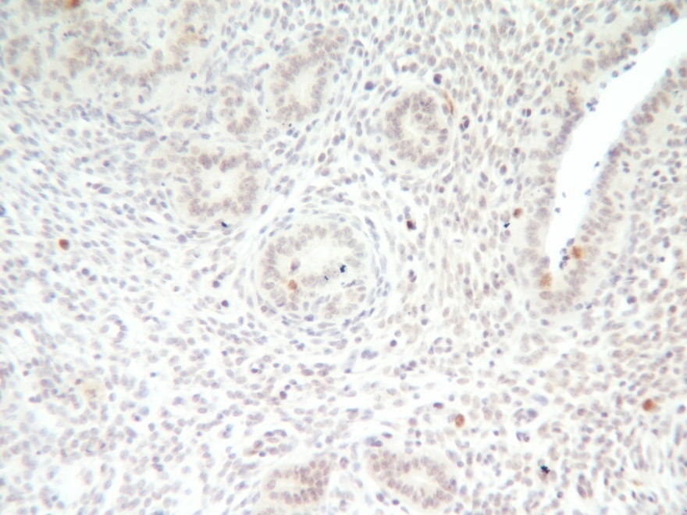
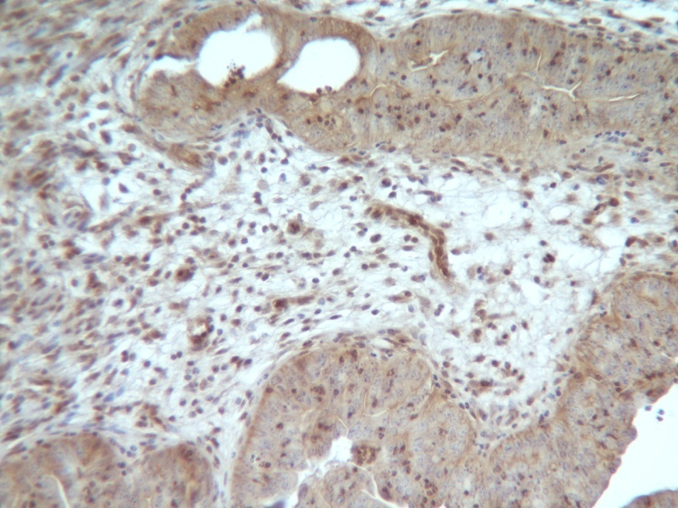
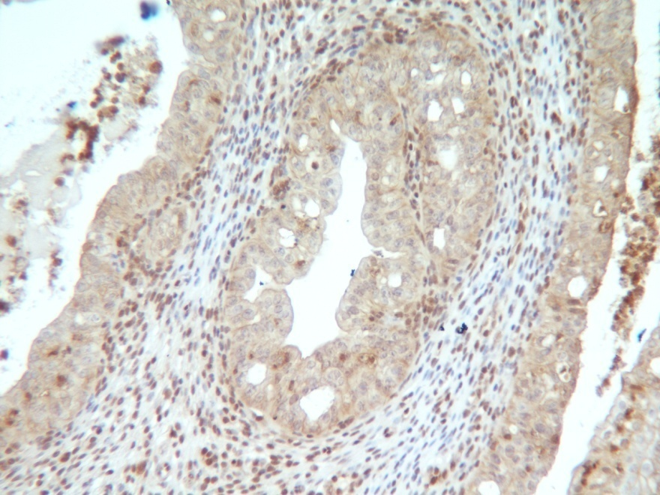
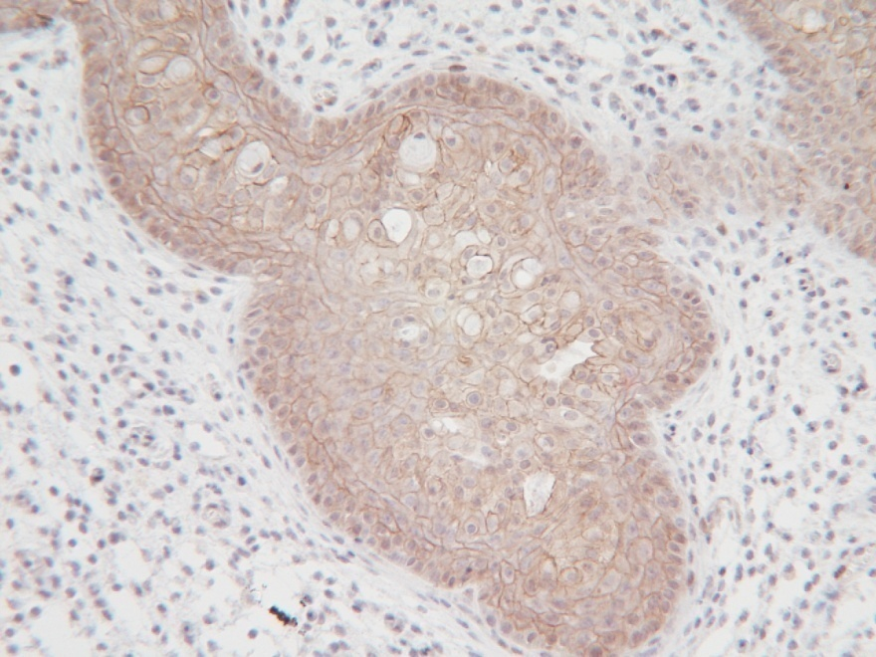
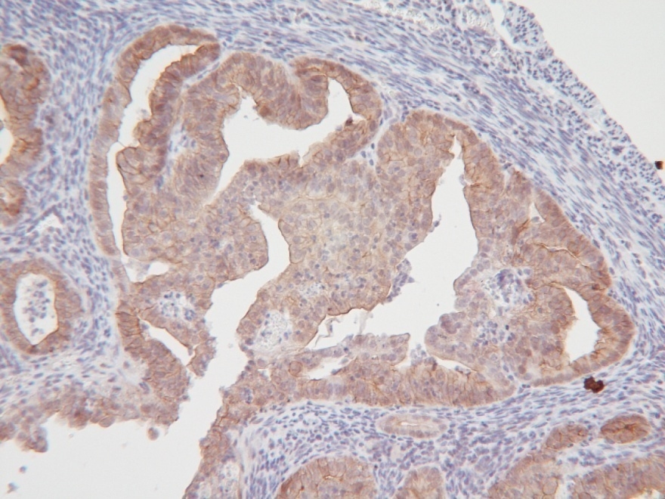
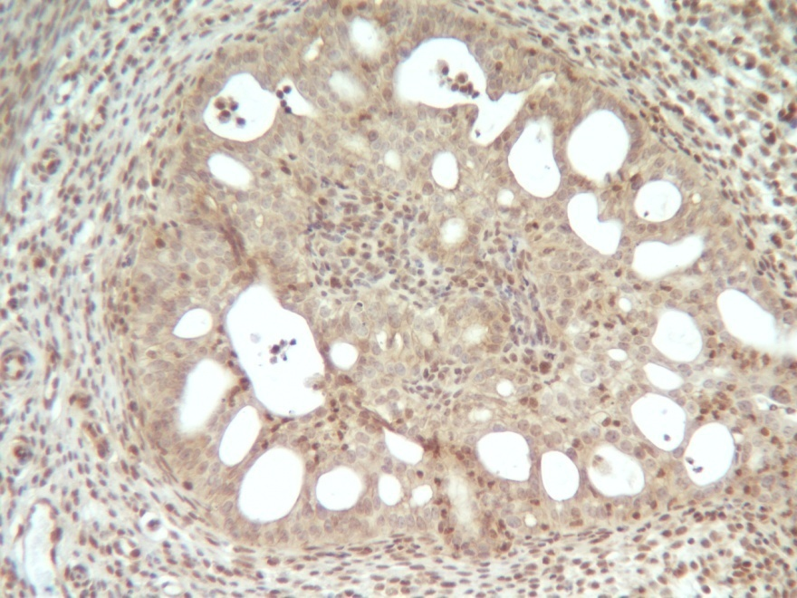
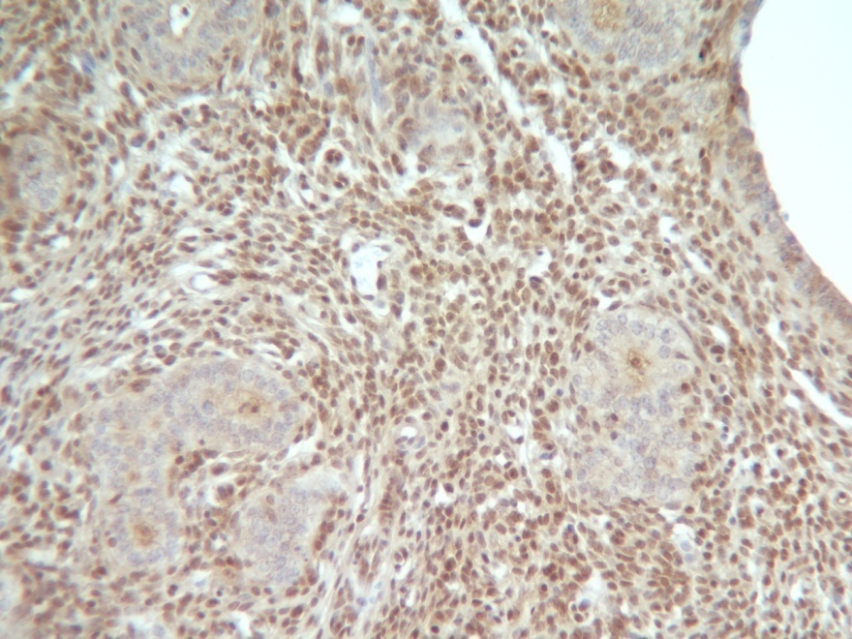
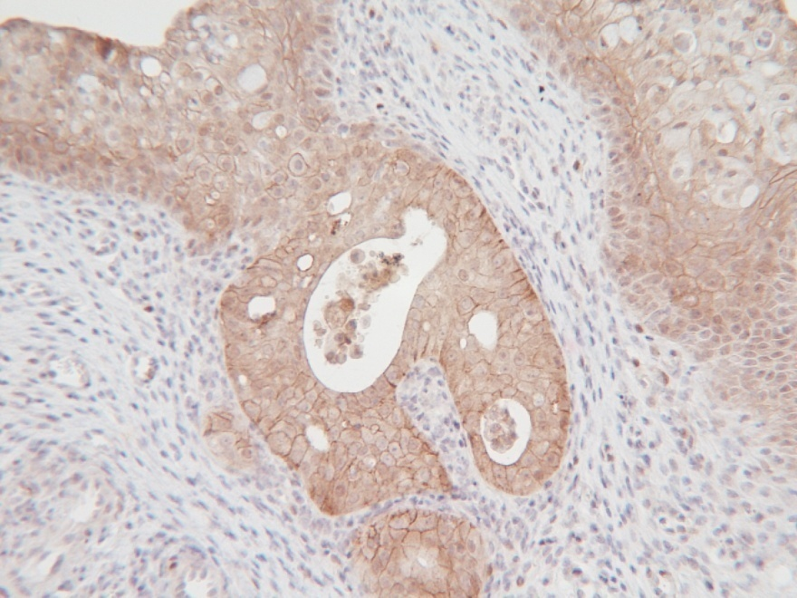
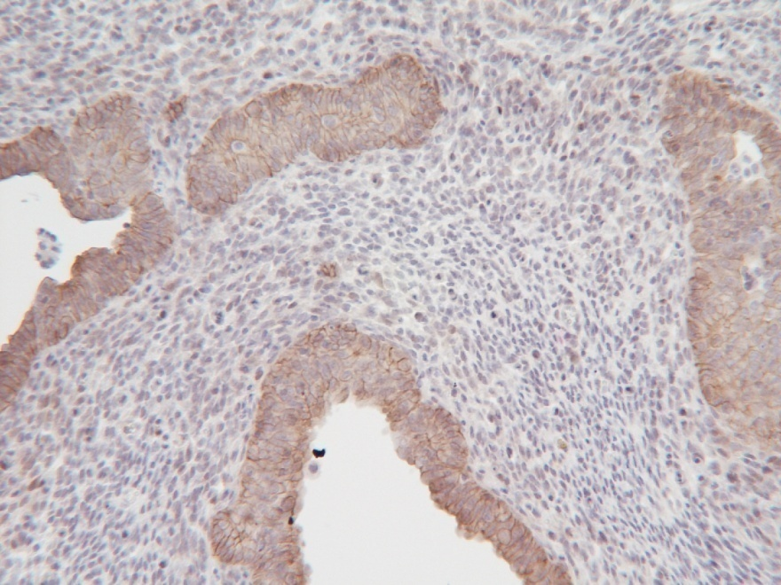
A
Pten^{d/d}
Mig-6^{over}Pten^{d/d}
B
Pten^{d/d}
Mig-6^{over}Pten^{d/d}
a
b
a
b
2M
2M
50μm
50μm
50μm
50μm
c
d
c
d
3M
3M
50μm
50μm
50μm
50μm
C
Pten^{d/d}
Mig-6^{over}Pten^{d/d}
D
Pten^{d/d}
Mig-6^{over}Pten^{d/d}
a
b
a
b
2M
2M
50μm
50μm
50μm
50μm
c
d
c
d
3M
3M
50μm
50μm
50μm
50μm
Supplemental Figure 5. Immunohistochemical analysis on uteri of Pten^{d/d} and Mig-6^{over}Pten^{d/d} mice at 2 and 3 months of age. Immunohistochemical analysis of (A) C/EBPβ, (B) phospho-C/EBPβ, (C) AKT and (D) phospho-AKT on uteri from Pten^{d/d} and Mig-6^{over}Pten^{d/d} mice at 2 (a and b) and 3 (c and d) months of age.

