Slide 1
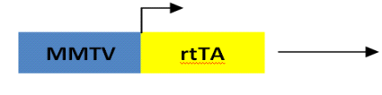
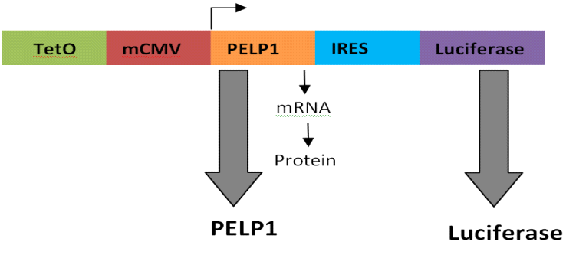
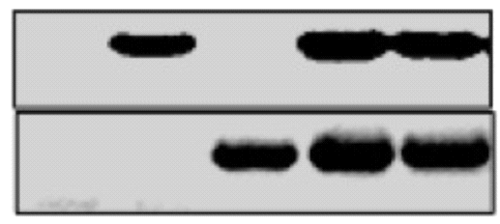
Supplementary Figure 1
A
MMTV-rtTA
TET0-PELP1
Line 1
rtTA
B
TetO-PELP1
MMTV-rtTA
TET0-PELP1
Line 2
MMTV-rtTA
+ Dox
WT
rtTA
T7-PELP1
T7-PELP1
C
D
120000
***
100000
***
80000
60000
Relative light units (RLU)
40000
20000
0
Dox
+
-
+
-
Line I
Line 2
Figure S1. Characterization of PELP1 Tg mice . A, Schematic representation of bitransgenic mouse model system. PELP1 transgene construct consists of a full-length T7 and His-tagged human PELP1 cDNA linked to luciferase gene reporter through an internal ribosomal entry site (IRES). B, pTetO-PELP1 mice crossed with mammary gland–specific rtTA mice (MMTVrtTA) to establish two independent MMTVrtTA-TetO-PELP1 transgenic lines. Identification and establishment of the transgenic lines was done by using PCR analysis with transgene-specific primers. C, To monitor luciferase activity in vitro, mammary gland homogenates of aged-matched experimental nulliparous adult female bitransgenic mice treated with or without doxycycline were assessed by using a Dual Luciferase Assay System. All experimental data points were generated from three biological replicates per transgenic line. Statistical significance was determined by using Student’s t test.****p<0.0001***p<0.001; ; *p<0.05. D, Human PELP1 transcript induction in mammary tissue of 6-month-old virgin mice by real-time RT-PCR analysis. Line 1 and Line 2 displayed two- and five-fold increases, respectively. Statistical significance was determined by using Student’s t test; n=3 per group, *p<0.05.

