Slide 1
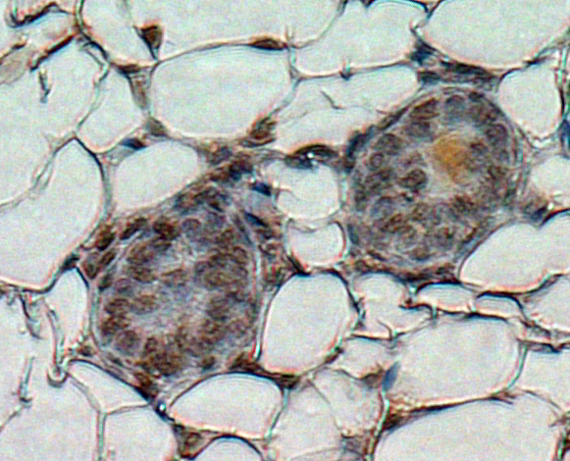
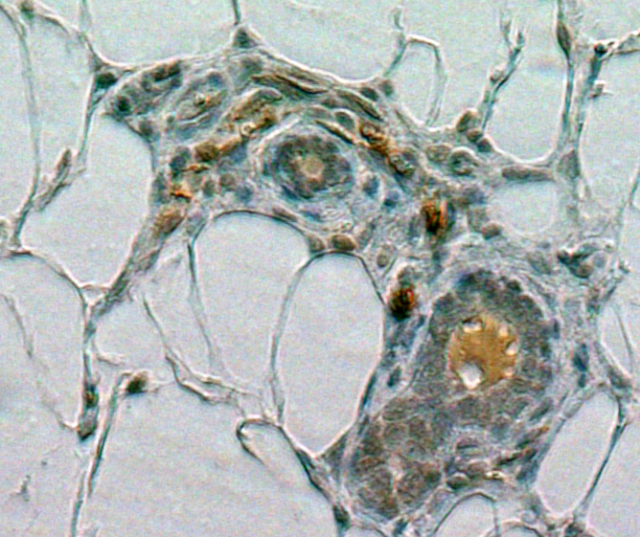
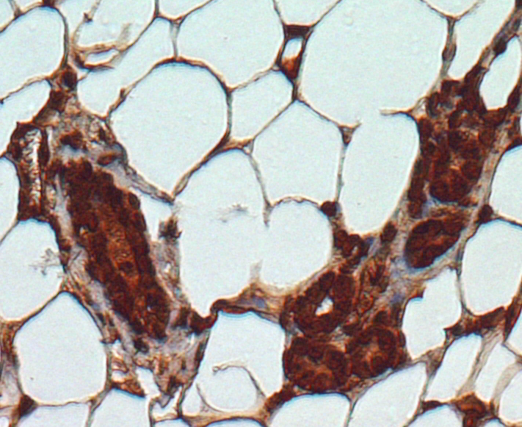
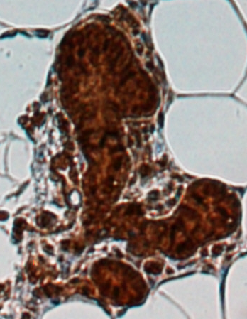
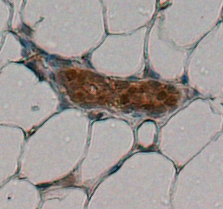
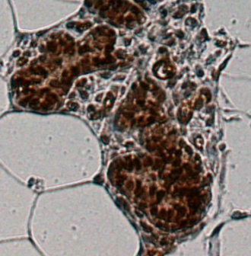
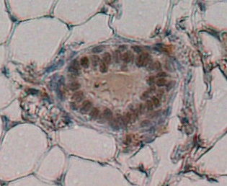
Supplementary Figure 4
A
WT
PELP1 TG
PELP1 TG +Par
DiK9me2
B
PELP1 TG
PELP1 TG + Par
C
PELP1 TG
PELP1 TG + Par
Cyclin D1
^{Ser991}PELP1
Figure S4. A, Representative IHC images showing the status of diK9me2 in the mammary glands of 6-month-old control and MMTV-rtTA-TetO-PELP1 bitransgenic mice treated with PBS or pargyline. B,C, Representative IHC images showing the status of cyclin D1 (B) and phos-PELP1 (C) in the mammary glands of 6-month-old MMTV-rtTA-TetO-PELP1 bitransgenic mice treated with PBS or pargyline.

