Slide 1
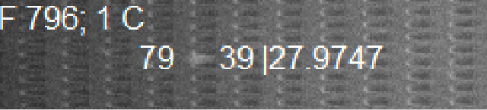
Figure S1 A
Frame (time)
Cell Label | Intensity

Slide 2
Figure S1B: Reduced RBC deformability over storage time

Slide 3
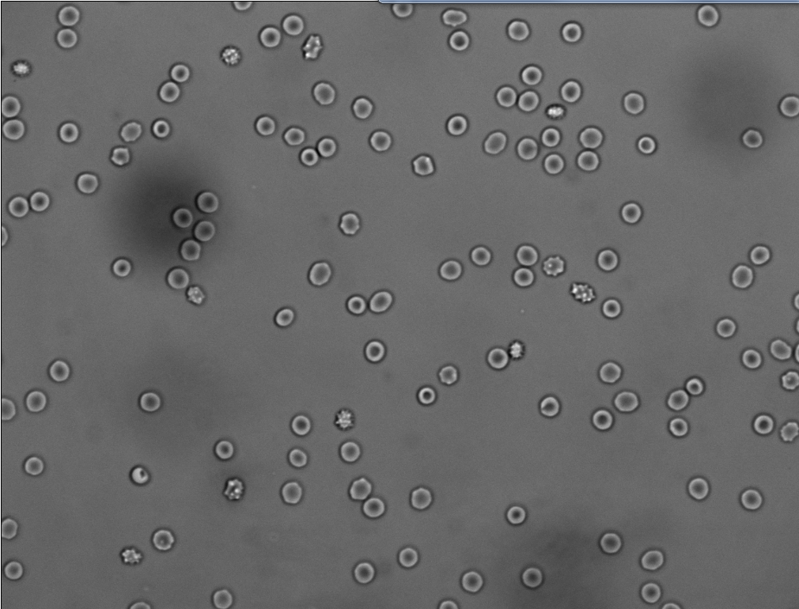
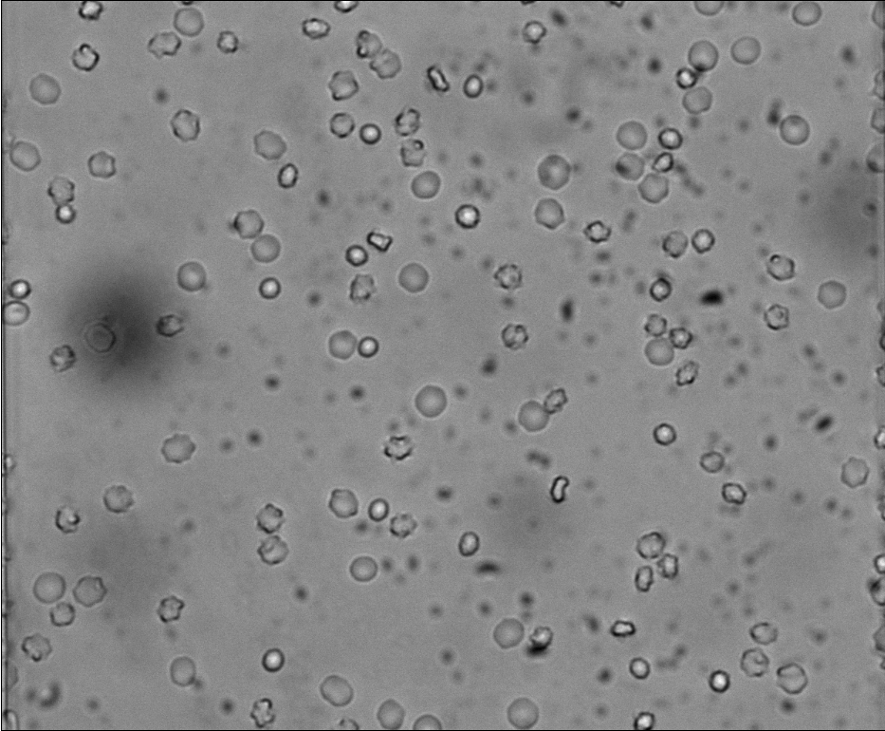
Figure S1 C
1-week-old
4-week-old
echinocyte
discocyte
spherocyte

Slide 4
Figure S2 A

Slide 5
Figure S2 B

Slide 6
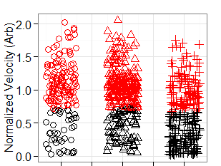
Figure S2 B
% of “slow” RBCs
Unsort | Center | Side
29.8 | 31.9 | 65.5
% of “slow” RBCs
Unsort | Center | Side
23.2% | 28.0% | 53.8%
Unsort Center Side

Slide 7
Figure S3

Slide 8
Figure S4A

Slide 9
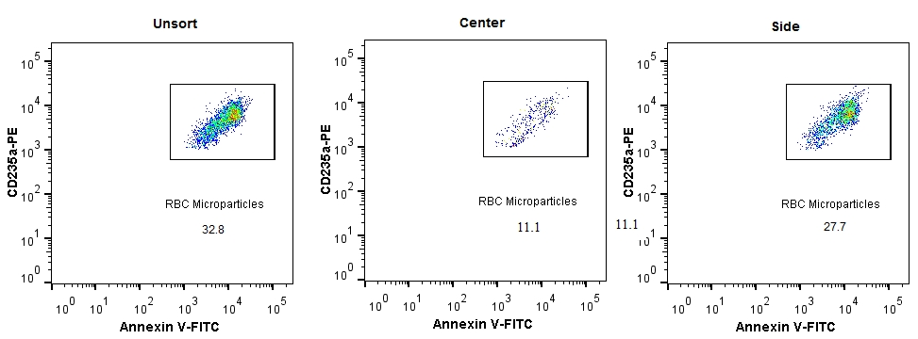
Figure S4B: microparticle analyses after sorting
Samples | Cell number (10^6/ml) | Cell number /uL | Normalized MPs #
0815 Unsort | 172.00 | 172000 | 0.04
0815 Center | 194.40 | 194400 | 0.09
0815 Side | 22.24 | 22240 | 0.19
0815B Unsort | 123.2 | 123200 | 0.08
0815B Center | 170.4 | 170400 | 0.01
0815B Side | 16.48 | 16480 | 0.42
0819 Unsort | 184.8 | 184800 | 0.07
0819 Center | 187.2 | 187200 | 0.03
0819 Side | 22.72 | 22720 | 0.36

