Slide 1
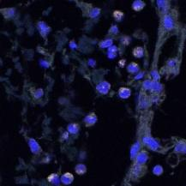
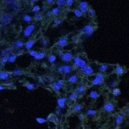
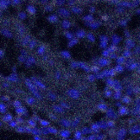
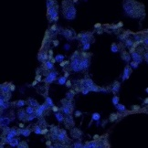
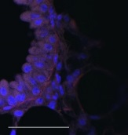
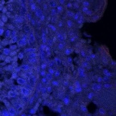
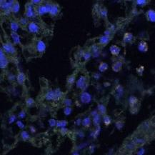
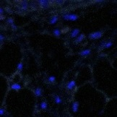
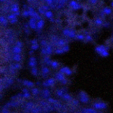
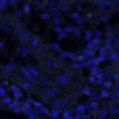
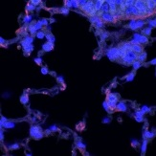
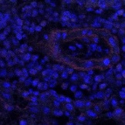
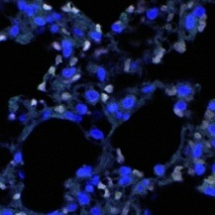
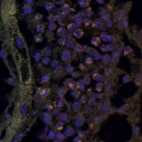
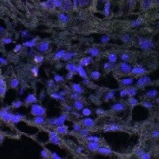
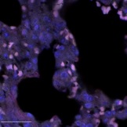
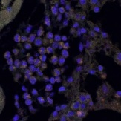
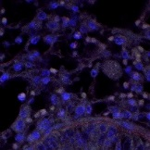
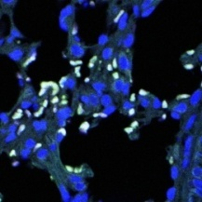
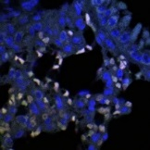
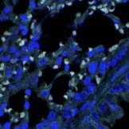
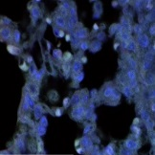
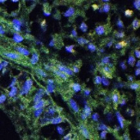
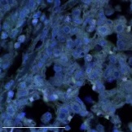
IV(Inf):+(-)
OVA (-)
IV(Inf):+(+)
IV(Inf):+(-)
OVA (+)
IV(Inf):+(+)
Supplementary Figure 4. Analysis of CTLA4⁺Foxp3⁺ cells in the lung of the CD4⁺Foxp3⁺T cell adoptive transferred mice before asthma induction. (Stage II). Paraffin sections of lungs from all of mice (6 mice/group) receiving CD4⁺Foxp3⁺T cells were immunofluorescently stained for CTLA-4, and nuclei (DAPI) representative pictures (merge of CTLA-4, GFP, and DAPI filed screens per high power filed) are shown (white bar = 100 µm). These figures were used for the analysis of population of CTLA4⁺Foxp3⁺ cells in lung tissue by Image J program, we calculated the number of the CTLA4⁺Foxp3⁺ cells per total 1 x 10⁵ DAPI positive cells. (The result was shown at Figure 7C in main text). OVA-; PBS treated mice, OVA+; allergic airway inflammation-induced mice, IV(inf)+(-); CD4⁺Foxp3⁺T cell of normal mice adoptive transferred mice, IV(inf)+(+); CD4⁺Foxp3⁺T cell of T. spiralis-infected mice adoptive transferred mice, a; *p < 0.05, **p < 0.01, n = 6 mice/group, 3 independent experiments].

