Slide 1
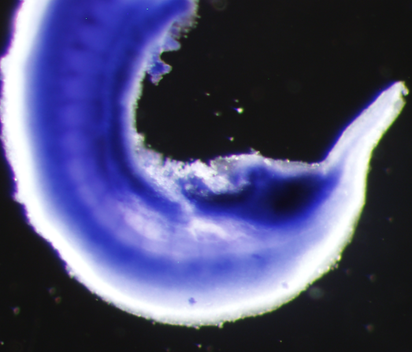
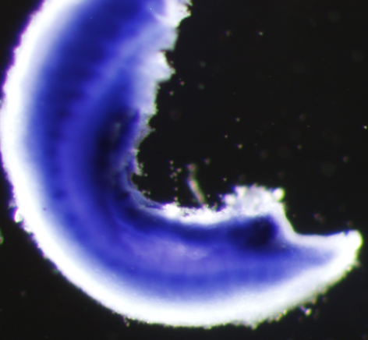
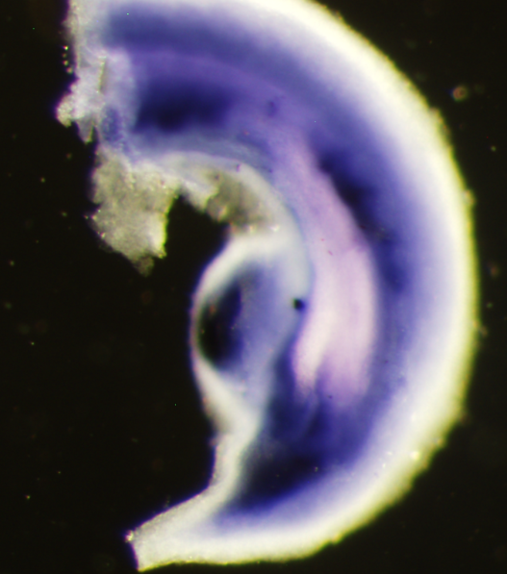
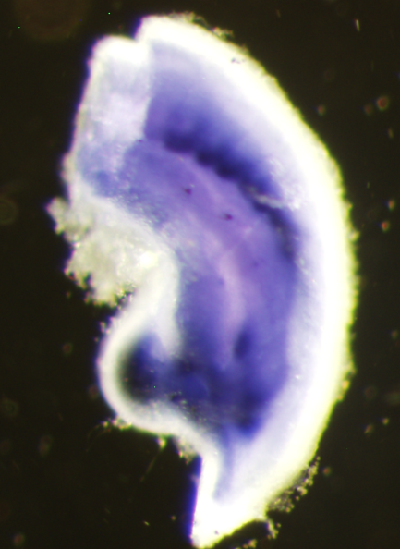
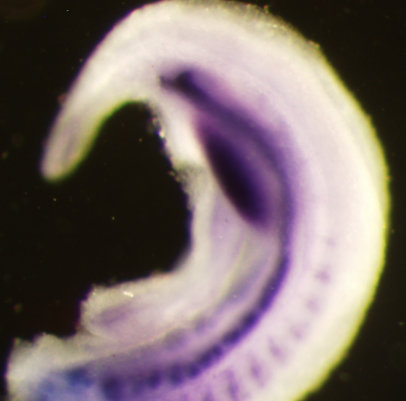
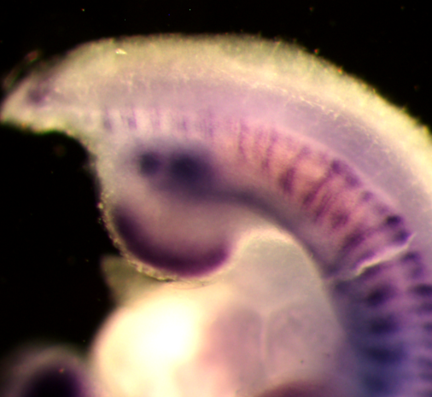
Supplemental Figure 1
Wnt5a fl/+;T-Cre
Wnt5a fl/Δ;T-Cre
A
E10.5: BMP4
IM
IM
B
E10.5: Gremlin1
IM
IM
C
E10.5: Sprouty1

Slide 2
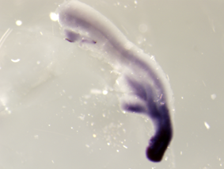

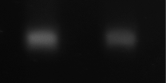
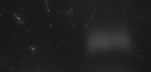

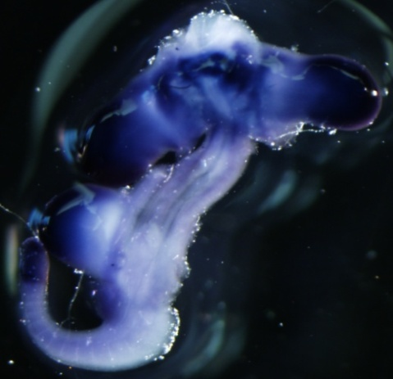
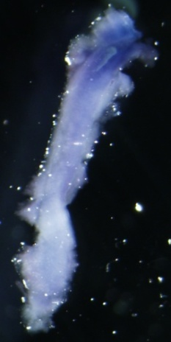
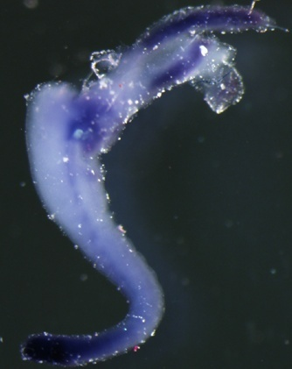
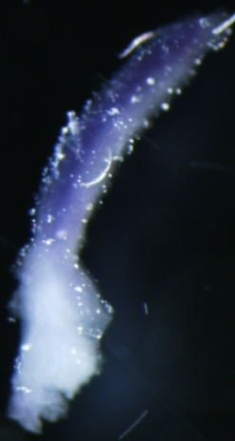
Supplemental Figure 2
A
A
D
MM UB
P
Wnt5a (43cy)
GAPDH (27cy)
C-Ret (35 cy)
Hindlimb
Six2 (33 cy)
Posterior IM
GDNF (35 cy)
tail
E9.5: Wnt5a
B
metanephros
E10.5
C
metanephros
E11.5
Notes:
Serial paraffin section

Slide 3
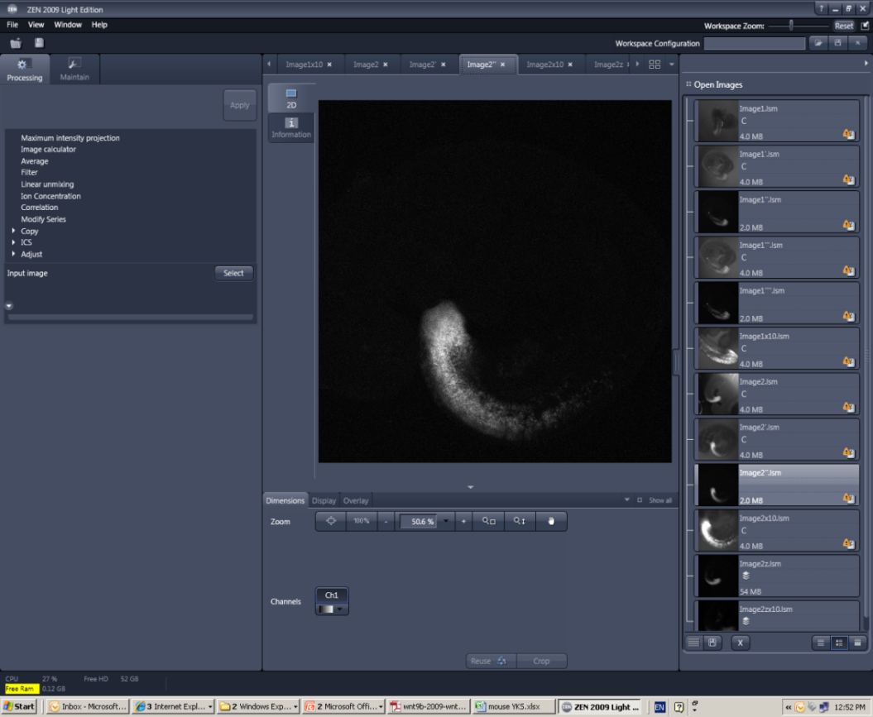
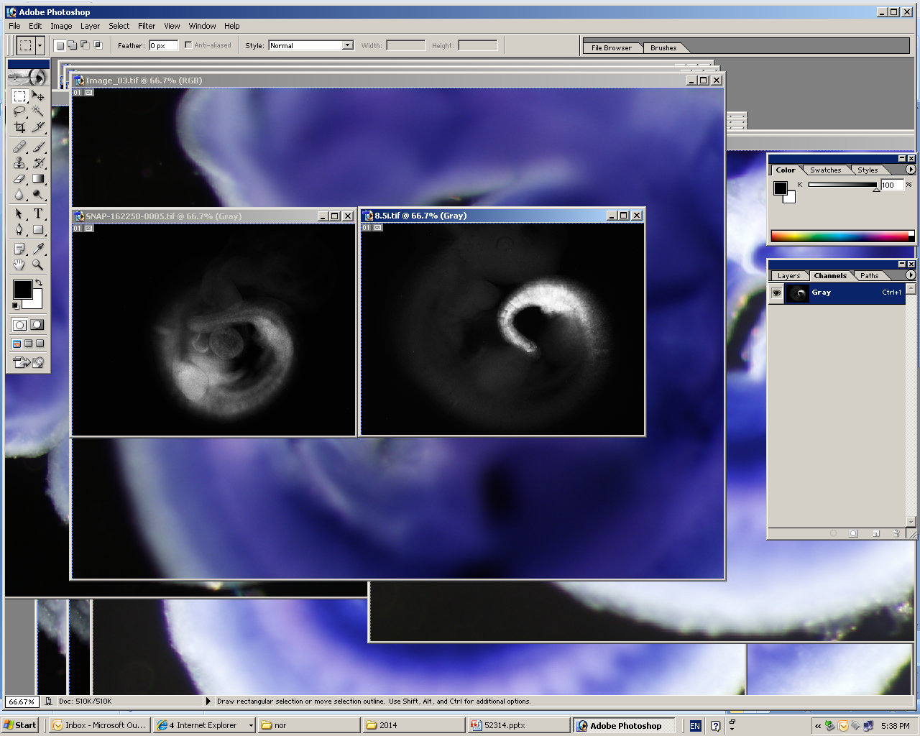
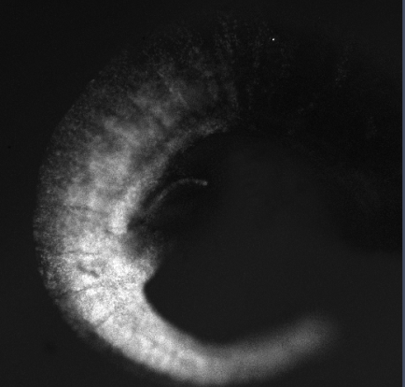
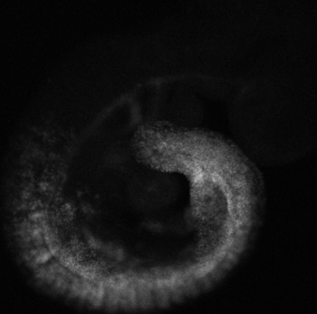
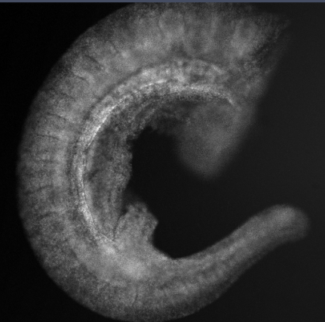
Supplemental Figure 3
Rosa26-YFP;T-CreER^{T2}
E9.5 E10.5 E10.5
A
E8.5
IM
Time of tamoxifen injection
tail
B
E7.5
IM
tail

Slide 4
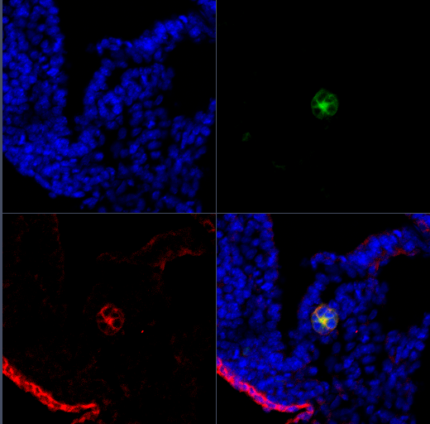
Supplemental Figure 4
DAPI
Hoxb7-myr-venus-YFP
E-Cadherin
Merge
Notes:
E-Cadherin staining complies with Hoxb7-myr-venus for Hoxb7-myr-venus-YFP for nephric duct morphology

Slide 5
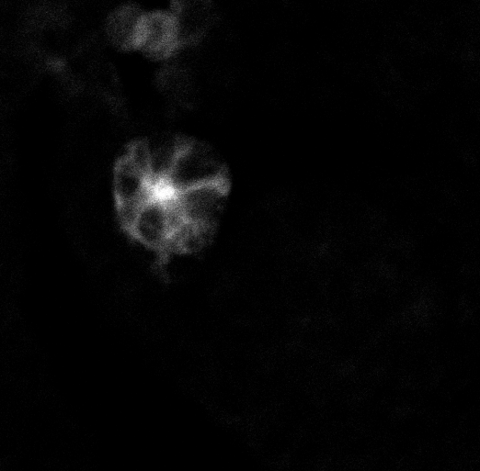
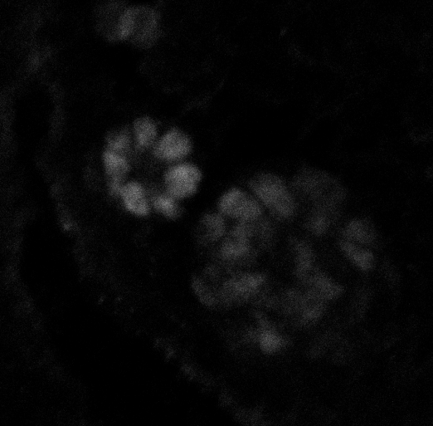
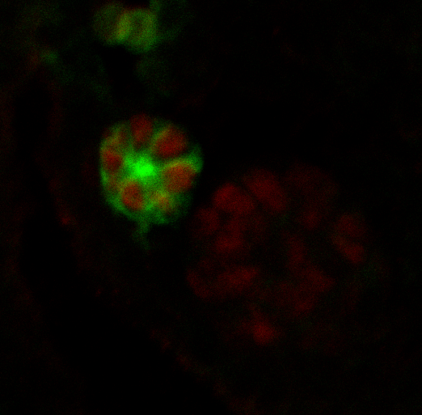
Supplemental Figure 5
Hoxb7-myr-venus-YFP
Pax-2
Merge
Notes:
Pax-2 staining represents for intermediate mesoderm

Slide 6
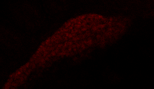
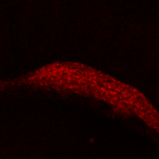
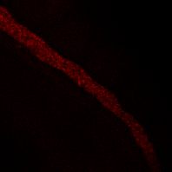
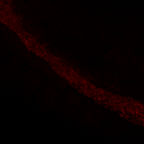
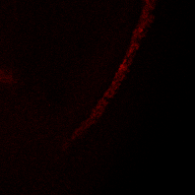
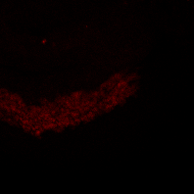
Supplemental Figure 6
Wnt5a fl/+;T-Cre
Wnt5a fl/Δ;T-Cre
A
Anterior
Pax2
Pax2
B
Middle
Pax2
Pax2
C
Posterior
Pax2
Pax2
Notes:
IM morphology in the middle of wnt5a mutant

Slide 7

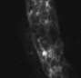
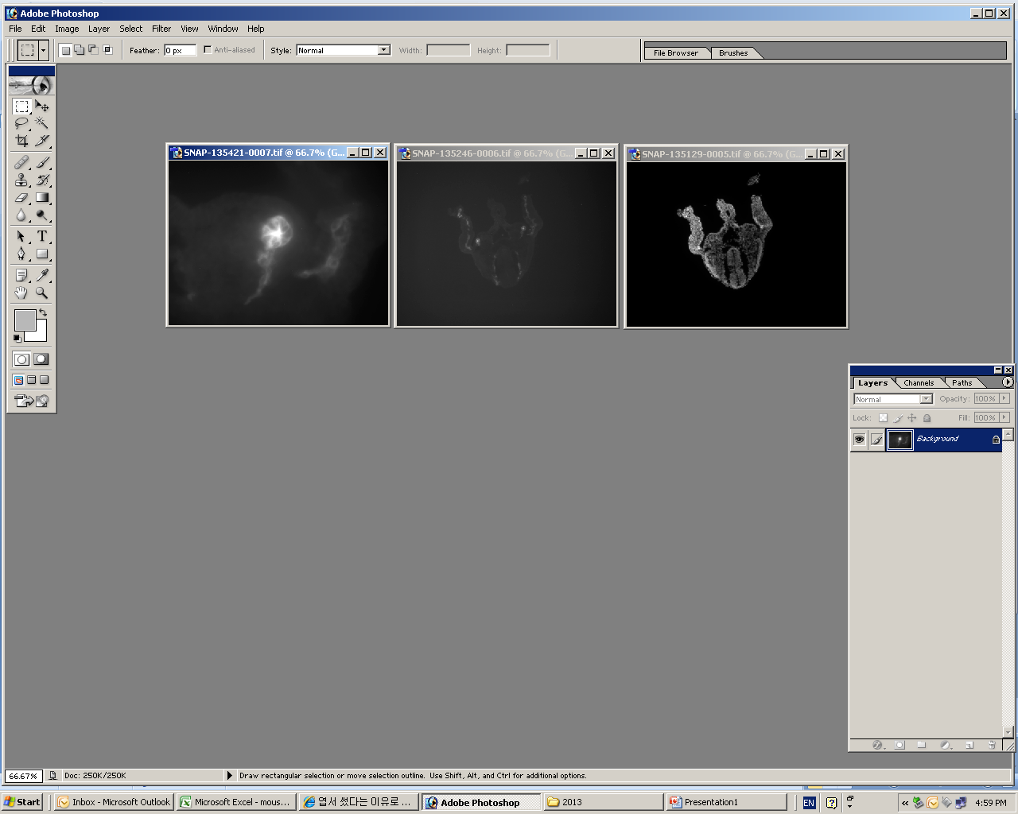
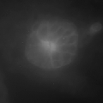
Supplemental Figure 7
Wnt5a fl/+;T-Cre
Wnt5a fl/Δ;T-Cre
A
Hoxb7-myr-venus-YFP
Hoxb7-myr-venus-YFP
B
Hoxb7-myr-venus-YFP
Hoxb7-myr-venus-YFP
Notes:
Widened ND in the middle of wnt5a mutant

Slide 8
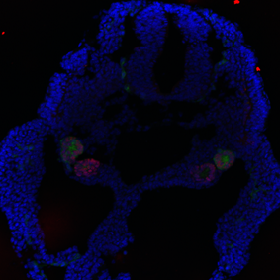
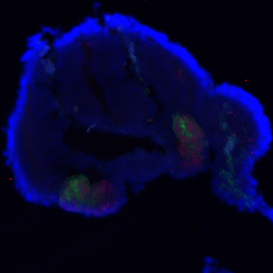
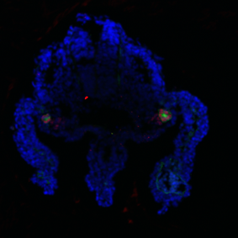
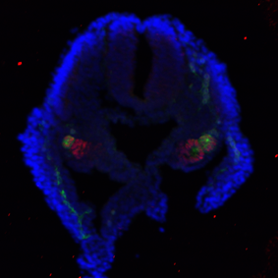
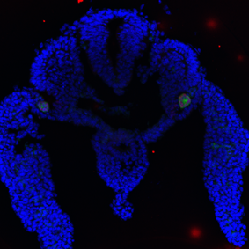
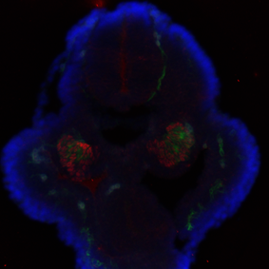
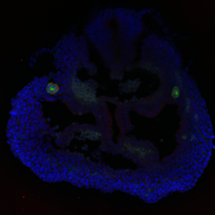
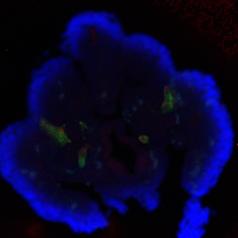
Supplemental Figure 8
Wnt5a fl/+;T-Cre
Wnt5a fl/Δ;T-Cre
Anterior
Middle
Posterior

Slide 9
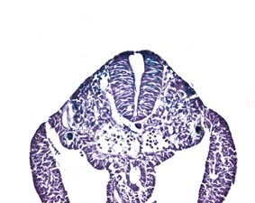
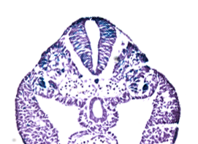
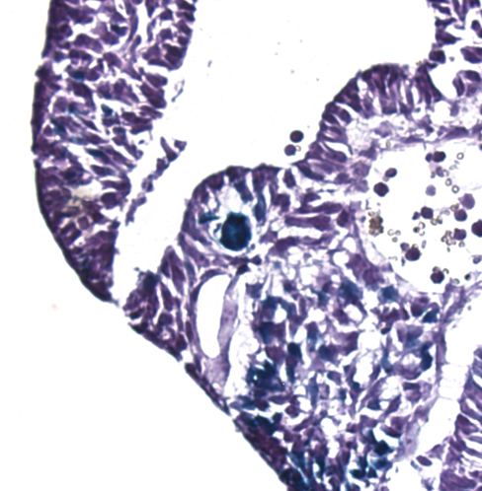
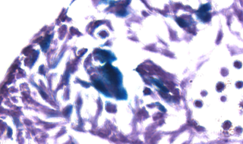
Supplemental Figure 9
Wnt5a fl/+;T-Cre;BATLacZ
Wnt5a fl/Δ;T-Cre;BATLacZ

