Slide 1
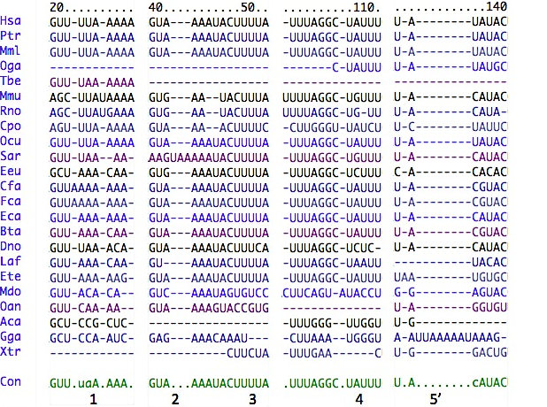
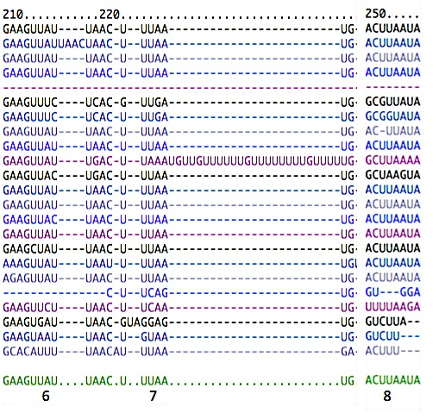
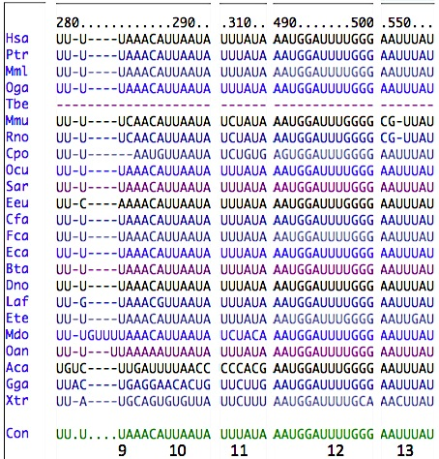
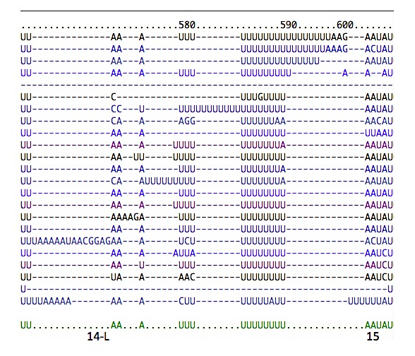
Putative HuR-binding sites in CTNNB1 3’-UTR (1/2) Suppl. Fig. 3A
1 2* 3* 4* 5 6* 7* 8*
9* 10* 11* 12* 13* 14* 15*

