Slide 1
Blautia hydrogenotrophica, ZP_03780888
Blautia schinkii, ADR32226
Ruminococcus obeum, ZP_01966292
Ruminococcus obeum, ZP_01966293
Blautia hydrogenotrophica, ZP_03780887
Blautia schinkii, ADR32225
Ruminococcus sp. 5_1_39BFAA, ZP_04855654
Blautia producta, ADR32234
Blautia coccoides, ADR32214
Blautia hansenii , ZP_05854611
OTU 4 (1 TWE) + Blautia hydrogenotrophica (ZP_03783902)
Bryantella formatexigens, ZP_05345576
Syntrophococcus sucromutans, ADR32227
Syntrophococcus sucromutans, ADR32228
OTU 1 (31 TWE) + TWA4_ACS1
Acetitomaculum ruminis (2)
OTU 2 (8 TWE) + OTU 3 (1 TWE) + TWA4_ACS2
Clostridium difficile, ADR32221
Clostridium carboxidivorans P7, ZP_05392956
Clostridium bartlettii, ZP_02211649
Alkaliphilus metalliredigens, YP_001319849
Clostridium aceticum, ADR32220
Acetobacterium woodii , ADR32229
Eubacterium limosum, ADR32216
Oxobacter pfennigii (2)
Dethiobacter alkaliphilus AHT 1, ZP_03729251
Sporomusa termitida (2)
Desulfitobacterium hafniense, YP_517885
Moorella thermoacetica, YP_430059
Desulfotomaculum acetoxidans (2)
Carboxydothermus hydrogenoformans, YP_360060
Desulfobacterium autotrophicum, YP_002602936
Desulfococcus oleovorans, YP_001531064
Desulfatibacillum alkenivorans, YP_002429854
Syntrophobacter fumaroxidans, YP_846678
Desulfurivibrio alkaliphilus, ZP_05709354
Desulfonatronospira thiodismutans, ZP_03735883
Candidatus Kuenenia stuttgartiensis, CAJ72290
Ammonifex degensii, YP_003238347
Candidatus Methanoregula boonei, YP_001404357
Thermodesulfovibrio yellowstonii, YP_002249267
Methanosarcinales (10)
Methanomicrobiales (2)
Methanococcales (3)
Methanococcales (5)
Methanothermobacter thermautotrophicus, NP_276822
0.10
Methanopyrus kandleri, NP_614004
Additional file 5a

Slide 2
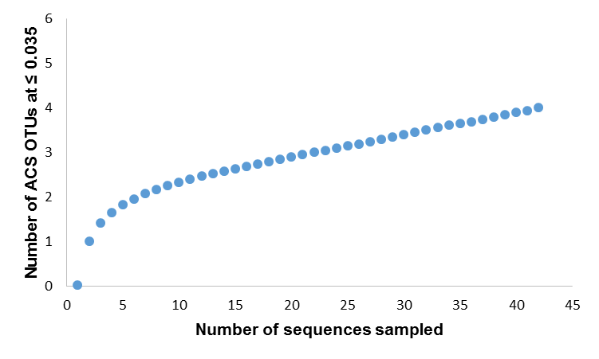
Additional file 5b

