Slide 1
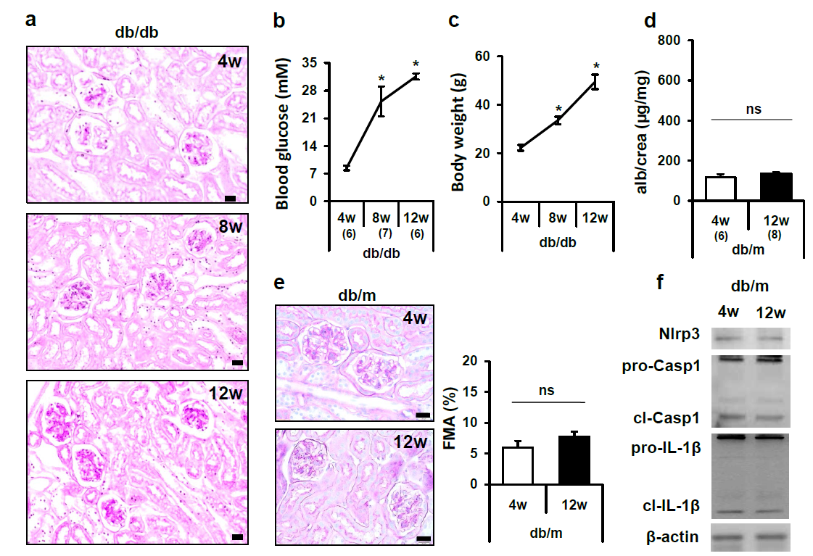
Supplementary figure 1
Supplementary Fig. S1: Age dependent changes in db/db and db/dm mice. Representative images of PAS-stained kidney sections of db/db mice age 4, 8, or 12 weeks at lower magnification (a). Blood glucose levels (b) and body weight (c) increase in db/db mice with age. Albuminuria (d), FMA (e), and Nlrp3 expression and IL-1β as well as caspase-1 cleavage (f, representative immunoblots, β-actin loading control) do not increase in non-diabetic db/m mice with age. Mean value ± SEM. Number of mice (a-c and d-f) in each group shown in brackets in b and d; *P<0.05; size bar (a, e): 20 µm.

Slide 2
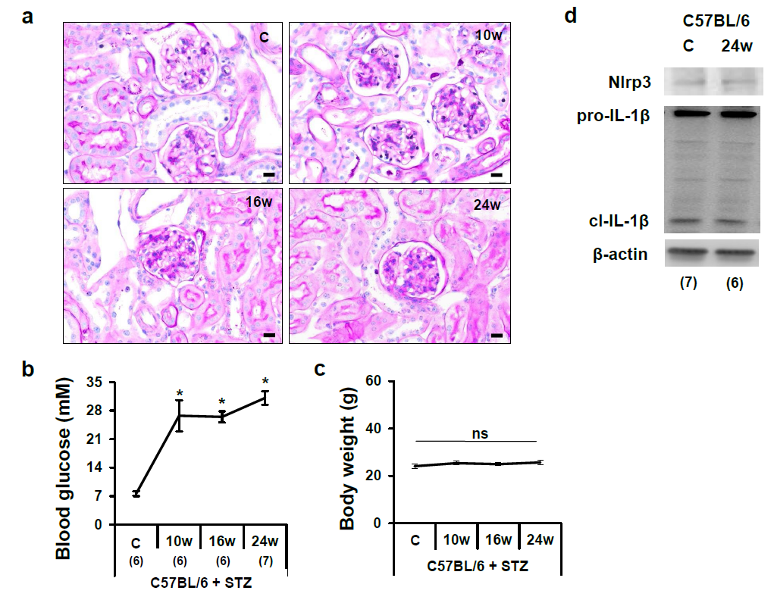
Supplementary figure 2
Supplementary Fig. S2: Age dependent changes in streptozotocin treated and control C57BL/6 mice. Representative images of PAS-stained kidney sections obtained from non-diabetic control C57BL/6 mice before (C) or 10, 16, or 24 weeks after the last streptozotocin (STZ) injection at lower magnification (a). Blood glucose levels (b) increase while the body weight remains constant (c). Nlrp3 expression and IL-1β cleavage remain stable in 32 weeks old non-diabetic C57BL/6 mice as compared to 8 weeks old control mice. Mean value ± SEM. Number of mice (a-c and d) in each group shown in brackets in b and d; *P<0.05; size bar (a): 20 µm.

Slide 3
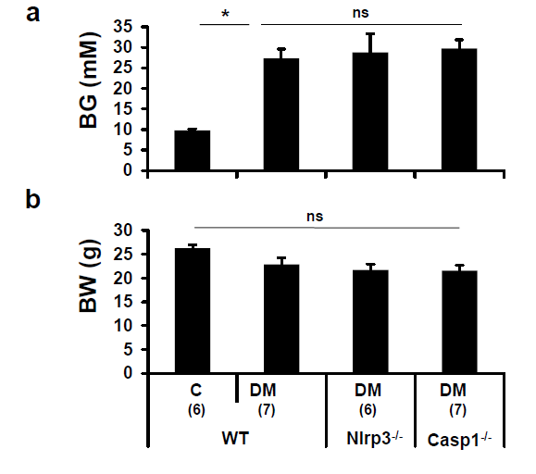
Supplementary figure 3
Supplementary Fig. S3: Body weight and blood glucose in Nlrp3 or caspase-1 deficient C57BL/6 mice. In diabetic mice (streptozotocin model) deficiency of Nlrp3 (Nlrp3^{-/-}) or caspase-1 (Casp1^{-/-}) has no impact on blood glucose levels (BG, a) or body weight (BW, b) in comparison to diabetic C57BL/6 (DM) mice; mean value ± SEM. Number of mice (a,b) in each group shown in brackets in b; *P<0.05.

Slide 4
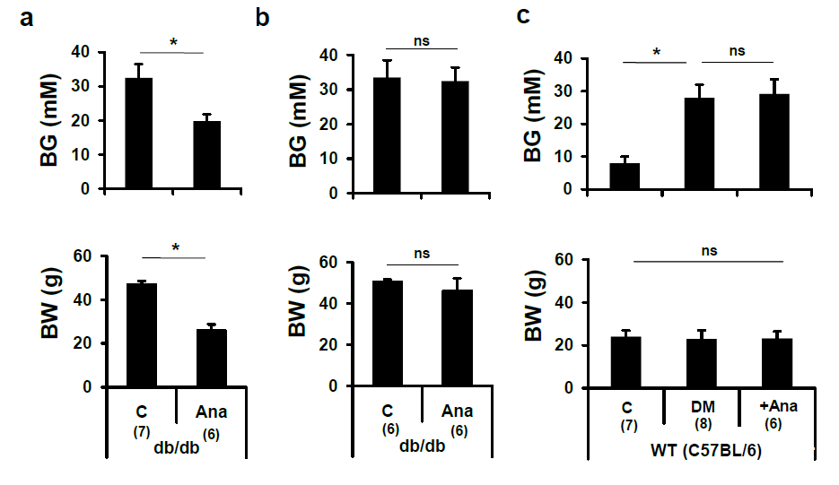
Supplementary figure 4
Supplementary Fig. S4: Body weight and blood glucose in anakinra treated mice. Inflammasome inhibition using anakinra reduces blood glucose levels (BG) and body weight (BW) in db/db mice treated for 12 weeks (a), but not db/db mice treated for 8 weeks (b) or in diabetic (STZ treated) C57BL/6 mice (c); mean value ± SEM. Number of mice in each group shown in brackets in a,b and c respectively; *P<0.05.

Slide 5
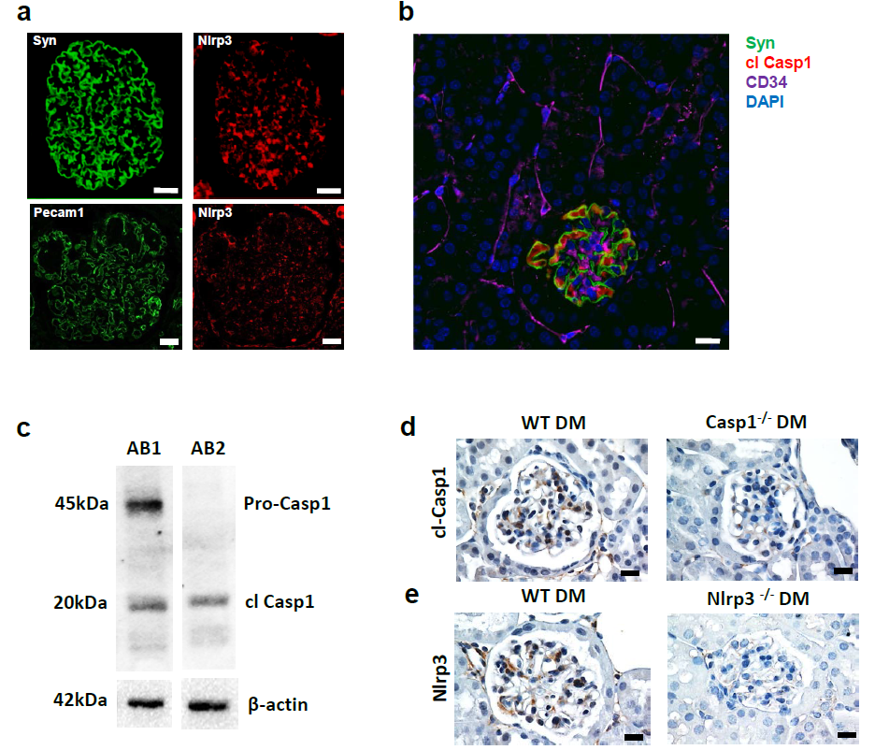
Supplementary figure 5
Supplementary Fig. S5: Inflammasome activation in resident glomerular cells. Single colour images (corresponding to Figure 6a) of human kidney biopsies obtained from patients with diabetic nephropathy (a; green: synaptopodin, top, or PECAM1, bottom; red: Nlrp3). Four colour confocal microscopy of a glomeruli obtained from a 12 week old db/db mouse (b), stained for synaptopodin (syn, green), cleaved caspase-1 (cl Casp1, red), the endothelial cell marker CD34 (CD34, pink), and DAPI (blue). Cleaved caspase-1 is only detectable in the glomerulus. The same glomerulus is shown in Fig. 6b, where CD34 is shown in green to allow better co-localization. Specificity of the antibody detecting cleaved caspase-1 (c,d). Immunoblots (c) using two antibodies against caspase-1 (AB1: Millipore #06-503; AB2: SantaCruz sc-22165) using renal cortex extracts from diabetic wild-type mice (c). AB2 detects only the cleaved form of caspase1. Immunohistochemistry (d) for cleaved caspase-1 (SantaCruz sc-22165) on histological sections of diabetic wild type (streptozotocin model, WT DM) or diabetic caspase-1^{-/-} (streptozotocin model, Casp1^{-/-} DM) mice. Immunohistochemistry (e) for Nlrp3 on histological sections of diabetic wild type (streptozotocin model, WT DM) or diabetic Nlrp3^{-/-} (streptozotocin model, Nlrp3^{-/-} DM) mice; size bar (a,b; 20µm, d; 30 µm).

Slide 6
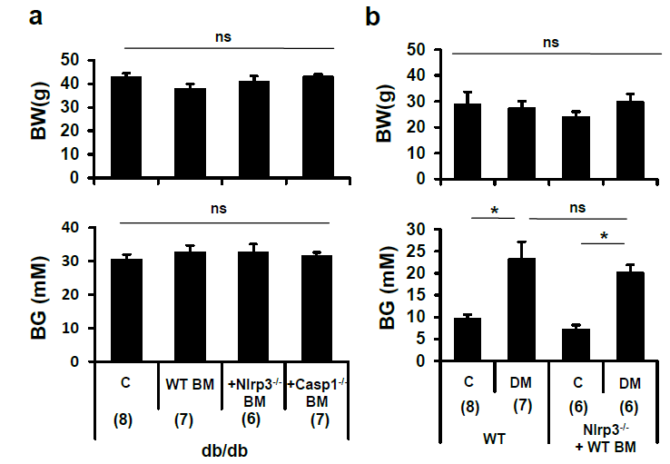
Supplementary figure 6
Supplementary Fig. S6: Effect of bone-marrow transplantation experiments on body weight and blood glucose. Transplantation of Nlrp3^{-/-} or caspase-1^{-/-} (Casp1^{-/-}) bone marrow into db/db mice has no impact on body weight (BW) or blood glucose levels (BG) in comparison to db/db mice transplanted with syngenic wild-type bone marrow (WT BM) or control (C, non-transplanted) db/db mice (a). Body weight (BW) and blood glucose levels (BG) are comparable in diabetic Nlrp^{-/-} mice transplanted with wild-type bone marrow and diabetic wild-type (WT) mice (b). Mean value ± SEM. Number of mice in each group shown in brackets in a and b; *P<0.05.

Slide 7
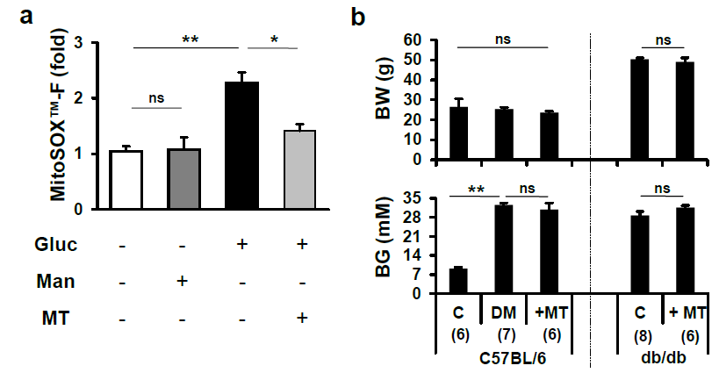
Supplementary figure 7
Supplementary Fig. S7: Mitochondrial ROS cause inflammasome activation and promote diabetic nephropathy. The mitochondrial targeted antioxidant MitoTempo (MT) reduces glucose (Gluc, 25 mM, 24 h) induced mitochondrial ROS production in mouse podocytes (a). Mannitol (Man, 25 mM, 24 h) has no effect (a). Mitochondrial ROS were detected using MitoSOX™. Body weight (BW) and blood glucose levels (BG) are not different in diabetic mice without or with MitoTempo (+MT) treatment (b). Bar graph summarizing results; mean value ± SEM of at least 3 independent experiments (a). Number of mice (b) in each group shown in brackets in b; *P<0.05. **P<0.01.

Slide 8
Supplementary table 1
 | Group statistics |  |  |  | p-value
 | Control (n=33) | DM (Alb <30) (n=21) | DM (Alb≥30) (n=66) |  | Control vs DM (Alb≥30) | DM (Alb <30) vs DM (Alb≥30)
Age (years) | 50.39 ± 1.991 | 58.67 ± 1.884 | 58.09 ± 0.9737 |  | <0.001 | ns
Sex (M/F) | 28/5 | 10/11 | 50/16 |  | ns | 0.028
Dis.duration (years) | - | 15.33 ± 1.559 | 10.20 ± 0.8182 |  | - | 0.003
HbA1c (%) | 5.588 ± 0.06303 | 7.167 ± 0.2330 | 7.411 ± 0.1539 |  | <0.0001 | ns
Chol (mg/dL) | 224.2 ± 9.012 | 214.0 ± 9.919 | 187.7 ± 8.079 |  | 0.006 | ns
TG (mg/dL) | 189.4 ± 24.73 | 196.1 ± 22.27 | 275.3 ± 55.08 |  | ns | ns
HT (Yes/No) | 27/6 | 17/4 | 62/4 |  | ns | ns
BMI (kg/m²) | 32.91 ± 1.096 | 30.88 ± 0.7462 | 33.50 ± 0.8266 |  | ns | ns
IL-1β (pg/ml) | 0.06679 ± 0.0336 | 0.2688 ± 0.0858 | 0.5876 ± 0.07524 |  | <0.0001 | 0.027
Supplementary Table 1. Clinical characteristics of patients with diabetes mellitus type 2 with microalbuminuria (≥30 mg/24h), without microalbuminuria (<30 mg/24h) and controls. Values are Means ± SEM for age, disease duration (Dis.duration), HbA1c, plasma cholesterol (Chol), plasma triglycerides (TG), and serum levels of IL-1β (IL-1β). The frequency (total numbers, n) is shown for sex distribution (Sex, Male/Female) and hypertension (HT). For statistical analysis of Sex and HT the Fisher’s exact test was used. For all other parameters analysis was performed with the unpaired two-tailed student’s t-test. For signigificant p-values the value is shown (ns: not significant).

