Slide 1
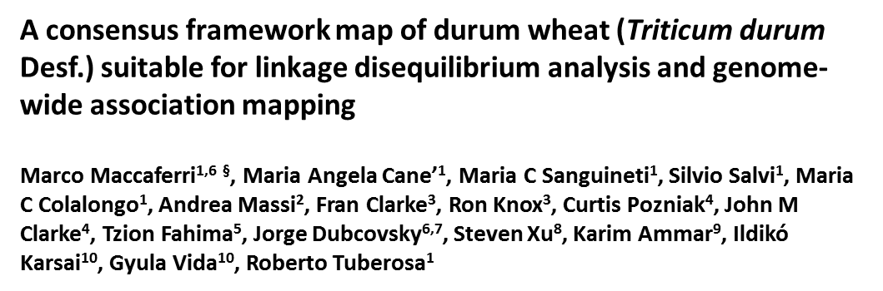
Additional file 6 – Figure S4 Detailed pairwise linkage disequilibrium plots, distribution of loci with highly significant Fst differentiation patterns and of the polymorphism index content values of SSR and DArT® markers along the tetraploid wheat consensus map, as estimated from the elite durum wheat germplasm accessions from world-wide.
Pairwise linkage disequilibrium (LD) patterns are shown for the squared coefficients of determination (r²) values between loci used to profile a panel of 183 elite durum accessions and mapped on the consensus map (left side of chromosome bars). Loci with highly significant F_{ST} differentiation values between durum sub-population groups are reported on the right side of the chromosome bars, as long with the locus polymorphism index content (PIC) plots, normalized for allele number.

Slide 2
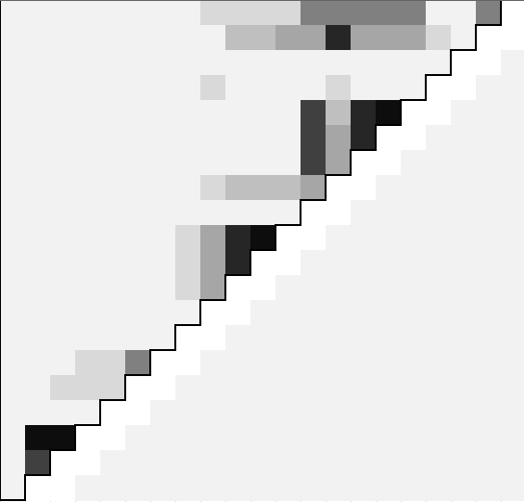
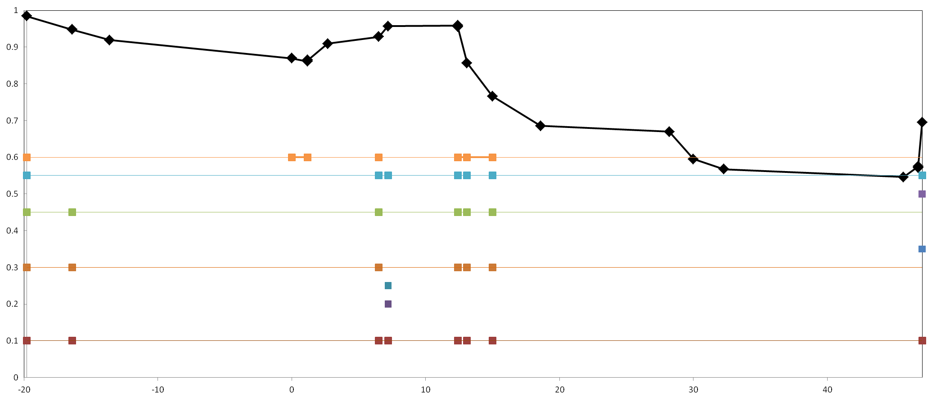
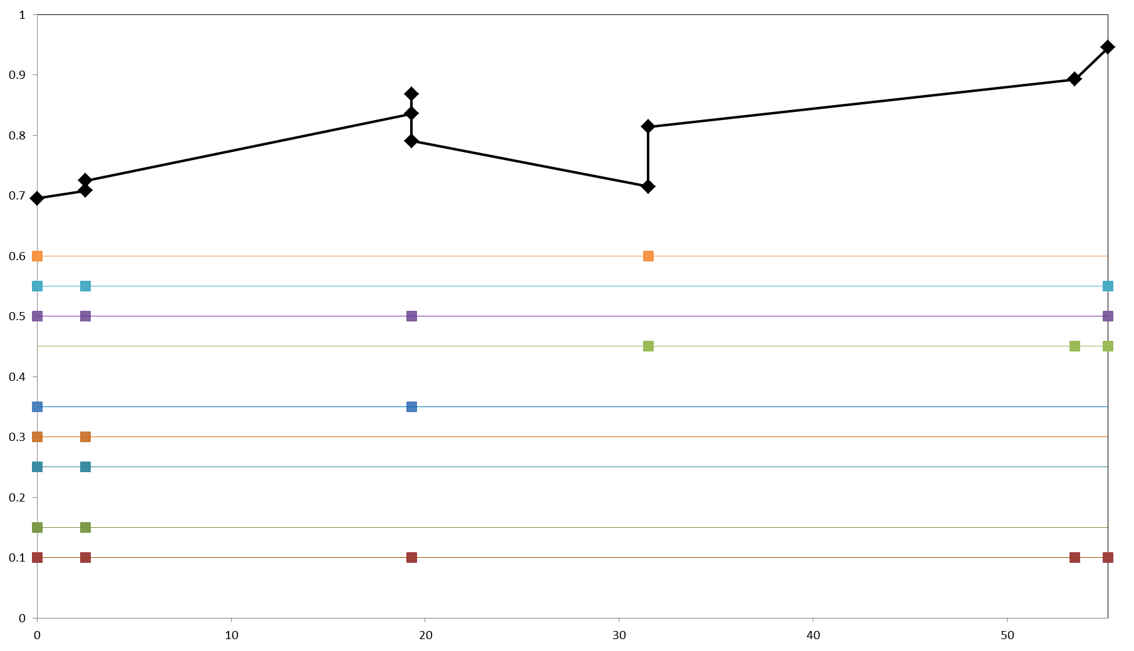
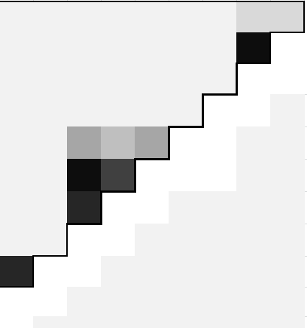
F_{ST} statistics (P ≤ 0.01)
PIC/PIC_{max}ratio (sliding window of 3 consecutive markers)
Chromosome 1A
F_{ST} ptn 3
Pairwise LD, r² values color key
0.0
0.2
0.4
0.6
0.8
1.0
F_{ST} ptn 3
F_{ST} statistics (P ≤ 0.01)
F_{ST} all 5 groups
F_{ST} ICARDA dryland / ICARDA temperate
F_{ST} ICARDA dryland / Italian, early CIMMYT
F_{ST} ICARDA dryland / mid CIMMYT, ICARDA
F_{ST} ICARDA dryland / late CIMMYT
F_{ST} ICARDA temperate / Italian, early CIMMYT
F_{ST} ICARDA temperate / mid CIMMYT, ICARDA
F_{ST} ICARDA temperate / late CIMMYT
F_{ST} Italian, early CIMMYT / mid CIMMYT, ICARDA
F_{ST} Italian, early CIMMYT / late CIMMYT
F_{ST} mid CIMMYT, ICARDA / late CIMMYT
F_{ST} ptn 2

Slide 3
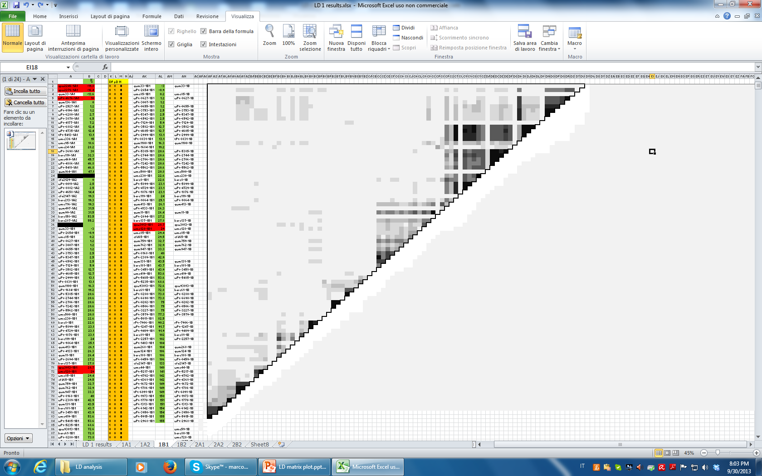
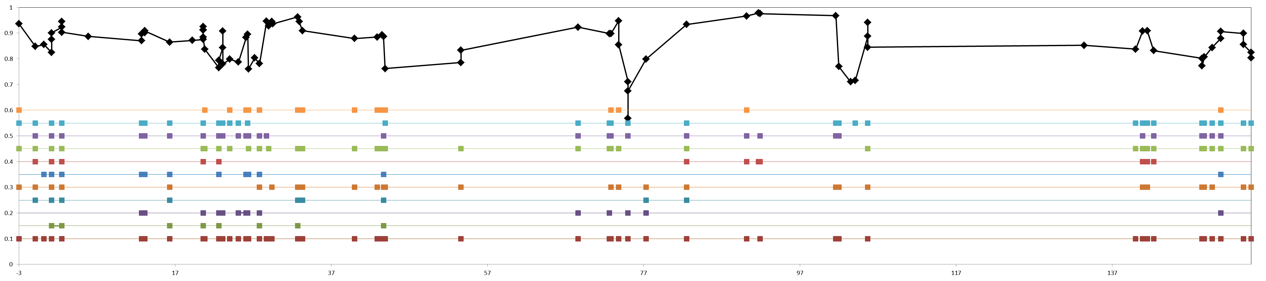
Single marker F_{ST} (P ≤ 0.01)
Chromosome 1B
F_{ST} ptn 1
Pairwise LD, r² values color key
0.0
0.2
0.4
0.6
0.8
1.0
F_{ST} ptn 3
F_{ST} all 5 groups
F_{ST} ICARDA dryland / ICARDA temperate
F_{ST} ICARDA dryland / Italian, early CIMMYT
F_{ST} ICARDA dryland / mid CIMMYT, ICARDA
F_{ST} ICARDA dryland / late CIMMYT
F_{ST} ICARDA temperate / Italian, early CIMMYT
F_{ST} ICARDA temperate / mid CIMMYT, ICARDA
F_{ST} ptn 1
F_{ST} ICARDA temperate / late CIMMYT
F_{ST} Italian, early CIMMYT / mid CIMMYT, ICARDA
F_{ST} Italian, early CIMMYT / late CIMMYT
F_{ST} mid CIMMYT, ICARDA / late CIMMYT
F_{ST} ptn 3
F_{ST} ptn 2
F_{ST} ptn 3
F_{ST} ptn 3

Slide 4
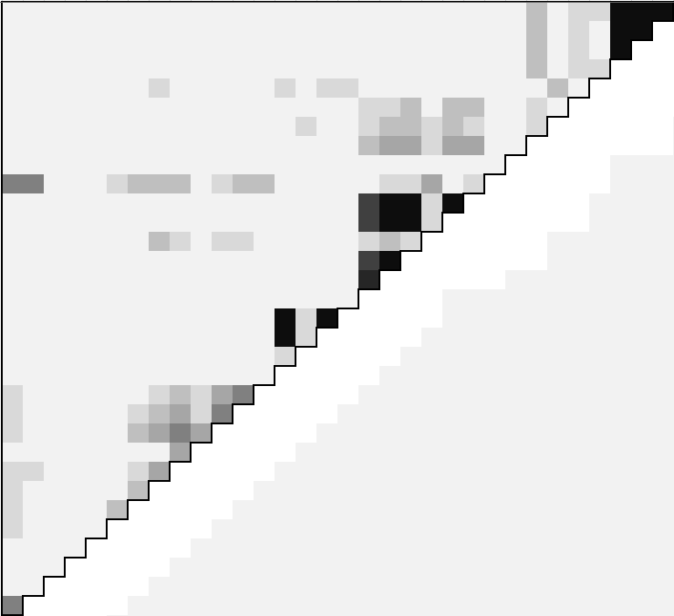
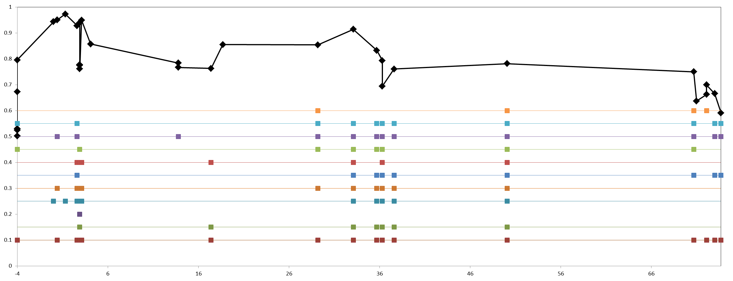
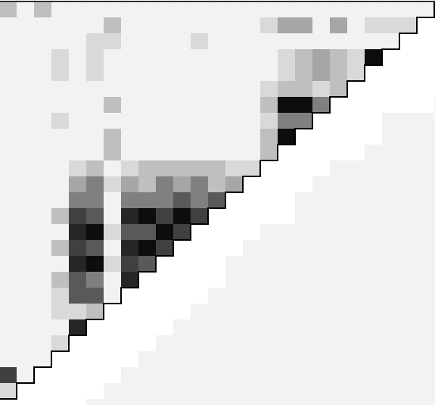
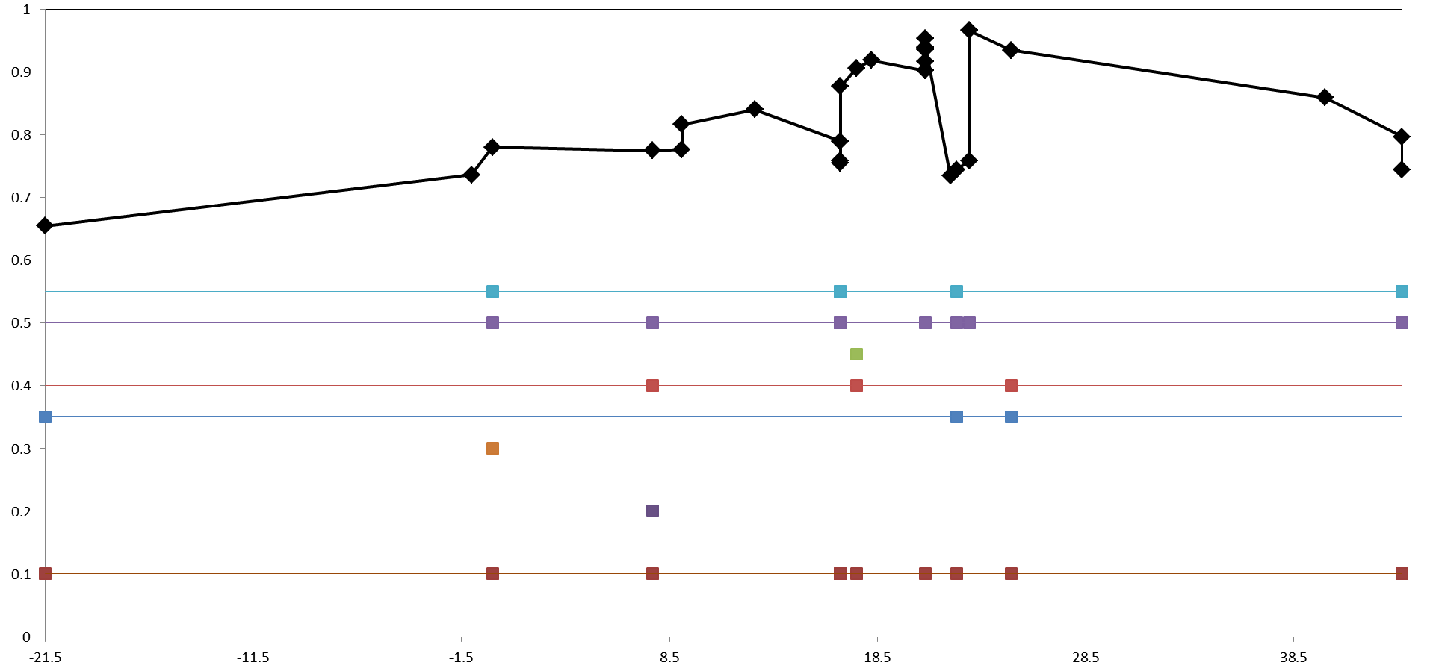
F_{ST} ptn 1
Chromosome 2A
Pairwise LD, r² values color key
0.0
0.2
0.4
0.6
0.8
1.0
F_{ST} ptn 3
F_{ST} all 5 groups
F_{ST} ptn 1
F_{ST} ICARDA dryland / ICARDA temperate
F_{ST} ICARDA dryland / Italian, early CIMMYT
F_{ST} ptn 1
F_{ST} ICARDA dryland / mid CIMMYT, ICARDA
F_{ST} ICARDA dryland / late CIMMYT
F_{ST} ICARDA temperate / Italian, early CIMMYT
F_{ST} ICARDA temperate / mid CIMMYT, ICARDA
F_{ST} ICARDA temperate / late CIMMYT
F_{ST} Italian, early CIMMYT / mid CIMMYT, ICARDA
F_{ST} Italian, early CIMMYT / late CIMMYT
F_{ST} mid CIMMYT, ICARDA / late CIMMYT
F_{ST} ptn 3
Single marker F_{ST} (P ≤ 0.01)

Slide 5
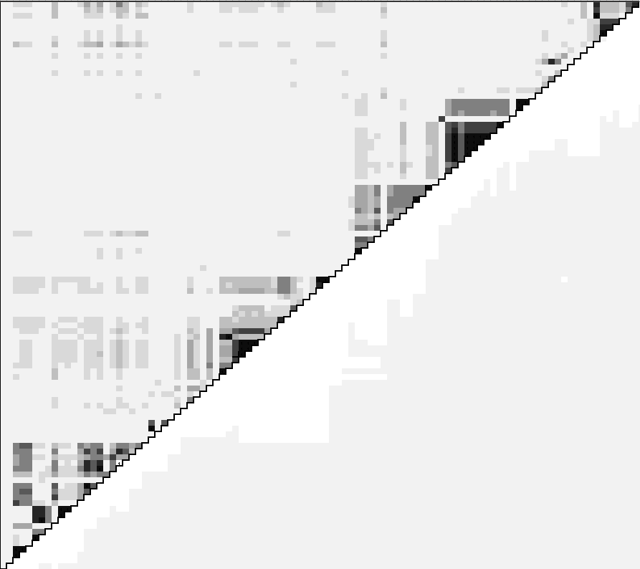
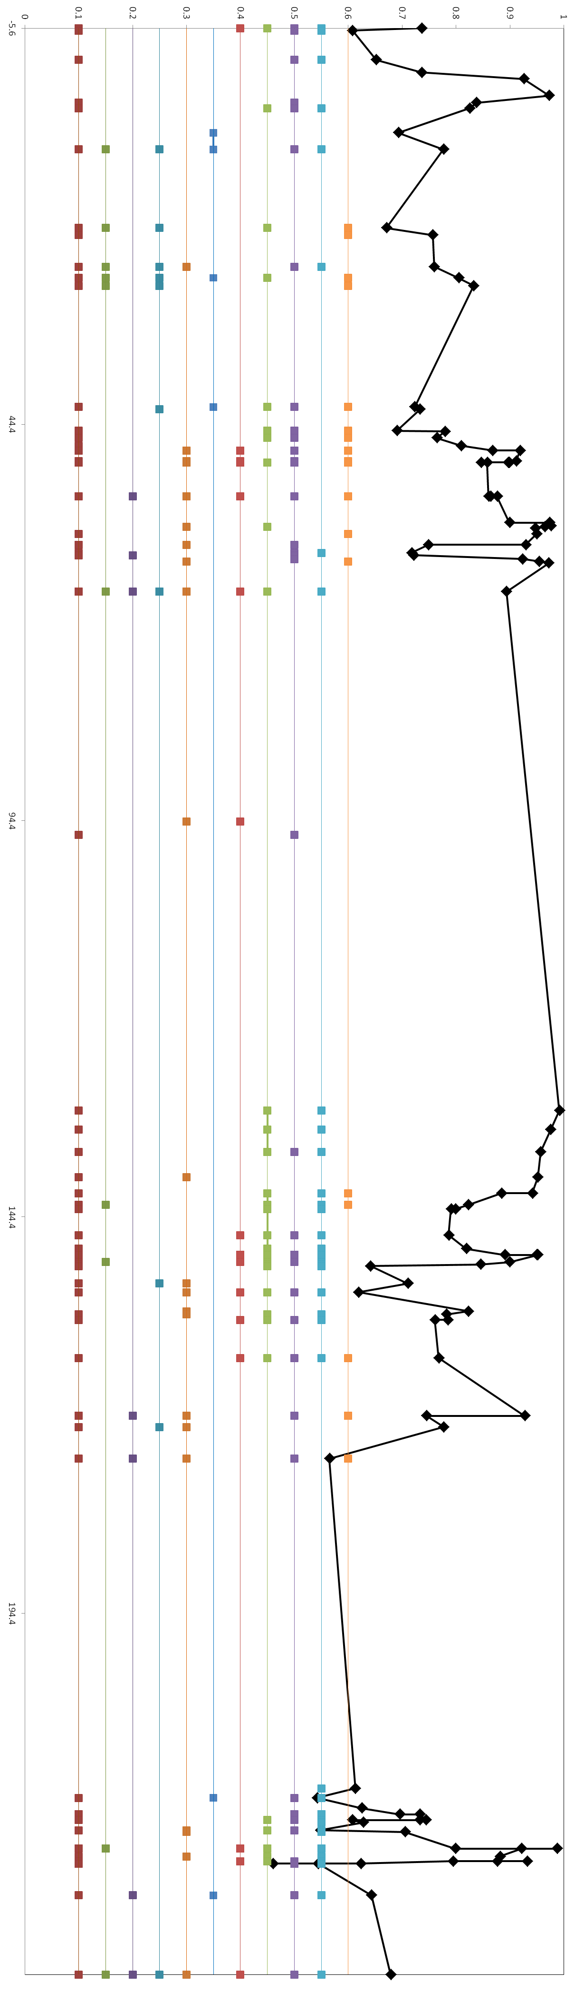
Single marker F_{ST} (P ≤ 0.01)
F_{ST} ptn 3
Chromosome 2B
Pairwise LD, r² values color key
0.0
0.2
0.4
0.6
0.8
1.0
F_{ST} all 5 groups
F_{ST} ptn 3
F_{ST} ICARDA dryland / ICARDA temperate
F_{ST} ICARDA dryland / Italian, early CIMMYT
F_{ST} ICARDA dryland / mid CIMMYT, ICARDA
F_{ST} ICARDA dryland / late CIMMYT
F_{ST} ptn 1 and 3
F_{ST} ICARDA temperate / Italian, early CIMMYT
F_{ST} ICARDA temperate / mid CIMMYT, ICARDA
F_{ST} ICARDA temperate / late CIMMYT
F_{ST} Italian, early CIMMYT / mid CIMMYT, ICARDA
F_{ST} Italian, early CIMMYT / late CIMMYT
F_{ST} mid CIMMYT, ICARDA / late CIMMYT
F_{ST} ptn 3
F_{ST} ptn 3
F_{ST} ptn 1

Slide 6
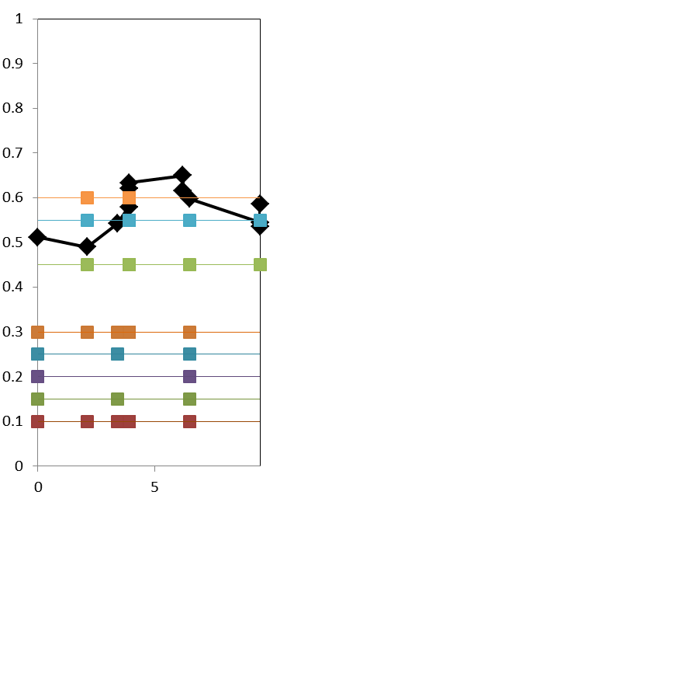
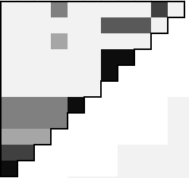
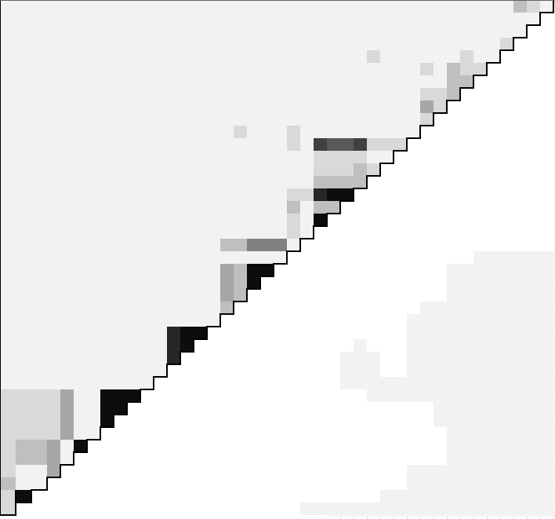
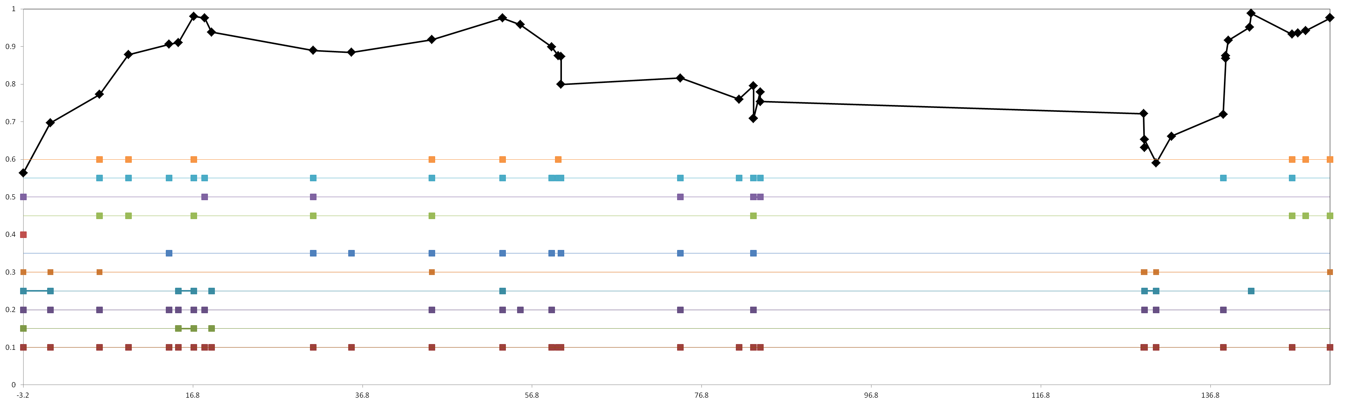
Single marker F_{ST} (P ≤ 0.01)
Chromosome 3A
F_{ST} ptns 2 and 3
Pairwise LD, r² values color key
0.0
0.2
0.4
0.6
0.8
1.0
F_{ST} all 5 groups
F_{ST} ptn 2
F_{ST} ICARDA dryland / ICARDA temperate
F_{ST} ICARDA dryland / Italian, early CIMMYT
F_{ST} ICARDA dryland / mid CIMMYT, ICARDA
F_{ST} ICARDA dryland / late CIMMYT
F_{ST} ptn 3
F_{ST} ptn 2
F_{ST} ICARDA temperate / Italian, early CIMMYT
F_{ST} ICARDA temperate / mid CIMMYT, ICARDA
F_{ST} ICARDA temperate / late CIMMYT
F_{ST} Italian, early CIMMYT / mid CIMMYT, ICARDA
F_{ST} Italian, early CIMMYT / late CIMMYT
F_{ST} ptn 3
F_{ST} mid CIMMYT, ICARDA / late CIMMYT
F_{ST} ptn 3
F_{ST} ptn 3
F_{ST} ptn 2
F_{ST} ptn 3

Slide 7
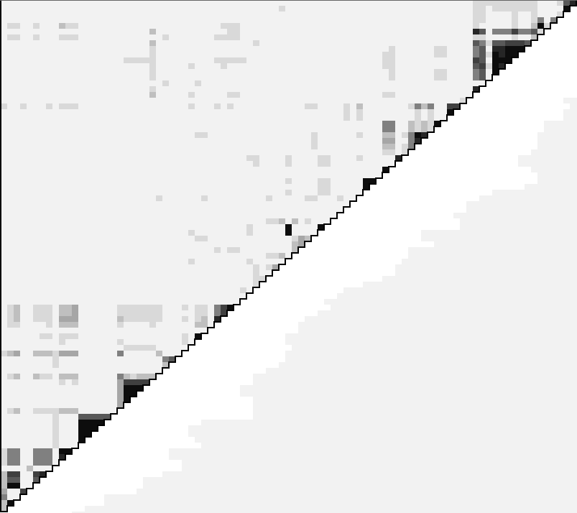
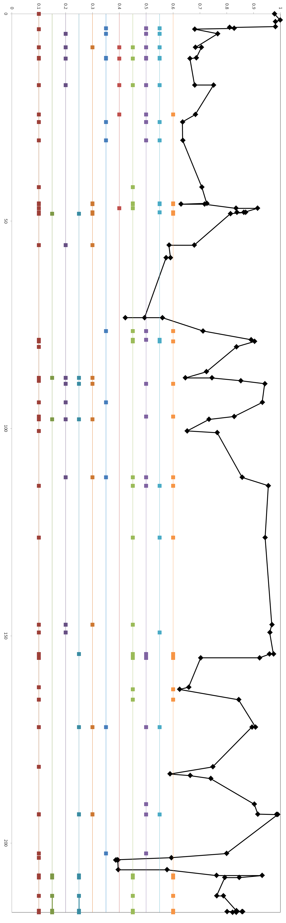
Single marker F_{ST} (P ≤ 0.01)
Chromosome 3B
Pairwise LD, r² values color key
F_{ST} ptn 3
0.0
0.2
0.4
0.6
0.8
1.0
F_{ST} all 5 groups
F_{ST} ICARDA dryland / ICARDA temperate
F_{ST} ptn 3
F_{ST} ICARDA dryland / Italian, early CIMMYT
F_{ST} ICARDA dryland / mid CIMMYT, ICARDA
F_{ST} ICARDA dryland / late CIMMYT
F_{ST} ICARDA temperate / Italian, early CIMMYT
F_{ST} ICARDA temperate / mid CIMMYT, ICARDA
F_{ST} ICARDA temperate / late CIMMYT
F_{ST} Italian, early CIMMYT / mid CIMMYT, ICARDA
F_{ST} Italian, early CIMMYT / late CIMMYT
F_{ST} ptn 3
F_{ST} mid CIMMYT, ICARDA / late CIMMYT
F_{ST} ptn 2
F_{ST} ptn 3
F_{ST} ptn 3
F_{ST} ptn 3

Slide 8
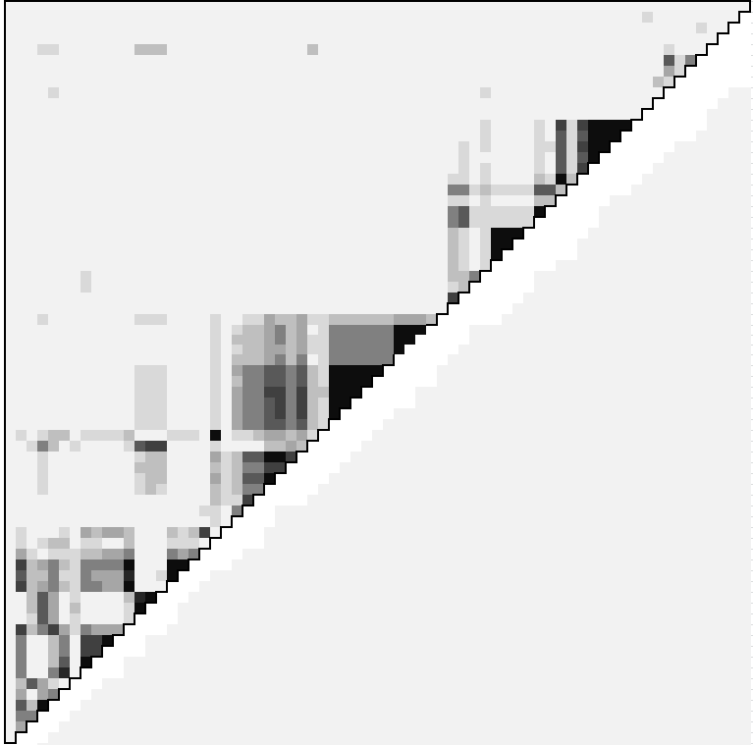
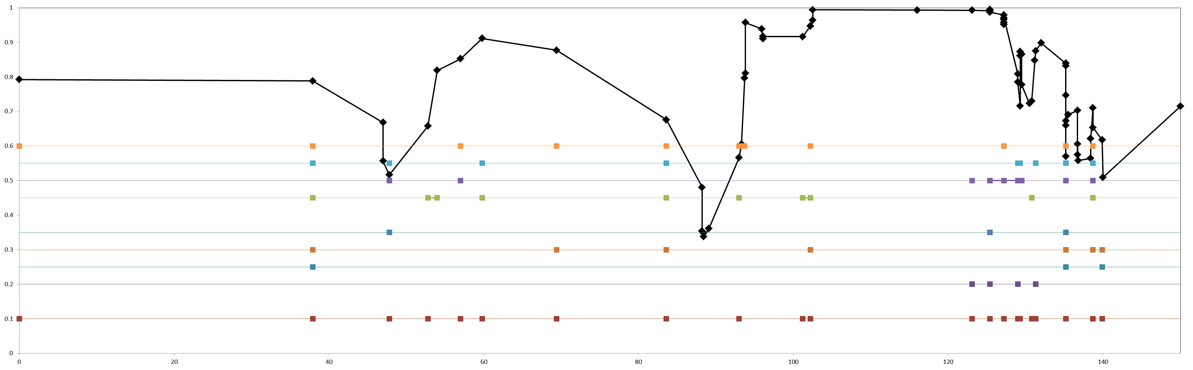
Chromosome 4A
Single marker F_{ST} (P ≤ 0.01)
Pairwise LD, r² values color key
0.0
0.2
0.4
0.6
0.8
1.0
F_{ST} all 5 groups
F_{ST} ICARDA dryland / ICARDA temperate
F_{ST} ICARDA dryland / Italian, early CIMMYT
F_{ST} ICARDA dryland / mid CIMMYT, ICARDA
F_{ST} ICARDA dryland / late CIMMYT
F_{ST} ICARDA temperate / Italian, early CIMMYT
F_{ST} ptn 3
F_{ST} ICARDA temperate / mid CIMMYT, ICARDA
F_{ST} ICARDA temperate / late CIMMYT
F_{ST} Italian, early CIMMYT / mid CIMMYT, ICARDA
F_{ST} Italian, early CIMMYT / late CIMMYT
F_{ST} mid CIMMYT, ICARDA / late CIMMYT
F_{ST} ptn 3
F_{ST} ptn 3

Slide 9
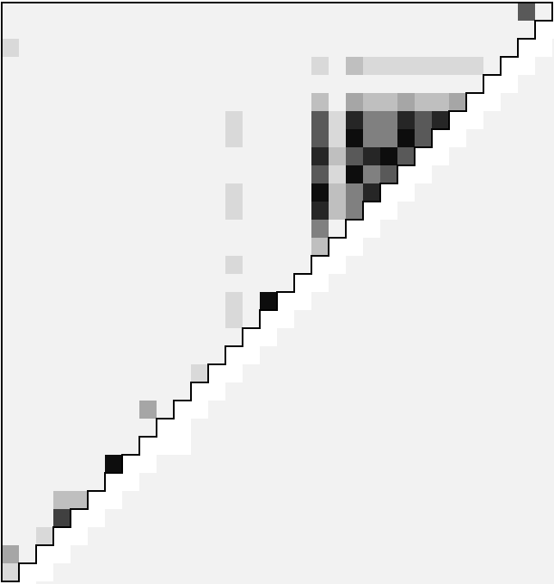
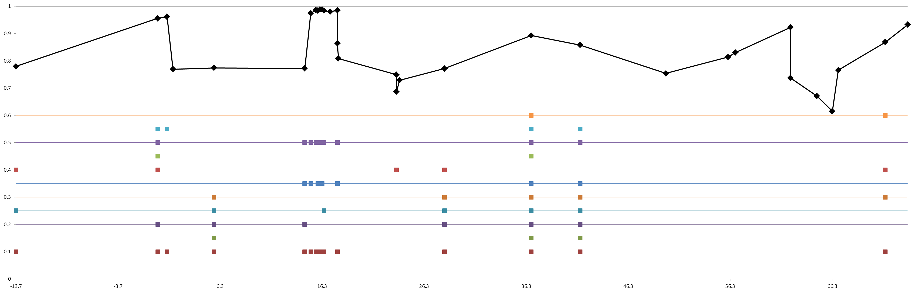
Single marker F_{ST} (P ≤ 0.01)
Chromosome 4B
Pairwise LD, r² values color key
0.0
0.2
0.4
0.6
0.8
1.0
F_{ST} ptn 3
F_{ST} all 5 groups
F_{ST} ICARDA dryland / ICARDA temperate
F_{ST} ptn 2
F_{ST} ICARDA dryland / Italian, early CIMMYT
F_{ST} ICARDA dryland / mid CIMMYT, ICARDA
F_{ST} ICARDA dryland / late CIMMYT
F_{ST} ICARDA temperate / Italian, early CIMMYT
F_{ST} ICARDA temperate / mid CIMMYT, ICARDA
F_{ST} ICARDA temperate / late CIMMYT
F_{ST} ptn 3
F_{ST} Italian, early CIMMYT / mid CIMMYT, ICARDA
F_{ST} Italian, early CIMMYT / late CIMMYT
F_{ST} mid CIMMYT, ICARDA / late CIMMYT
F_{ST} ptn 2
F_{ST} ptns 1 and 2

Slide 10
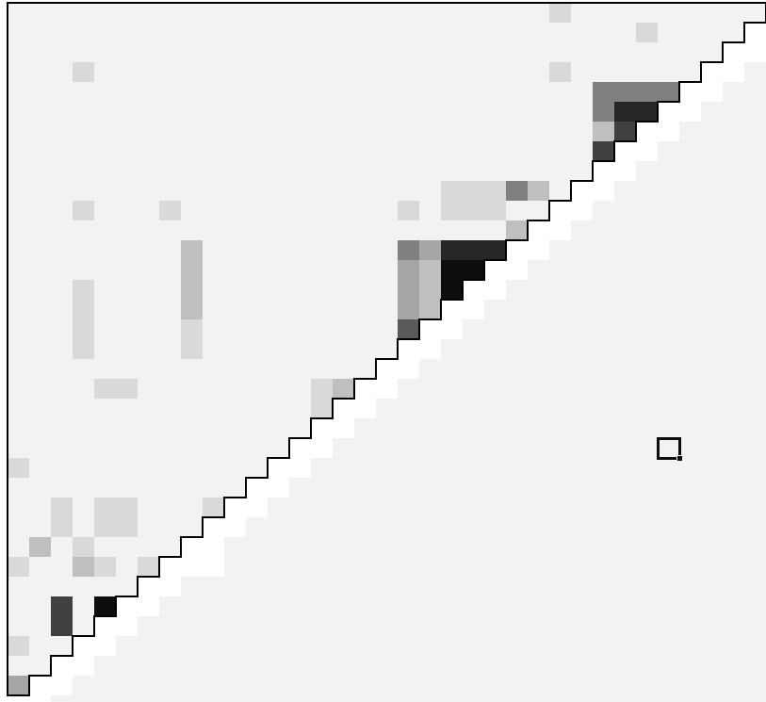
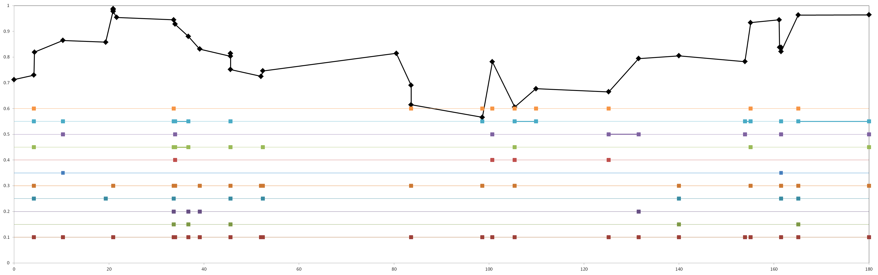
Single marker F_{ST} (P ≤ 0.01)
Chromosome 5A
F_{ST} ptn 3
Pairwise LD, r² values color key
0.0
0.2
0.4
0.6
0.8
1.0
F_{ST} ptn 1
F_{ST} all 5 groups
F_{ST} ptn 2
F_{ST} ICARDA dryland / ICARDA temperate
F_{ST} ICARDA dryland / Italian, early CIMMYT
F_{ST} ICARDA dryland / mid CIMMYT, ICARDA
F_{ST} ICARDA dryland / late CIMMYT
F_{ST} ICARDA temperate / Italian, early CIMMYT
F_{ST} ICARDA temperate / mid CIMMYT, ICARDA
F_{ST} ICARDA temperate / late CIMMYT
F_{ST} Italian, early CIMMYT / mid CIMMYT, ICARDA
F_{ST} Italian, early CIMMYT / late CIMMYT
F_{ST} mid CIMMYT, ICARDA / late CIMMYT
F_{ST} ptn 3
F_{ST} ptn 2
F_{ST} ptn 3
F_{ST} ptn 2

Slide 11
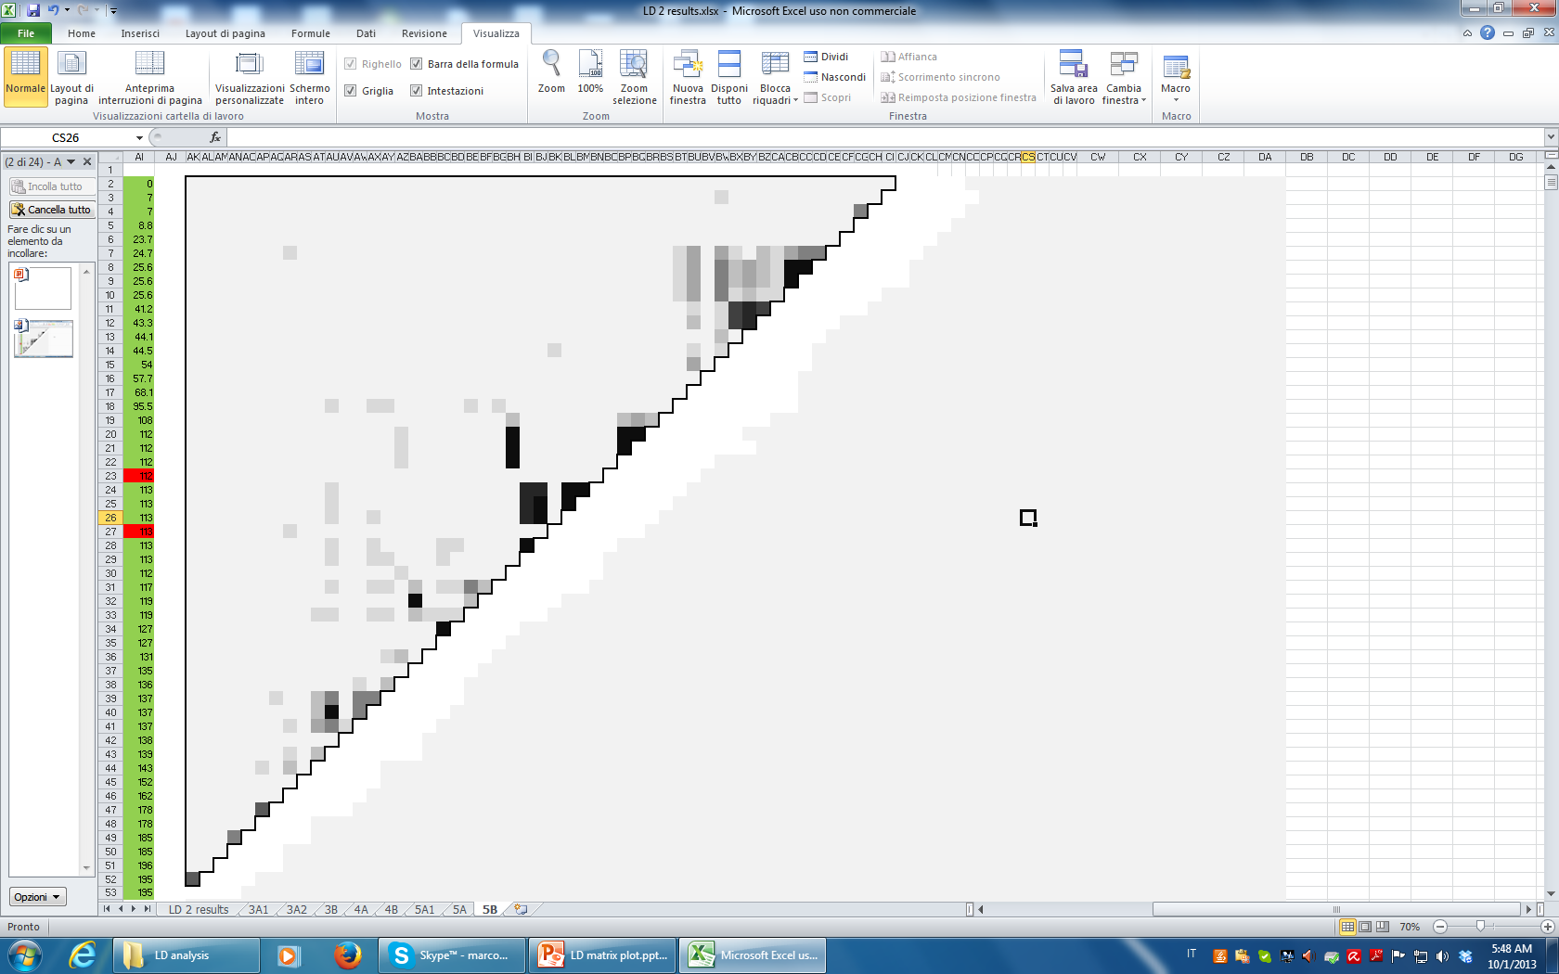
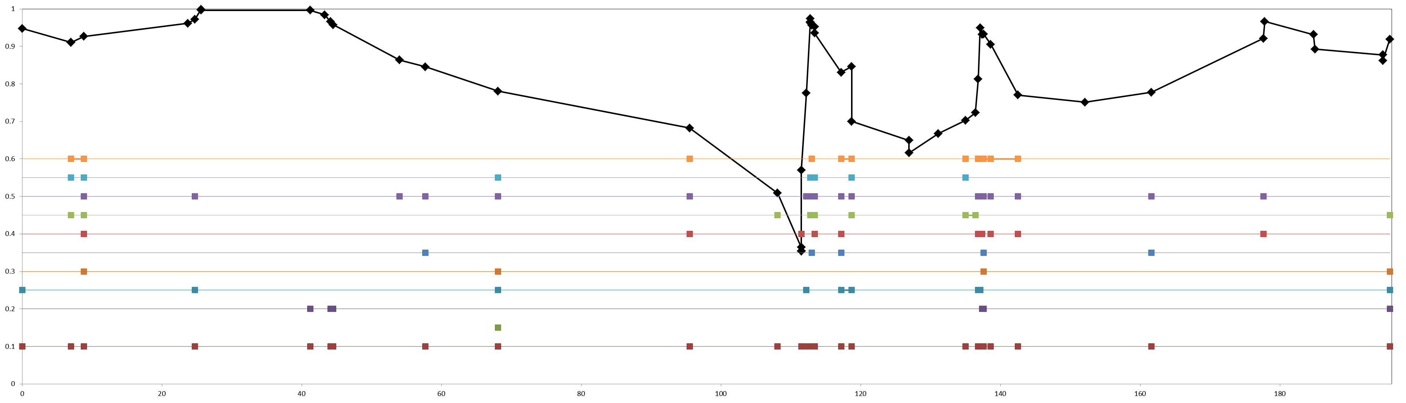

Chromosome 5B
Single marker F_{ST} (P ≤ 0.01)
Pairwise LD, r² values color key
F_{ST} ptn 3
0.0
0.2
0.4
0.6
0.8
1.0
F_{ST} all 5 groups
F_{ST} ICARDA dryland / ICARDA temperate
F_{ST} ICARDA dryland / Italian, early CIMMYT
F_{ST} ICARDA dryland / mid CIMMYT, ICARDA
F_{ST} ICARDA dryland / late CIMMYT
F_{ST} ICARDA temperate / Italian, early CIMMYT
F_{ST} ICARDA temperate / mid CIMMYT, ICARDA
F_{ST} ICARDA temperate / late CIMMYT
F_{ST} Italian, early CIMMYT / mid CIMMYT, ICARDA
F_{ST} Italian, early CIMMYT / late CIMMYT
F_{ST} mid CIMMYT, ICARDA / late CIMMYT
F_{ST} ptn 2
F_{ST} ptn 3
F_{ST} ptns 2 and 3
F_{ST} ptn 1

Slide 12
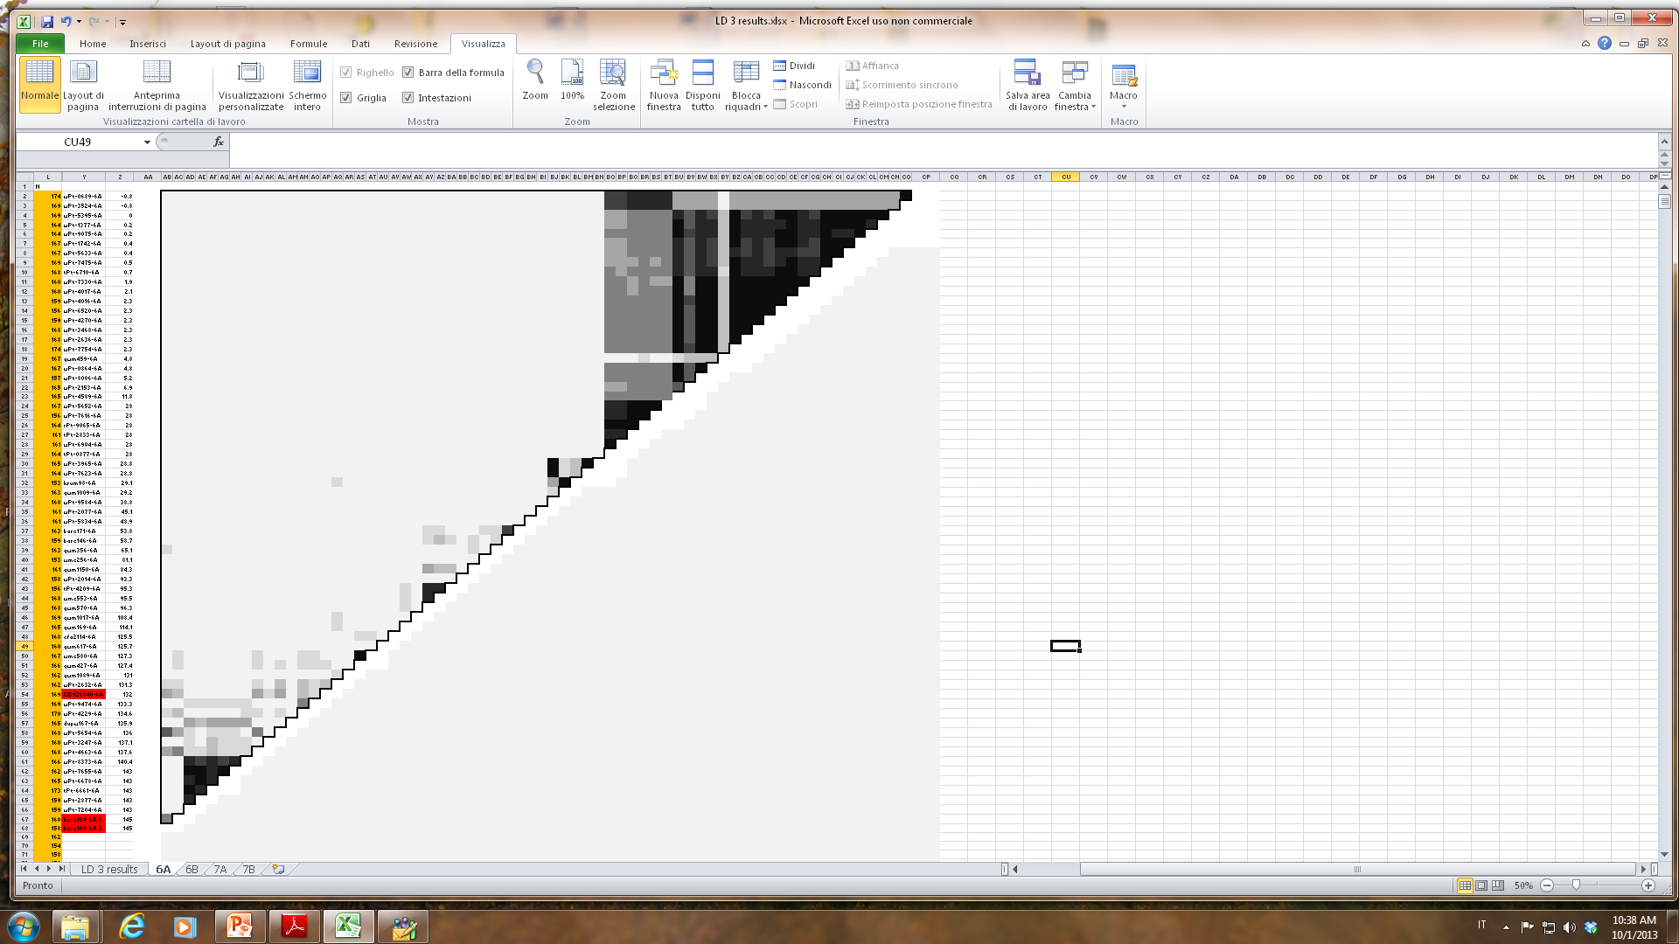
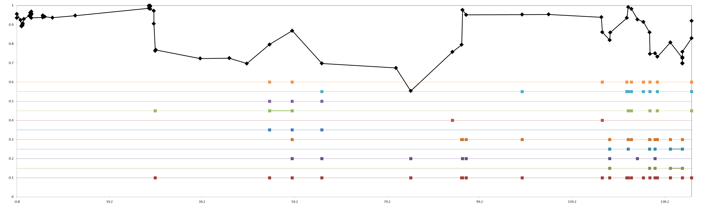
Chromosome 6A
Single marker F_{ST} (P ≤ 0.01)
Pairwise LD, r² values color key
0.0
0.2
0.4
0.6
0.8
1.0
F_{ST} all 5 groups
F_{ST} ICARDA dryland / ICARDA temperate
F_{ST} ICARDA dryland / Italian, early CIMMYT
F_{ST} ICARDA dryland / mid CIMMYT, ICARDA
F_{ST} ICARDA dryland / late CIMMYT
F_{ST} ICARDA temperate / Italian, early CIMMYT
F_{ST} ICARDA temperate / mid CIMMYT, ICARDA
F_{ST} ICARDA temperate / late CIMMYT
F_{ST} Italian, early CIMMYT / mid CIMMYT, ICARDA
F_{ST} Italian, early CIMMYT / late CIMMYT
F_{ST} mid CIMMYT, ICARDA / late CIMMYT
F_{ST} ptn 3
F_{ST} ptn 2
F_{ST} ptn 3
F_{ST} ptn 2

Slide 13
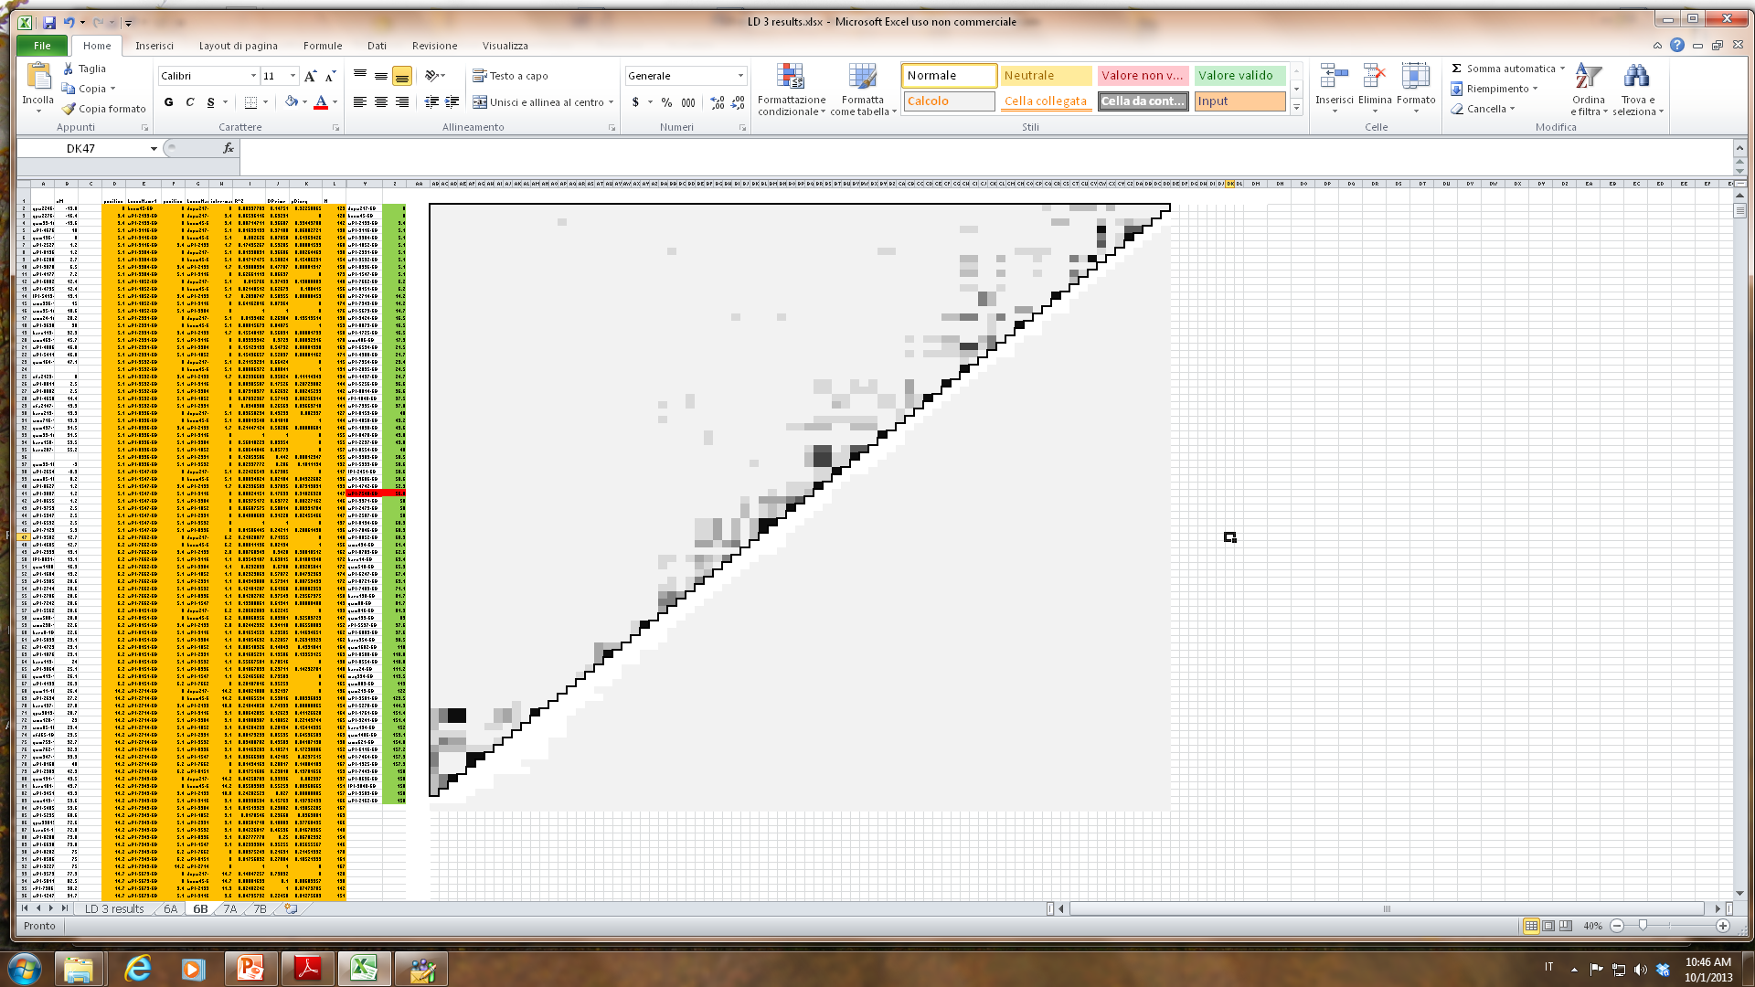
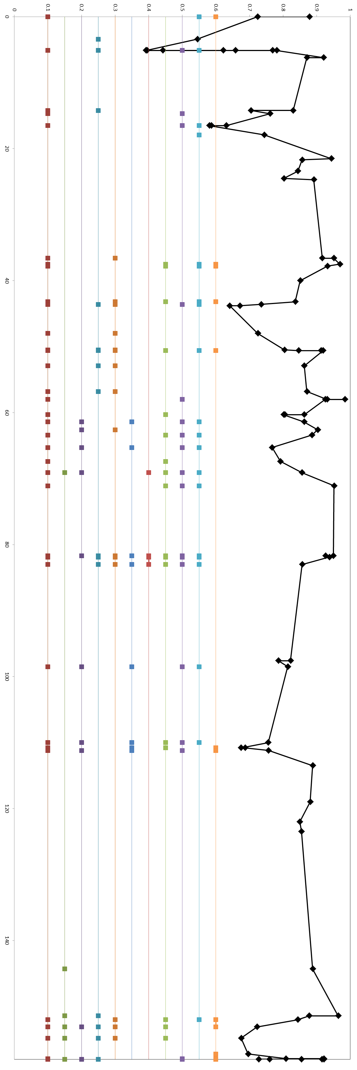
Single marker F_{ST} (P ≤ 0.01)
Chromosome 6B
Pairwise LD, r² values color key
0.0
0.2
0.4
0.6
0.8
1.0
F_{ST} all 5 groups
F_{ST} ICARDA dryland / ICARDA temperate
F_{ST} ICARDA dryland / Italian, early CIMMYT
F_{ST} ICARDA dryland / mid CIMMYT, ICARDA
F_{ST} ICARDA dryland / late CIMMYT
F_{ST} ICARDA temperate / Italian, early CIMMYT
F_{ST} ICARDA temperate / mid CIMMYT, ICARDA
F_{ST} ICARDA temperate / late CIMMYT
F_{ST} ptn 3
F_{ST} Italian, early CIMMYT / mid CIMMYT, ICARDA
F_{ST} Italian, early CIMMYT / late CIMMYT
F_{ST} mid CIMMYT, ICARDA / late CIMMYT
F_{ST} ptn 3
F_{ST} ptn 1
F_{ST} ptn 3
F_{ST} ptn 2

Slide 14
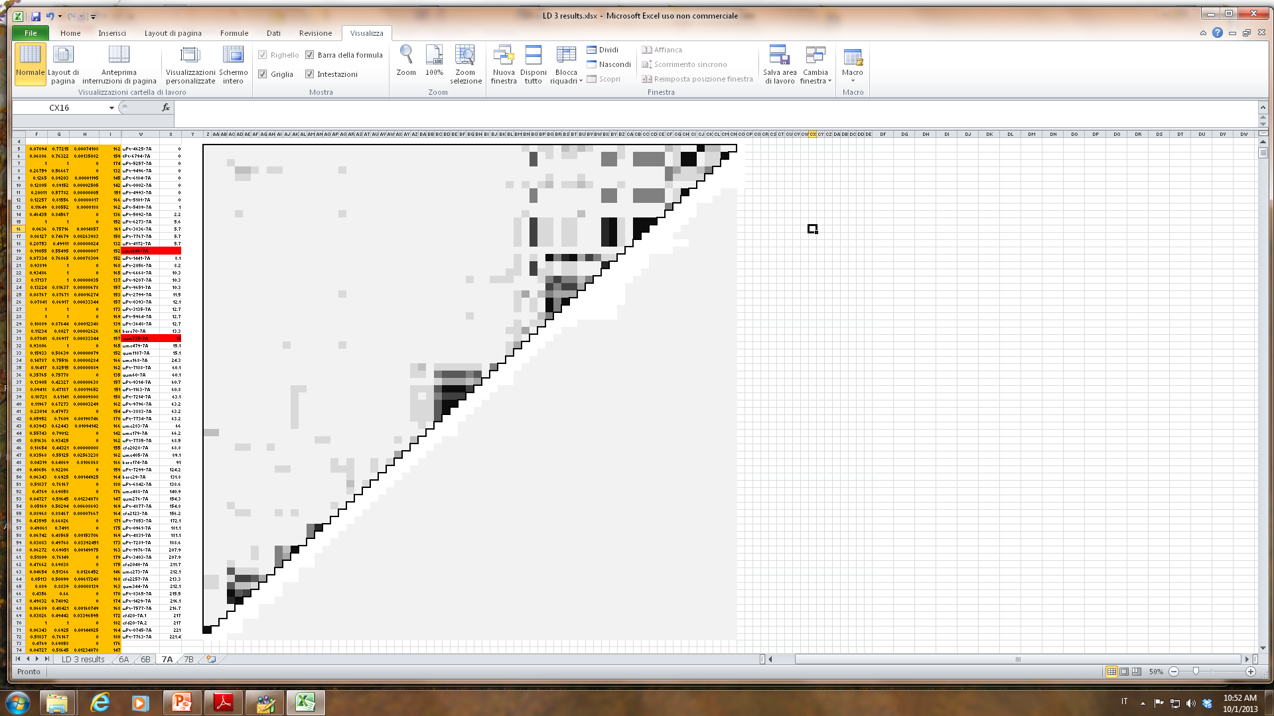
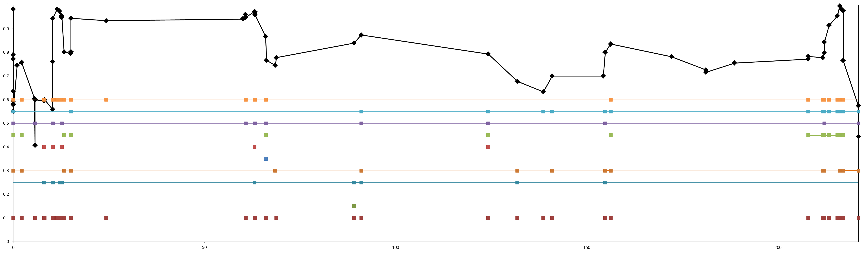
Single marker F_{ST} (P ≤ 0.01)
Chromosome 7A
Pairwise LD, r² values color key
F_{ST} ptn 3
0.0
0.2
0.4
0.6
0.8
1.0
F_{ST} all 5 groups
F_{ST} ICARDA dryland / ICARDA temperate
F_{ST} ICARDA dryland / Italian, early CIMMYT
F_{ST} ICARDA dryland / mid CIMMYT, ICARDA
F_{ST} ICARDA dryland / late CIMMYT
F_{ST} ICARDA temperate / Italian, early CIMMYT
F_{ST} ICARDA temperate / mid CIMMYT, ICARDA
F_{ST} ICARDA temperate / late CIMMYT
F_{ST} Italian, early CIMMYT / mid CIMMYT, ICARDA
F_{ST} ptn 3
F_{ST} Italian, early CIMMYT / late CIMMYT
F_{ST} mid CIMMYT, ICARDA / late CIMMYT
F_{ST} ptn 3
F_{ST} ptn 3
F_{ST} ptn 3

Slide 15
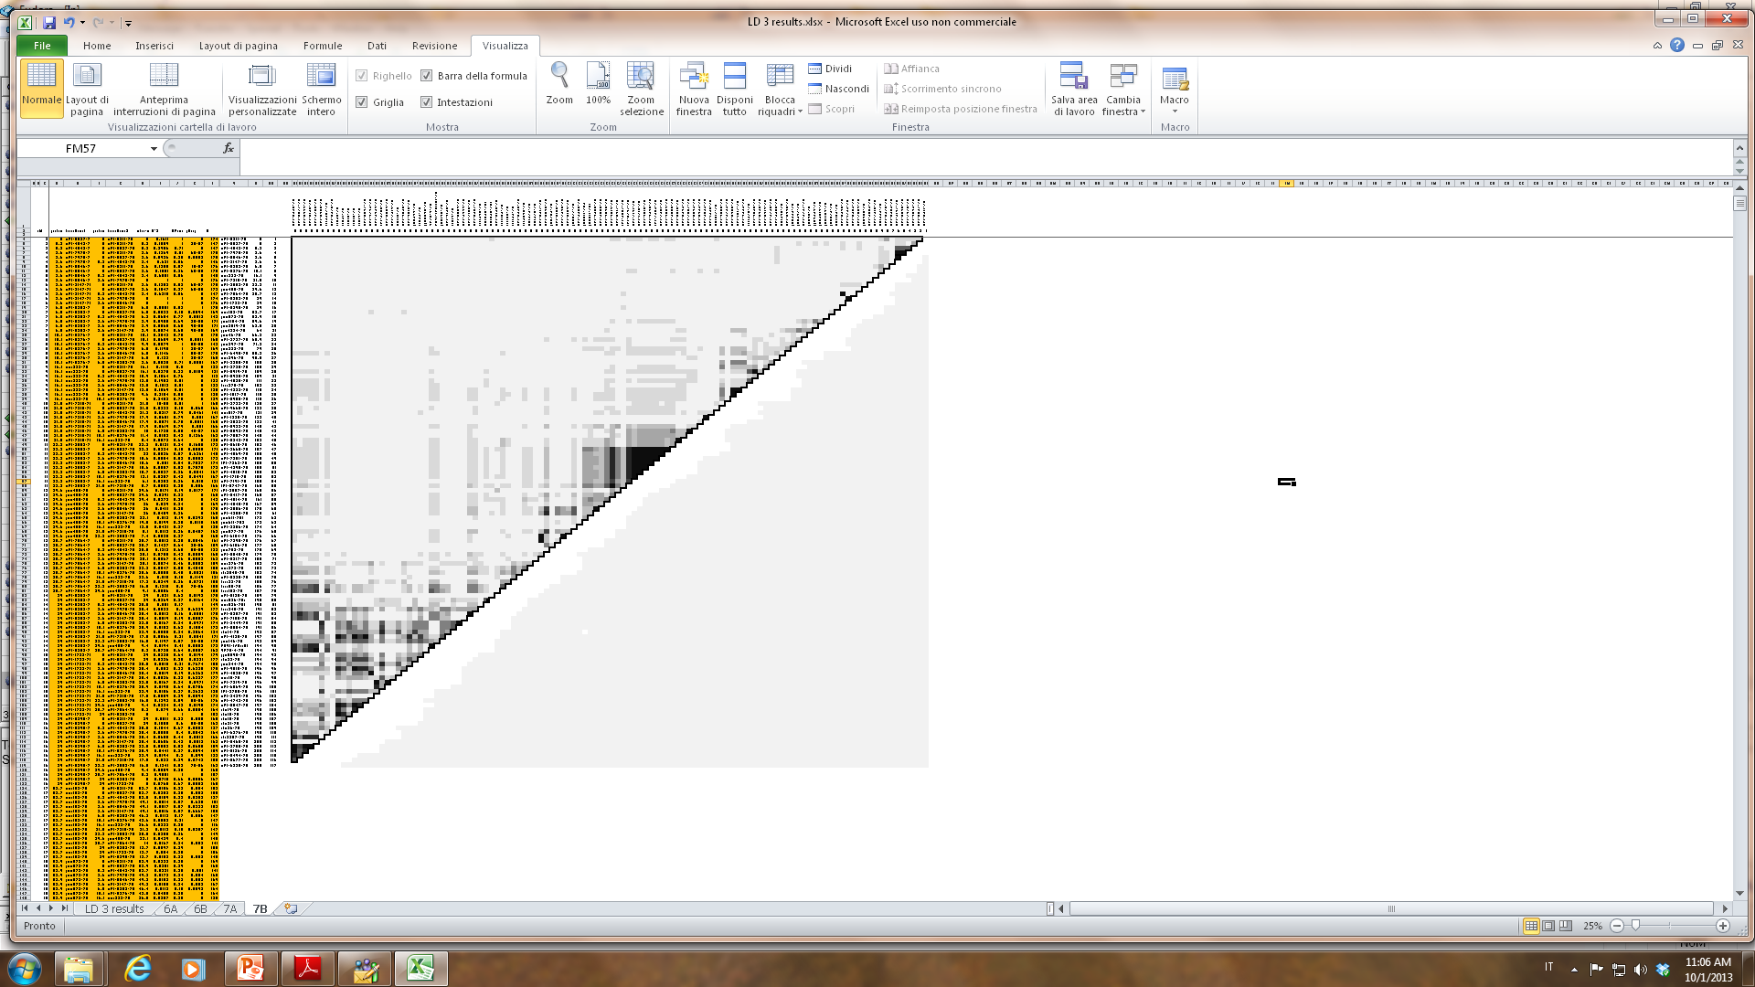
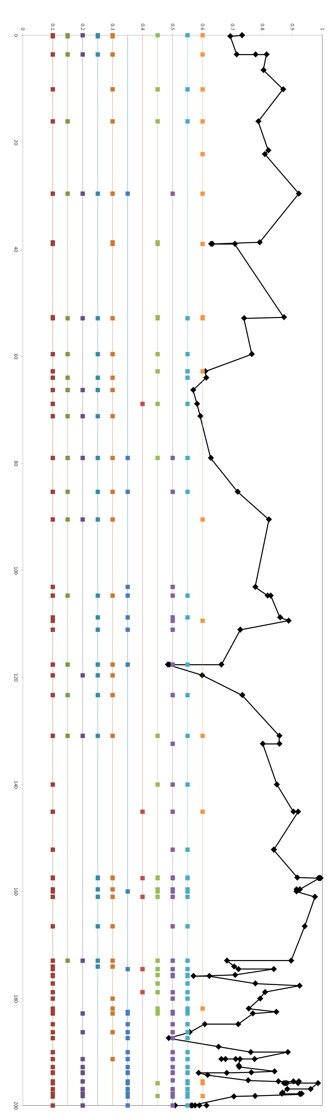
Single marker F_{ST} (P ≤ 0.01)
Chromosome 7B
F_{ST} ptns 2 and 3
Pairwise LD, r² values color key
F_{ST} ptn 3
0.0
0.2
0.4
0.6
0.8
1.0
F_{ST} all 5 groups
F_{ST} ptn 2
F_{ST} ICARDA dryland / ICARDA temperate
F_{ST} ICARDA dryland / Italian, early CIMMYT
F_{ST} ICARDA dryland / mid CIMMYT, ICARDA
F_{ST} ICARDA dryland / late CIMMYT
F_{ST} ICARDA temperate / Italian, early CIMMYT
F_{ST} ICARDA temperate / mid CIMMYT, ICARDA
F_{ST} ICARDA temperate / late CIMMYT
F_{ST} Italian, early CIMMYT / mid CIMMYT, ICARDA
F_{ST} Italian, early CIMMYT / late CIMMYT
F_{ST} mid CIMMYT, ICARDA / late CIMMYT
F_{ST} ptns 2 and 3
F_{ST} ptn 2
F_{ST} ptn 3
F_{ST} ptn 2
F_{ST} ptn 3
F_{ST} ptn 3
F_{ST} ptn 3
F_{ST} ptn 3

