Slide 1
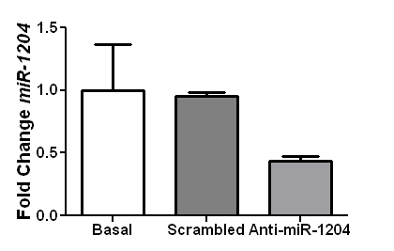
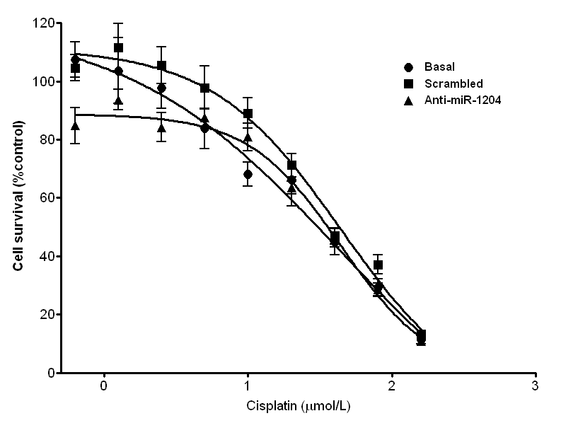
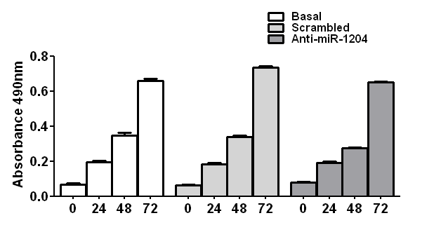
Supplementary Figure 1
A
**
B
C

Slide 2
Supplementary Figure 2
MSTO-211H
Basal
siControl
siC-MYC
siPVT1
C-MYC
cleaved Casp3
ACTIN

